Slide 1
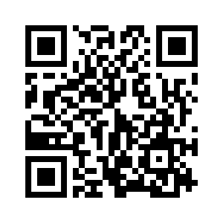
1.1 MEET MY FAMILY
UNIT 1 FAMILY BUSINESS
Notes:
https://hr.izzi.digital/#/repository/204

Slide 2
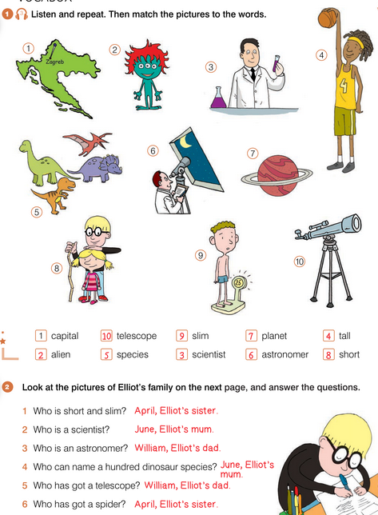
UNIT 1 FAMILY BUSINESS
MEET MY FAMILY
capital = glavni grad
alien = vanzemaljac
scientist = znanstvenik
tall = visok
species = vrste
astronomer = astronom
planet = planet
short = nizak
slim = mršav
telescope = teleskop

Slide 3
UNIT 1 FAMILY BUSINESS
MEET MY FAMILY

Slide 4
UNIT 1 FAMILY BUSINESS
MEET MY FAMILY
stories = priče
cakes = kolači, torte
collect = skupljati
spider = pauk
pretty = zgodna
job = posao
interesting = zanimljivo
scientist = znanstvenik
name = imenovati
grey = sivo
special = posebno
blond(e) = plavokos(a)
boring = dosadno
clever = pametan
strange = neobičan
hide = sakriti

Slide 5
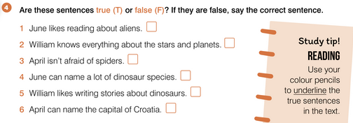
UNIT 1 FAMILY BUSINESS
MEET MY FAMILY

Slide 6
UNIT 1 FAMILY BUSINESS
MEET MY FAMILY

Slide 7
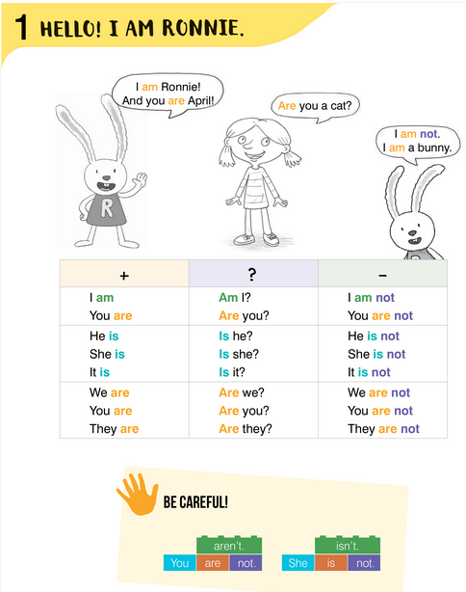
UNIT 1 FAMILY BUSINESS
MEET MY FAMILY

Slide 8
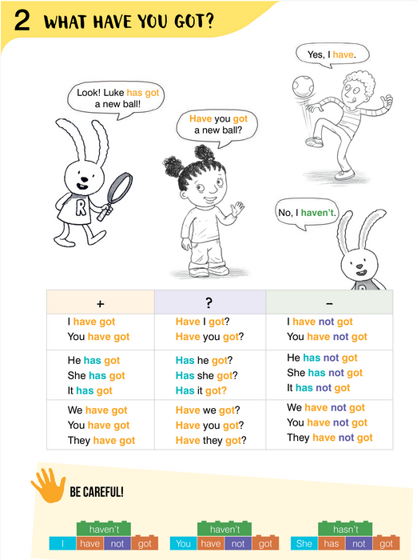
UNIT 1 FAMILY BUSINESS
MEET MY FAMILY

Slide 9
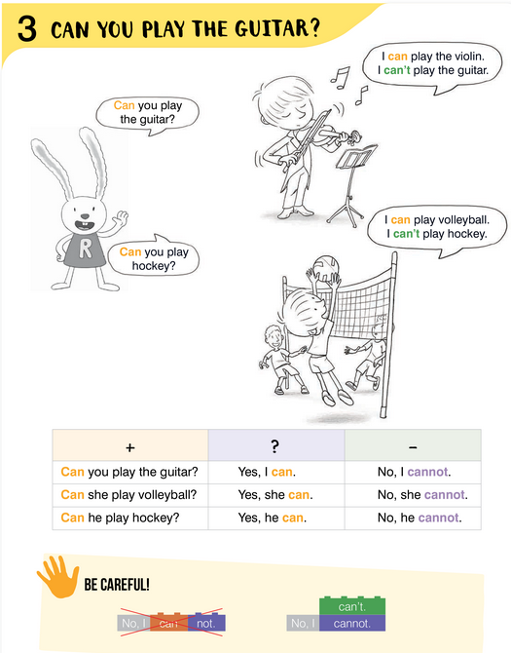
UNIT 1 FAMILY BUSINESS
MEET MY FAMILY

Slide 10
+ | - | ? | Yes | No
I can swim. | I can’t / cannot swim. | Can I swim? | Yes, I can . | No, I can’t / cannot.
You can swim. | You can’t / cannot swim. | Can you swim? | Yes, you can . | No, you can’t / cannot.
He can swim. | He can’t / cannot swim. | Can he swim? | Yes, he can . | No, he can’t / cannot.
She can swim. | She can’t / cannot swim. | Can she swim? | Yes, she can . | No, she can’t / cannot.
It can swim. | It can’t / cannot swim. | Can it swim? | Yes, it can . | No, it can’t / cannot.
We can swim. | We can’t / cannot swim. | Can we swim? | Yes, we can . | No, we can’t / cannot.
You can swim. | You can’t / cannot swim. | Can you swim? | Yes, you can . | No, you can’t / cannot.
They can swim. | They can’t / cannot swim. | Can they swim? | Yes, they can . | No, they can’t / cannot.

Slide 11
UNIT 1 FAMILY BUSINESS
MEET MY FAMILY

Slide 12
UNIT 1 FAMILY BUSINESS
MEET MY FAMILY

Slide 13
UNIT 1 FAMILY BUSINESS
MEET MY FAMILY

Slide 14
UNIT 1 FAMILY BUSINESS
MEET MY FAMILY

Slide 15
UNIT 1 FAMILY BUSINESS
MEET MY FAMILY

Slide 16
UNIT 1 FAMILY BUSINESS
MEET MY FAMILY

Slide 17
UNIT 1 FAMILY BUSINESS
MEET MY FAMILY

Slide 18
UNIT 1 FAMILY BUSINESS
MEET MY FAMILY

Slide 19
UNIT 1 FAMILY BUSINESS
MEET MY FAMILY

Slide 20
UNIT 1 FAMILY BUSINESS
MEET MY FAMILY

Slide 21
UNIT 1 FAMILY BUSINESS
MEET MY FAMILY

Slide 22
UNIT 1 FAMILY BUSINESS
MEET MY FAMILY

Slide 23
UNIT 1 FAMILY BUSINESS
MEET MY FAMILY

Slide 24
UNIT 1 FAMILY BUSINESS
MEET MY FAMILY

Slide 25
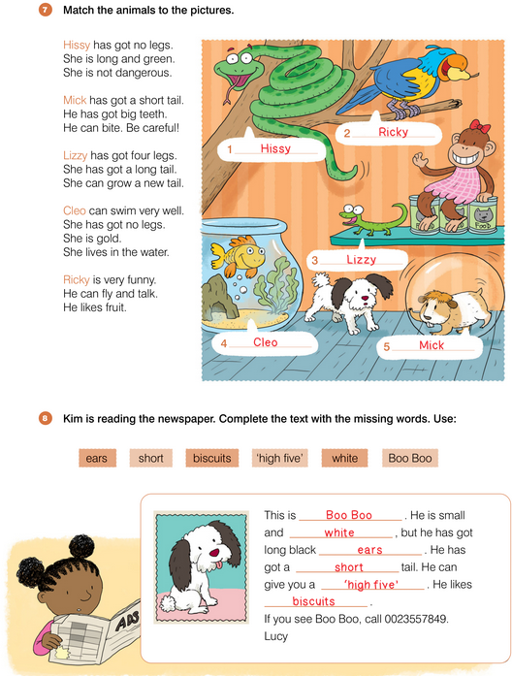
UNIT 1 FAMILY BUSINESS
MEET MY FAMILY

Slide 26
UNIT 1 FAMILY BUSINESS
MEET MY FAMILY

Slide 27
UNIT 1 FAMILY BUSINESS
MEET MY FAMILY

Slide 28
UNIT 1 FAMILY BUSINESS
MEET MY FAMILY

