Slide 1

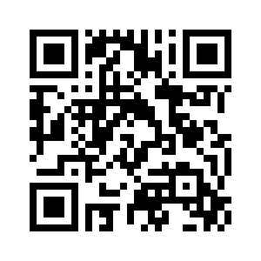
1.2 THE ZENEX FAMILY
UNIT 1 FAMILY BUSINESS
Notes:
https://hr.izzi.digital/#/repository/204

Slide 2

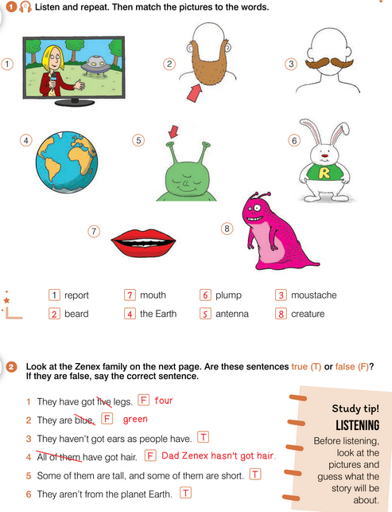
UNIT 1 FAMILY BUSINESS
THE ZENEX FAMILY
report = izvještaj
beard = brada
moustache = brkovi
the Earth = Zemlja
antenna = antena
plump = punašan
mouth = usta
creature = biće

Slide 3
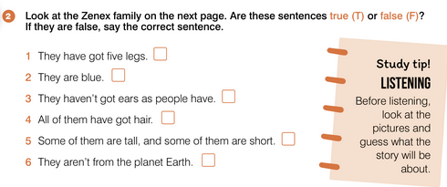
UNIT 1 FAMILY BUSINESS
THE ZENEX FAMILY

Slide 4
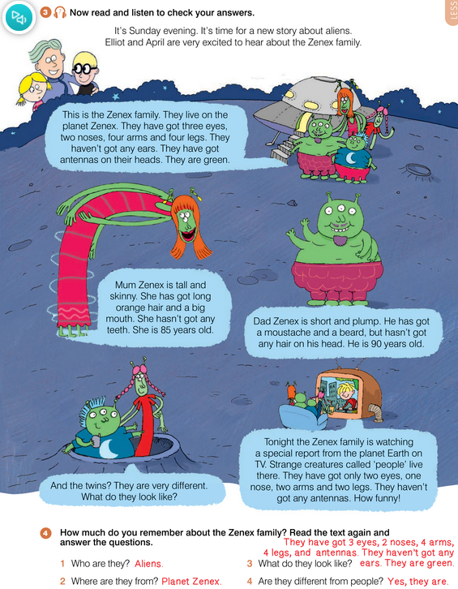
UNIT 1 FAMILY BUSINESS
THE ZENEX FAMILY
excited = uzbuđen
eye = oko
nose = nos
arm = ruka
leg = noga
head = glava
skinny = mršav
teeth = zubi
hair = kosa
twins = blizanci
tonight = večeras
special = poseban
funny = smiješno

Slide 5
UNIT 1 FAMILY BUSINESS
THE ZENEX FAMILY

Slide 6
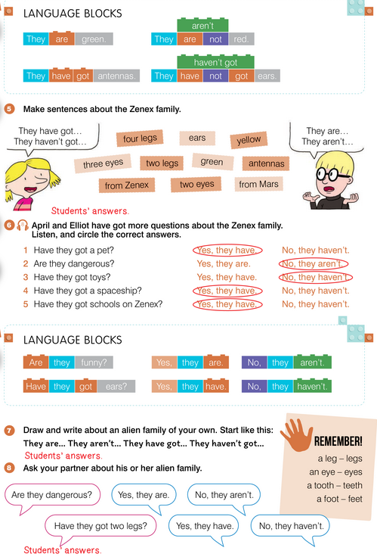
UNIT 1 FAMILY BUSINESS
THE ZENEX FAMILY

Slide 7
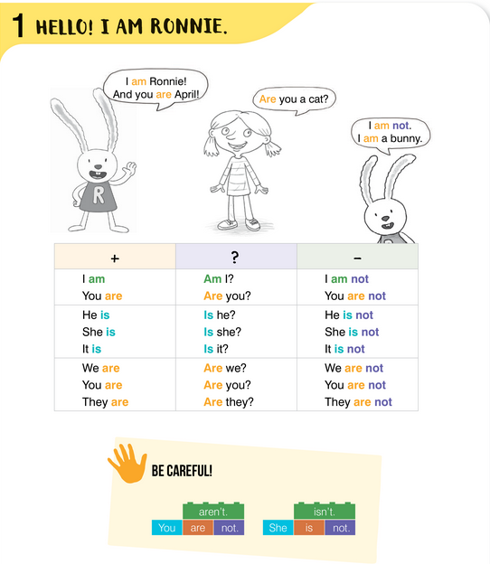
UNIT 1 FAMILY BUSINESS
THE ZENEX FAMILY

Slide 8
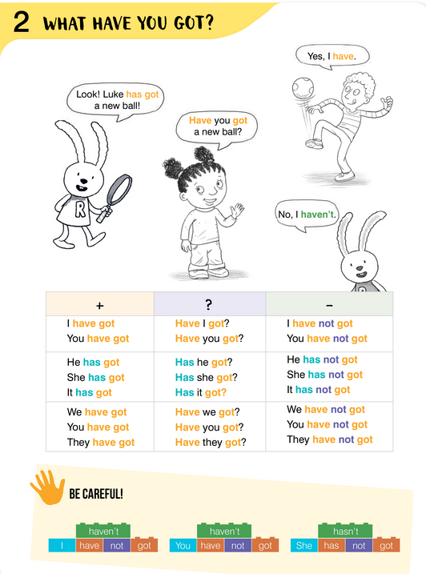
UNIT 1 FAMILY BUSINESS
THE ZENEX FAMILY

Slide 9
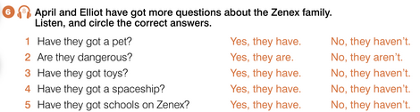
UNIT 1 FAMILY BUSINESS
THE ZENEX FAMILY

Slide 10
UNIT 1 FAMILY BUSINESS
THE ZENEX FAMILY

Slide 11
UNIT 1 FAMILY BUSINESS
THE ZENEX FAMILY

Slide 12
UNIT 1 FAMILY BUSINESS
THE ZENEX FAMILY

Slide 13
UNIT 1 FAMILY BUSINESS
THE ZENEX FAMILY

Slide 14
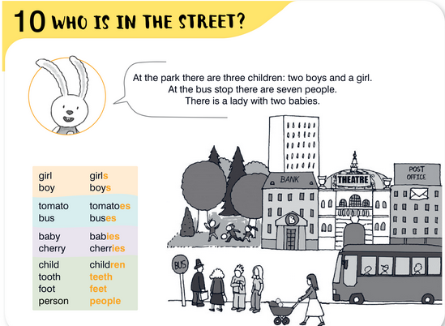
UNIT 1 FAMILY BUSINESS
THE ZENEX FAMILY

Slide 15
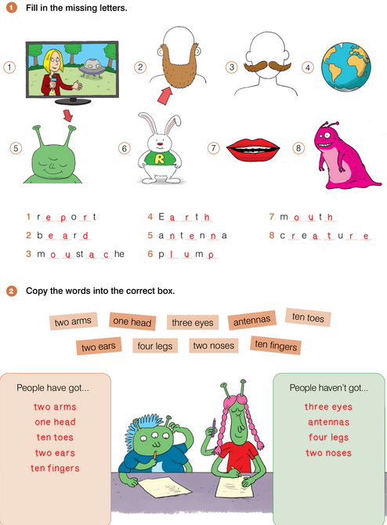
UNIT 1 FAMILY BUSINESS
THE ZENEX FAMILY

Slide 16
UNIT 1 FAMILY BUSINESS
THE ZENEX FAMILY

Slide 17
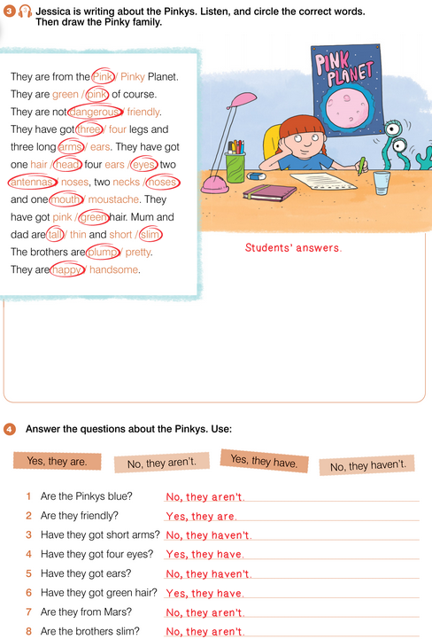
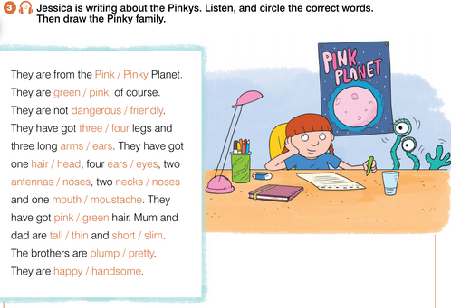
UNIT 1 FAMILY BUSINESS
THE ZENEX FAMILY

Slide 18
UNIT 1 FAMILY BUSINESS
THE ZENEX FAMILY

Slide 19
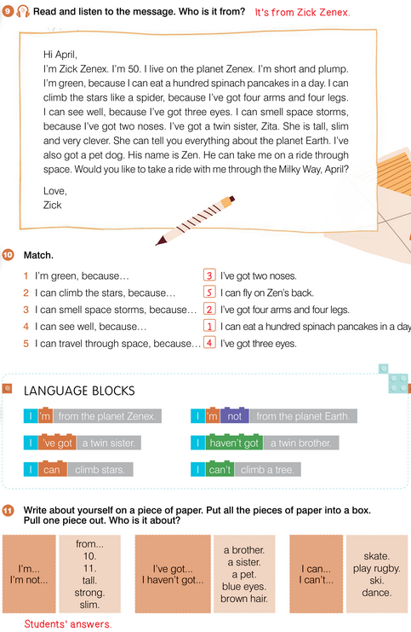
UNIT 1 FAMILY BUSINESS
THE ZENEX FAMILY
spinach = špinat
pancakes = palačinke
see well = vidjeti dobro
smell = njušiti
space = svemirski
storm = oluja
ride = putovanje, vožnja
through = kroz

Slide 20
UNIT 1 FAMILY BUSINESS
THE ZENEX FAMILY

Slide 21
UNIT 1 FAMILY BUSINESS
THE ZENEX FAMILY

Slide 22
UNIT 1 FAMILY BUSINESS
THE ZENEX FAMILY

Slide 23
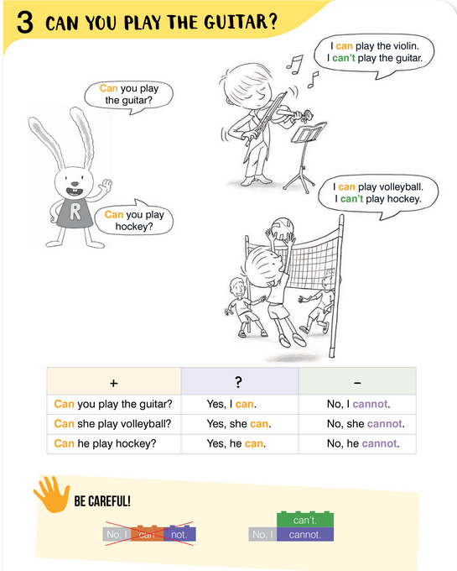
UNIT 1 FAMILY BUSINESS
THE ZENEX FAMILY

Slide 24
UNIT 1 FAMILY BUSINESS
THE ZENEX FAMILY

Slide 25
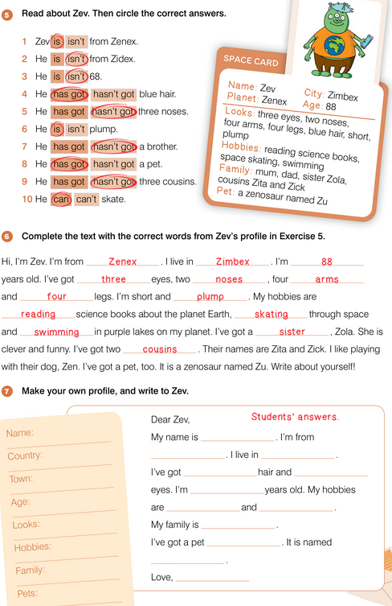
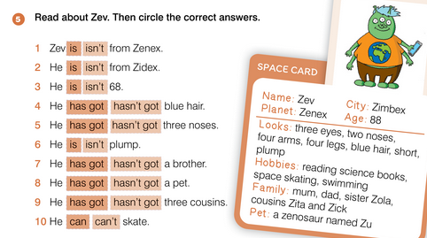
UNIT 1 FAMILY BUSINESS
THE ZENEX FAMILY

Slide 26
UNIT 1 FAMILY BUSINESS
THE ZENEX FAMILY

Slide 27
UNIT 1 FAMILY BUSINESS
THE ZENEX FAMILY

Slide 28
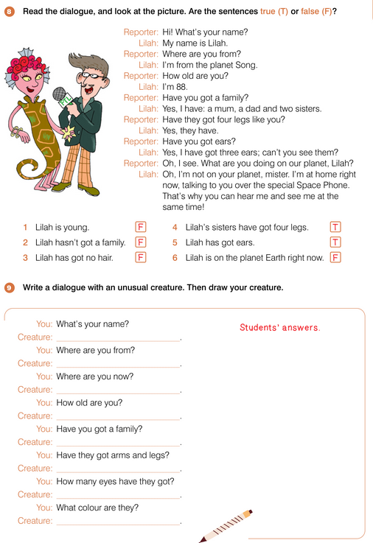
UNIT 1 FAMILY BUSINESS
THE ZENEX FAMILY

Slide 29
UNIT 1 FAMILY BUSINESS
THE ZENEX FAMILY

