Slide 1
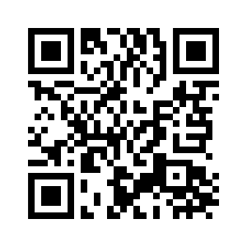
1.3 A HAPPY FAMILY
UNIT 1 FAMILY BUSINESS
Notes:
https://hr.izzi.digital/#/repository/204

Slide 2
UNIT 1 FAMILY BUSINESS
A HAPPY FAMILY
parents = roditelji
son = sin
daughter = kći
grandma = baka
grandpa = djed
cousins = bratići i sestrične
uncle = ujak, stric, tetak
aunt = ujna, strina, teta
grandparents = baka i djed

Slide 3
UNIT 1 FAMILY BUSINESS
A HAPPY FAMILY

Slide 4
UNIT 1 FAMILY BUSINESS
A HAPPY FAMILY

Slide 5
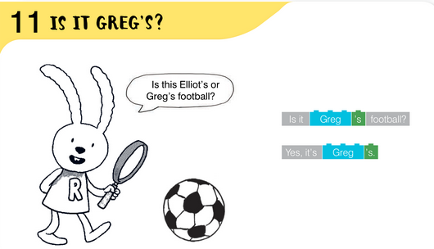
UNIT 1 FAMILY BUSINESS
A HAPPY FAMILY

Slide 6
UNIT 1 FAMILY BUSINESS
A HAPPY FAMILY

Slide 7
UNIT 1 FAMILY BUSINESS
A HAPPY FAMILY

Slide 8
UNIT 1 FAMILY BUSINESS
A HAPPY FAMILY

Slide 9
UNIT 1 FAMILY BUSINESS
A HAPPY FAMILY

Slide 10
UNIT 1 FAMILY BUSINESS
A HAPPY FAMILY

Slide 11
UNIT 1 FAMILY BUSINESS
A HAPPY FAMILY

Slide 12
UNIT 1 FAMILY BUSINESS
A HAPPY FAMILY

Slide 13
UNIT 1 FAMILY BUSINESS
A HAPPY FAMILY

Slide 14
UNIT 1 FAMILY BUSINESS
A HAPPY FAMILY

