Slide 1
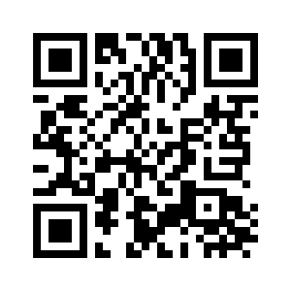
1.4 GOLDILOCKS AND THE THREE BEARS
UNIT 1 FAMILY BUSINESS
ZLATOKOSA
Notes:
https://hr.izzi.digital/#/repository/204

Slide 2
UNIT 1 FAMILY BUSINESS
GOLDILOCKS AND THE THREE BEARS
get into trouble = naći se u nevolji
curious = znatiželjan
thirsty = žedan

Slide 3
UNIT 1 FAMILY BUSINESS
GOLDILOCKS AND THE THREE BEARS
woods = šuma
tiny = sićušan
porridge = kaša
just right = baš kako treba
yummy = njam
eat it all up = sve pojesti
tired = umoran
living room = dnevni boravak
fall down = pasti na pod
sleepy = pospan
hard = tvrd
soft = mekan
fall asleep = zaspati
has eaten = je pojeo
has broken = je polomio
has fallen asleep = je zaspao
still = još uvijek
cry = plakati
wake up = probuditi se
scream = zavrištati
run away = pobjeći
come back = vratiti se

Slide 4
UNIT 1 FAMILY BUSINESS
GOLDILOCKS AND THE THREE BEARS

Slide 5
UNIT 1 FAMILY BUSINESS
GOLDILOCKS AND THE THREE BEARS
most famous = najpoznatiji
flag = zastava
the Royal Family = Kraljevska obitelj

Slide 6
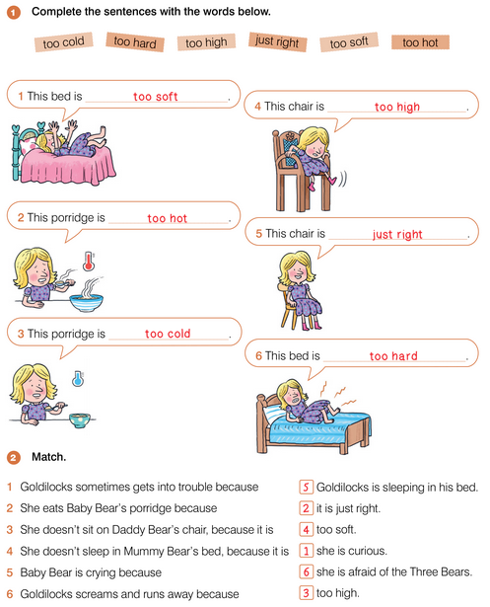
UNIT 1 FAMILY BUSINESS
GOLDILOCKS AND THE THREE BEARS

Slide 7
UNIT 1 FAMILY BUSINESS
GOLDILOCKS AND THE THREE BEARS

Slide 8
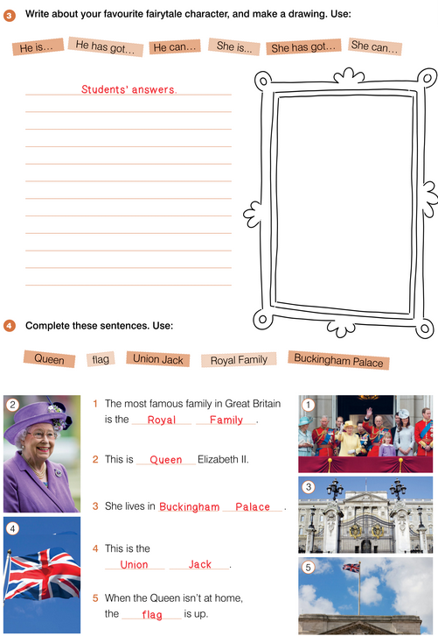
UNIT 1 FAMILY BUSINESS
GOLDILOCKS AND THE THREE BEARS

Slide 9
UNIT 1 FAMILY BUSINESS
GOLDILOCKS AND THE THREE BEARS

