Slide 1
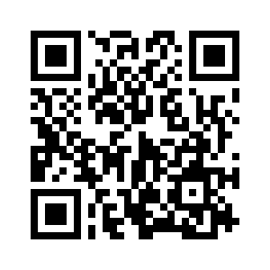
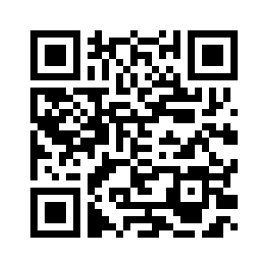

1.5 LET’S CHECK!
REVISION
UNIT 1 FAMILY BUSINESS
Notes:
https://hr.izzi.digital/#/repository/204

Slide 2
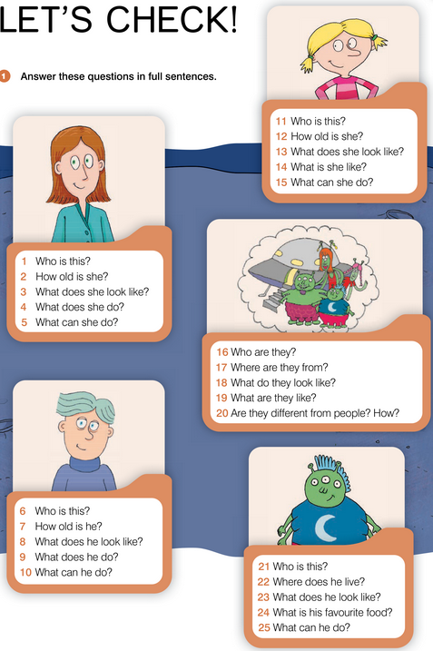
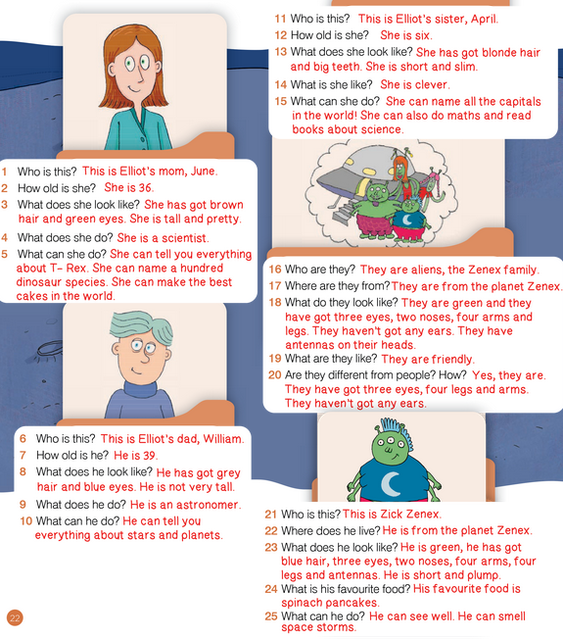
UNIT 1 FAMILY BUSINESS
LET’S CHECK!

Slide 3
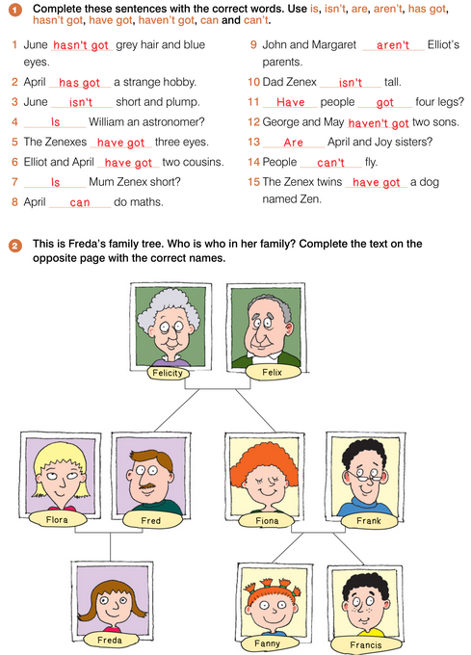
UNIT 1 FAMILY BUSINESS
LET’S CHECK!

Slide 4
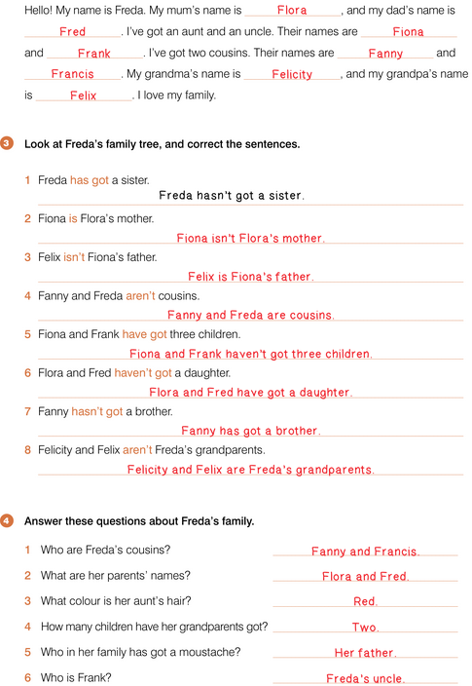
UNIT 1 FAMILY BUSINESS
LET’S CHECK!

Slide 5
UNIT 1 FAMILY BUSINESS
LET’S CHECK!

Slide 6
UNIT 1 FAMILY BUSINESS
LET’S CHECK!

Slide 7
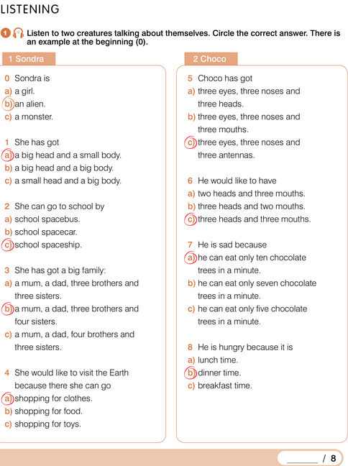

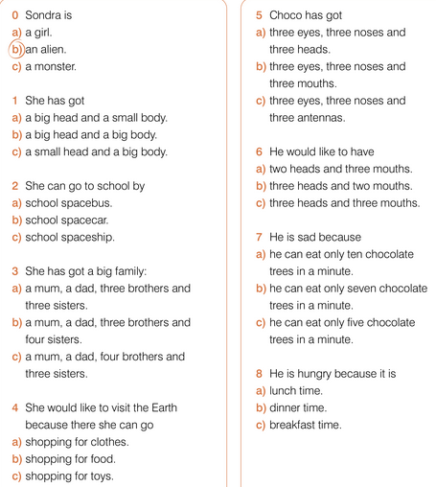
UNIT 1 FAMILY BUSINESS
REVISION

Slide 8
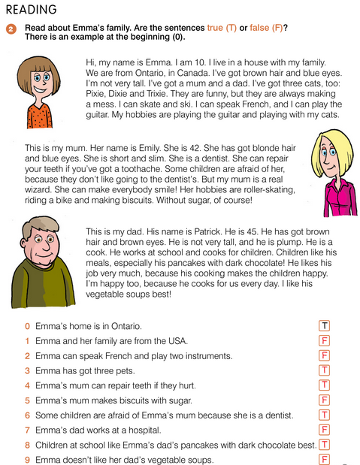
UNIT 1 FAMILY BUSINESS
REVISION

