Slide 1
1.6 NOW I CAN!
UNIT 1 FAMILY BUSINESS
Notes:
https://hr.izzi.digital/#/repository/204

Slide 2
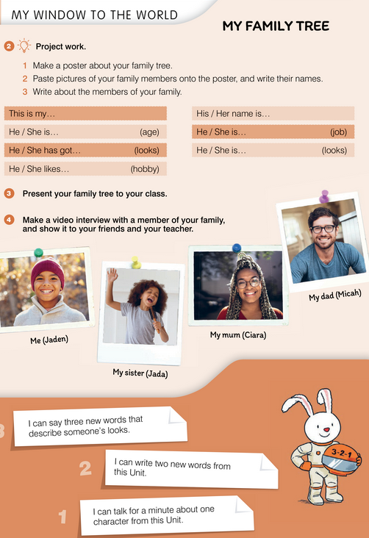
UNIT 1 FAMILY BUSINESS
NOW I CAN!

Slide 3
UNIT 1 FAMILY BUSINESS
NOW I CAN!

