Slide 1
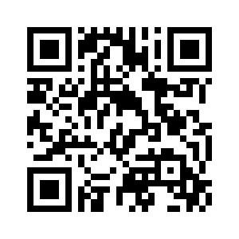
2.1 SCHOOL CAN BE FUN
UNIT 2 EVERY DAY
Notes:
https://hr.izzi.digital/#/repository/204

Slide 2
UNIT 2 EVERY DAY
SCHOOL CAN BE FUN
English = Engleski jezik
French = Francuski jezik
German = Njemači jezik
Italian = Talijanski jezik
Croatian = Hrvatski jezik
maths = Matematika
science = Priroda
music = Glazbena umjetnost
art = Likovna umjetnost
IT (computer science) = Informatika
R.E. (religious education) = Vjeronauk
P.E. (physical education) = Tjelesna kultura

Slide 3
UNIT 2 EVERY DAY
SCHOOL CAN BE FUN
great = odlično
learn = naučiti
have fun = zabaviti se
subject = školski predmet
be excellent at = biti odličan u
volleyball = odbojka
practice = trening
twice = dvaput
be busy = biti zaposlen
do homework = napisati zadaću
be good at = biti dobar u
swimming = plivanje
every day = svaki dan
always = uvijek
sometimes = ponekad
be boring = biti dosadan
have problems with = imati probleme s(a)
week = tjedan
ice hockey = hokej na ledu

Slide 4
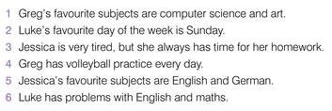
UNIT 2 EVERY DAY
SCHOOL CAN BE FUN

Slide 5
UNIT 2 EVERY DAY
SCHOOL CAN BE FUN

Slide 6
UNIT 2 EVERY DAY
SCHOOL CAN BE FUN

Slide 7
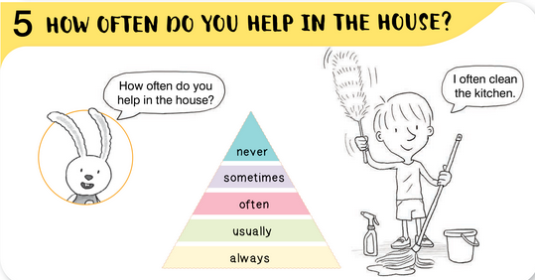
UNIT 2 EVERY DAY
SCHOOL CAN BE FUN

Slide 8
UNIT 2 EVERY DAY
SCHOOL CAN BE FUN

Slide 9
UNIT 2 EVERY DAY
SCHOOL CAN BE FUN

Slide 10
UNIT 2 EVERY DAY
SCHOOL CAN BE FUN

Slide 11
UNIT 2 EVERY DAY
SCHOOL CAN BE FUN

Slide 12
UNIT 2 EVERY DAY
SCHOOL CAN BE FUN

Slide 13
UNIT 2 EVERY DAY
SCHOOL CAN BE FUN

