Slide 1

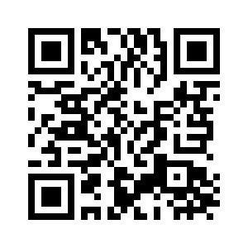
2.2 MY FAVOURITE PART
OF THE DAY
UNIT 2 EVERY DAY
Notes:
https://hr.izzi.digital/#/repository/204

Slide 2
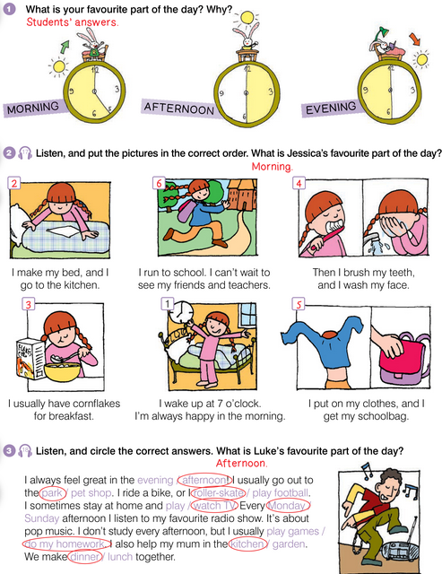
UNIT 2 EVERY DAY
MY FAVOURITE PART OF THE DAY
jutro / prijepodne
poslijepodne
večer

Slide 3

UNIT 2 EVERY DAY
MY FAVOURITE PART OF THE DAY

Slide 4
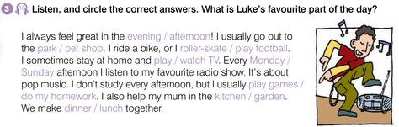
UNIT 2 EVERY DAY
MY FAVOURITE PART OF THE DAY

Slide 5
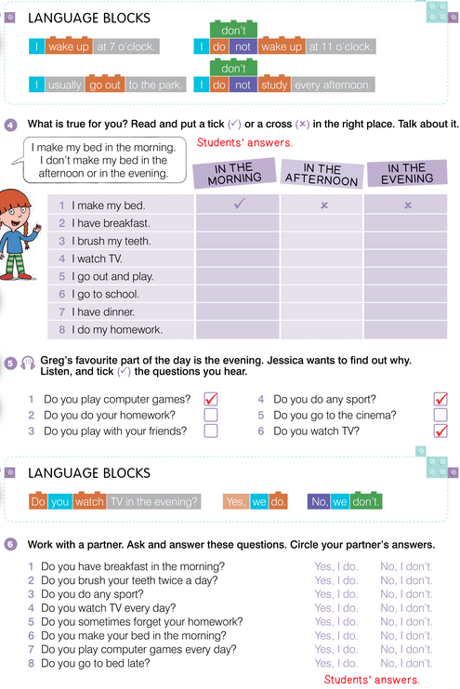
UNIT 2 EVERY DAY
MY FAVOURITE PART OF THE DAY

Slide 6
What do you do every day?
UNIT 2 EVERY DAY
MY FAVOURITE PART OF THE DAY
+ | - | ?
I wake up at 7. | I do not wake up at 7. | Do I wake up at 7?
You wake up at 7. | You do not wake up at 7. | Do you wake up at 7?
He wakes up at 7. She wakes up at 7. It wakes up at 7. | He does not wake up at 7. She does not wake up at 7. It does not wake up at 7. | Does he wake up at 7? Does she wake up at 7? Does it wake up at 7?
We wake up at 7. | We do not wake up at 7. | Do we wake up at 7?
You wake up at 7. | You do not wake up at 7. | Do you wake up at 7?
They wake up at 7. | They do not wake up at 7. | Do they wake up at 7?
DO + NOT = DON’T
DOES + NOT = DOESN’T

Slide 7
UNIT 2 EVERY DAY
MY FAVOURITE PART OF THE DAY
What do you do every day?
+ | - | ?
He wakes up at 7. She wakes up at 7. It wakes up at 7. | He does not wake up at 7. She does not wake up at 7. It does not wake up at 7. | Does he wake up at 7? Does she wake up at 7? Does it wake up at 7?
DOES + NOT = DOESN’T

Slide 8
? | + | -
Do I wake up at 7? | Yes, I do. | No, I don’t.
Do you wake up at 7? | Yes, you do. | No, you don’t.
Does he wake up at 7? Does she wake up at 7? Does it wake up at 7? | Yes, he does. Yes, she does. Yes, it does. | No, he doesn’t. No, she doesn’t. No, it doesn’t.
Do we wake up at 7? | Yes, we do. | No, we don’t.
Do you wake up at 7? | Yes, you do. | No, you don’t.
Do they wake up at 7? | Yes, they do. | No, they don’t.
DON’T = DO + NOT
DOESN’T = DOES + NOT

Slide 9
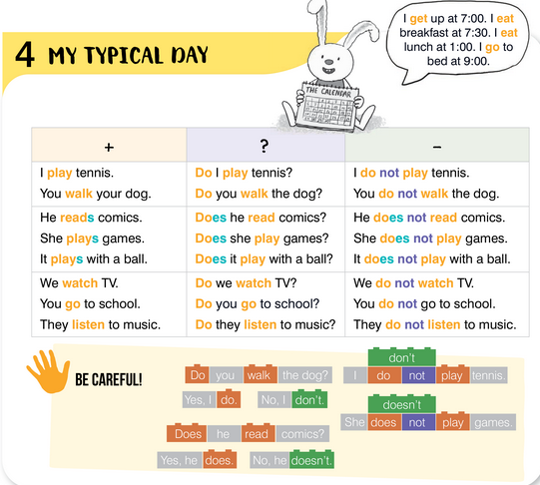
UNIT 2 EVERY DAY
MY FAVOURITE PART OF THE DAY

Slide 10
UNIT 2 EVERY DAY
MY FAVOURITE PART OF THE DAY

Slide 11
UNIT 2 EVERY DAY
MY FAVOURITE PART OF THE DAY

Slide 12
How often does it happen?
never
sometimes
always
often

Slide 13
never
sometimes
often
always

Slide 14
How often does it happen?
never
sometimes
often
always
nikada
ponekad
uvijek
često

Slide 15
How often does it happen?
never
sometimes
often
always
nikada
ponekad
često
uvijek

Slide 16
How often does it happen?
I make the bed.
always
always
always
always

Slide 17
How often does it happen?
I am happy.
always
always
always

Slide 18
UNIT 2 EVERY DAY
MY FAVOURITE PART OF THE DAY

Slide 19
UNIT 2 EVERY DAY
MY FAVOURITE PART OF THE DAY

Slide 20
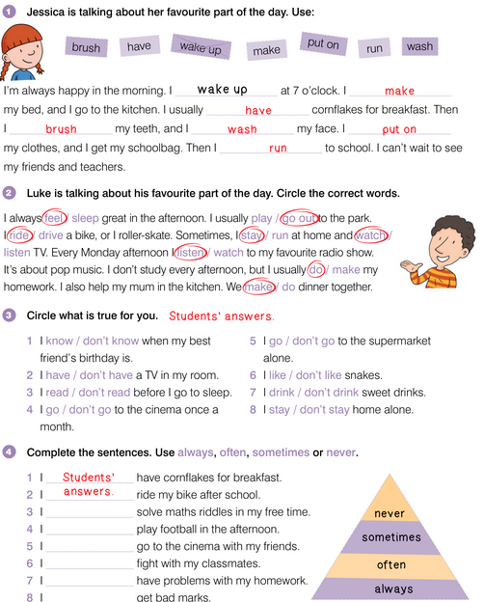
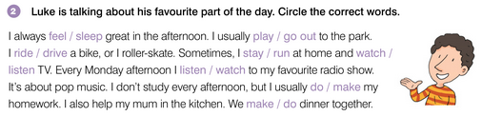
UNIT 2 EVERY DAY
MY FAVOURITE PART OF THE DAY

Slide 21
UNIT 2 EVERY DAY
MY FAVOURITE PART OF THE DAY

Slide 22
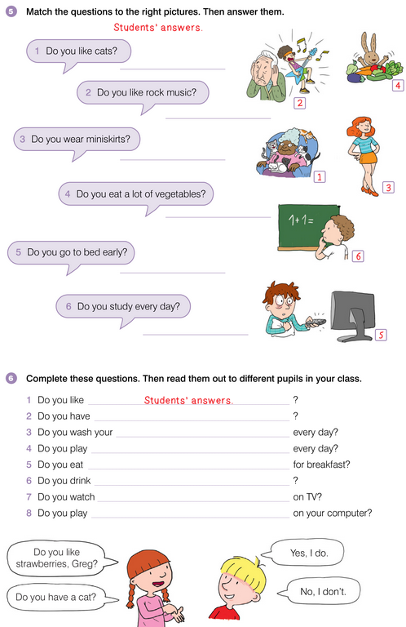
UNIT 2 EVERY DAY
MY FAVOURITE PART OF THE DAY

Slide 23
UNIT 2 EVERY DAY
MY FAVOURITE PART OF THE DAY

