Slide 1

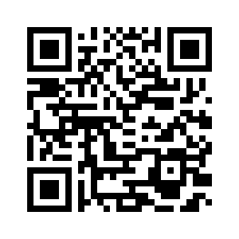
2.3 ELLIOT AND TESS
UNIT 2 EVERY DAY
Notes:
https://hr.izzi.digital/#/repository/204

Slide 2

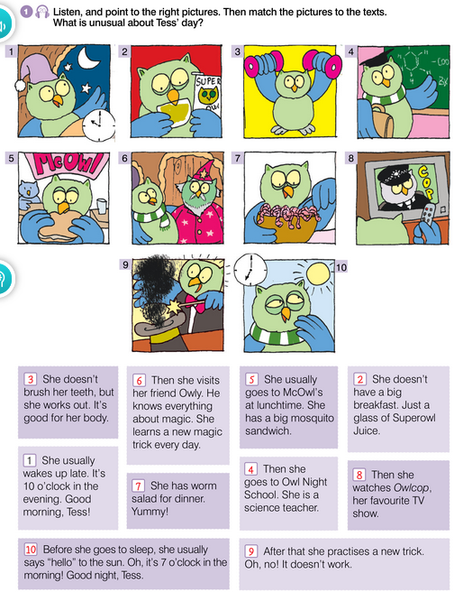
UNIT 2 EVERY DAY
ELLIOT AND TESS

Slide 3
UNIT 2 EVERY DAY
ELLIOT AND TESS
usually = uobičajeno, inače
in the evening = navečer
glass = čaša
work out = vježbati
body = tijelo
night school = večernja škola
lunchtime = vrijeme ručka
mosquito = komarac
visit = posjetiti
magic = čarolija
magic trick = čarobni trik
worm = crv
tv show = televizijska emisija
practise = vježbati
go to sleep = ići na spavanje

Slide 4
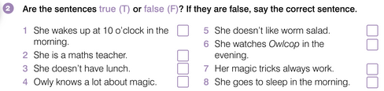
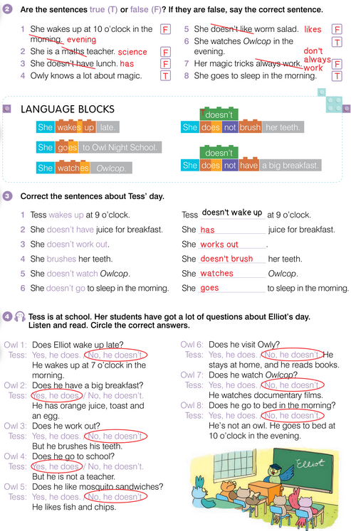
UNIT 2 EVERY DAY
ELLIOT AND TESS

Slide 5
UNIT 2 EVERY DAY
ELLIOT AND TESS

Slide 6
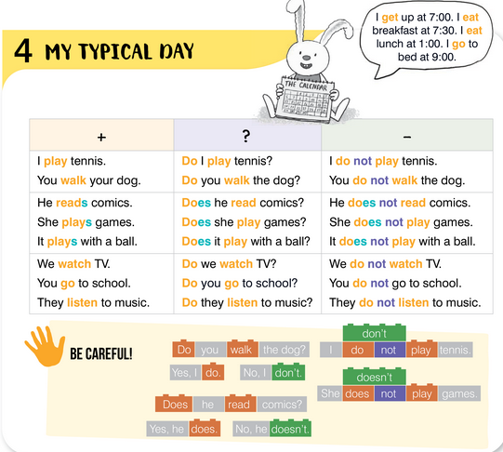
UNIT 2 EVERY DAY
MY FAVOURITE PART OF THE DAY

Slide 7
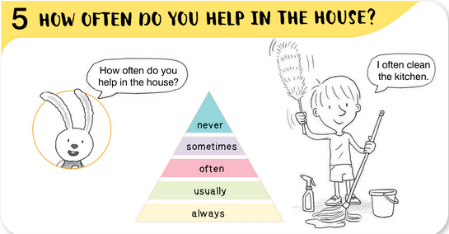
UNIT 2 EVERY DAY
MY FAVOURITE PART OF THE DAY

Slide 8
UNIT 2 EVERY DAY
ELLIOT AND TESS

Slide 9
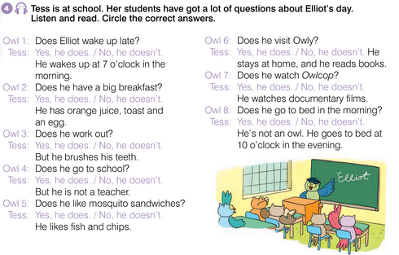
UNIT 2 EVERY DAY
ELLIOT AND TESS

Slide 10
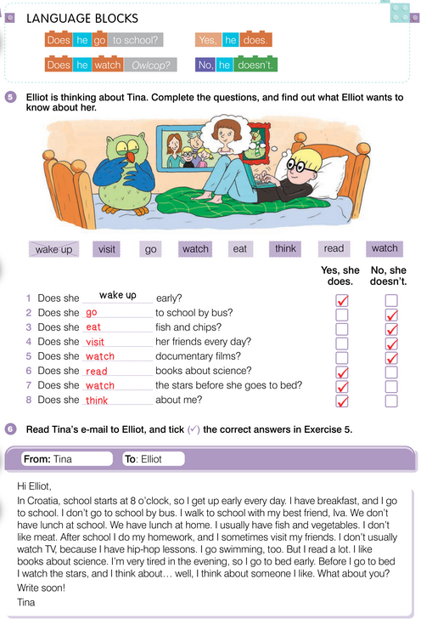
UNIT 2 EVERY DAY
ELLIOT AND TESS

Slide 11
UNIT 2 EVERY DAY
MY FAVOURITE PART OF THE DAY

Slide 12
UNIT 2 EVERY DAY
MY FAVOURITE PART OF THE DAY

Slide 13
UNIT 2 EVERY DAY
ELLIOT AND TESS

Slide 14
UNIT 2 EVERY DAY
ELLIOT AND TESS

Slide 15
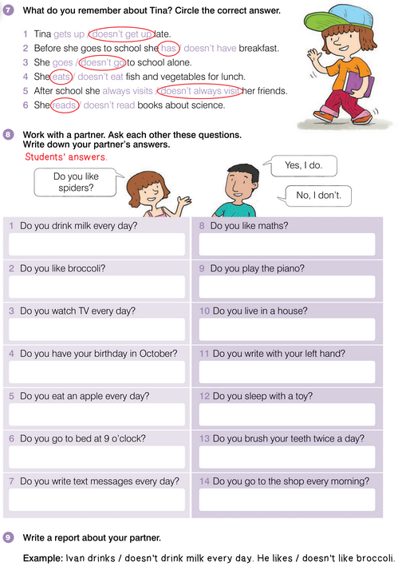
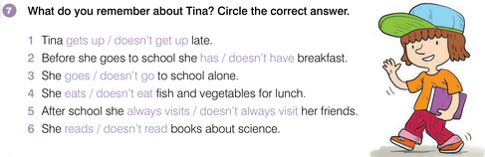
UNIT 2 EVERY DAY
ELLIOT AND TESS

Slide 16
UNIT 2 EVERY DAY
ELLIOT AND TESS

Slide 17
UNIT 2 EVERY DAY
ELLIOT AND TESS

Slide 18
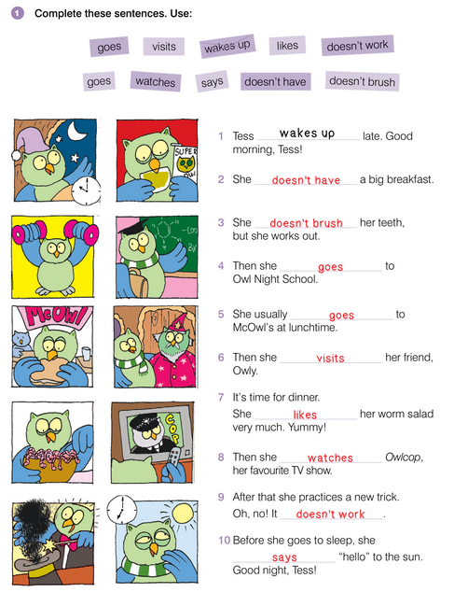
UNIT 2 EVERY DAY
ELLIOT AND TESS

Slide 19
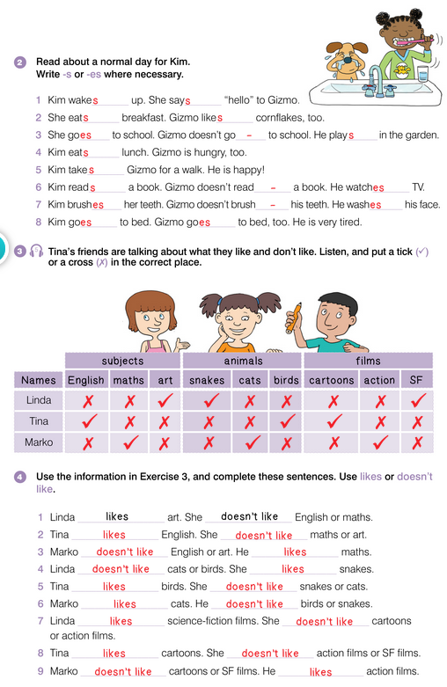
UNIT 2 EVERY DAY
ELLIOT AND TESS

Slide 20
UNIT 2 EVERY DAY
ELLIOT AND TESS

Slide 21
UNIT 2 EVERY DAY
ELLIOT AND TESS

Slide 22
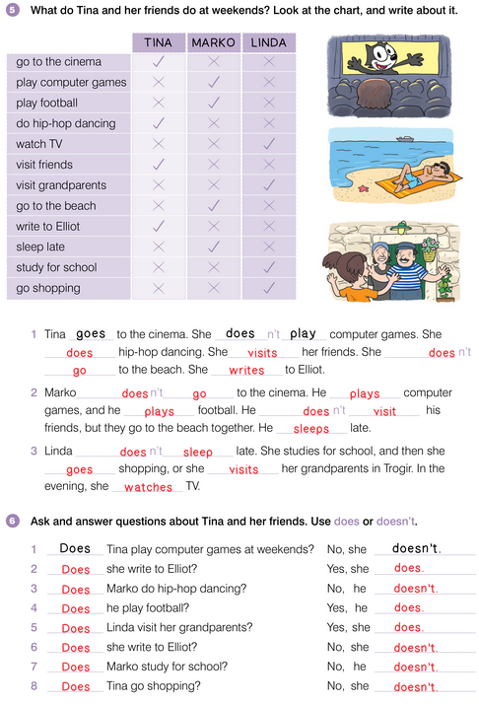
UNIT 2 EVERY DAY
ELLIOT AND TESS

Slide 23
UNIT 2 EVERY DAY
ELLIOT AND TESS

Slide 24
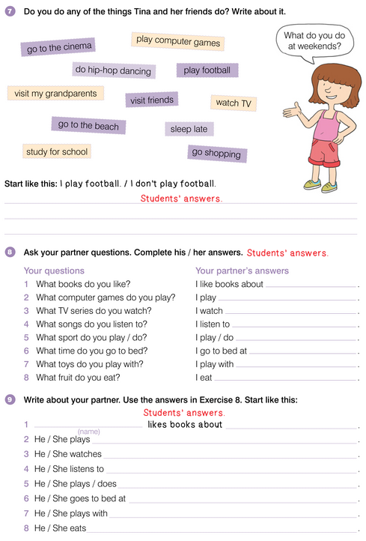
UNIT 2 EVERY DAY
ELLIOT AND TESS

Slide 25
UNIT 2 EVERY DAY
ELLIOT AND TESS

Slide 26
UNIT 2 EVERY DAY
ELLIOT AND TESS

