Slide 1

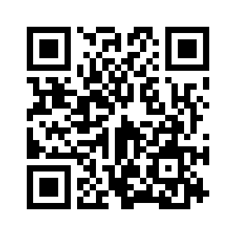
2.4 AFTER SCHOOL
UNIT 2 EVERY DAY
Notes:
https://hr.izzi.digital/#/repository/204

Slide 2

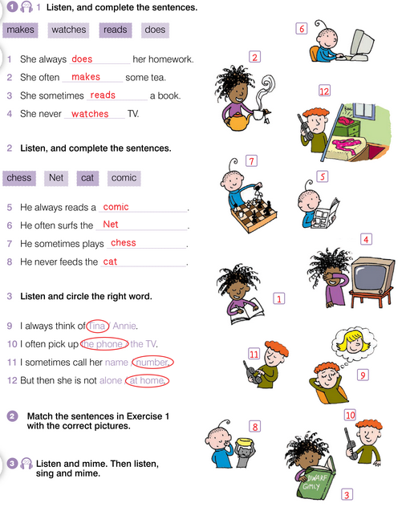
UNIT 2 EVERY DAY
AFTER SCHOOL

Slide 3
UNIT 2 EVERY DAY
AFTER SCHOOL
chess = šah
surf = surfati, pretraživati
Net = Internet
comic = strip
feed = hraniti

Slide 4
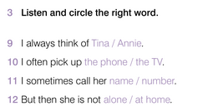
UNIT 2 EVERY DAY
AFTER SCHOOL
think of = razmišljati o
pick up = podići
call = nazvati
alone = sam

Slide 5
UNIT 2 EVERY DAY
AFTER SCHOOL

Slide 6
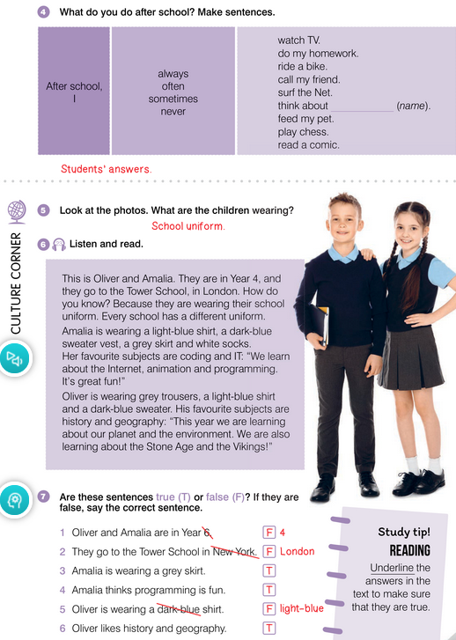
UNIT 2 EVERY DAY
AFTER SCHOOL

Slide 7
UNIT 2 EVERY DAY
AFTER SCHOOL
school uniform = školska uniforma
different = različit
light-blue = svijetloplavo
shirt = košulja
dark-blue = tamnoplavo
sweater vest = pleteni prsluk
grey = siv
skirt = suknja
socks = čarape
coding = kodiranje
animation = animacija
programming = programiranje
trousers = hlače
sweater = vesta
history = povijest
geography = zemljopis
the environment = okoliš
the Stone Age = Kameno doba
the Vikings = Vikinzi

Slide 8
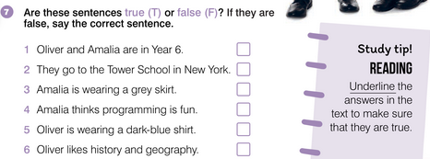
UNIT 2 EVERY DAY
AFTER SCHOOL

Slide 9
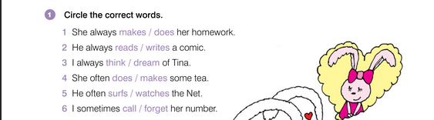
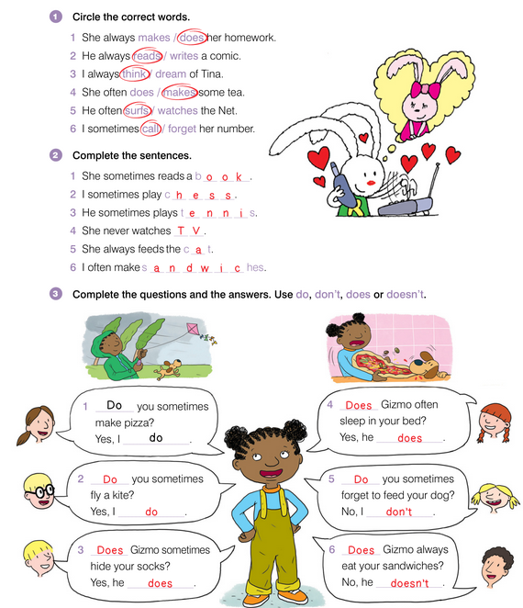
UNIT 2 EVERY DAY
AFTER SCHOOL

Slide 10
UNIT 2 EVERY DAY
AFTER SCHOOL

Slide 11
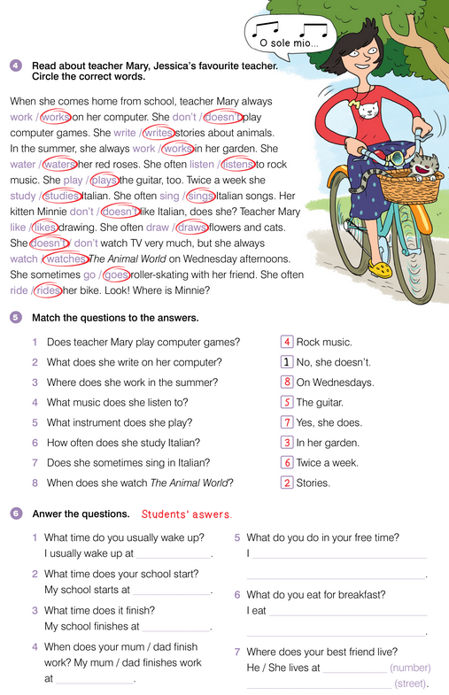
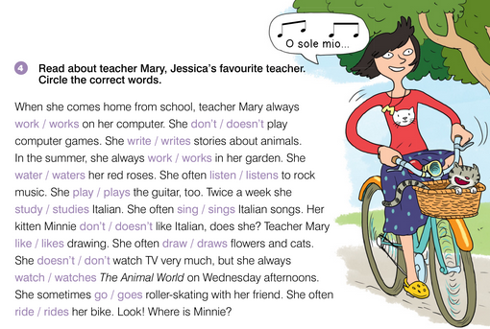
UNIT 2 EVERY DAY
AFTER SCHOOL

Slide 12
UNIT 2 EVERY DAY
AFTER SCHOOL

Slide 13
UNIT 2 EVERY DAY
AFTER SCHOOL

