Slide 1
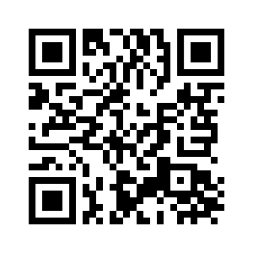
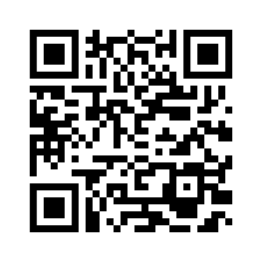
2.5 LET'S CHECK! REVISION
UNIT 2 EVERY DAY
Notes:
https://hr.izzi.digital/#/repository/204

Slide 2
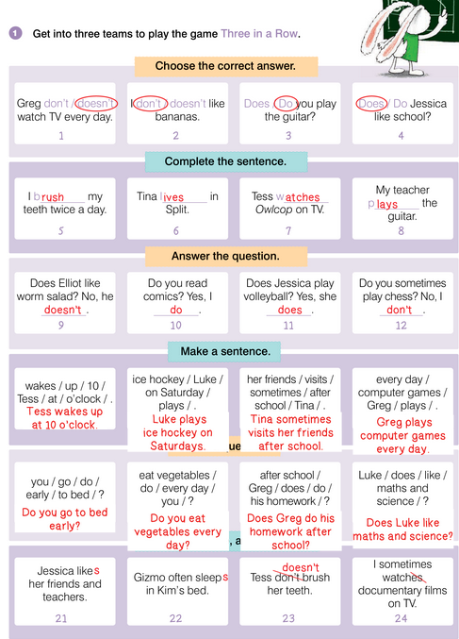
UNIT 2 EVERY DAY
LET’S CHECK!

Slide 3
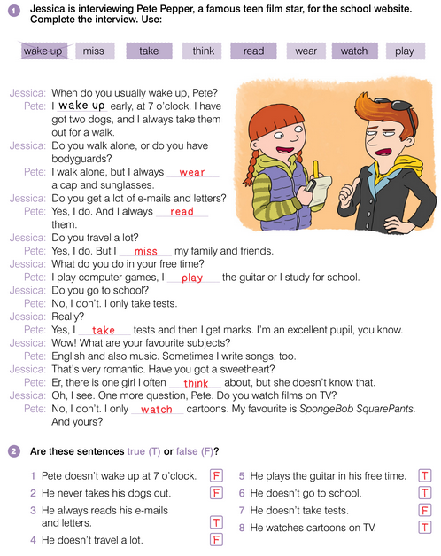
UNIT 2 EVERY DAY
LET’S CHECK!

Slide 4
UNIT 2 EVERY DAY
LET’S CHECK!

Slide 5
UNIT 2 EVERY DAY
LET’S CHECK!

Slide 6
UNIT 2 EVERY DAY
LET’S CHECK!

Slide 7
UNIT 2 EVERY DAY
LET’S CHECK!

Slide 8
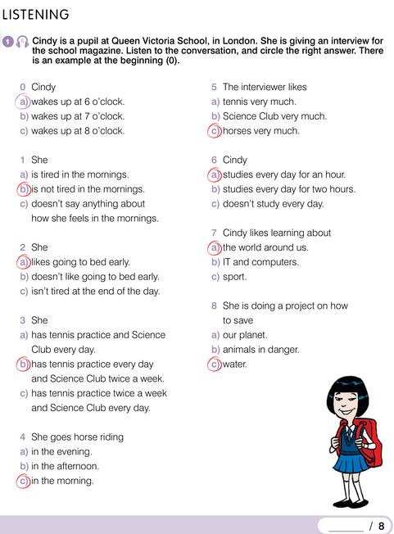
UNIT 2 EVERY DAY
REVISION

Slide 9
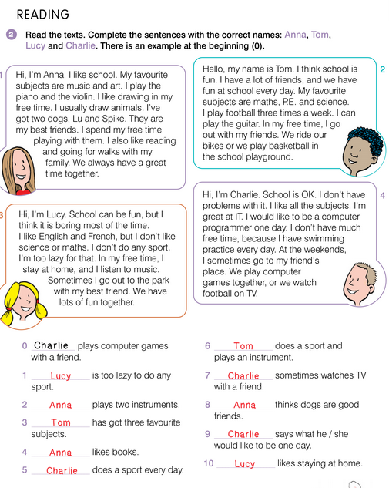
UNIT 2 EVERY DAY
REVISION

