Slide 1


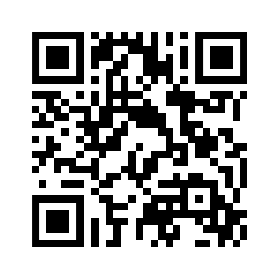
3.1 UNCLE PHIL’S RELATIVES
UNIT 3 DOWN UNDER
rođaci
Notes:
https://hr.izzi.digital/#/repository/204

Slide 2
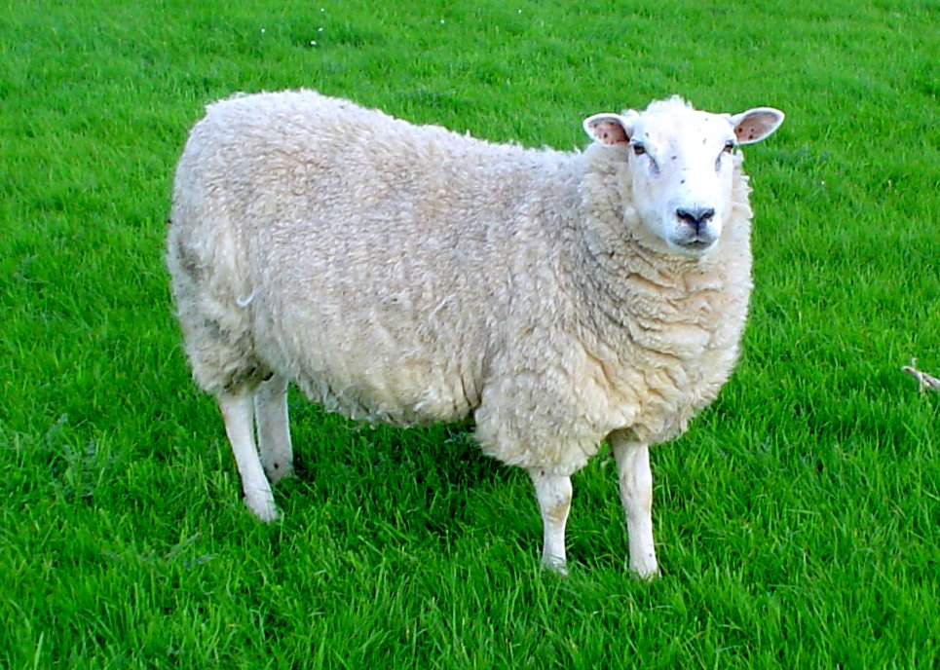
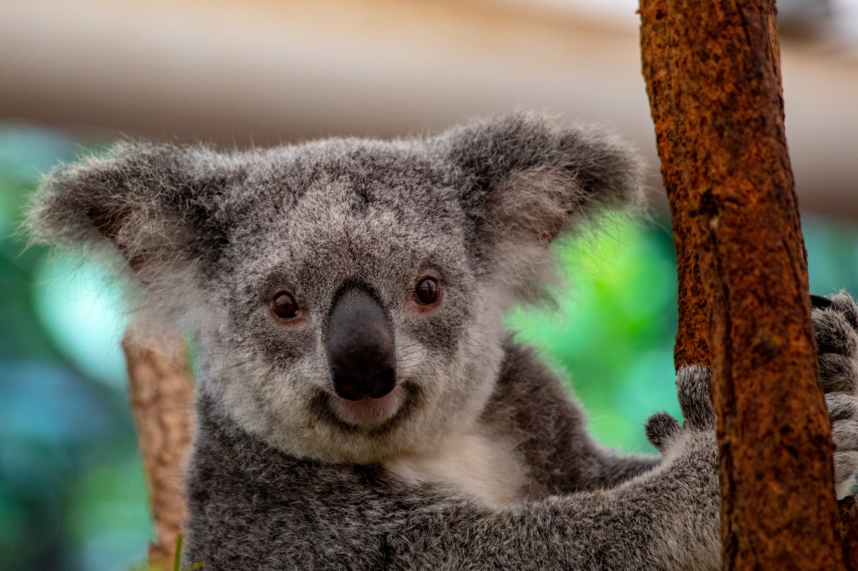
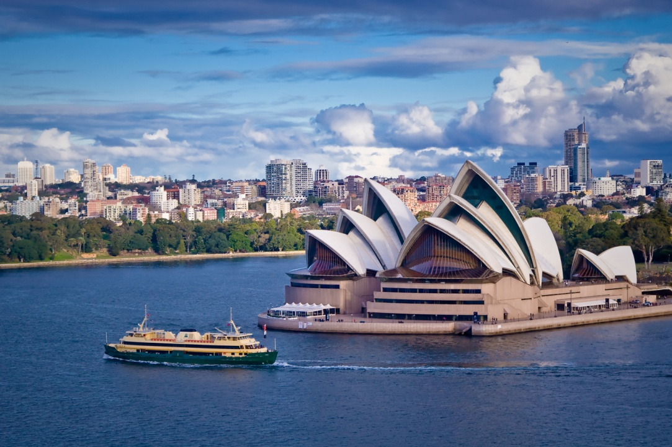
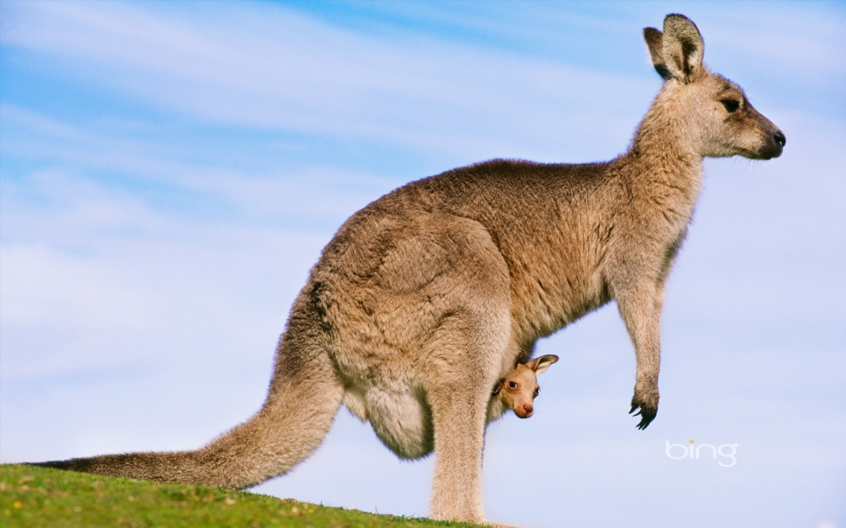
Look at the pictures. Guess where Uncle Phil’s relatives live.
UNIT 3 DOWN UNDER
UNCLE PHIL’S RELATIVES
Australia

Slide 3
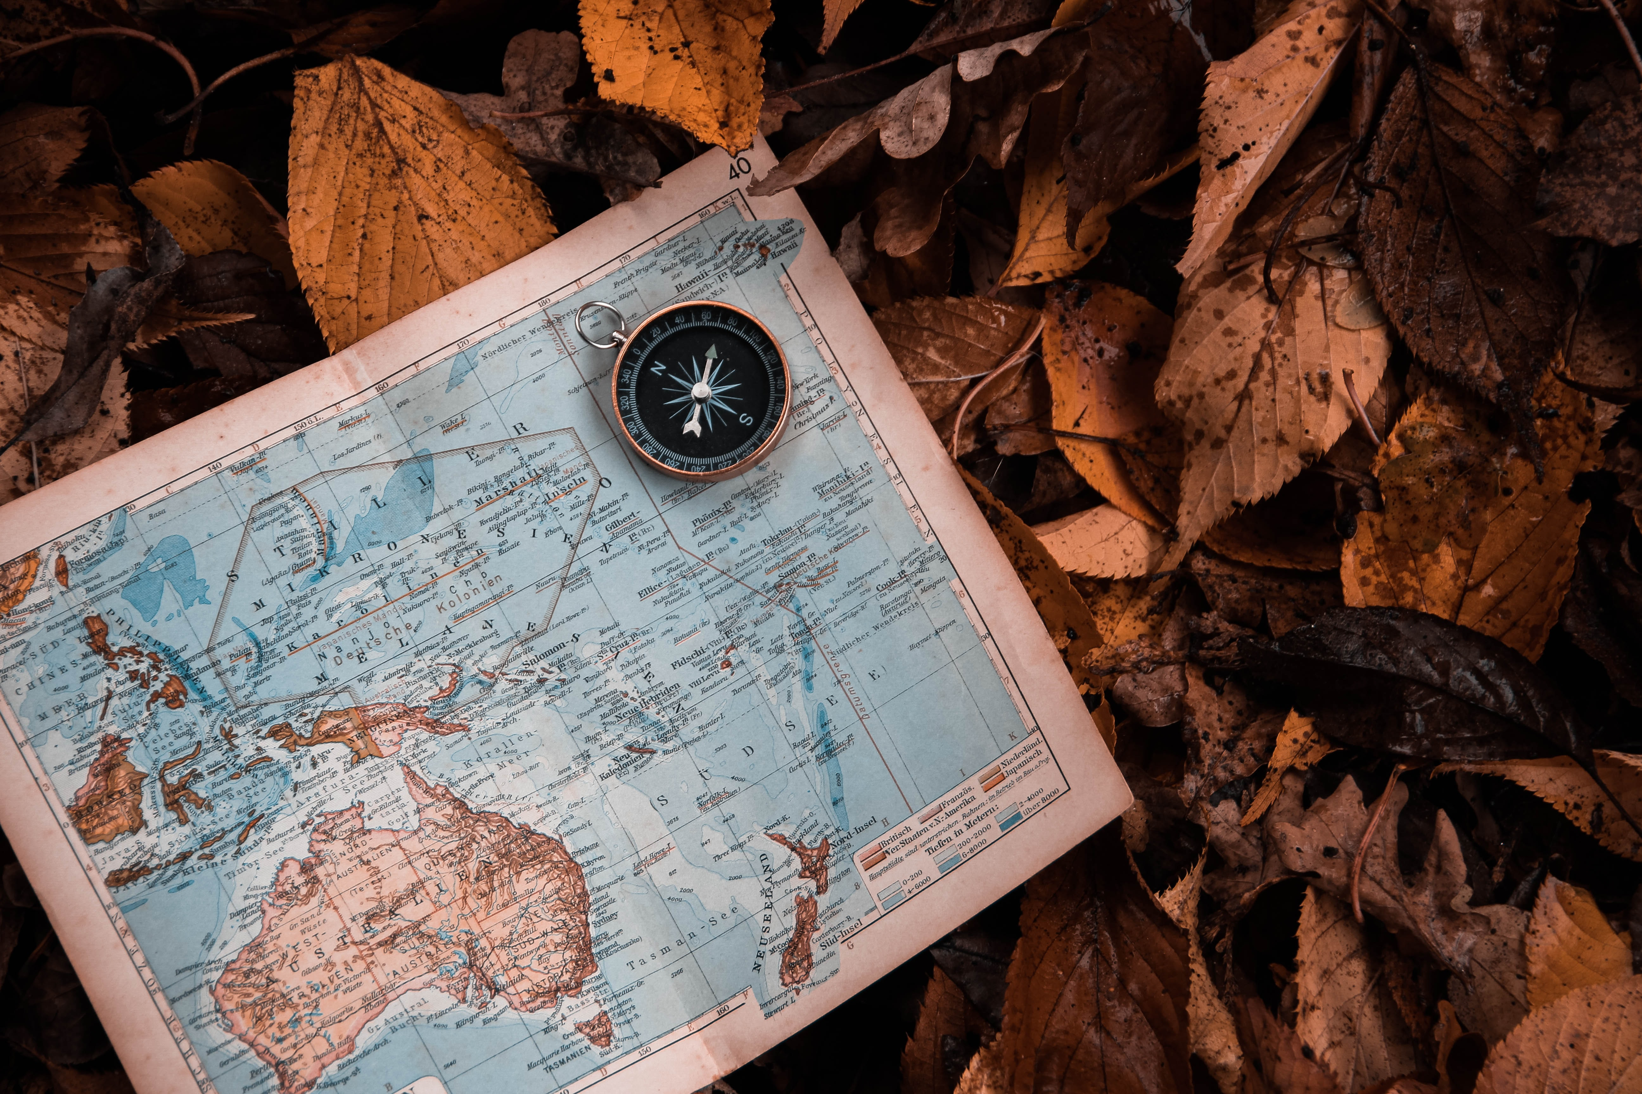
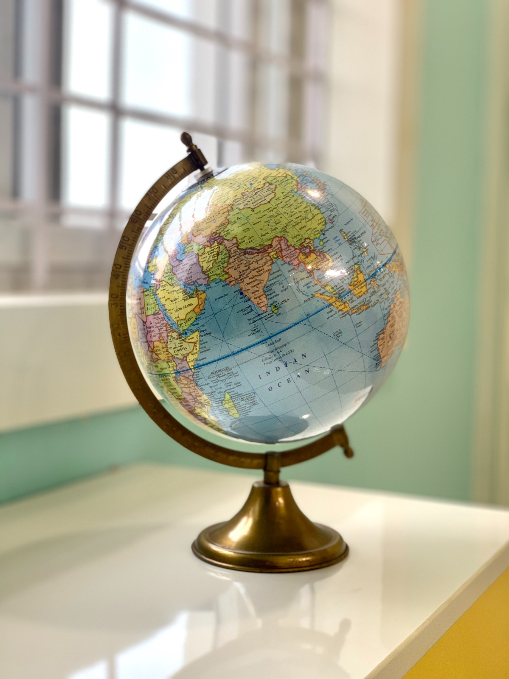
Match the pictures to the words.
UNIT 3 DOWN UNDER
UNCLE PHIL’S RELATIVES
kangaroo map sheep globe koala
1
2
3
4
koala
sheep
map
kangaroo
5
globe

Slide 4
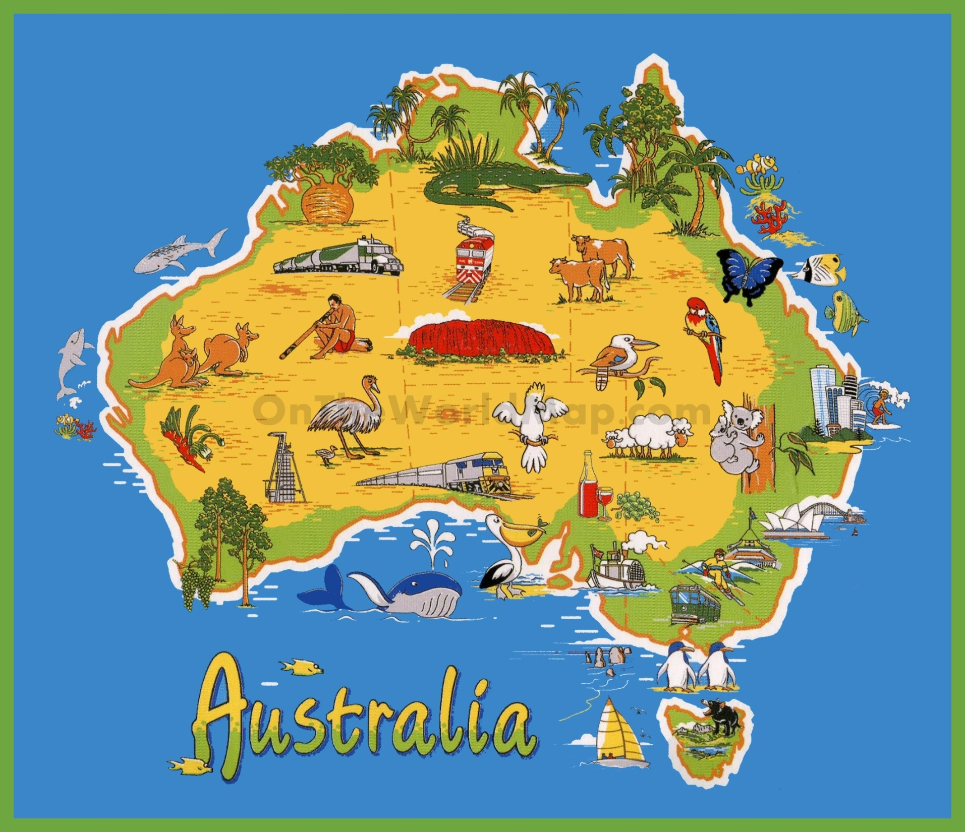
UNIT 3 DOWN UNDER
UNCLE PHIL’S RELATIVES
Study the picture for 1 minute.
What can you see?
How many things can you remember?

Slide 5
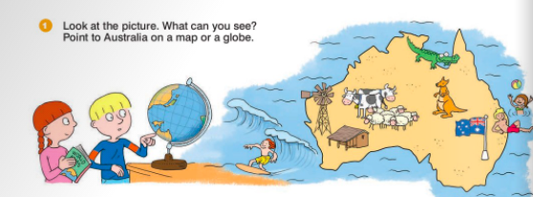
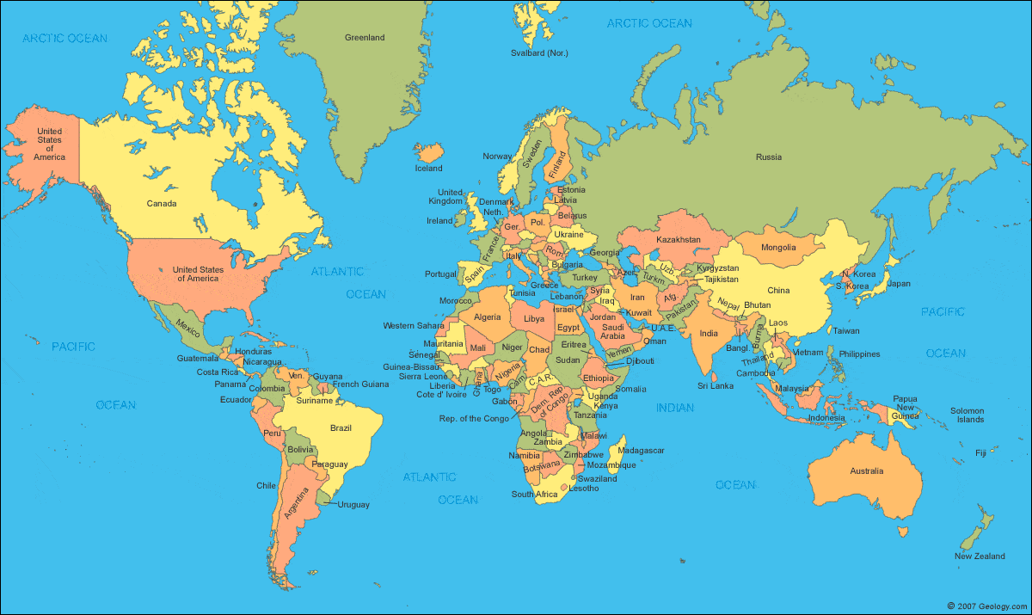
UNIT 3 DOWN UNDER
UNCLE PHIL’S RELATIVES

Slide 6
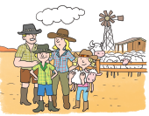
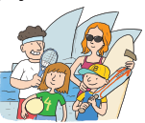
Meet the Taylors and the Whites.
UNIT 3 DOWN UNDER
UNCLE PHIL’S RELATIVES
The Taylors
The Whites

Slide 7
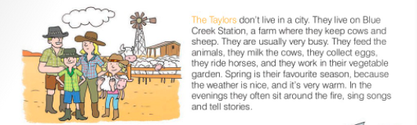

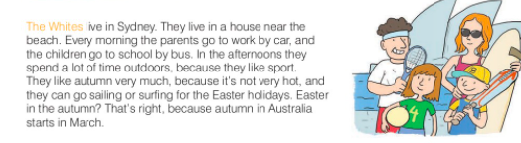
UNIT 3 DOWN UNDER
UNCLE PHIL’S RELATIVES
2
Listen and read about Uncle Phil’s relatives in Australia. Where do they live?

Slide 8
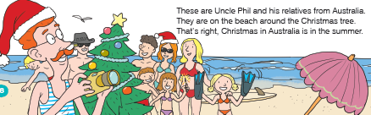
UNIT 3 DOWN UNDER
UNCLE PHIL’S RELATIVES
1
Listen and read about Uncle Phil’s relatives in Australia.

Slide 9
UNIT 3 DOWN UNDER
UNCLE PHIL’S RELATIVES
2
How do you say it in English?
potok
krave
ovce
hraniti životinje
musti krave
skupljat jaja
creek
cows
sheep
feed animals
milk cows
collect eggs
jahati konje
povrtnjak
sjediti oko vatre
pjevati pjesme
pričati priče
plaža
ride horses
vegetable garden
sit around the fire
to sing songs
tell stories
beach
vani
jedrenje
surfanjea
outdoors
sailing
surfing

Slide 10
UNIT 3 DOWN UNDER
The Whites
The Taylors
They like sports.
They like autumn.
They live on a farm.
They can go sailing or surfing for the Easter holidays.
They collect eggs.
They spend a lot of time outdoors.
The parents go to work by car.
The children go to school by bus.
They keep cows and sheep.
They often sit around the fire, sing songs and tell stories.
They live in Sydney.
They ride horses.
They milk the cows.
They feed the animals.
They are on the beach around the Christmas tree.
They don’t live in a city.
They live in a house near the beach.
Their favourite season is spring.
They are usually very busy.
They work in their vegetable garden.

Slide 11
UNIT 3 DOWN UNDER
The Whites
The Taylors
They don’t live in a city.
They live in Sydney.
They live on a farm.
They live in a house near the beach.
They keep cows and sheep.
The parents go to work by car.
The children go to school by bus.
They are usually very busy.
They spend a lot of time outdoors.
They feed the animals.
They like sports.
They collect eggs.
They milk the cows.
They ride horses.
They like autumn.
They work in their vegetable garden.
They are on the beach
around the Christmas tree.
Their favourite season is spring.
They can go sailing or
surfing for the Easter holidays.
They often sit around the fire,
sing songs and tell stories.

Slide 12
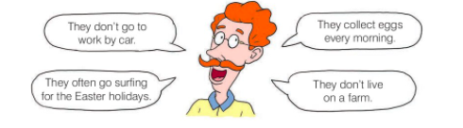
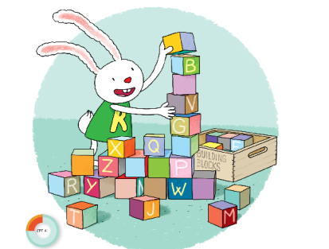
UNIT 3 DOWN UNDER
UNCLE PHIL’S RELATIVES
3
Who is Uncle Phil talking about: the Taylors or the Whites?
LANGUAGE BLOCKS
They
live
in the city.
don’t
They
do
not
live
on a farm.
don’t

Slide 13
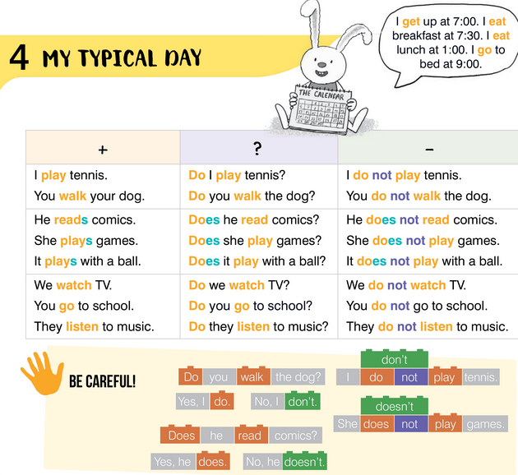
UNIT 3 DOWN UNDER
UNCLE PHIL’S RELATIVES

Slide 14
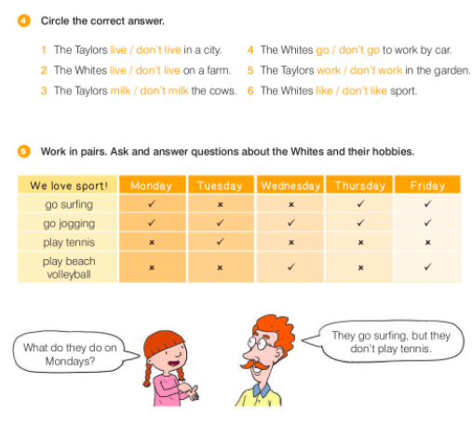
UNIT 3 DOWN UNDER
UNCLE PHIL’S RELATIVES

Slide 15
UNIT 3 DOWN UNDER
UNCLE PHIL’S RELATIVES
live
keep
work
sit
sing
live
live
go
go
spend
like

Slide 16
UNIT 3 DOWN UNDER
UNCLE PHIL’S RELATIVES
live
go
work
like

Slide 17
UNIT 3 DOWN UNDER
UNCLE PHIL’S RELATIVES
5
6
4
2
3
They sing songs.
They ride horses.
They feed animals.

Slide 18
UNIT 3 DOWN UNDER
UNCLE PHIL’S RELATIVES
4
How do you say it in Croatian?
day
week
study room
breakfast
text message
afternoon
dan
tjedan
radna soba
doručak
Sms poruka
popodne
morning
lunch
project
summer camp
camera
laptop
jutro
ručak
projekt
ljetni kamp
kamera
prijenosno računalo

Slide 19
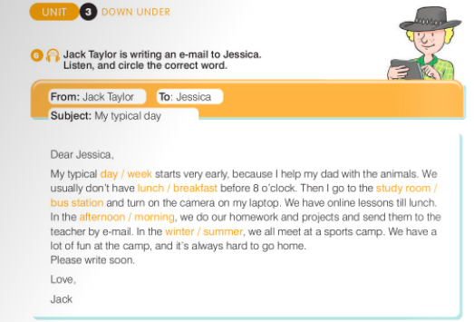
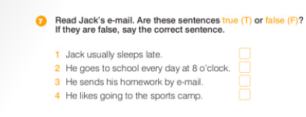
UNIT 3 DOWN UNDER
UNCLE PHIL’S RELATIVES
F
F
T
T

Slide 20
UNIT 3 DOWN UNDER
UNCLE PHIL’S RELATIVES
LANGUAGE BLOCKS
We
have
school every day.
don’t
We
do
not
go
to school by bus.

Slide 21
UNIT 3 DOWN UNDER
UNCLE PHIL’S RELATIVES

Slide 22
UNIT 3 DOWN UNDER
UNCLE PHIL’S RELATIVES
REMEMBER!
always
usually
often
sometimes
never
How often?

Slide 23
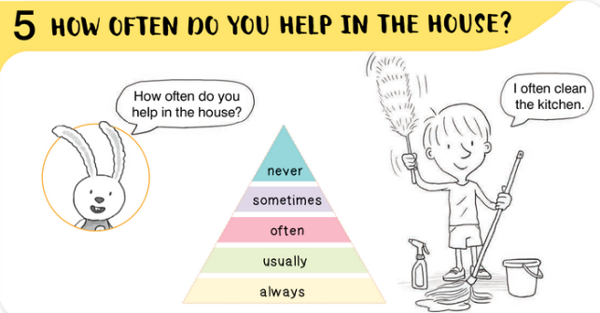
UNIT 3 DOWN UNDER
UNCLE PHIL’S RELATIVES

Slide 24
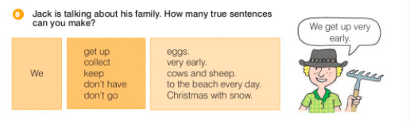
UNIT 3 DOWN UNDER
UNCLE PHIL’S RELATIVES
We get up very early.
We collect eggs.
We keep cows and sheeps.
We don’t have Christmas with snow.
We don’t go to the beach every day.

Slide 25
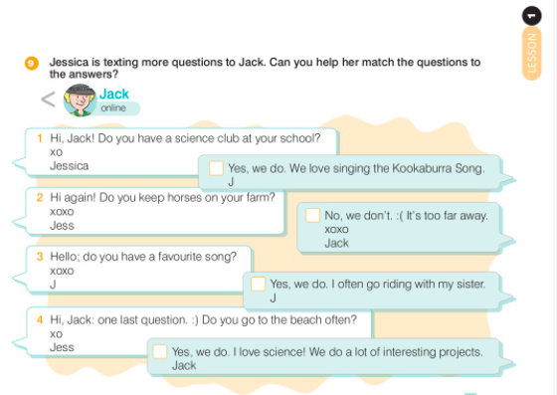
UNIT 3 DOWN UNDER
UNCLE PHIL’S RELATIVES

Slide 26
UNIT 3 DOWN UNDER
UNCLE PHIL’S RELATIVES
Hi Jack! Do you have a Science club at your school?
xo
Jessica
Yes, we do. I love science.
We do a lot of interesting projects.
Jack
Hi again,
Do you keep horses on your farm?
Xoxo
Jes
Yes, we do. I often go riding with
my sister.
JT
Hello,
Do you have a favourite song?
xoxo
J
Yes, we do. We love singing
the Kookabura Song.
J
Hi Jack, one last question. ☺
Do you go to the beach often?
☹ No, we don't. It' s too far away.
xoxo
Jack

Slide 27
UNIT 3 DOWN UNDER
UNCLE PHIL’S RELATIVES
LANGUAGE BLOCKS
Do
You
keep
animals.
you
animals?
Yes,
we
do.
Do
you
to school.
You
go
to school?
No,
we
don’t

Slide 28
UNIT 3 DOWN UNDER
UNCLE PHIL’S RELATIVES

Slide 29
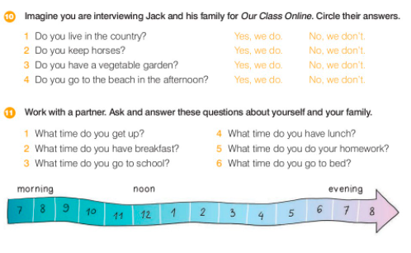
UNIT 3 DOWN UNDER
UNCLE PHIL’S RELATIVES

Slide 30
UNIT 3 DOWN UNDER
UNCLE PHIL’S RELATIVES
3
5
2
7
4
6

Slide 31
UNIT 3 DOWN UNDER
UNCLE PHIL’S RELATIVES
Christmas in Australia is in the summer.
The Taylor’s don’t live in Sydney.
What do you usually do on Mondays?
Do you see your friends often?
3
1
4
2

Slide 32
UNIT 3 DOWN UNDER
UNCLE PHIL’S RELATIVES

Slide 33
UNIT 3 DOWN UNDER
UNCLE PHIL’S RELATIVES

Slide 34
UNIT 3 DOWN UNDER
UNCLE PHIL’S RELATIVES
At 8 o’clock.
Toast and tea.
In the afternoon.
By bus.

Slide 35
UNIT 3 DOWN UNDER
UNCLE PHIL’S RELATIVES

