Slide 1
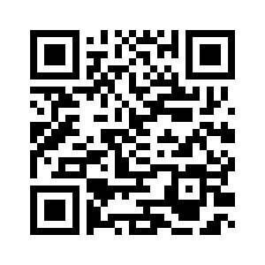
UNIT 3 DOWN UNDER
SCIENCE REPORT
What is the weather like?

Slide 2
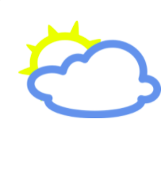
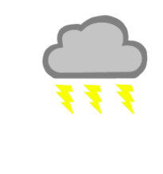
UNIT 3 DOWN UNDER
SCIENCE REPORT
WHAT’S THE WEATHER LIKE?
Match pictures to the words.
It’s windy. It’s sunny. It’s cloudy.
It’s snowy. It’s rainy. It’s stormy.
1
2
3
It’s sunny.
It’s cloudy.
It’s windy.
5
6
4
It’s snowy.
It’s stormy.
It’s rainy.
1
Look through the window. What’s the weather like today?

Slide 3
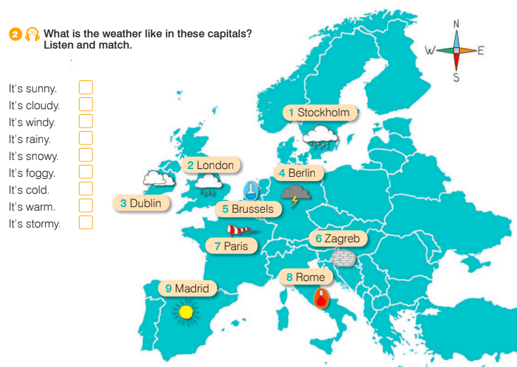
UNIT 3 DOWN UNDER
SCIENCE REPORT
WHAT’S THE WEATHER LIKE?
What’s the weather like in London?
9
3
7
What’s the weather like in Paris?
2
1
6
5
8
4
What’s the weather like in Dublin?

Slide 4
UNIT 3 DOWN UNDER
SCIENCE REPORT
Match the countries to their capitals.
Ireland
London
Sweden
Paris
Germany
Rome
Spain
Zagreb
Croatia
Madrid
Great Britain
Dublin
Italy
Stockholm
France
Brussels
Belgium
Berlin

Slide 5
UNIT 3 DOWN UNDER
SCIENCE REPORT
Match the countries to their capitals.
Ireland
Dublin
Sweden
Stockholm
Germany
Berlin
Spain
Madrid
Croatia
Zagreb
Great Britain
London
Italy
Rome
France
Paris
Belgium
Brussels

Slide 6
Put in order on the thermometer.
UNIT 3 DOWN UNDER
SCIENCE REPORT
freezing
cold
warm
hot

Slide 7
Put in order on the thermometer.
UNIT 3 DOWN UNDER
SCIENCE REPORT
hot
warm
cold
freezing

Slide 8
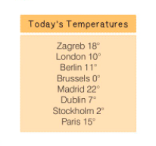
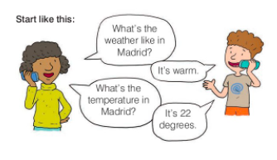
UNIT 3 DOWN UNDER
SCIENCE REPORT
3
Talk to your partner about the weather in Europe.

Slide 9
UNIT 3 DOWN UNDER
SCIENCE REPORT
How do you say it in English?
Sunčano je.
Hladno je.
Vjetrovito je.
Maglovito je.
Olujno je.
Pada kiša.
It’s sunny.
It’s cold.
It’s windy.
It’s foggy.
It’s stormy.
It’s rainy.
Pada snijeg.
Toplo je.
Oblačno je.
glavni grad
Kakvo je vrijeme?
Koja je temperatura?
It’s snowy.
It’s warm.
It’s cloudy.
capital
What’s the weather like?
What’s the temperature?

Slide 10
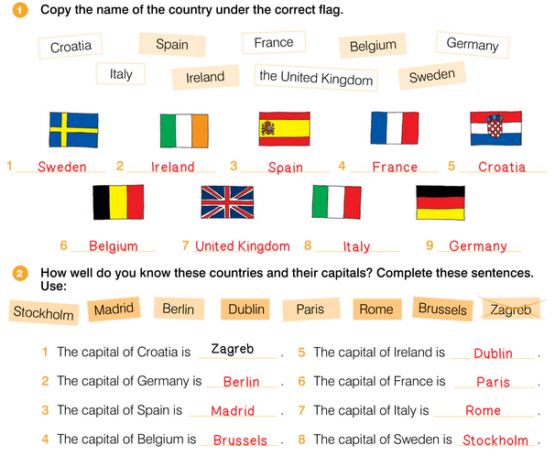
UNIT 3 DOWN UNDER
SCIENCE REPORT

Slide 11
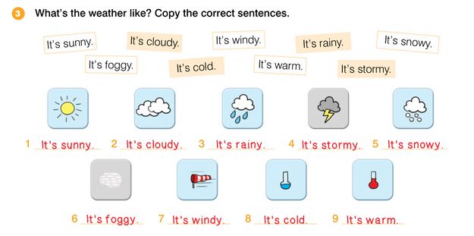
UNIT 3 DOWN UNDER
SCIENCE REPORT

Slide 12
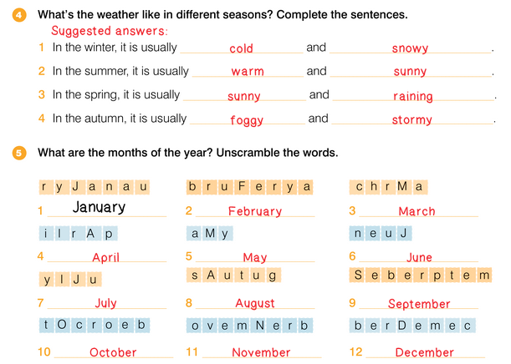
UNIT 3 DOWN UNDER
SCIENCE REPORT

Slide 13
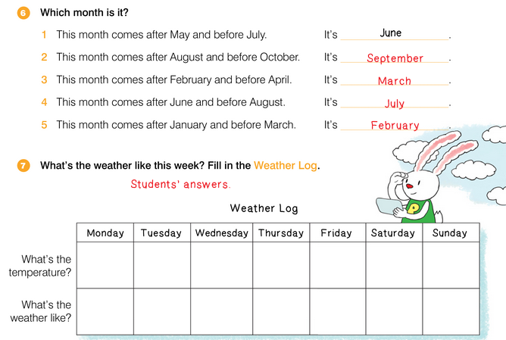
UNIT 3 DOWN UNDER
SCIENCE REPORT

Slide 14
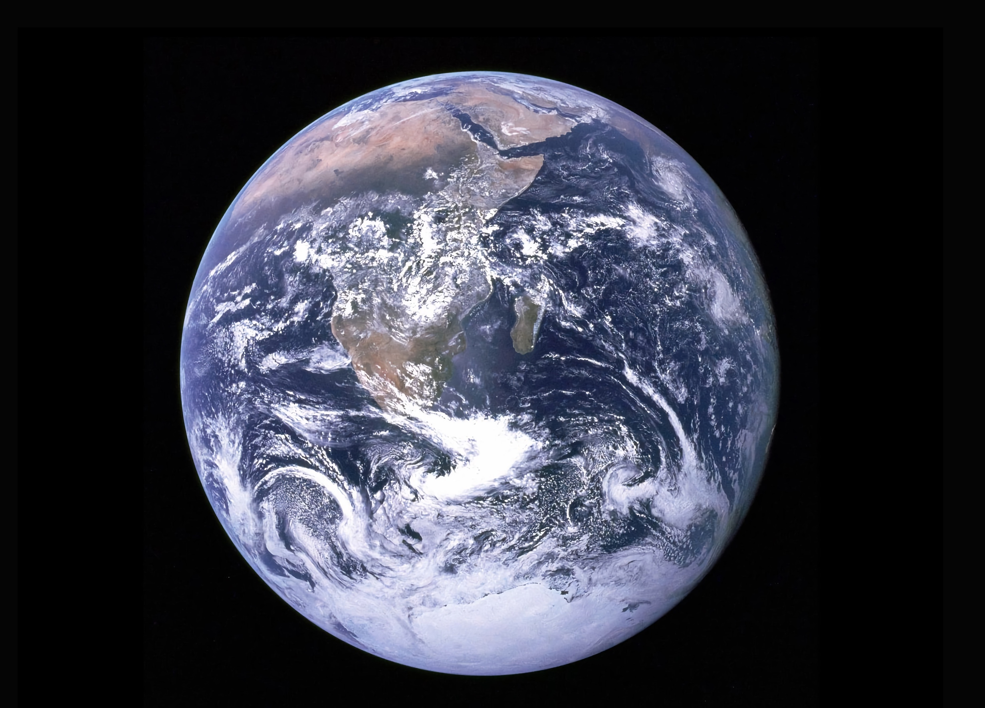
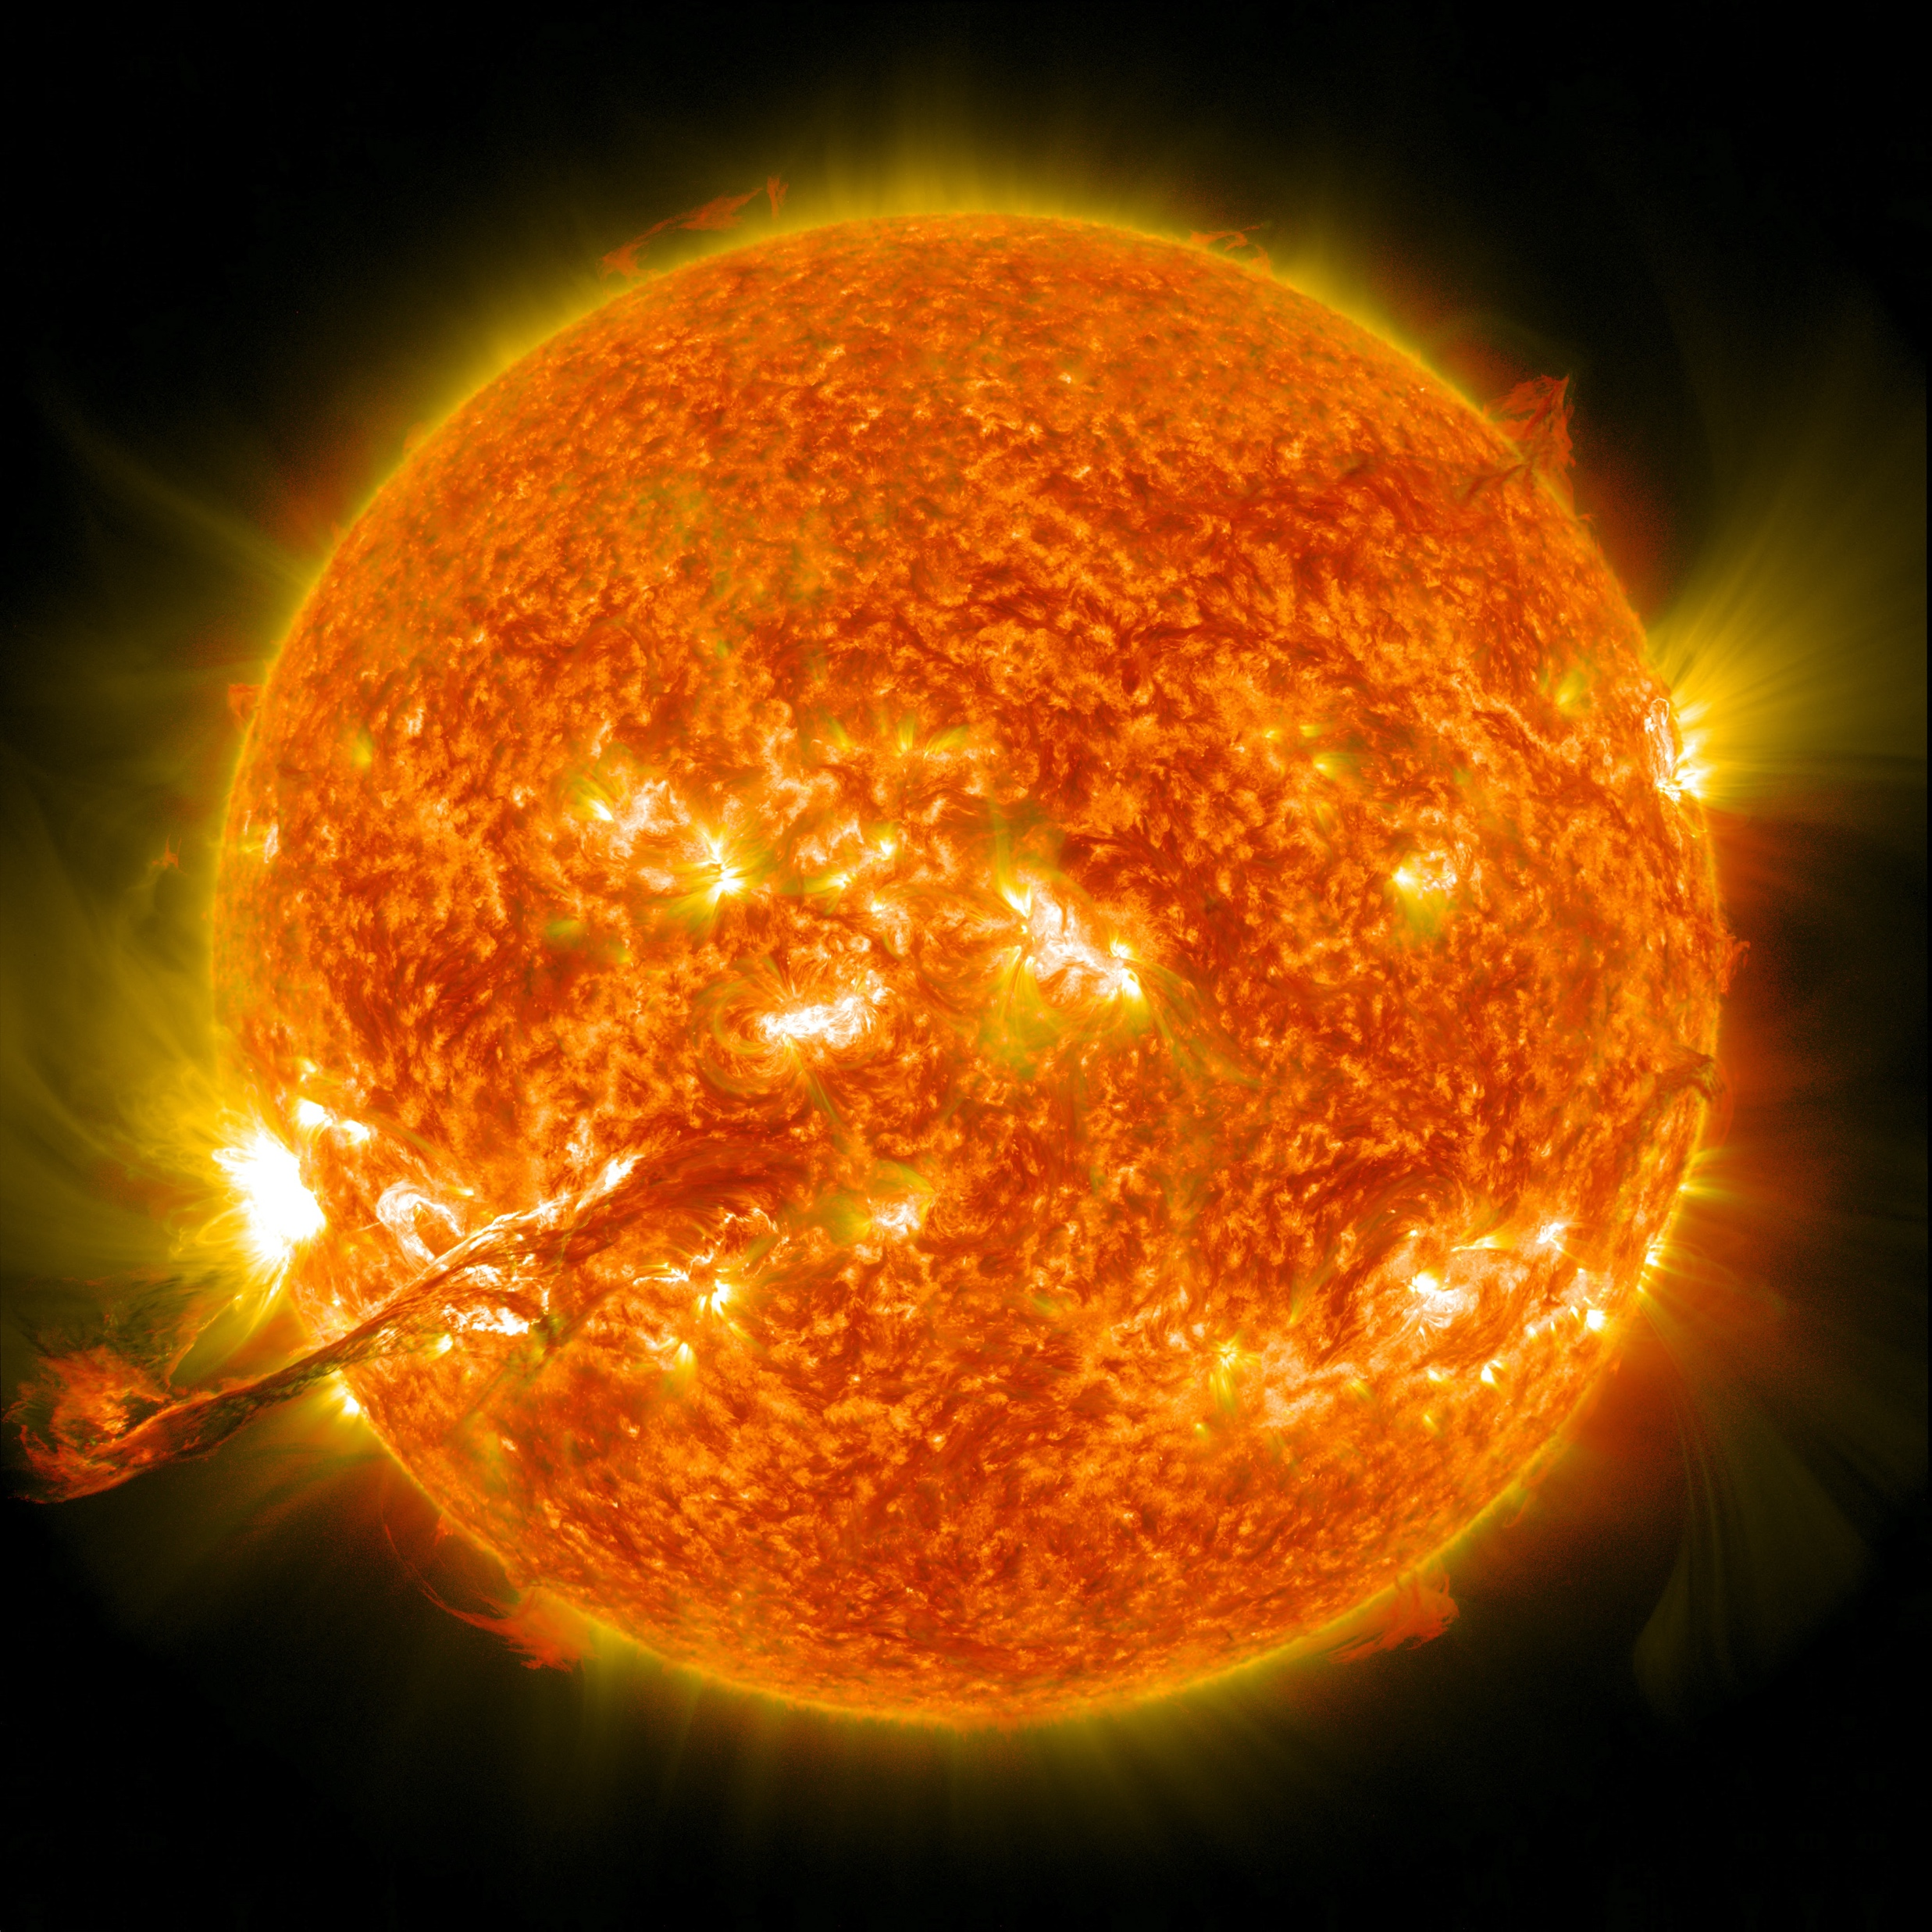
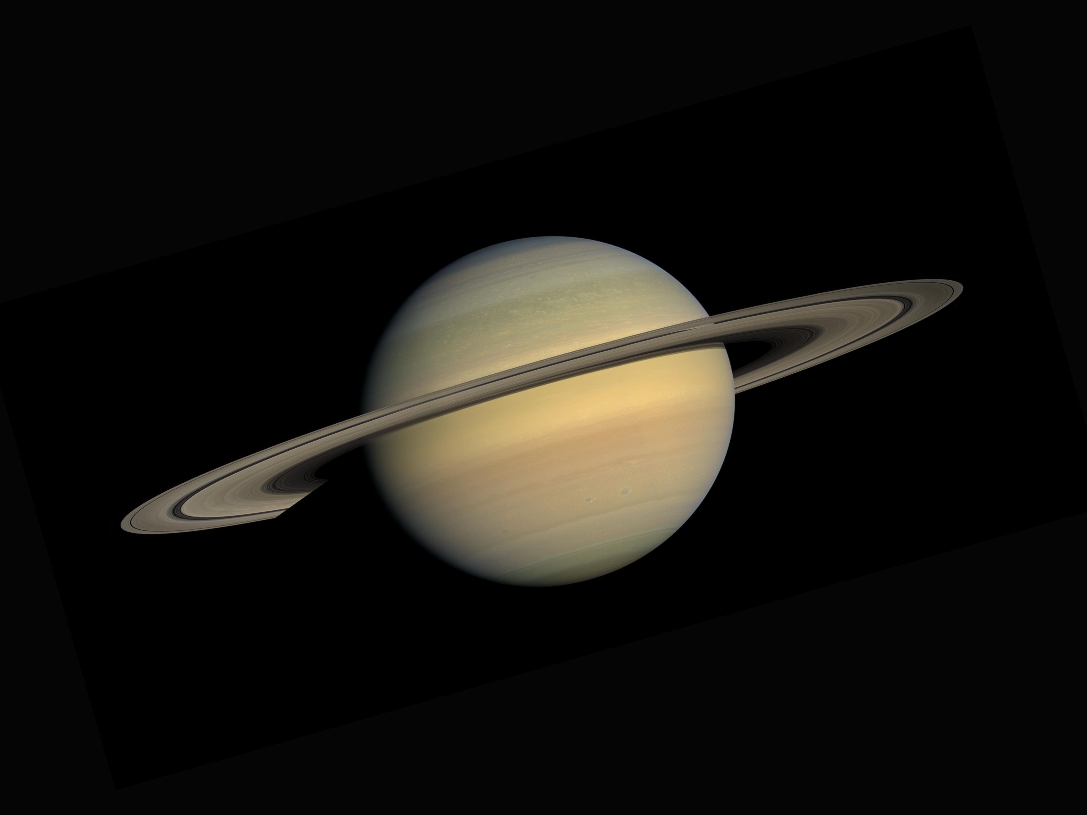
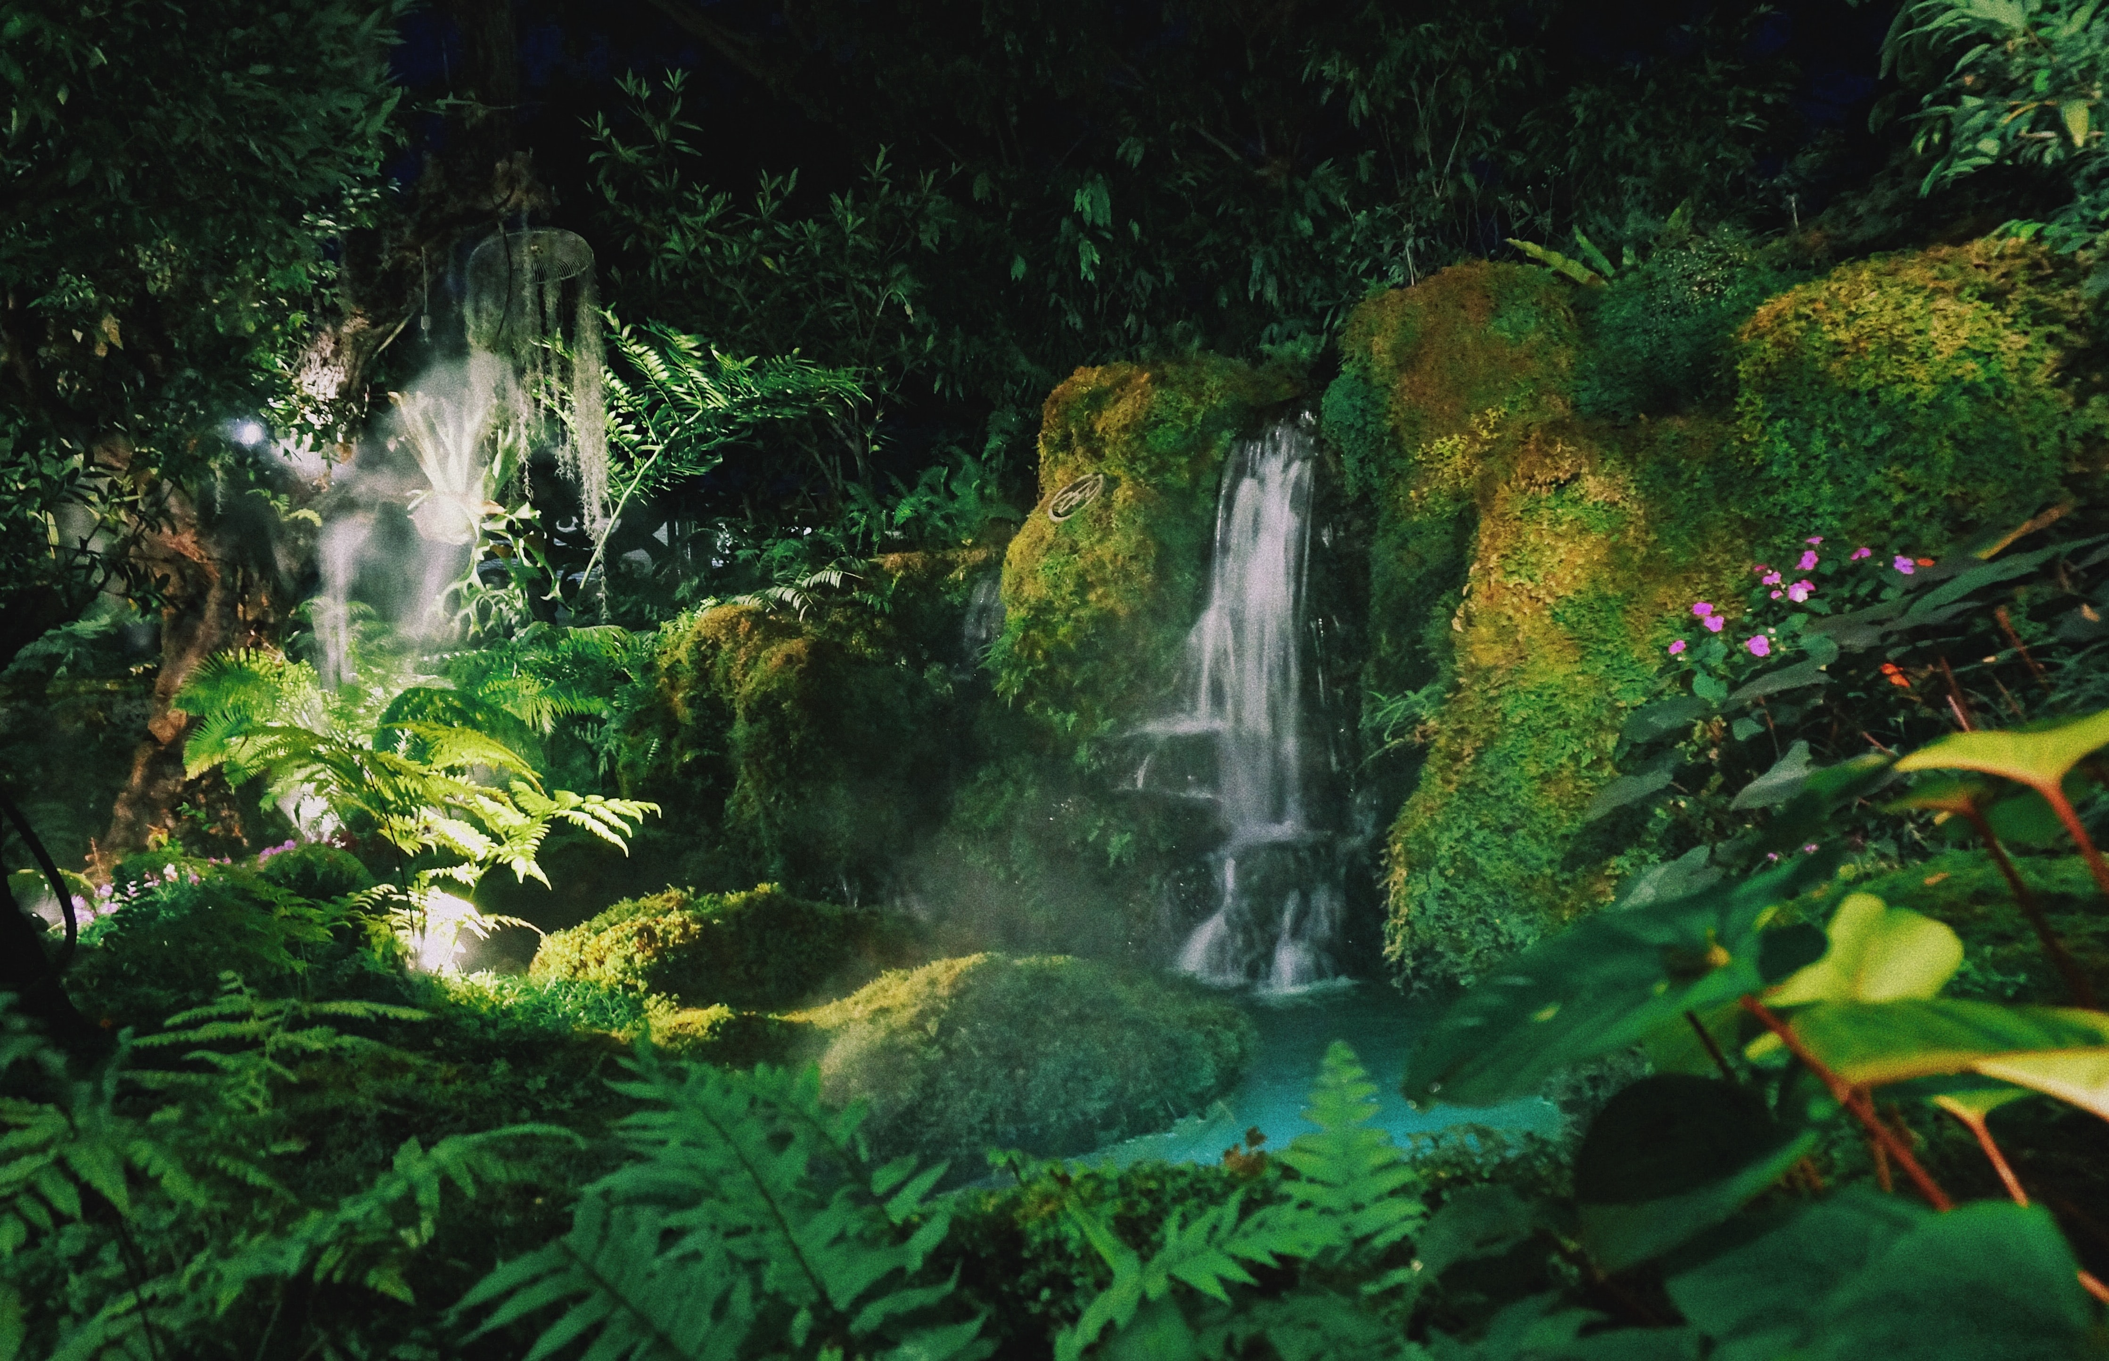
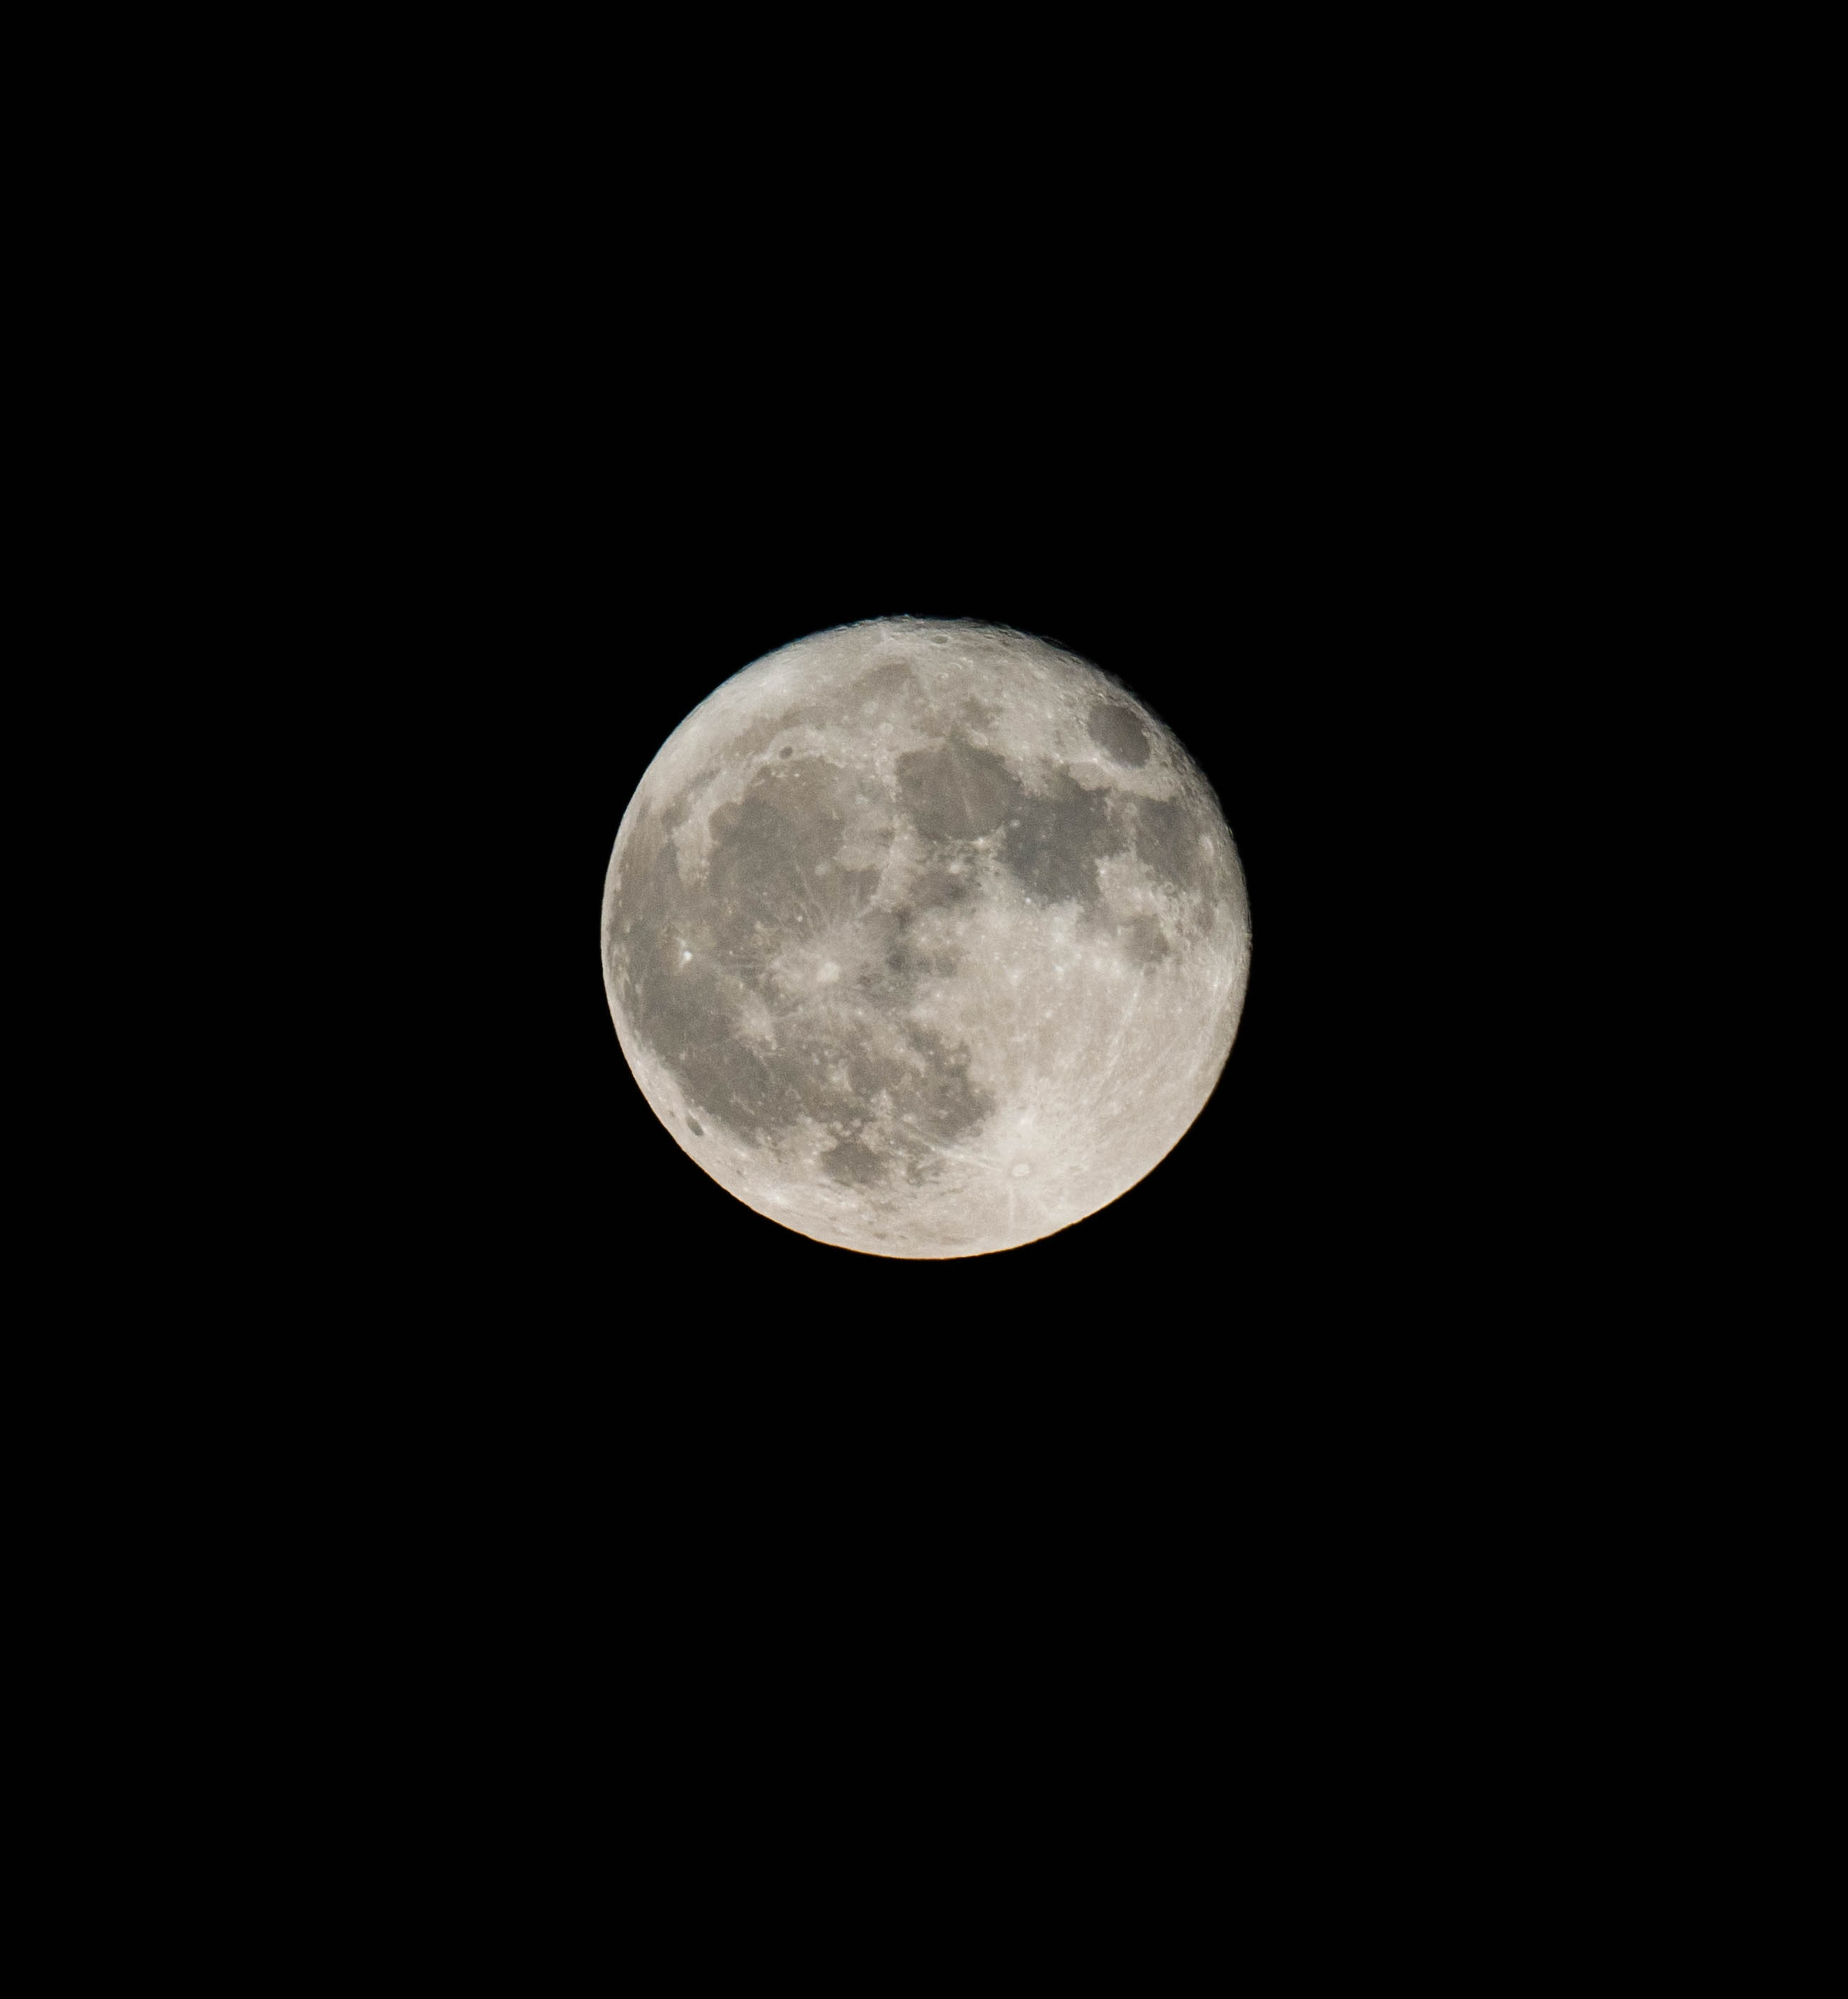
Match the pictures to the words.
UNIT 3 DOWN UNDER
SCIENCE REPORT
the sun planet rainforest the Earth moon
1
2
3
4
the Earth
sun
planet
rainforest
5
moon

Slide 15
Which one is the South Pole and which one is the North Pole?
UNIT 3 DOWN UNDER
SCIENCE REPORT
the South Pole
the North Pole

Slide 16
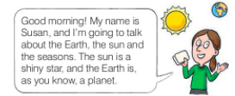
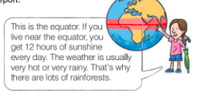
UNIT 3 DOWN UNDER
SCIENCE REPORT
5
Now listen to and read Susan’s science report.
star = zvjezda
equator = ekvator, polutnik
hour = sat
sunshine = sunčeva svjetlost

Slide 17
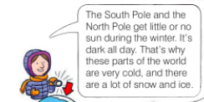
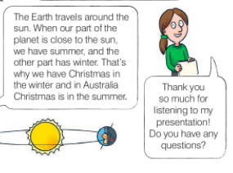
UNIT 3 DOWN UNDER
SCIENCE REPORT
5
Now listen to and read Susan’s science report.
South Pole = južni pol
North Pole = sjeveni pol
ice = led
travel = putovati
part = dio
close = blizu
presentation =prezentacija

Slide 18
UNIT 3 DOWN UNDER
SCIENCE REPORT
Are the sentences true or false? If they are false, say the correct sentence.
Susan is going to talk about the moon.
Our planet, the Earth, is round like a big ball.
The weather near the equator is very hot and very rainy.
It's very hot on the South Pole.
The Australians have Christmas in the summer.
x
✓
✓
x
✓

Slide 19
UNIT 3 DOWN UNDER
SCIENCE REPORT
Read Susan’s science report once again. Where does it say…?
Dobro jutro! Moje ime je Susan i govorit ću o zemlji, suncu i planetama.
Vrijeme je obično jako vruće ili jako kišovito.
Zemlja putuje oko sunca.
Imate li pitanja?

Slide 20
UNIT 3 DOWN UNDER
SCIENCE REPORT
Over to you. Can you answer these question?
Why is the weather warm and sunny in the summer?
Why is the sun so hot?
Why is there snow and ice on the North Pole?

Slide 21
UNIT 3 DOWN UNDER
SCIENCE REPORT
7
Look through the window. What’s the weather like today? What are you wearing?
Make a short presentation for your classmates.
REMEBER
Good morning! My name is…, and I’m going to talk about…
Keep your body and hands still.
Use a strong voice. Don't talk too fast.
Prepare well and practise.
When you start,
make eye contact.
The weather today is….
I’m wearing…
Thank you for listening to my presentation.
Do you have any questions?

Slide 22
UNIT 3 DOWN UNDER
SCIENCE REPORT

Slide 23
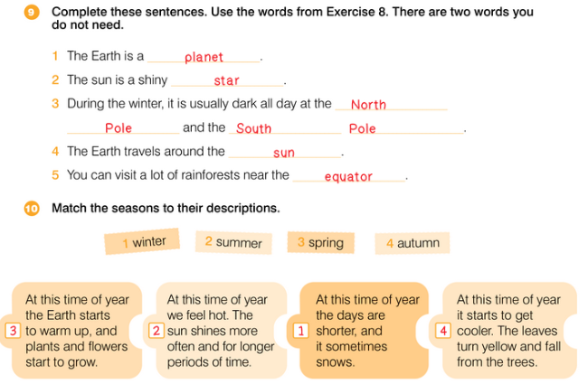
UNIT 3 DOWN UNDER
SCIENCE REPORT

Slide 24
UNIT 3 DOWN UNDER
SCIENCE REPORT

Slide 25
UNIT 3 DOWN UNDER
SCIENCE REPORT

