Slide 1
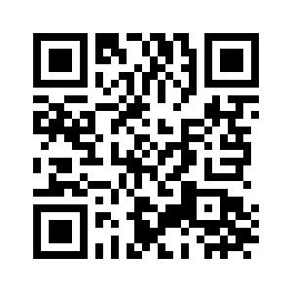
UNIT 3 DOWN UNDER
KEEP MOVING

Slide 2
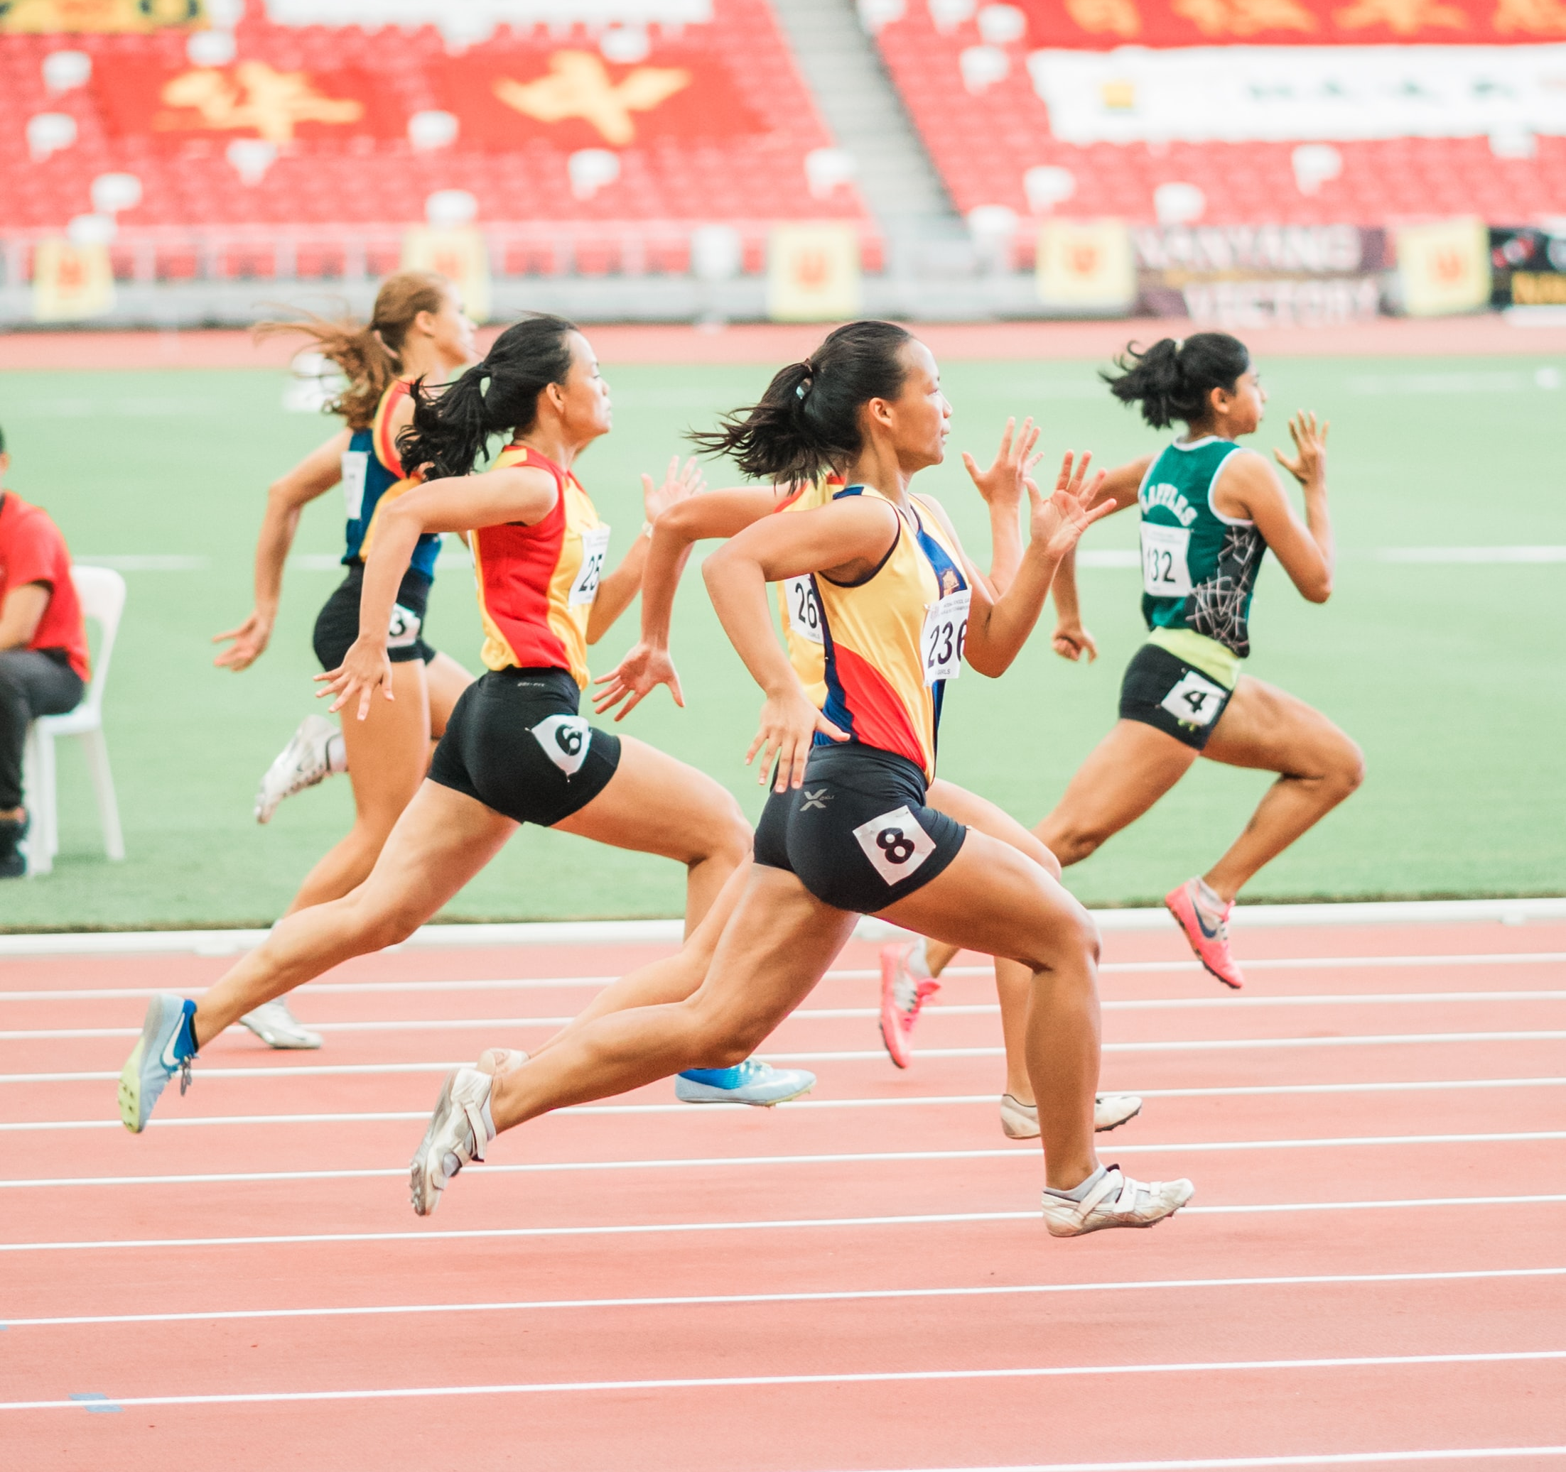
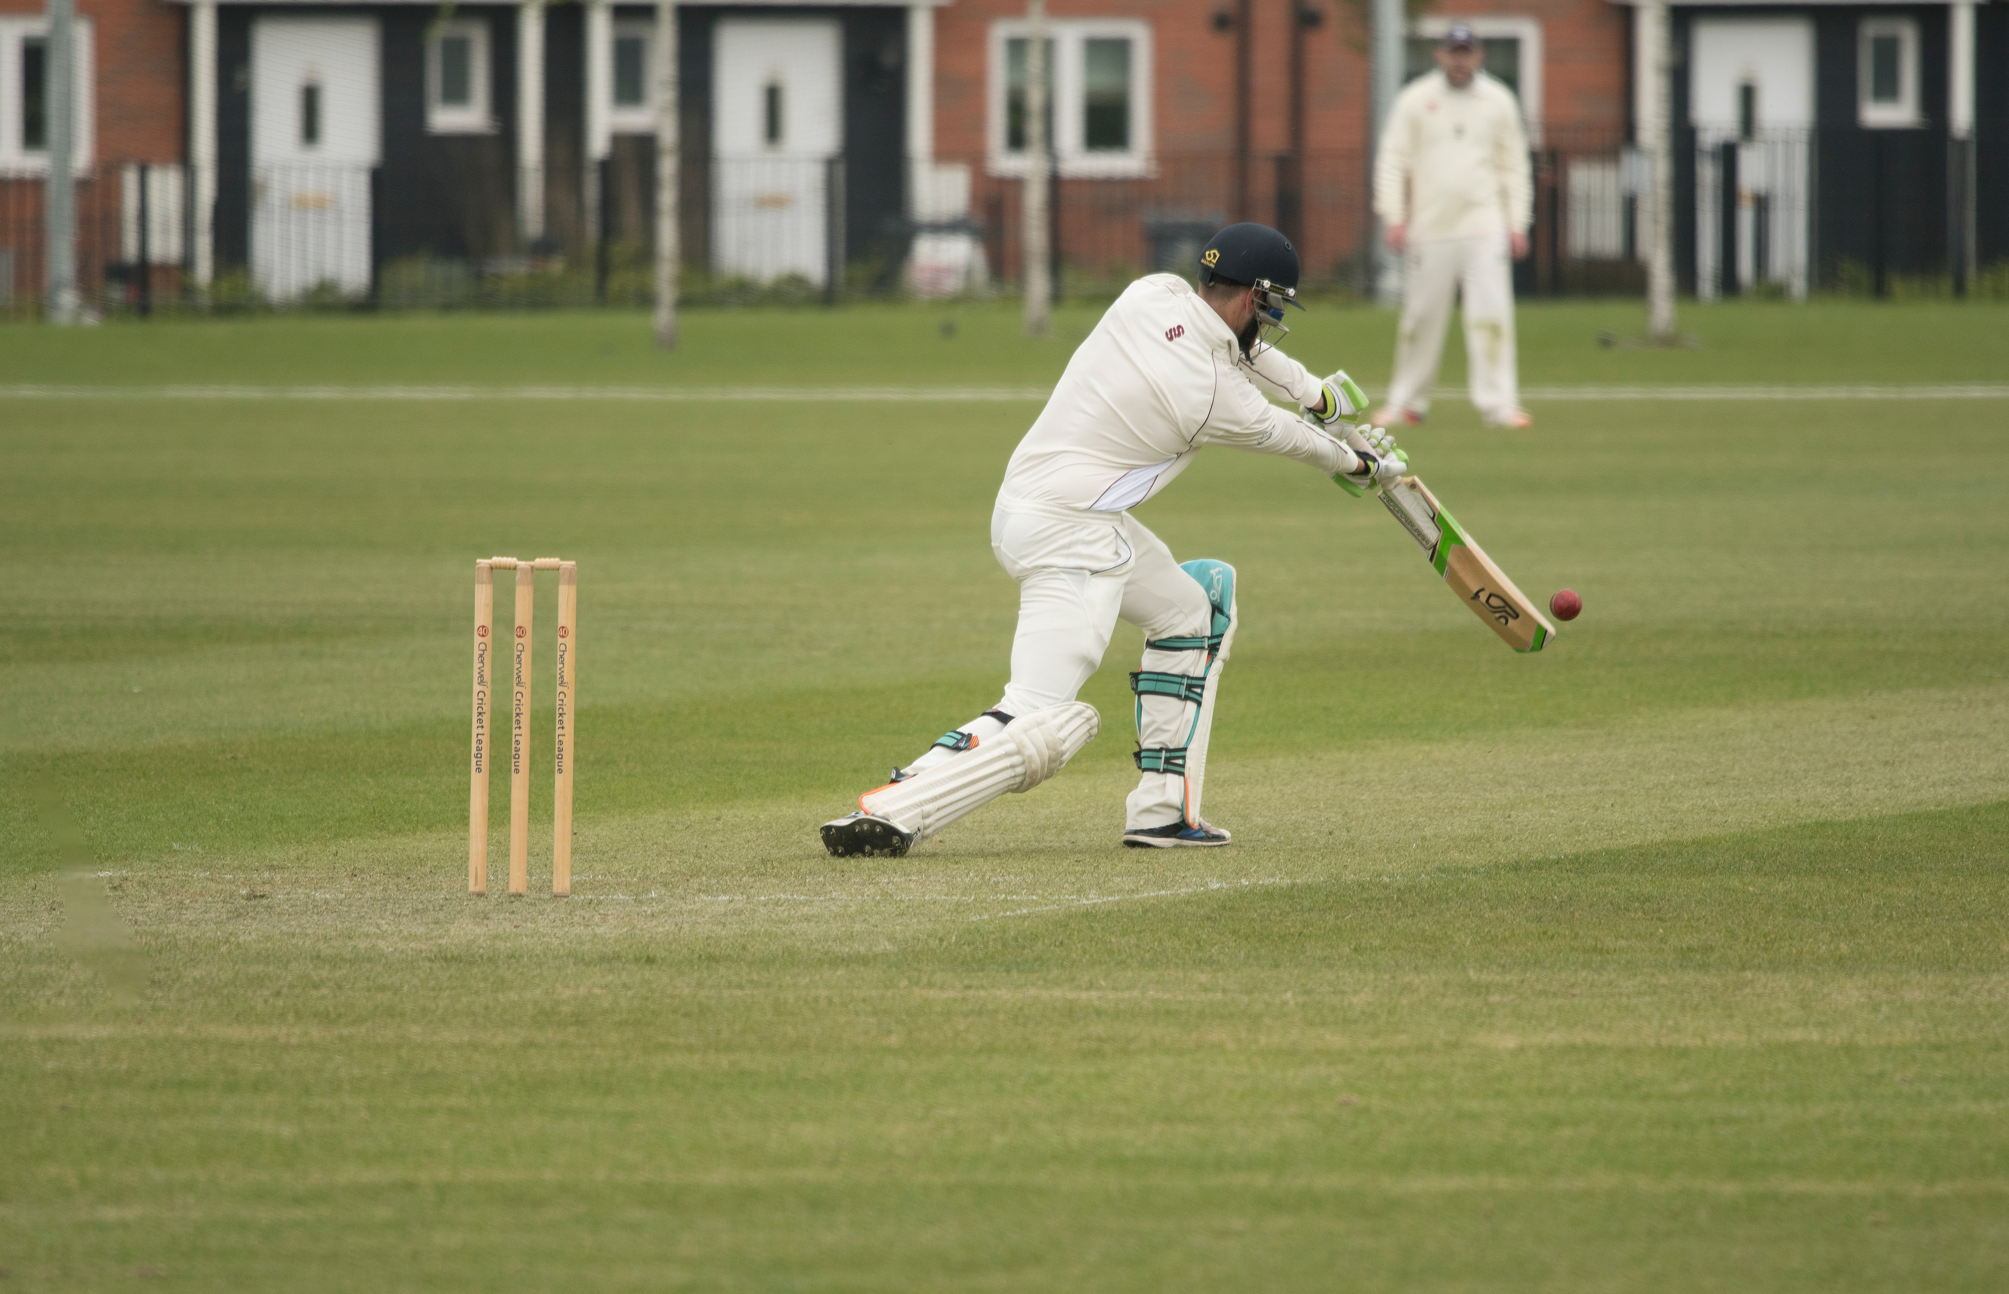
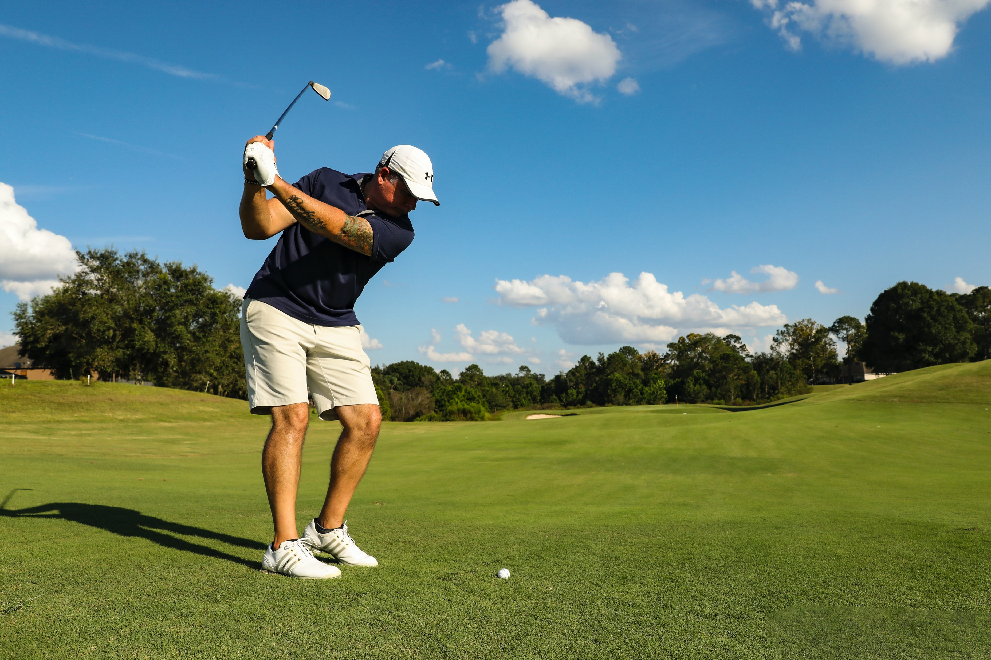
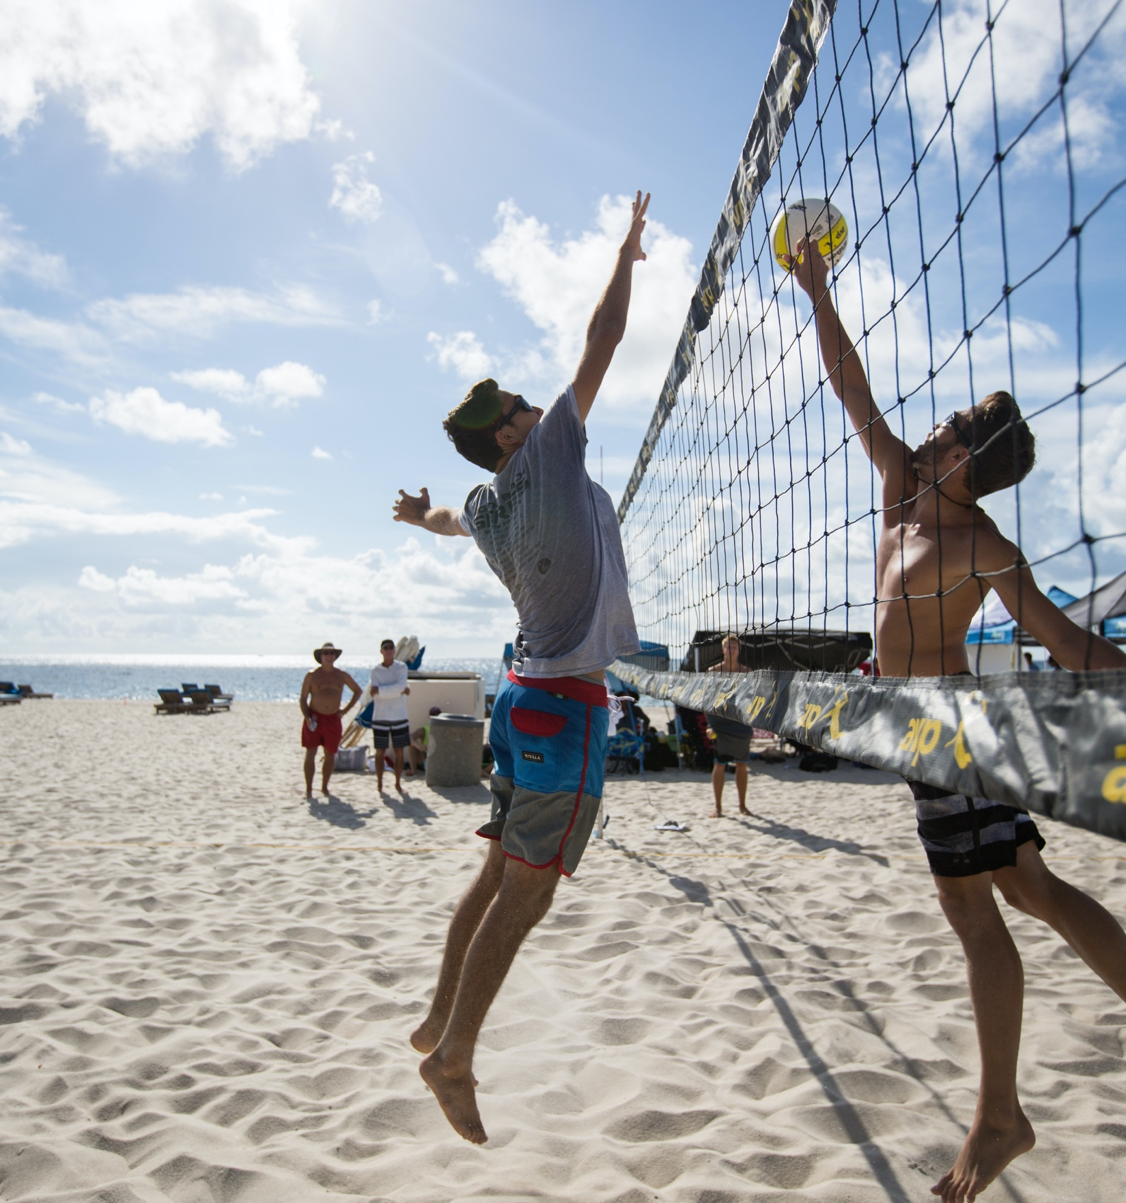
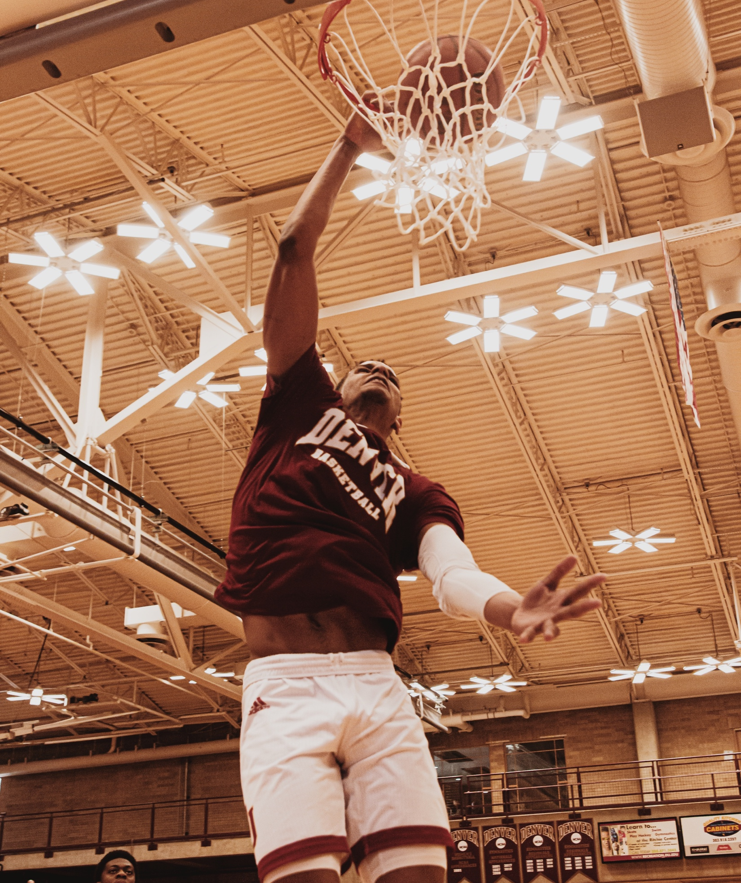
UNIT 3 DOWN UNDER
KEEP MOVING
SPORTS
Match the pictures to the words.
cycling running cricket volleyball
basketball golf swimming
1
2
3
4
running
swimming
cricket
golf
5
7
6
volleyball
cycling
basketball
Do you like sports? What’s your favourite sport?

Slide 3
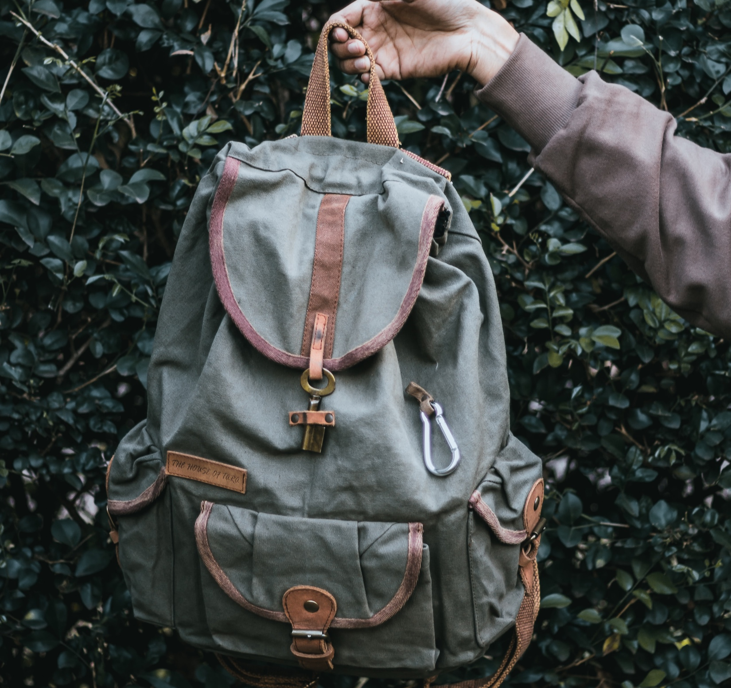
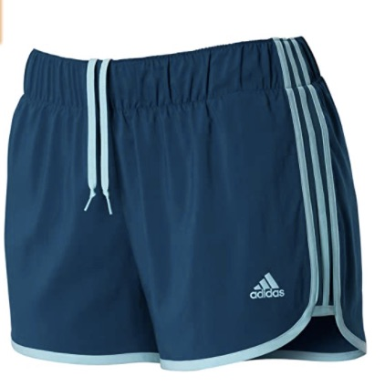
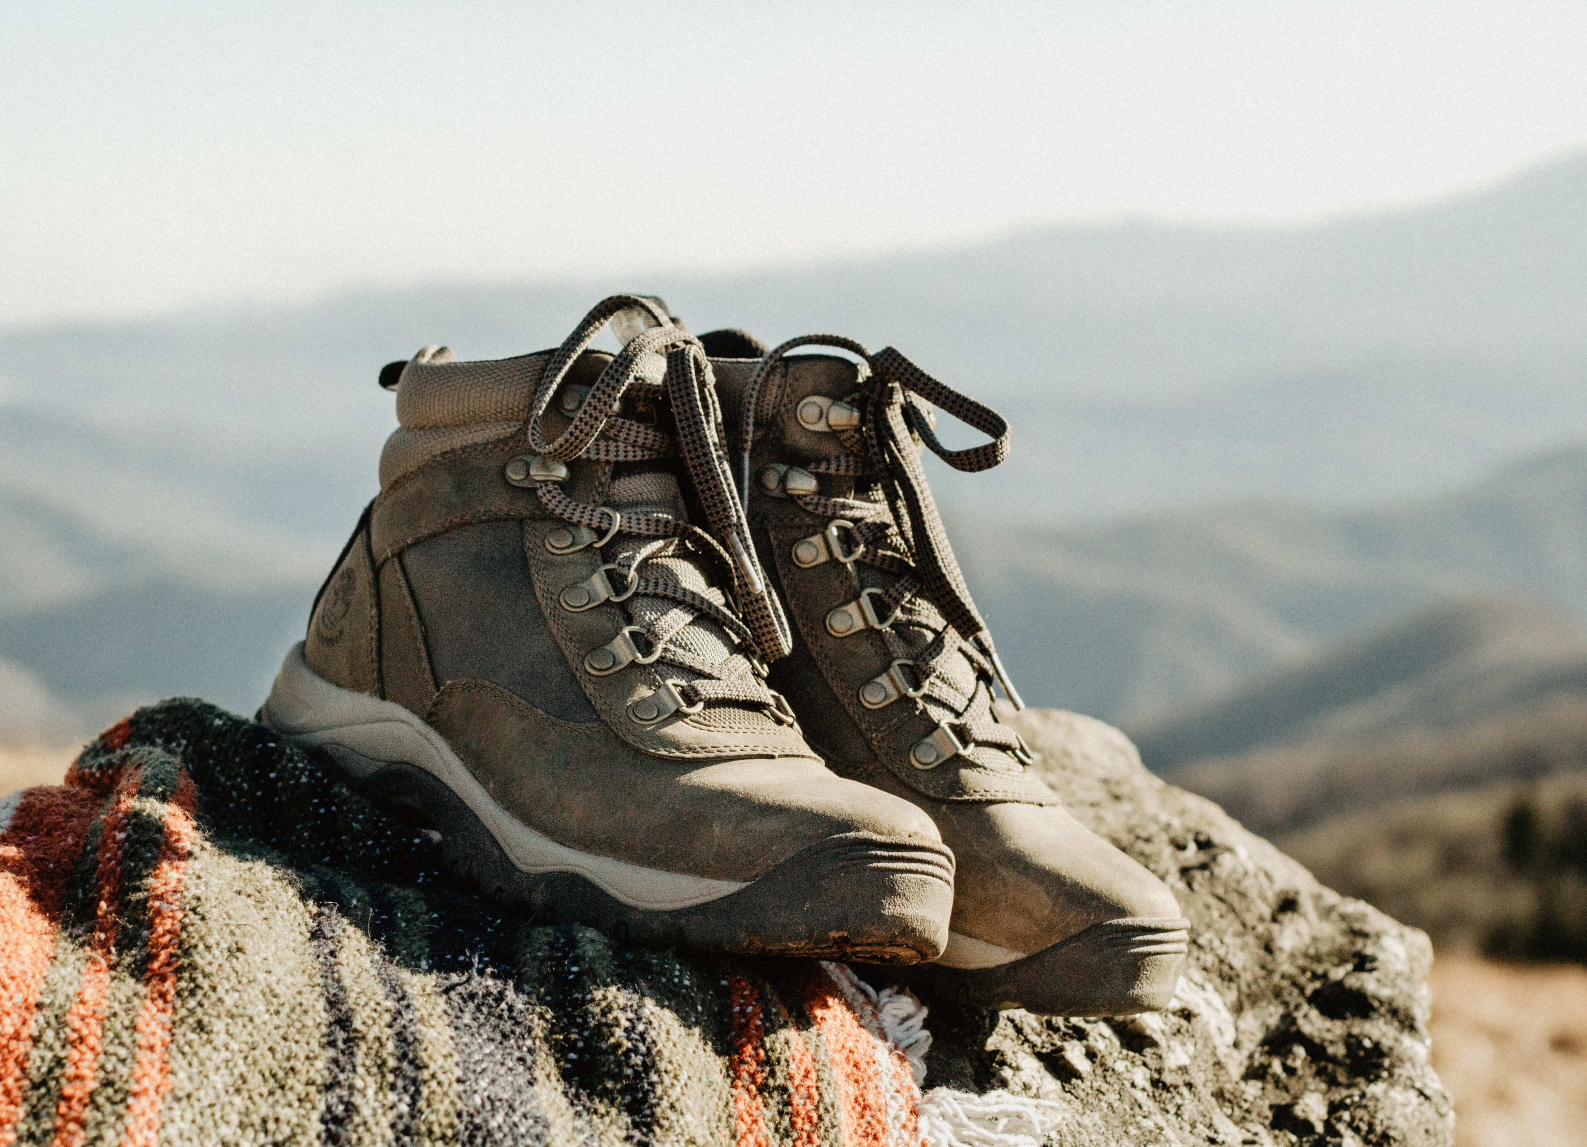
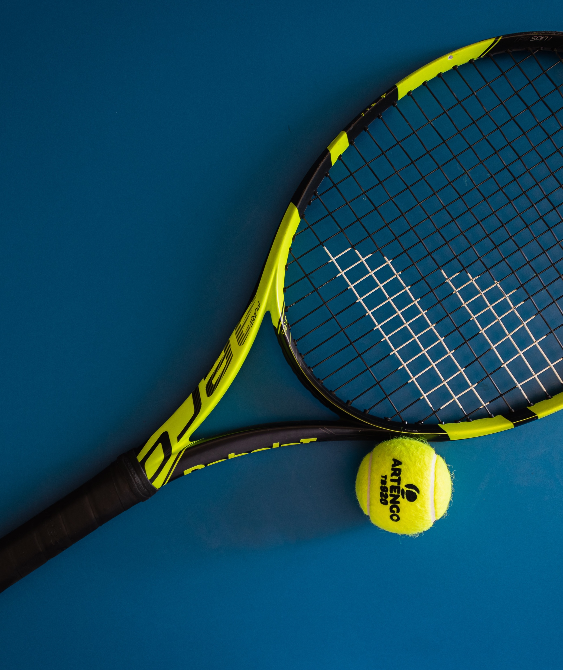
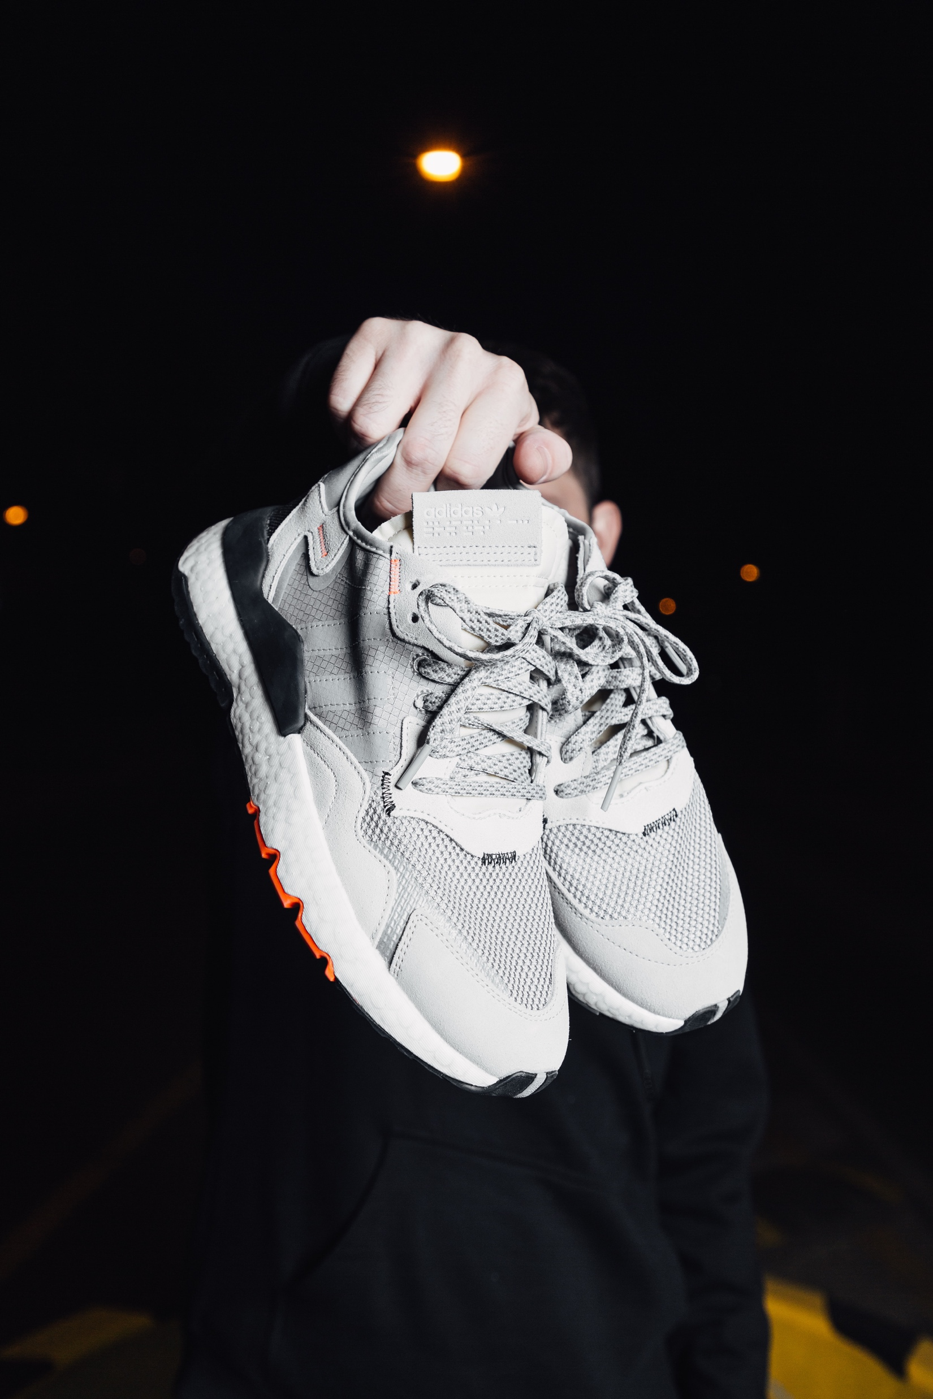
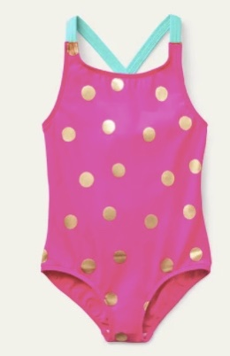
UNIT 3 DOWN UNDER
KEEP MOVING
SPORTS EQUIPMENT
Match the pictures to the words.
football shorts racket helmet trainers
basketball hiking boots backpack swmsuit
1
2
3
4
backpack
basketball
shorts
hiking boots
5
6
7
8
9
racket
helmet
football
trainers
swimsuit

Slide 4
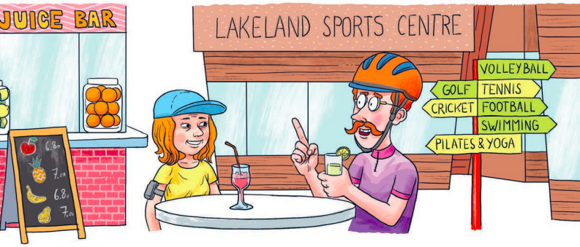
UNIT 3 DOWN UNDER
KEEP MOVING
Look at the picture. Where are Ms White and Uncle Phil? What are they doing?
What can you do at the Lakeland Sports Centre?

Slide 5
UNIT 3 DOWN UNDER
KEEP MOVING
Match
running
Ms White’s daughter
cricket
Ms White
volleyball
Uncle Phil
tennis
The White family
football
Ms White’s son

Slide 6
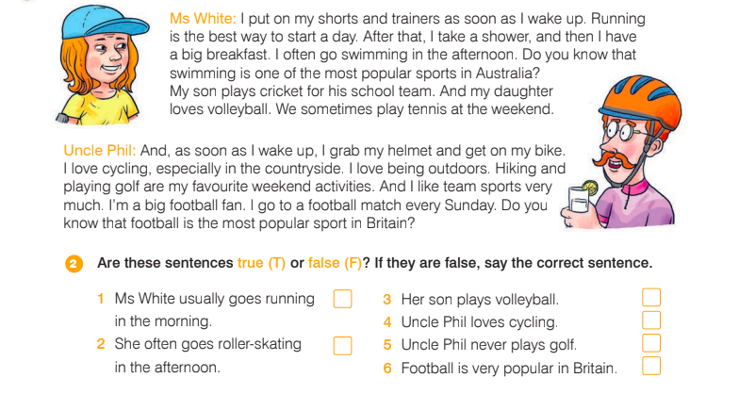
UNIT 3 DOWN UNDER
KEEP MOVING
T
F
T
F
F
F

Slide 7
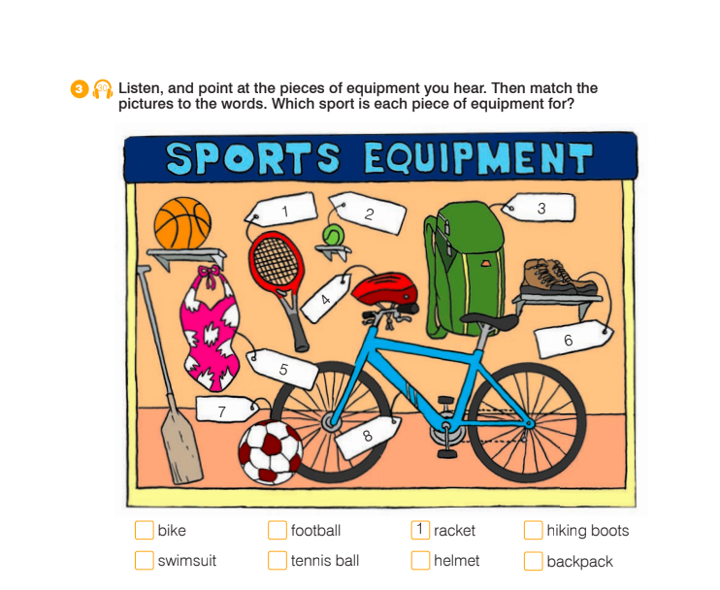
UNIT 3 DOWN UNDER
KEEP MOVING
8
7
6
5
2
4
3

Slide 8
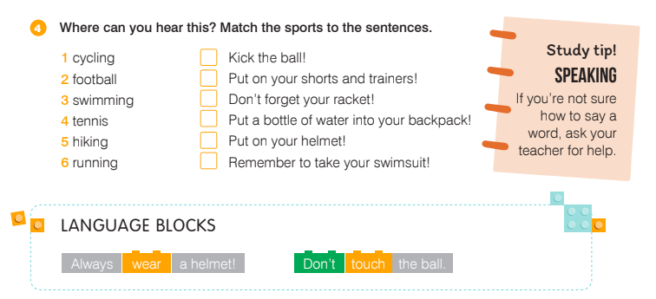
UNIT 3 DOWN UNDER
KEEP MOVING

Slide 9
UNIT 3 DOWN UNDER
KEEP MOVING

Slide 10
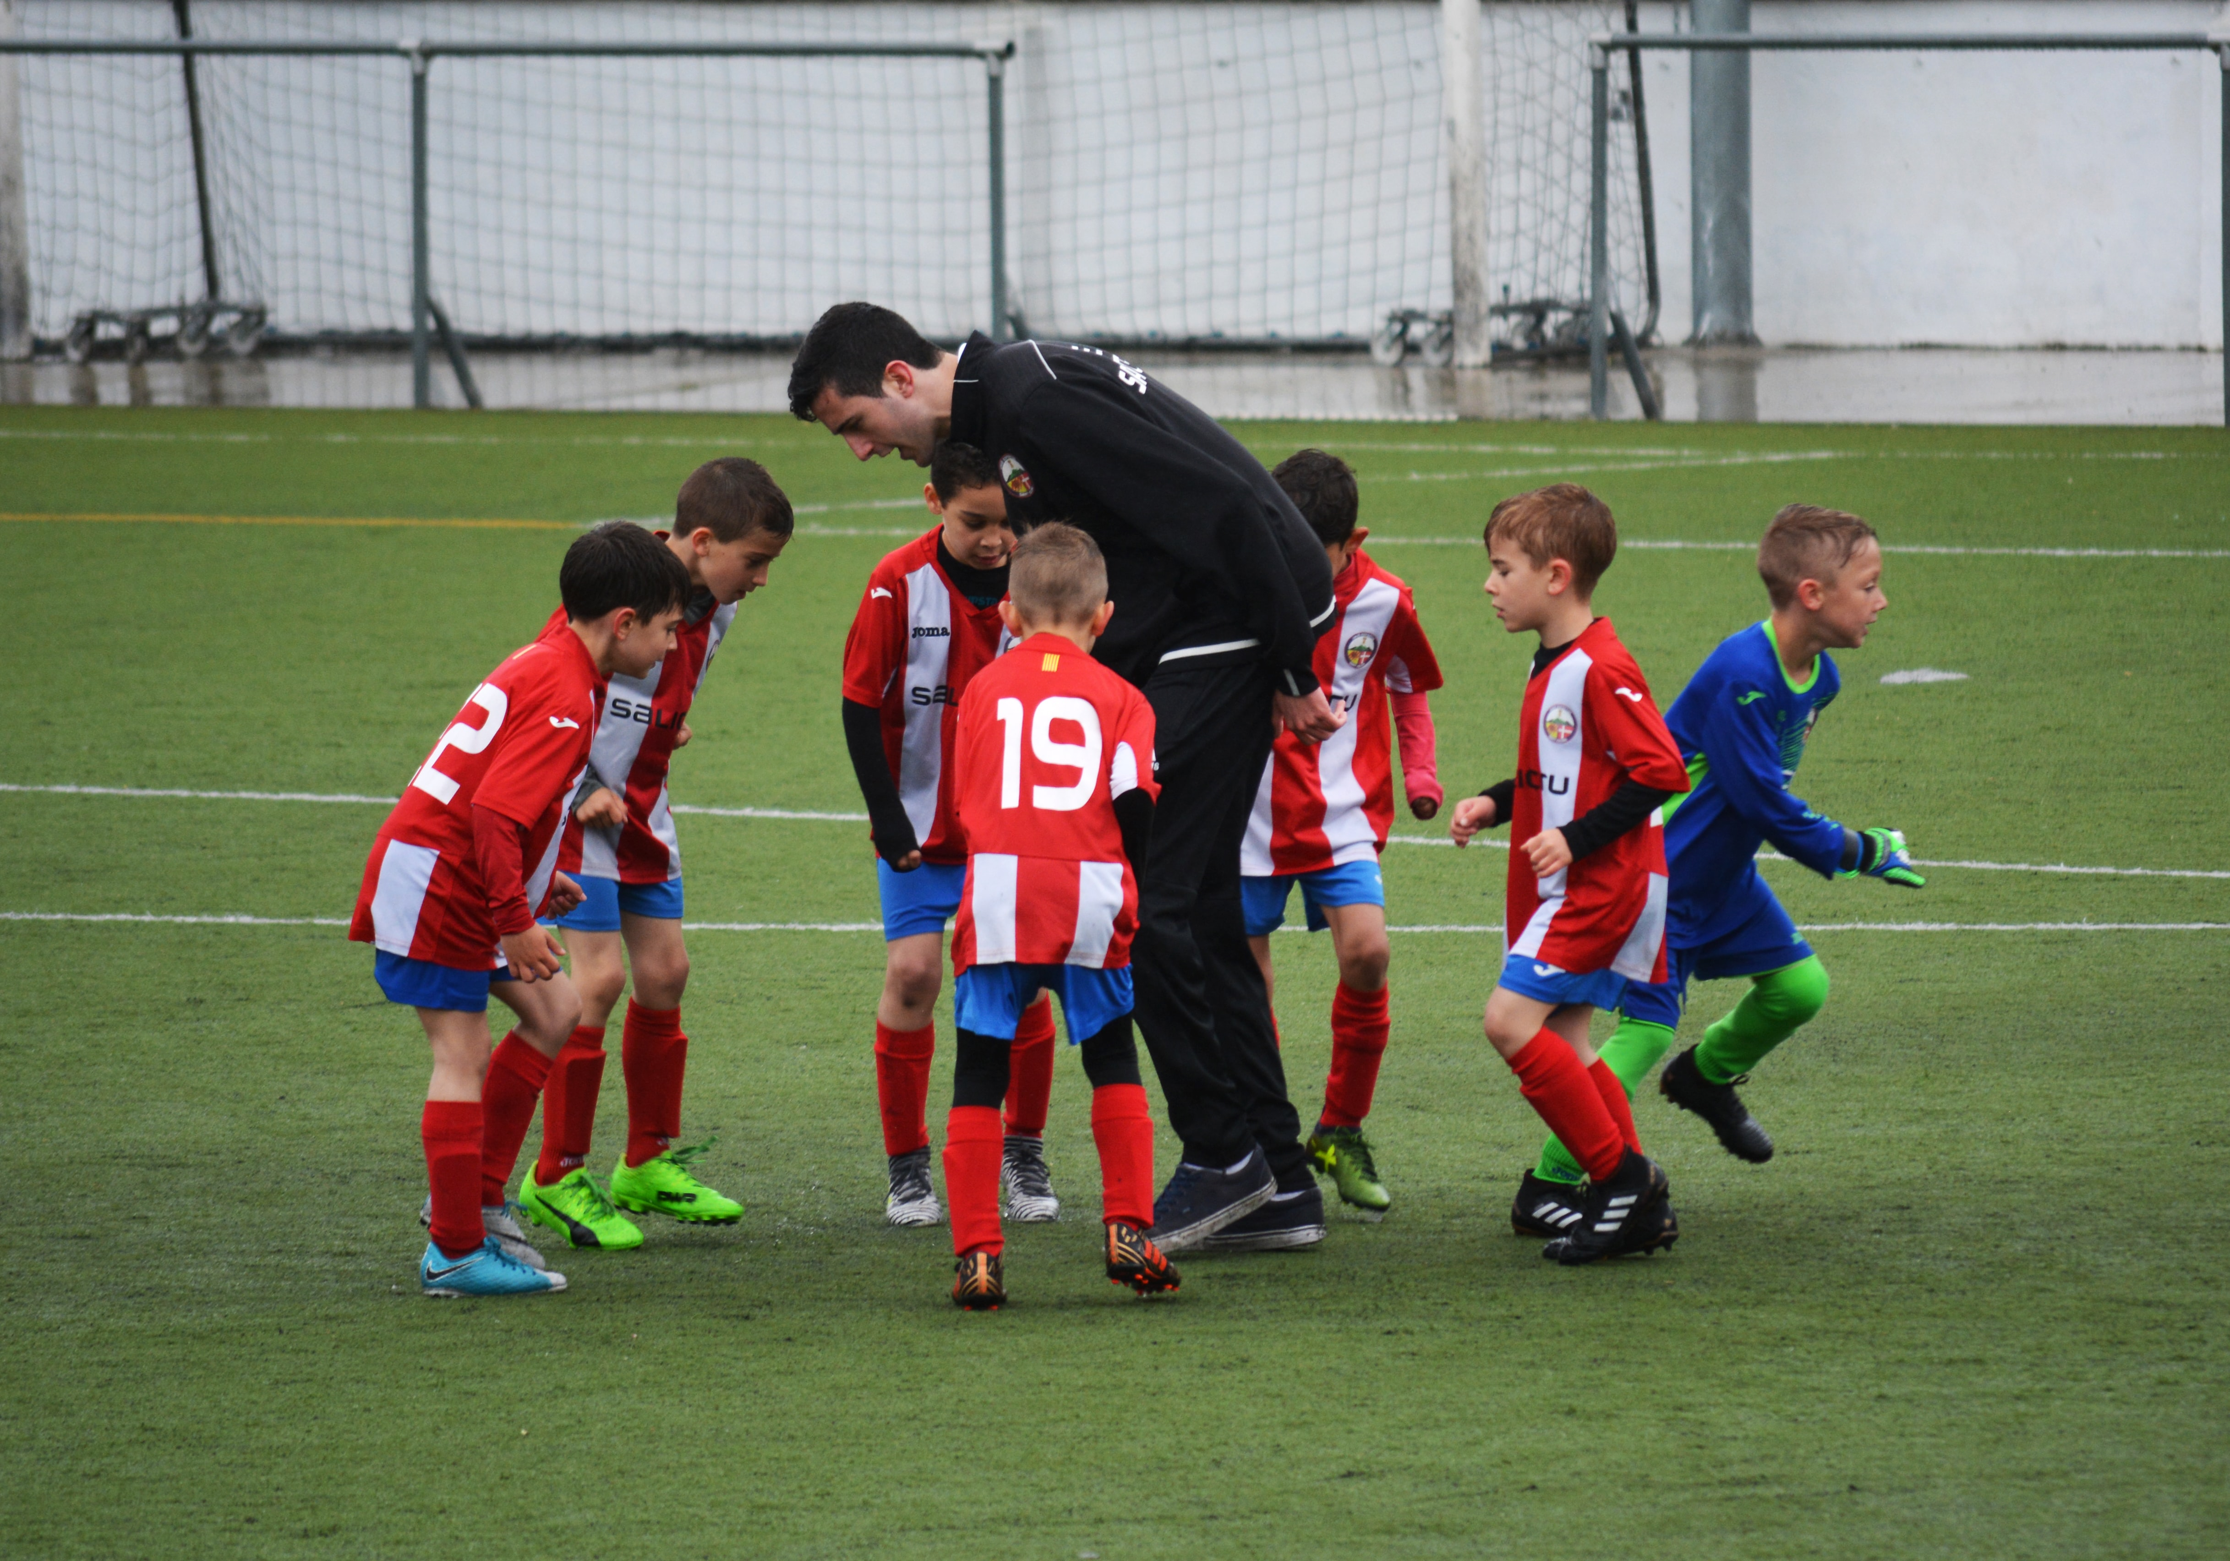
UNIT 3 DOWN UNDER
KEEP MOVING
My favourite sport is ________._
You need __________________________
There are__________________________
I like it because ___________
football
a football and two goal posts.
eleven players on each team.
it’s fun.

Slide 11
UNIT 3 DOWN UNDER
KEEP MOVING

Slide 12
UNIT 3 DOWN UNDER
KEEP MOVING

Slide 13
UNIT 3 DOWN UNDER
KEEP MOVING

Slide 14
UNIT 3 DOWN UNDER
KEEP MOVING

Slide 15
UNIT 3 DOWN UNDER
KEEP MOVING

Slide 16
UNIT 3 DOWN UNDER
KEEP MOVING

