Slide 1
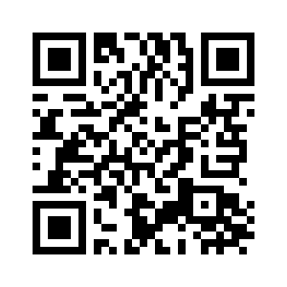
UNIT 3 DOWN UNDER
KOOKABURRA

Slide 2
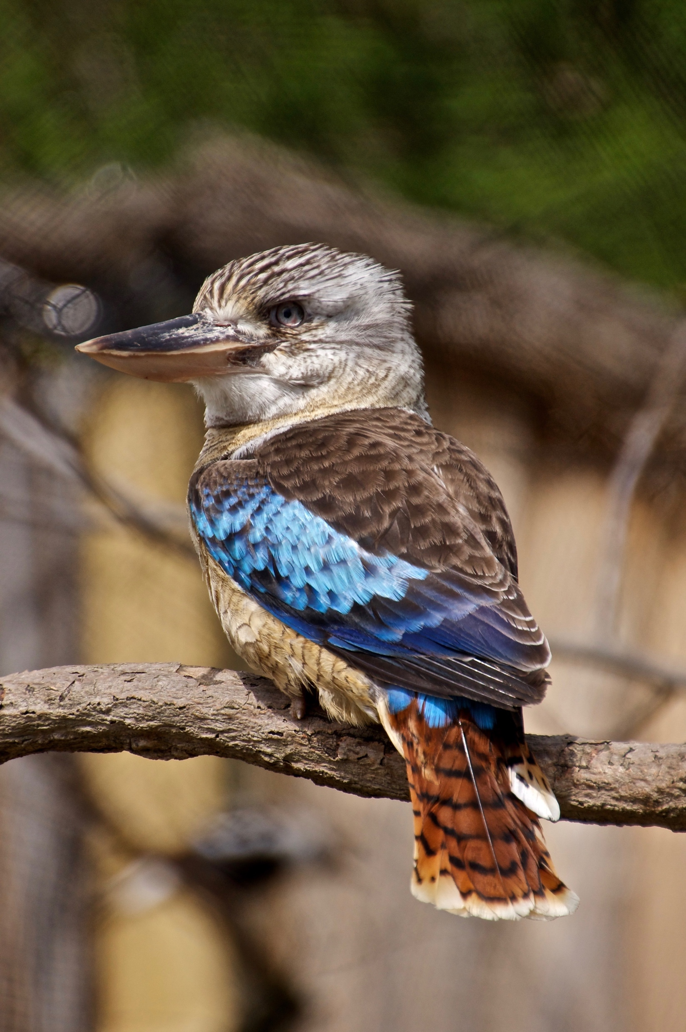
UNIT 3 DOWN UNDER
KOOKABURRA
What can you tell about this animal?
unusual = neobičan
funny call = smiješan način glasanja
sounds like = zvuči kao
forest = šuma
Insect = insekt, kukac

Slide 3
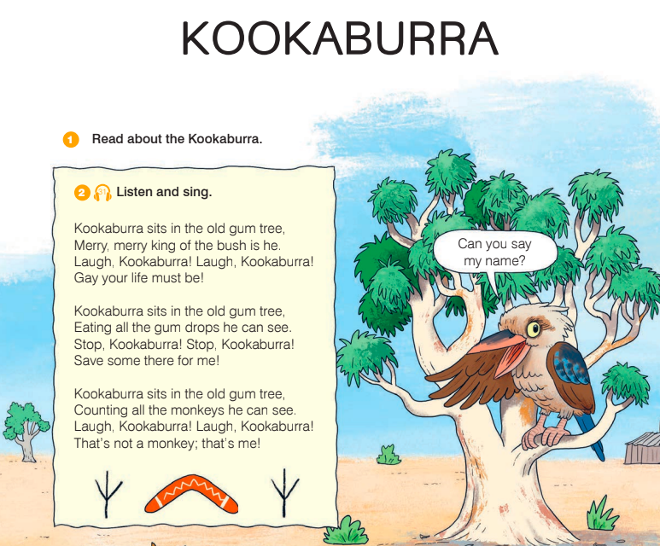
UNIT 3 DOWN UNDER
KOOKABURRA
gum tree = drvo eukaliptusa
bush = nisko raslinje
laugh = smijati se
gay = veseo
count = brojati

Slide 4
UNIT 3 DOWN UNDER
KOOKABURRA

Slide 5
UNIT 3 DOWN UNDER
KOOKABURRA

Slide 6
UNIT 3 DOWN UNDER
KOOKABURRA

Slide 7
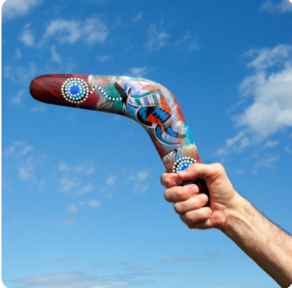
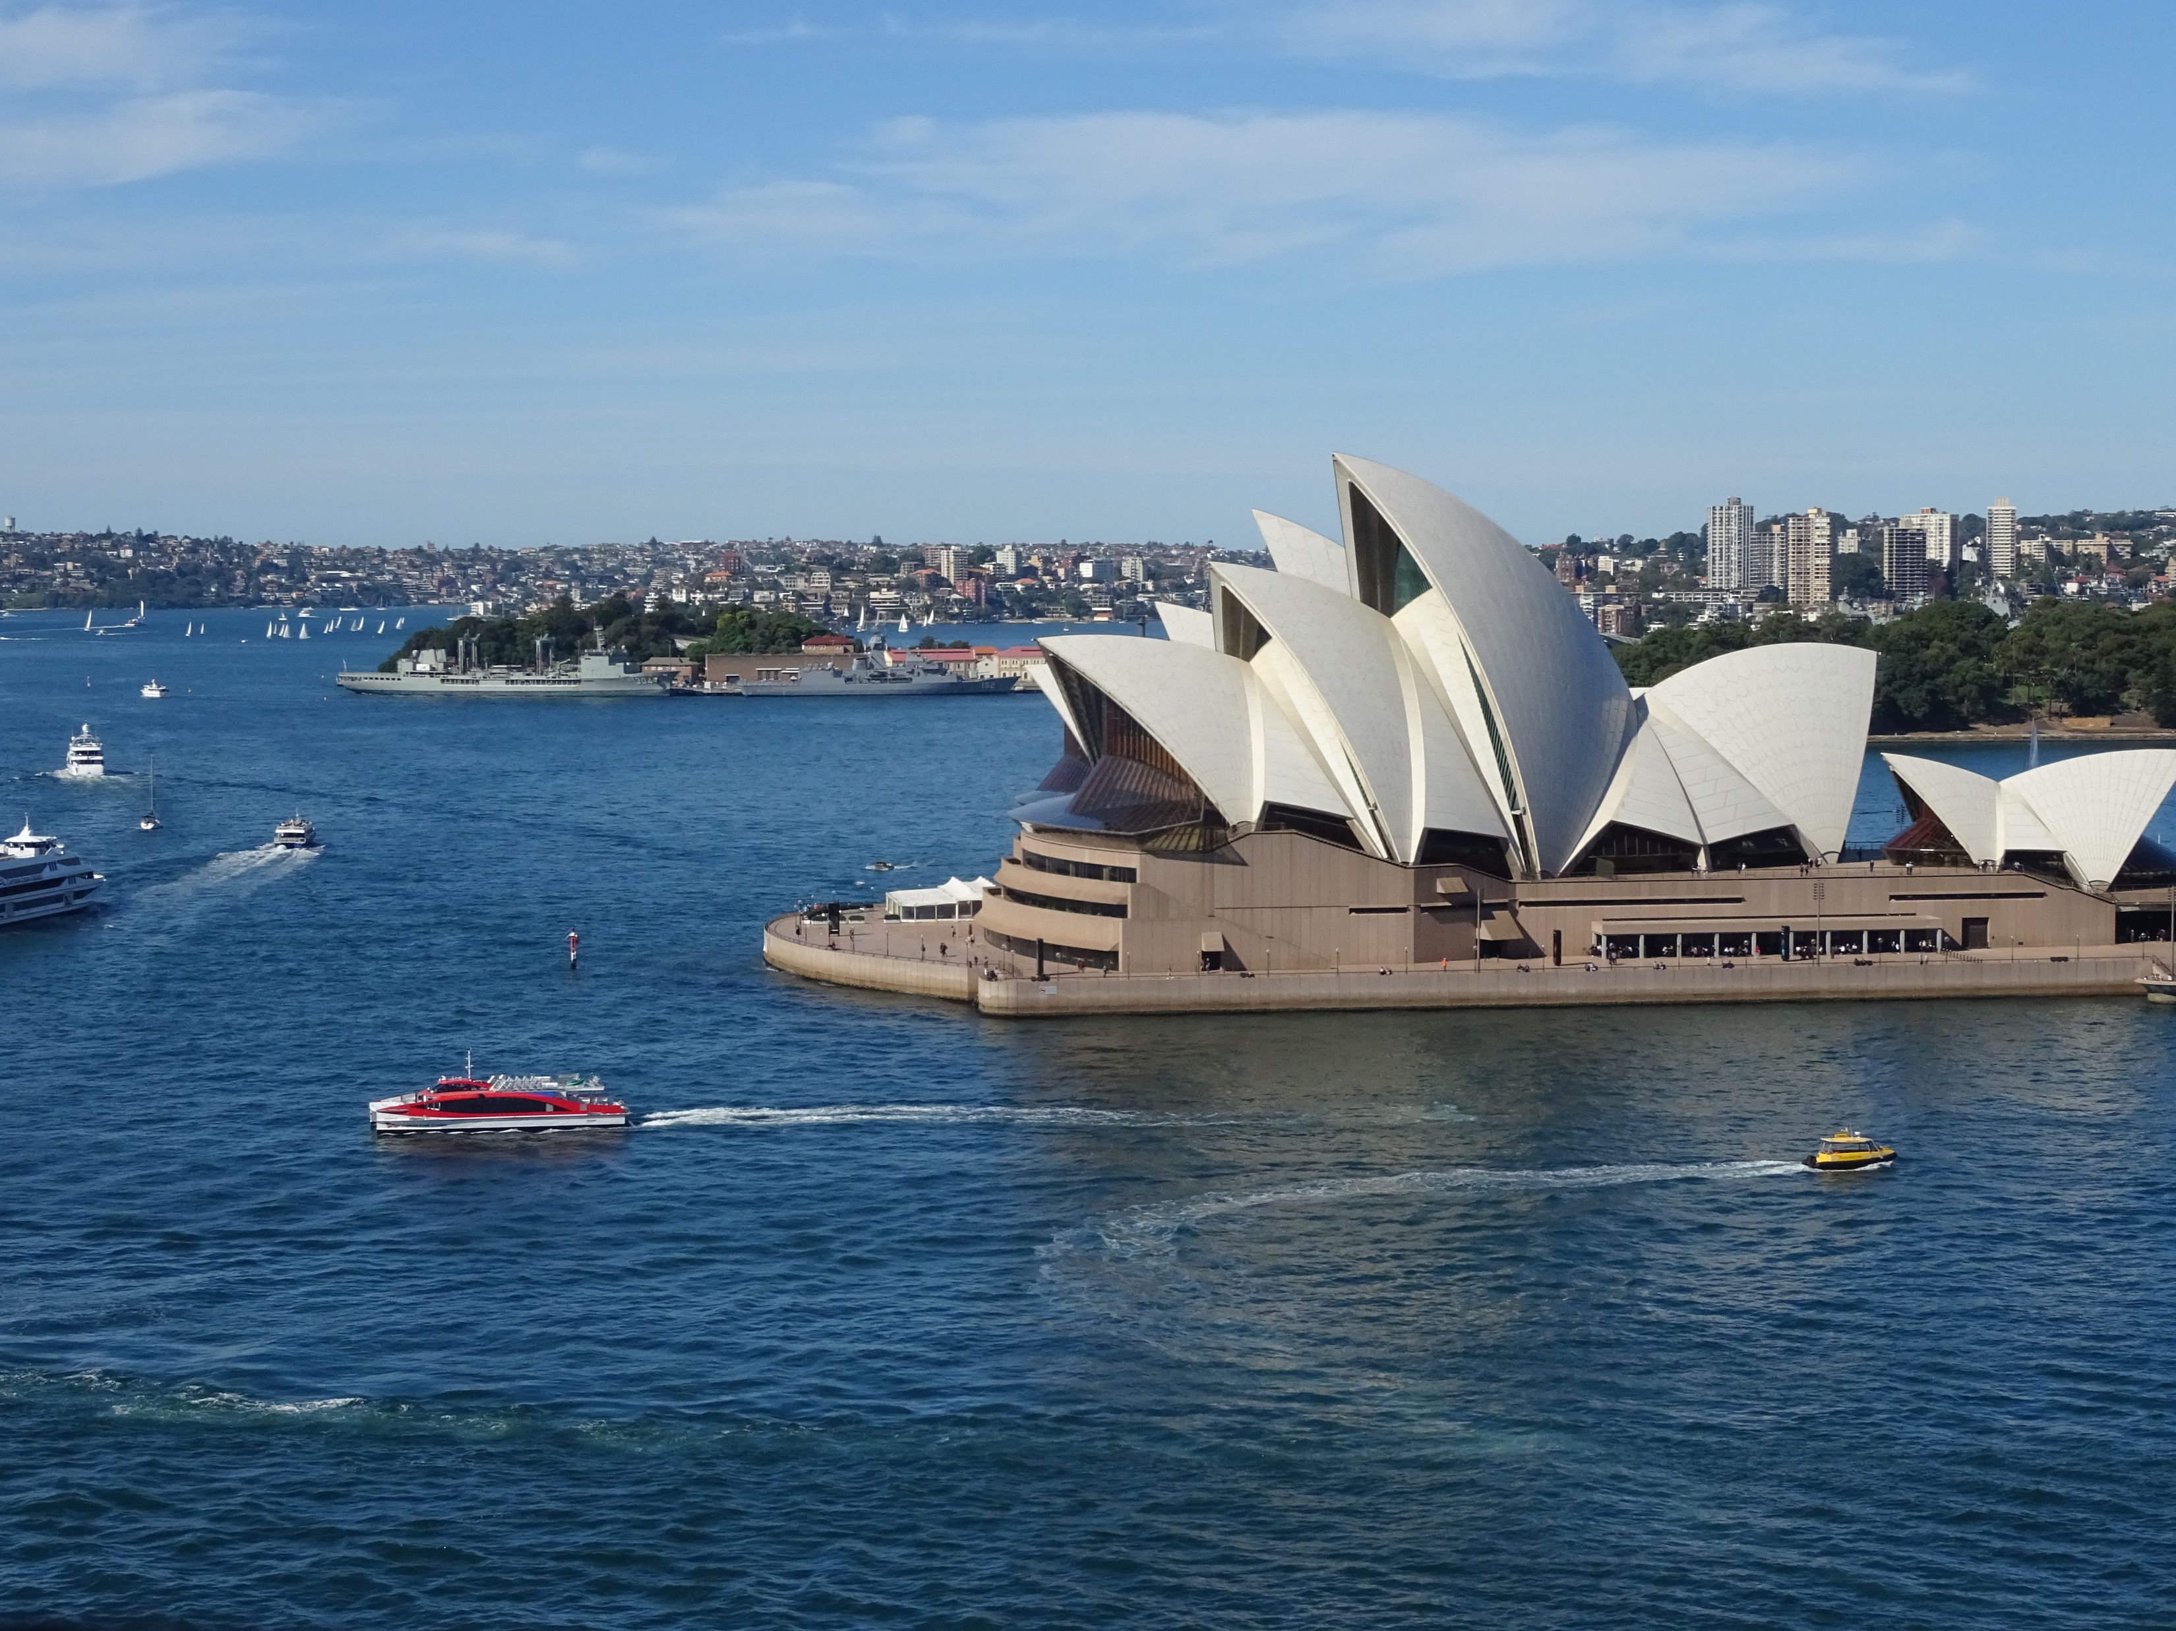
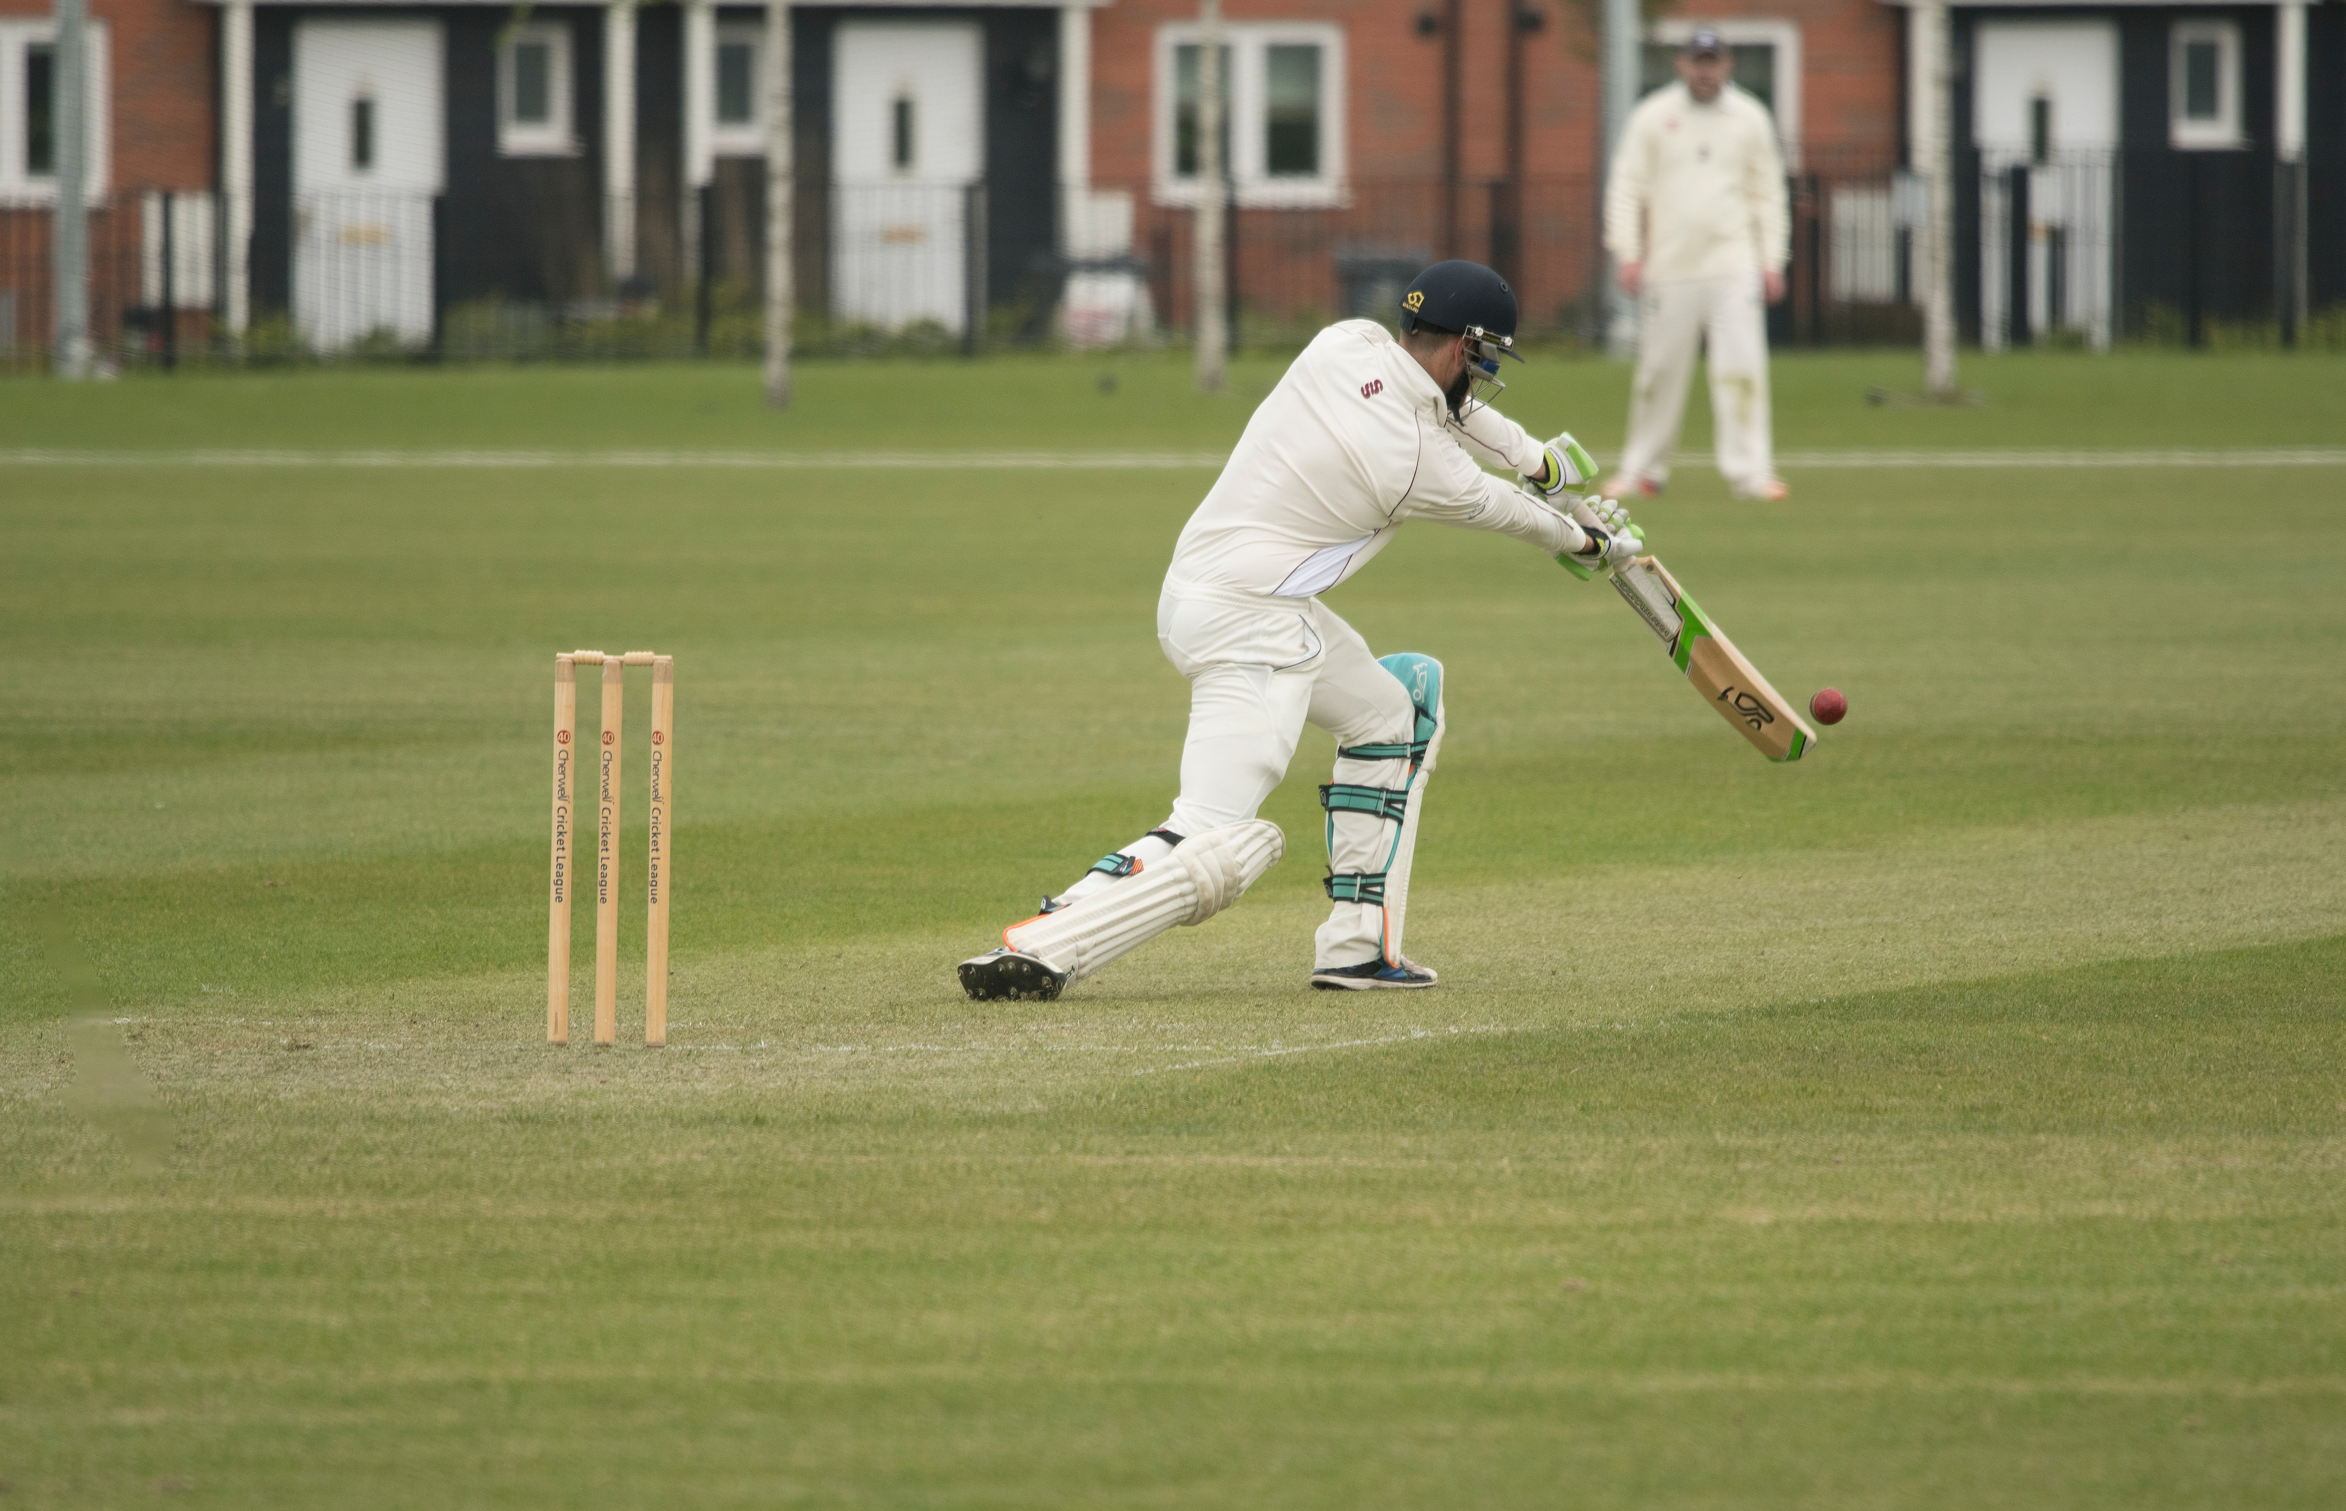
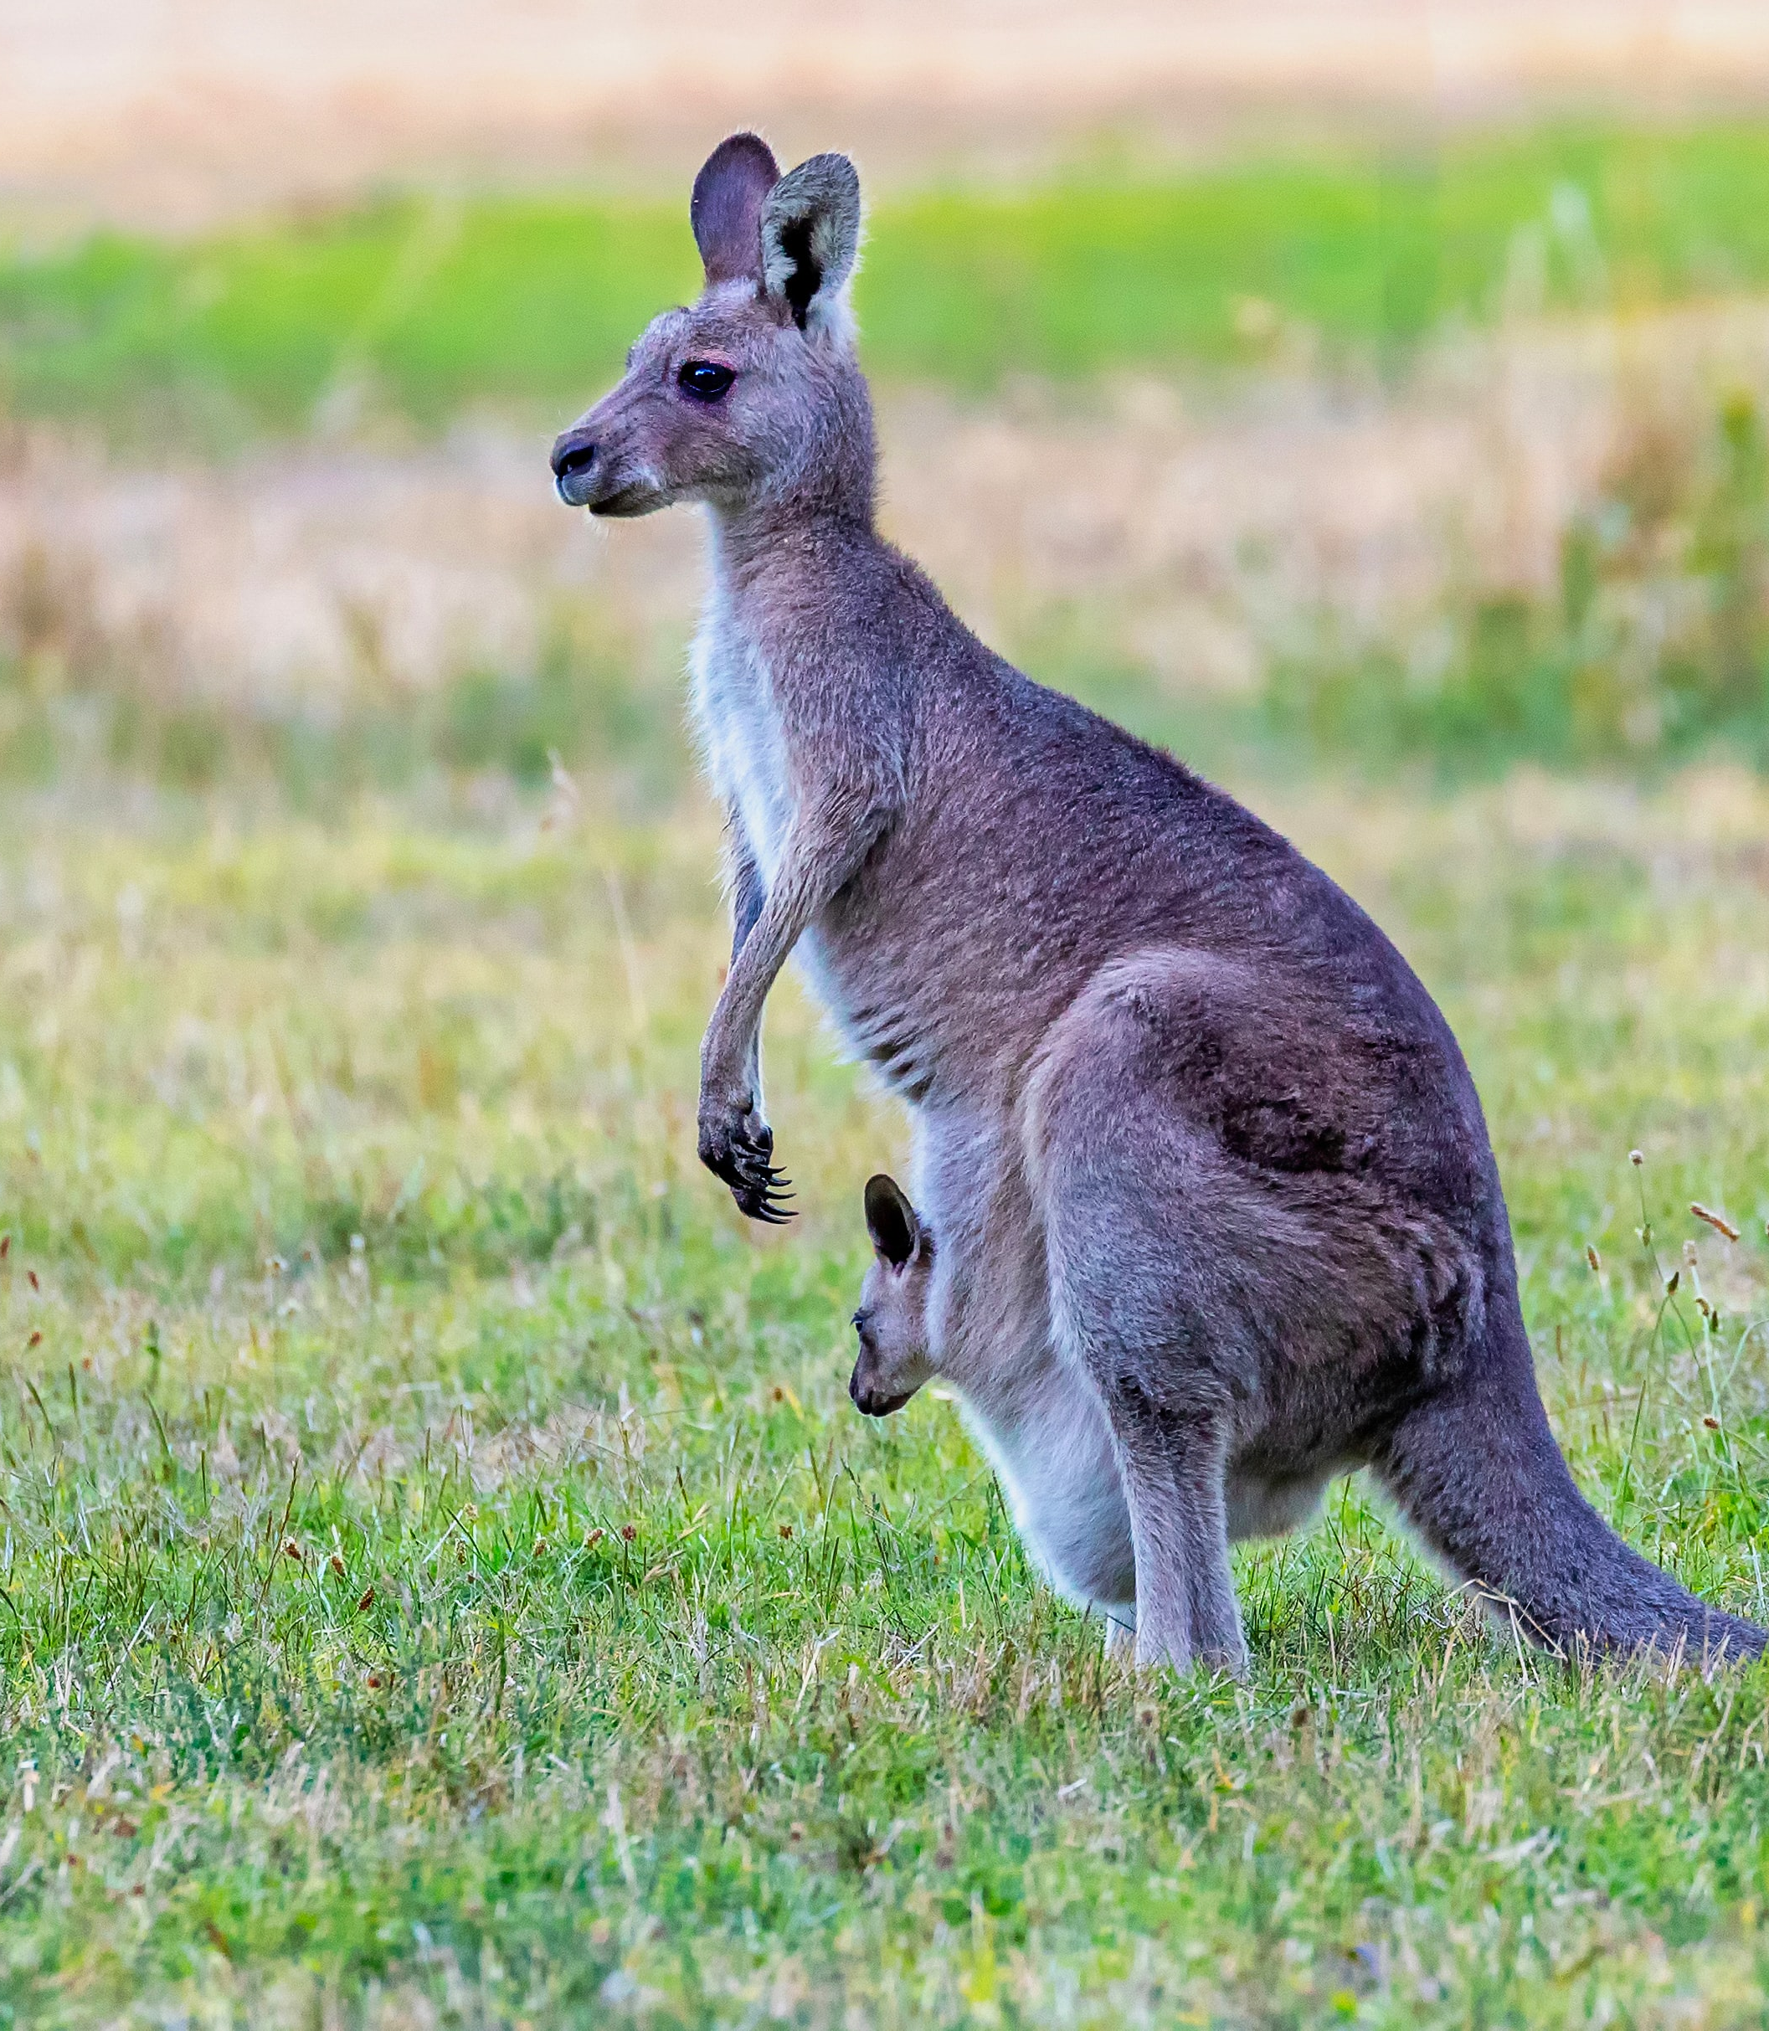
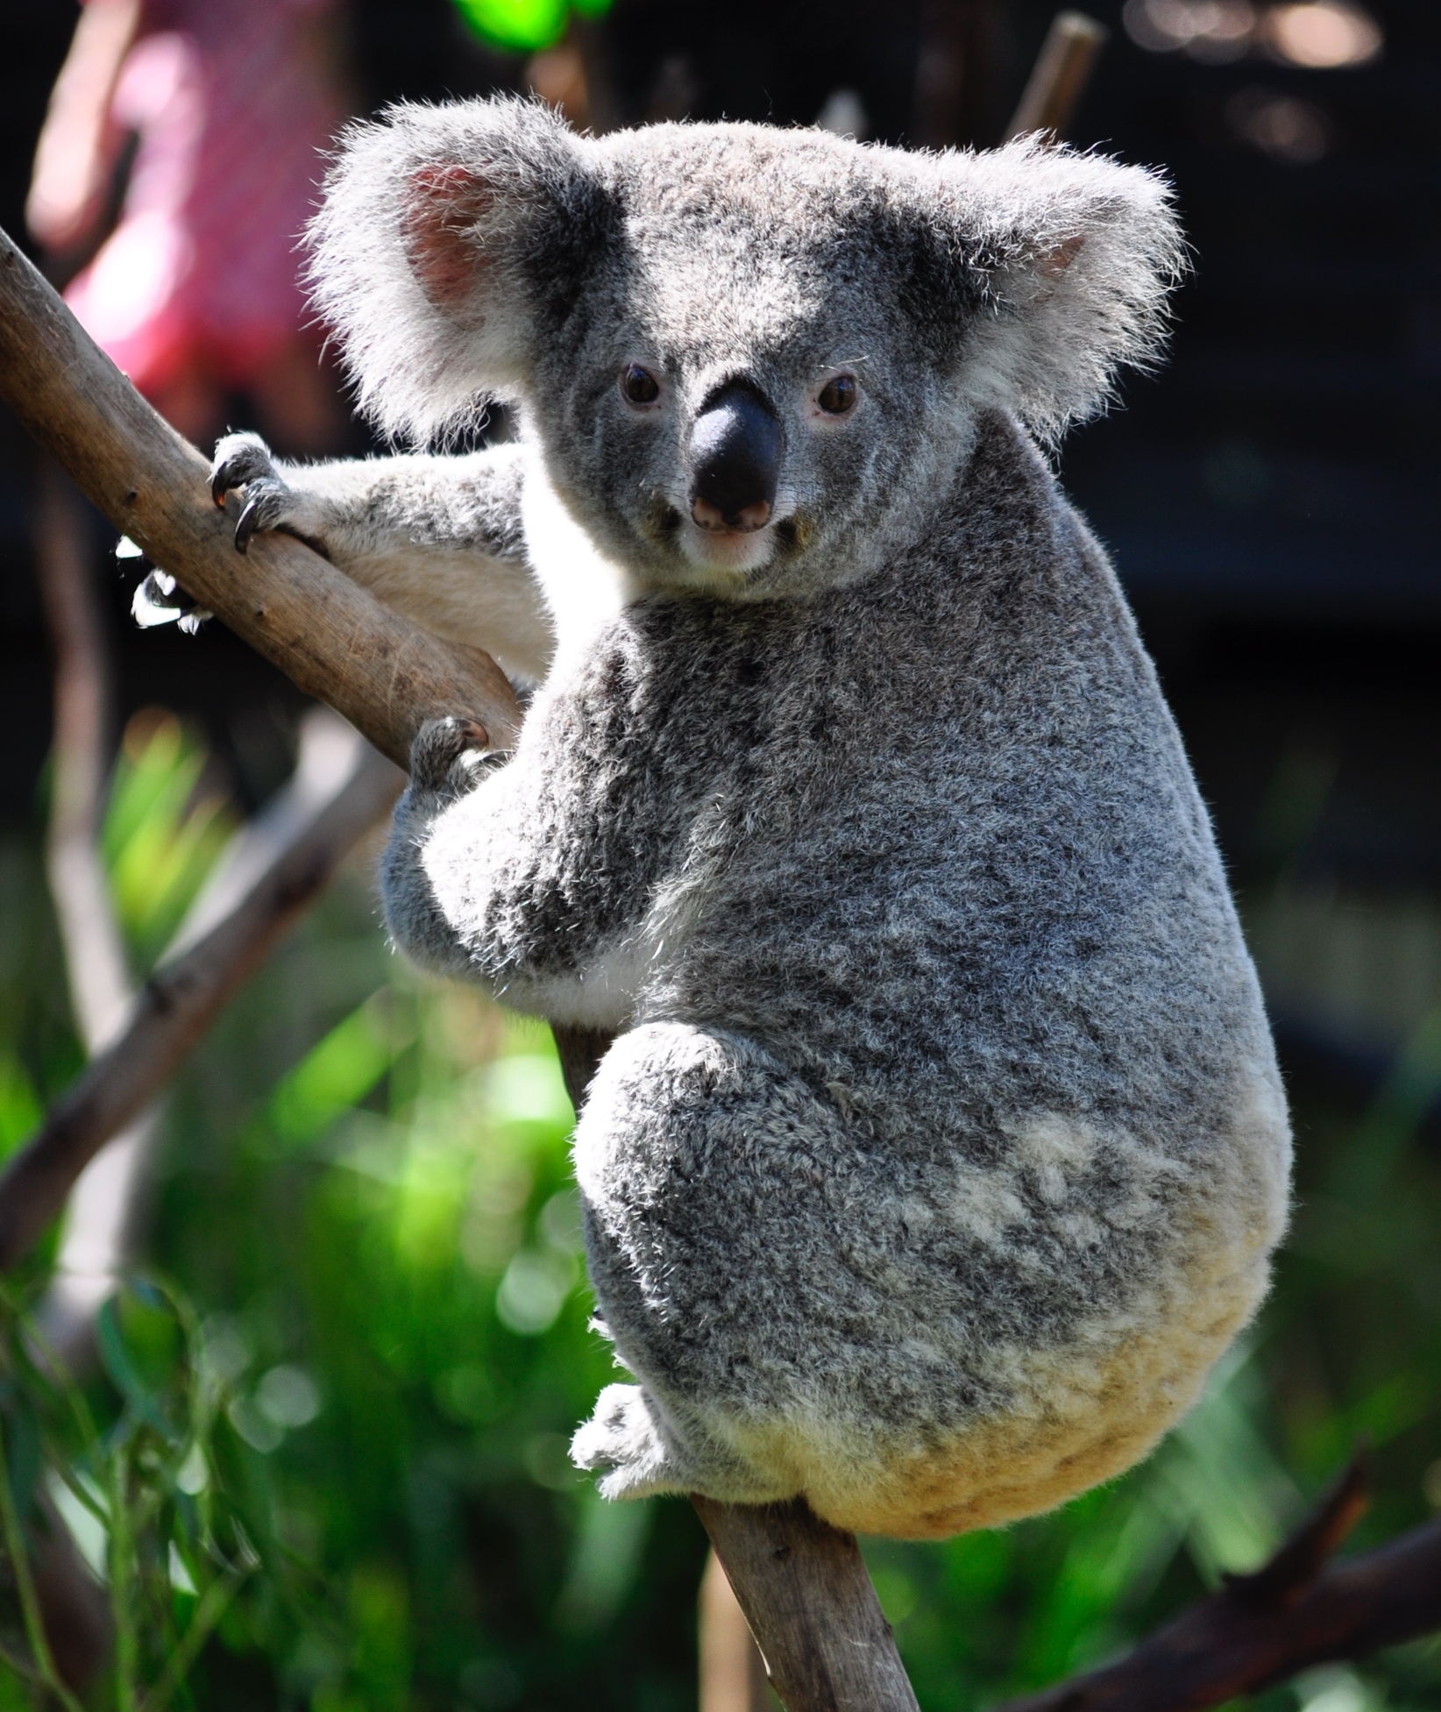
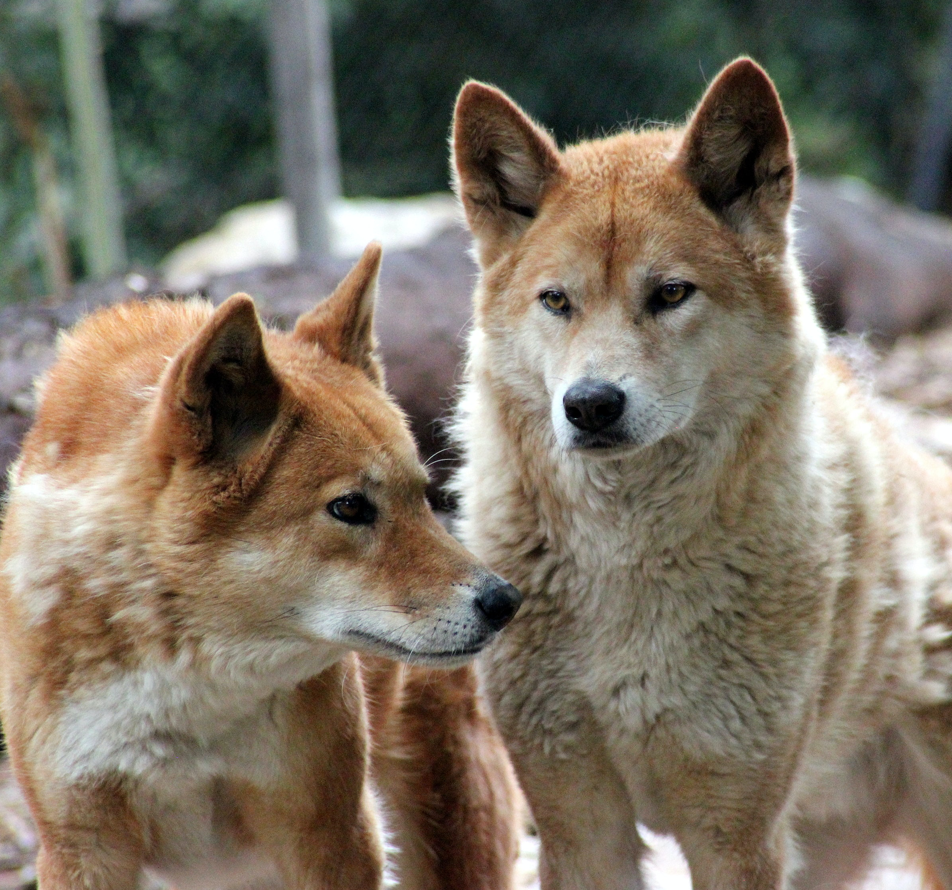
UNIT 3 DOWN UNDER
KOOKABURRA
AUSTRALIA
Match the pictures to the words.
koala kangaroo cricket flag
dingos opera house
1
2
3
4
flag
boomerang
cricket
opera house
5
7
6
dingos
kangaroo
koala
Can you say three things about Australia?

Slide 8
UNIT 3 DOWN UNDER
KOOKABURRA
4
Listen and read

Slide 9
UNIT 3 DOWN UNDER
KOOKABURRA
T
F
T
T
F
F

Slide 10
UNIT 3 DOWN UNDER
KOOKABURRA

