Slide 1
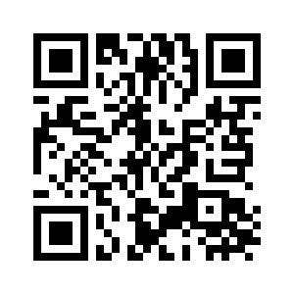
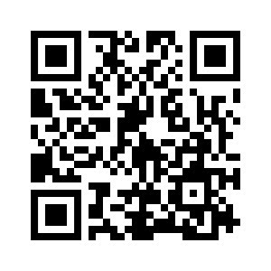

UNIT 3 DOWN UNDER
LET’S CHECK! REVISION
LET’S CHECK!
REVISION

Slide 2
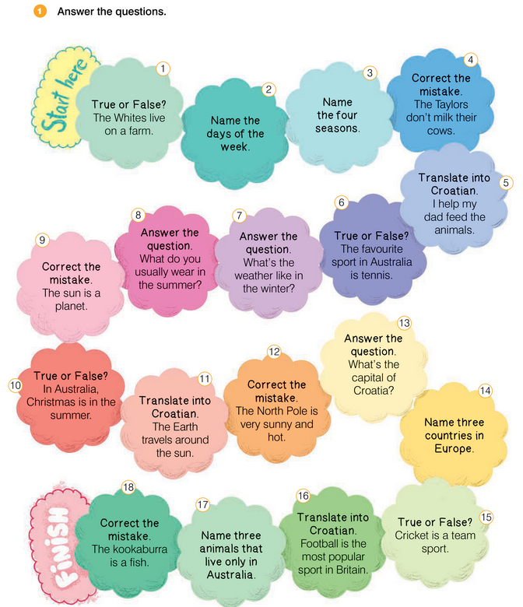
UNIT 3 DOWN UNDER
LET’S CHECK!

Slide 3
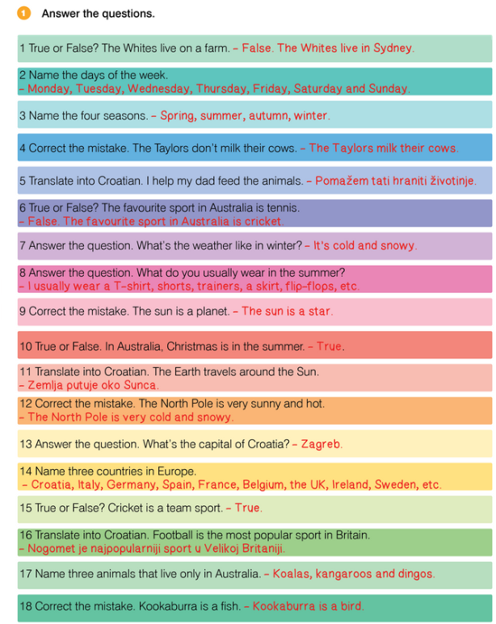
UNIT 3 DOWN UNDER
LET’S CHECK!

Slide 4
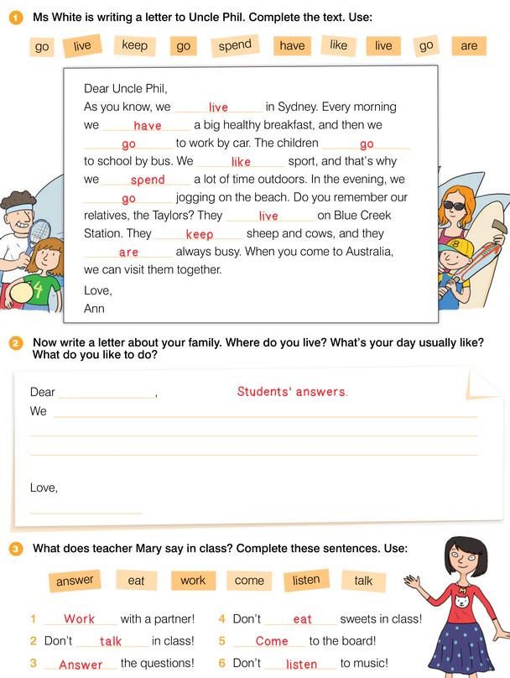
UNIT 3 DOWN UNDER
LET’S CHECK!

Slide 5
UNIT 3 DOWN UNDER
LET’S CHECK!

Slide 6
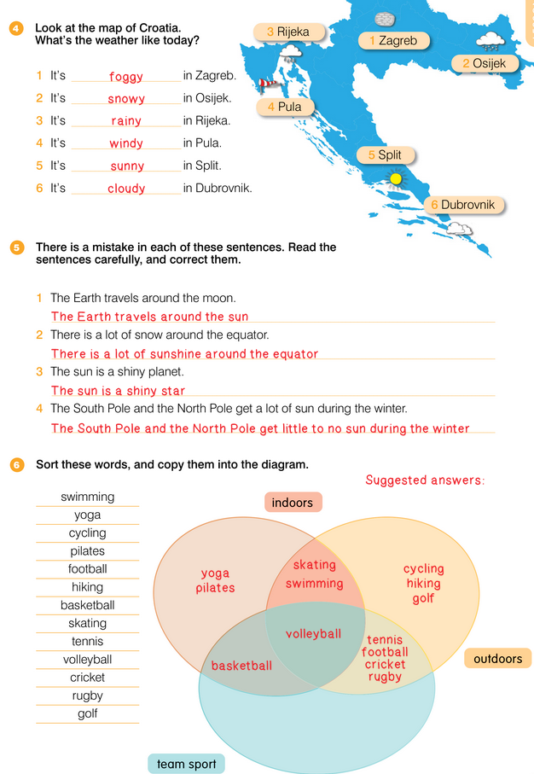
UNIT 3 DOWN UNDER
LET’S CHECK!

Slide 7
UNIT 3 DOWN UNDER
LET’S CHECK!

Slide 8
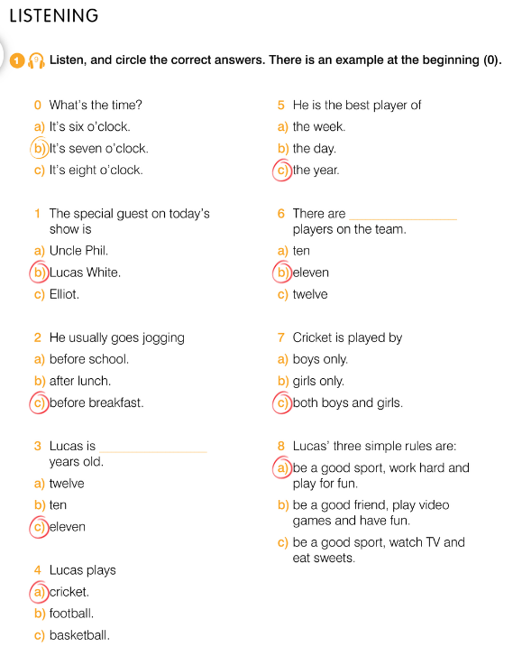
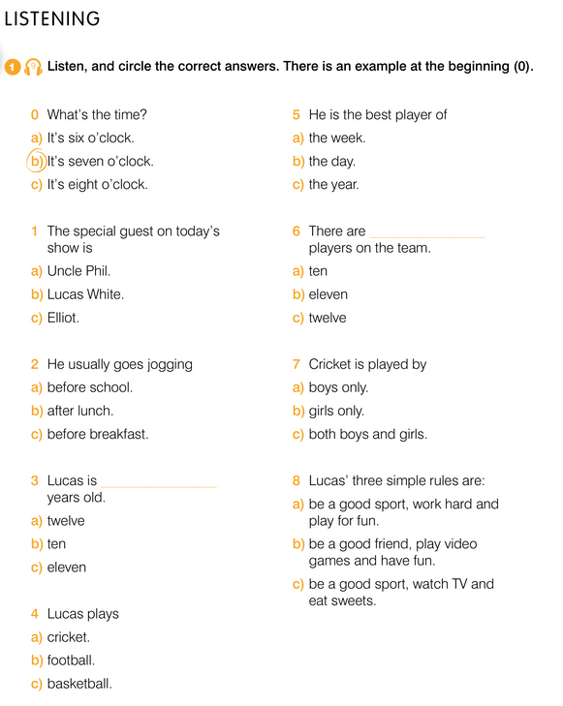

UNIT 3 DOWN UNDER
LET’S CHECK! REVISION

Slide 9
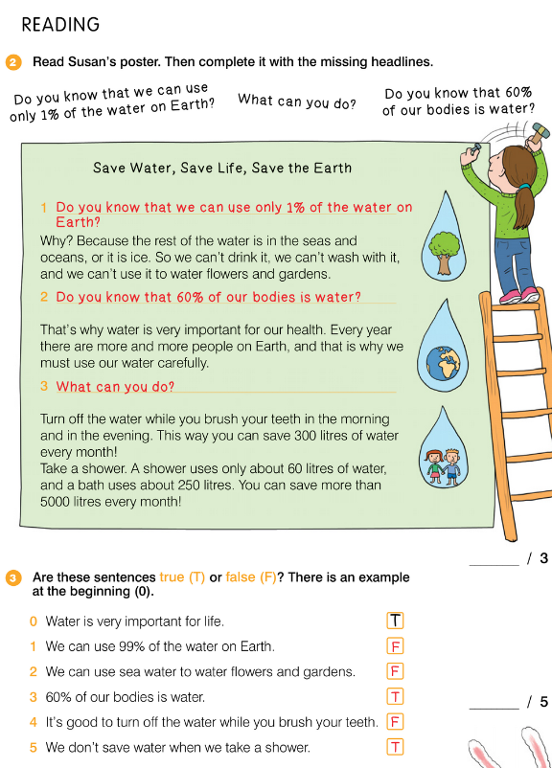
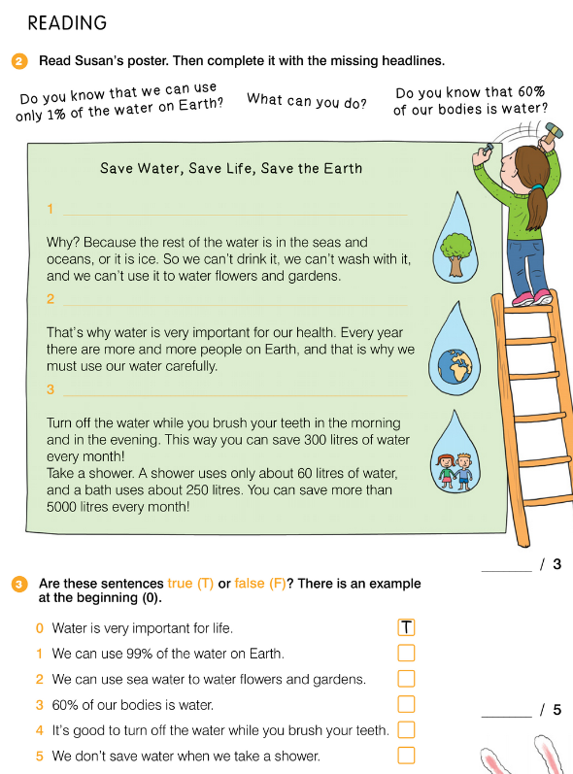
UNIT 3 DOWN UNDER
LET’S CHECK! REVISION

