Slide 1
4.1 WHAT A DAY!
UNIT 4 WILDLIFE
Notes:
https://hr.izzi.digital/#/repository/204

Slide 2
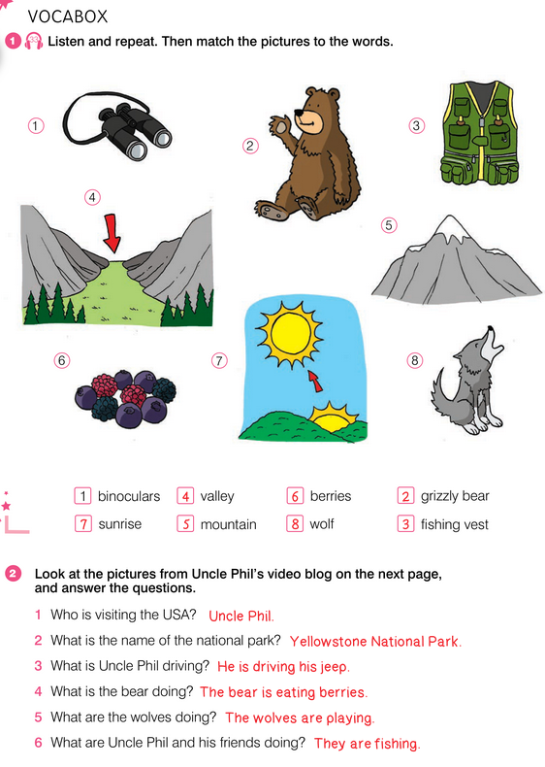
WHAT A DAY!
UNIT 4 WILDLIFE
binoculars = dvogled, dalekozor
grizzly bear = grizli
fishing vest = prsluk za ribolov
valley = dolina
mountain = planina
berries = bobice
sunrise = izlazak sunca
wolf = vuk
Notes:
https://hr.izzi.digital/#/repository/204

Slide 3
WHAT A DAY!
UNIT 4 WILDLIFE
Notes:
https://hr.izzi.digital/#/repository/204

Slide 4
WHAT A DAY!
UNIT 4 WILDLIFE
footprints = otisci stopala
jeep = terensko vozilo
backpack = ruksak, ranac
map = karta
during = tijekom, za vrijeme
top = vrh
cute = slatko, zgodno
scare = uplašiti
Notes:
https://hr.izzi.digital/#/repository/204

Slide 5
WHAT A DAY!
UNIT 4 WILDLIFE
Notes:
https://hr.izzi.digital/#/repository/204

Slide 6
WHAT A DAY!
UNIT 4 WILDLIFE
Notes:
https://hr.izzi.digital/#/repository/204

Slide 7
WHAT A DAY!
UNIT 4 WILDLIFE
Notes:
https://hr.izzi.digital/#/repository/204

Slide 8
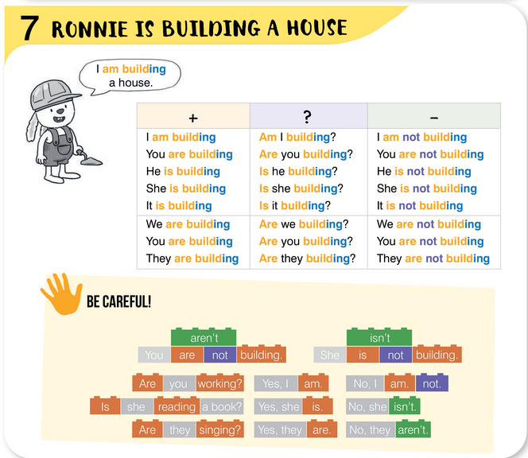
WHAT A DAY!
UNIT 4 WILDLIFE
Notes:
https://hr.izzi.digital/#/repository/204

Slide 9
WHAT A DAY!
UNIT 4 WILDLIFE
Notes:
https://hr.izzi.digital/#/repository/204

Slide 10
WHAT A DAY!
UNIT 4 WILDLIFE
Notes:
https://hr.izzi.digital/#/repository/204

Slide 11
WHAT A DAY!
UNIT 4 WILDLIFE
riddle = zagonetka
frozen = zaleđeno
Notes:
https://hr.izzi.digital/#/repository/204

Slide 12
WHAT A DAY!
UNIT 4 WILDLIFE
Notes:
https://hr.izzi.digital/#/repository/204

Slide 13
WHAT A DAY!
UNIT 4 WILDLIFE
Notes:
https://hr.izzi.digital/#/repository/204

Slide 14
WHAT A DAY!
UNIT 4 WILDLIFE
Notes:
https://hr.izzi.digital/#/repository/204

Slide 15
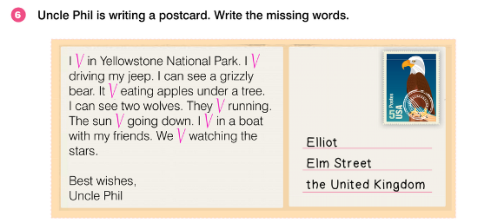
WHAT A DAY!
UNIT 4 WILDLIFE
Notes:
https://hr.izzi.digital/#/repository/204

Slide 16
WHAT A DAY!
UNIT 4 WILDLIFE
Notes:
https://hr.izzi.digital/#/repository/204

Slide 17
WHAT A DAY!
UNIT 4 WILDLIFE
Notes:
https://hr.izzi.digital/#/repository/204

Slide 18
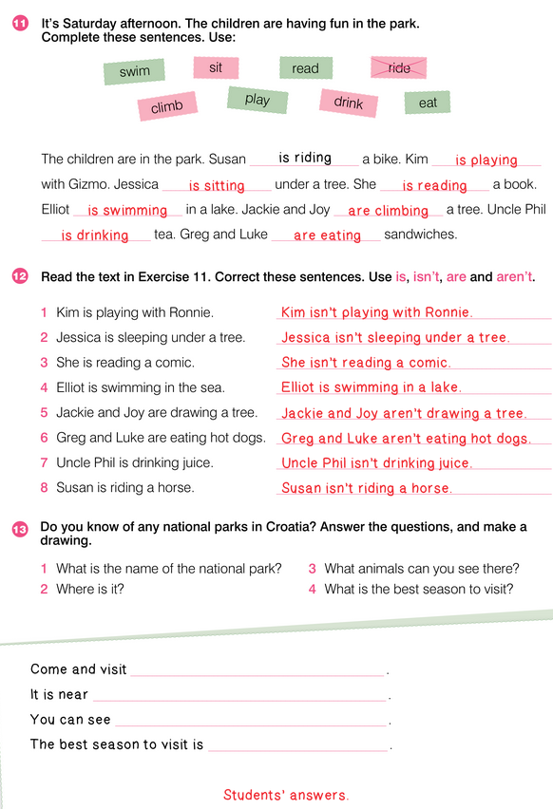
WHAT A DAY!
UNIT 4 WILDLIFE
Notes:
https://hr.izzi.digital/#/repository/204

Slide 19
WHAT A DAY!
UNIT 4 WILDLIFE
Notes:
https://hr.izzi.digital/#/repository/204

