Slide 1
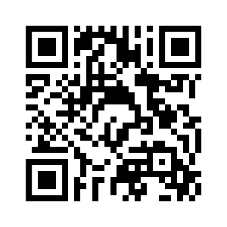
4.2 WILDLIFE WATCHING
UNIT 4 WILDLIFE
Notes:
https://hr.izzi.digital/#/repository/204

Slide 2
WILDLIFE WATCHING
UNIT 4 WILDLIFE
bald eagle = bjeloglavi orao
bison = bizon
beaver = dabar
herd = stado
tail = rep
wings = krila
horns = rogovi
pond = jezerce
Notes:
https://hr.izzi.digital/#/repository/204

Slide 3
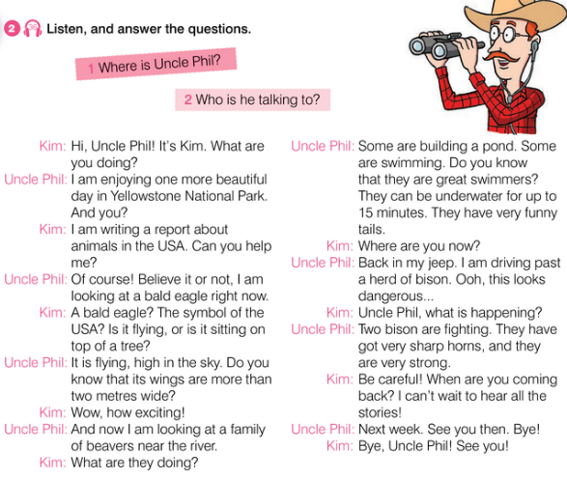
WILDLIFE WATCHING
UNIT 4 WILDLIFE
symbol = simbol
wide = širok
exciting = uzbudljivo
near = blizu, u blizini
underwater = ispod površine vode
past = pokraj, uz
sharp = oštar
Notes:
https://hr.izzi.digital/#/repository/204

Slide 4
WILDLIFE WATCHING
UNIT 4 WILDLIFE
Notes:
https://hr.izzi.digital/#/repository/204

Slide 5
WILDLIFE WATCHING
UNIT 4 WILDLIFE
Notes:
https://hr.izzi.digital/#/repository/204

Slide 6
WILDLIFE WATCHING
UNIT 4 WILDLIFE
Notes:
https://hr.izzi.digital/#/repository/204

Slide 7
WILDLIFE WATCHING
UNIT 4 WILDLIFE
Notes:
https://hr.izzi.digital/#/repository/204

Slide 8
WILDLIFE WATCHING
UNIT 4 WILDLIFE
Notes:
https://hr.izzi.digital/#/repository/204

Slide 9
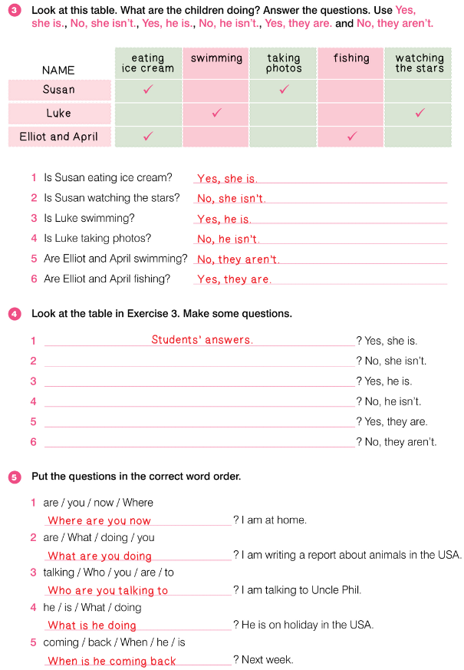
WILDLIFE WATCHING
UNIT 4 WILDLIFE
Notes:
https://hr.izzi.digital/#/repository/204

Slide 10
WILDLIFE WATCHING
UNIT 4 WILDLIFE
Notes:
https://hr.izzi.digital/#/repository/204

