Slide 1
4.3 WILD THINGS
UNIT 4 WILDLIFE
Notes:
https://hr.izzi.digital/#/repository/204

Slide 2
WILD THINGS
UNIT 4 WILDLIFE
reindeer = sob
owl = sova
seal = morski lav, tuljan
elephant = slon
rhino = nosorog
hippo = vodenkonj, nilski konj
lion = lav
jaguar = jaguar
llama = ljama
dolphin = dupin
Notes:
https://hr.izzi.digital/#/repository/204

Slide 3
WILD THINGS
UNIT 4 WILDLIFE
Notes:
https://hr.izzi.digital/#/repository/204

Slide 4
WILD THINGS
UNIT 4 WILDLIFE
greetings = pozdrav(i)
Finland = Finska
Lapland = Laponija
photo safari = foto safari
while = dok, za to vrijeme
Notes:
https://hr.izzi.digital/#/repository/204

Slide 5
WILD THINGS
UNIT 4 WILDLIFE
round = uokolo
rainforest = kišna šuma, prašuma
Notes:
https://hr.izzi.digital/#/repository/204

Slide 6
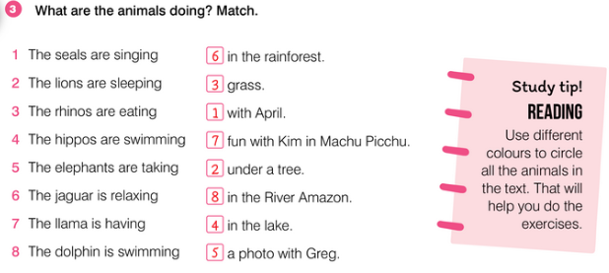
WILD THINGS
UNIT 4 WILDLIFE
Notes:
https://hr.izzi.digital/#/repository/204

Slide 7
WILD THINGS
UNIT 4 WILDLIFE
Notes:
https://hr.izzi.digital/#/repository/204

Slide 8
WILD THINGS
UNIT 4 WILDLIFE
Notes:
https://hr.izzi.digital/#/repository/204

Slide 9
WILD THINGS
UNIT 4 WILDLIFE
Notes:
https://hr.izzi.digital/#/repository/204

Slide 10
WILD THINGS
UNIT 4 WILDLIFE
Notes:
https://hr.izzi.digital/#/repository/204

Slide 11
WILD THINGS
UNIT 4 WILDLIFE
Notes:
https://hr.izzi.digital/#/repository/204

