Slide 1

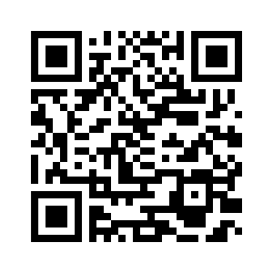
4.4 THE ANIMAL FAIR
UNIT 4 WILDLIFE
Notes:
https://hr.izzi.digital/#/repository/204

Slide 2
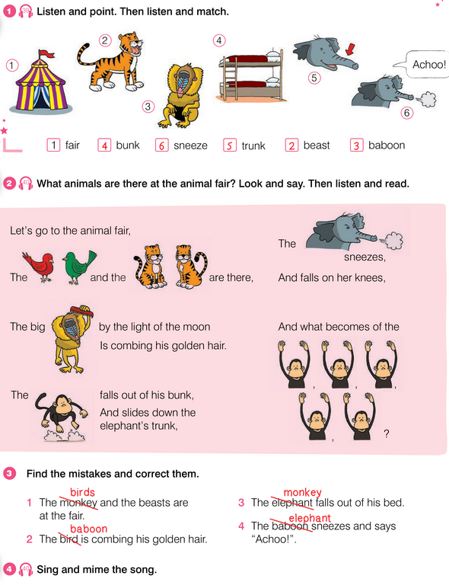
THE ANIMAL FAIR
UNIT 4 WILDLIFE
fair = sajam
beast = divlja životinja
baboon = pavijan
bunk = krevet na kat
trunk = surla
sneeze = kihnuti
Notes:
https://hr.izzi.digital/#/repository/204

Slide 3

THE ANIMAL FAIR
UNIT 4 WILDLIFE
comb = počešljati se
slide down = otklizati se prema dolje
Notes:
https://hr.izzi.digital/#/repository/204

Slide 4
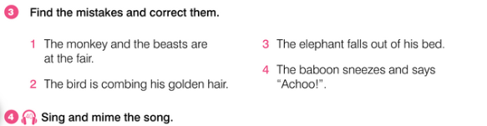
THE ANIMAL FAIR
UNIT 4 WILDLIFE
Notes:
https://hr.izzi.digital/#/repository/204

Slide 5
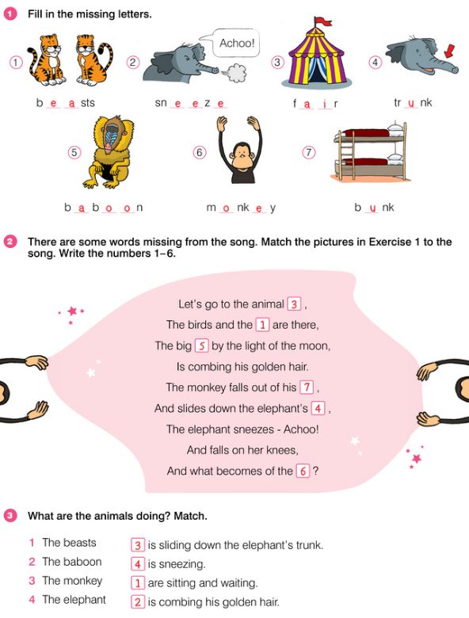
THE ANIMAL FAIR
UNIT 4 WILDLIFE
Notes:
https://hr.izzi.digital/#/repository/204

Slide 6
THE ANIMAL FAIR
UNIT 4 WILDLIFE
Notes:
https://hr.izzi.digital/#/repository/204

Slide 7
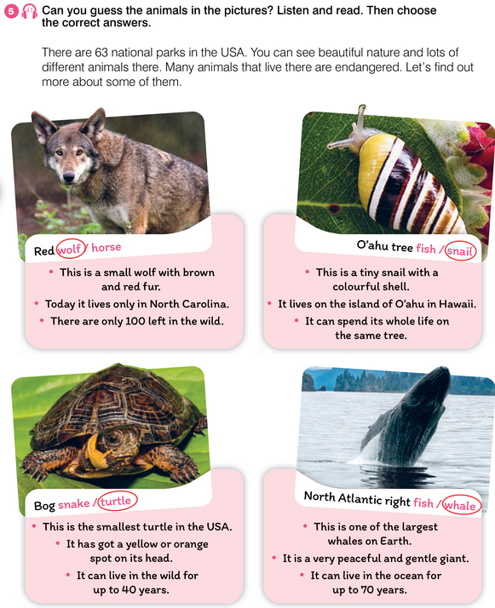
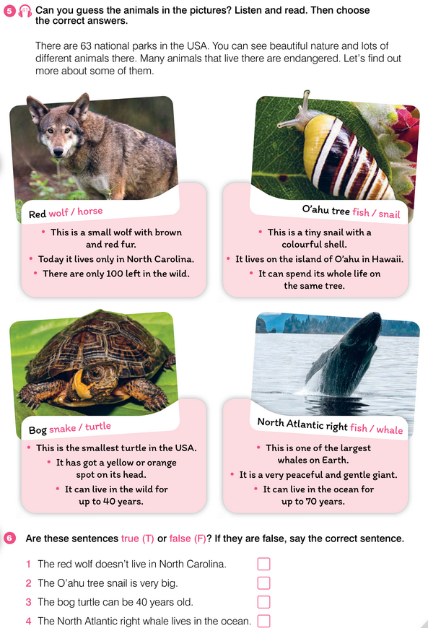
CULTURE CORNER
UNIT 4 WILDLIFE
endangered = ugrožen
fur = krzno
in the wild = u divljini
snail = puž
tiny = sićušan
spot = mrlja
peaceful = miroljubiv
gentle = nježan
giant = div, gorostas
Notes:
https://hr.izzi.digital/#/repository/204

Slide 8
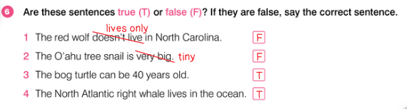
CULTURE CORNER
UNIT 4 WILDLIFE
Notes:
https://hr.izzi.digital/#/repository/204

Slide 9
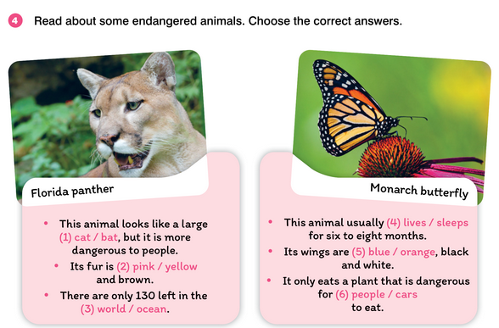
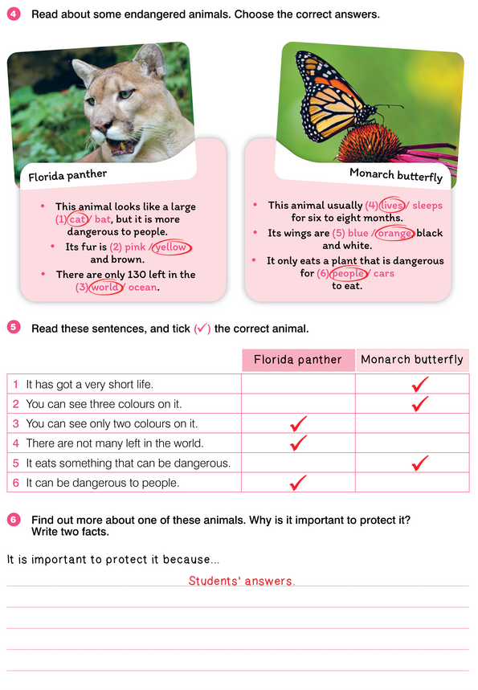
CULTURE CORNER
UNIT 4 WILDLIFE
Notes:
https://hr.izzi.digital/#/repository/204

Slide 10
CULTURE CORNER
UNIT 4 WILDLIFE
Notes:
https://hr.izzi.digital/#/repository/204

