Slide 1
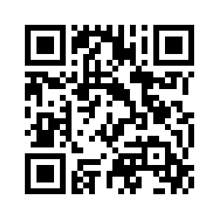
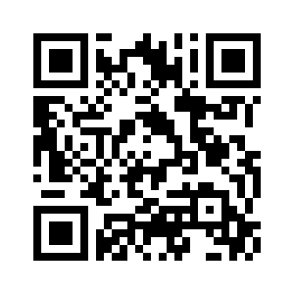

4.5 LET’S CHECK!
REVISION
UNIT 4 WILDLIFE
Notes:
https://hr.izzi.digital/#/repository/204

Slide 2
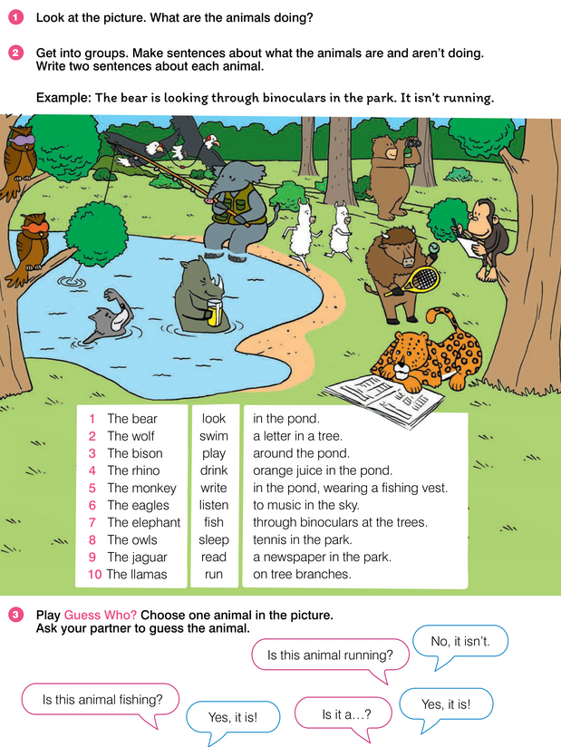
LET’S CHECK!
UNIT 4 WILDLIFE
Notes:
https://hr.izzi.digital/#/repository/204

Slide 3
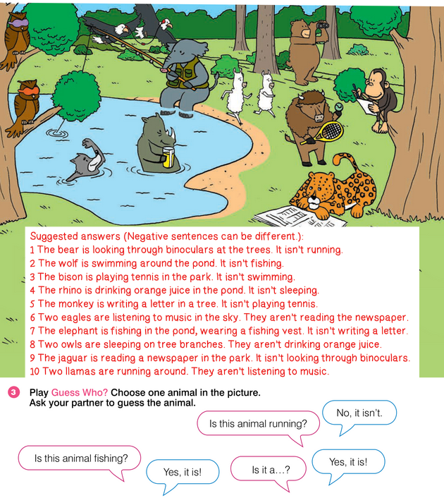
LET’S CHECK!
UNIT 4 WILDLIFE
Notes:
https://hr.izzi.digital/#/repository/204

Slide 4
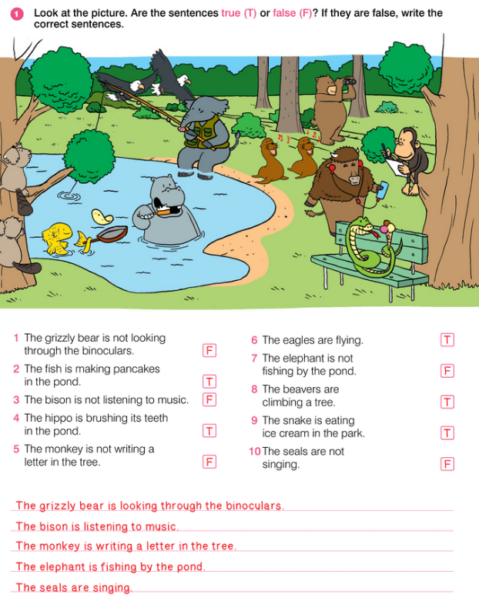
LET’S CHECK!
UNIT 4 WILDLIFE
Notes:
https://hr.izzi.digital/#/repository/204

Slide 5
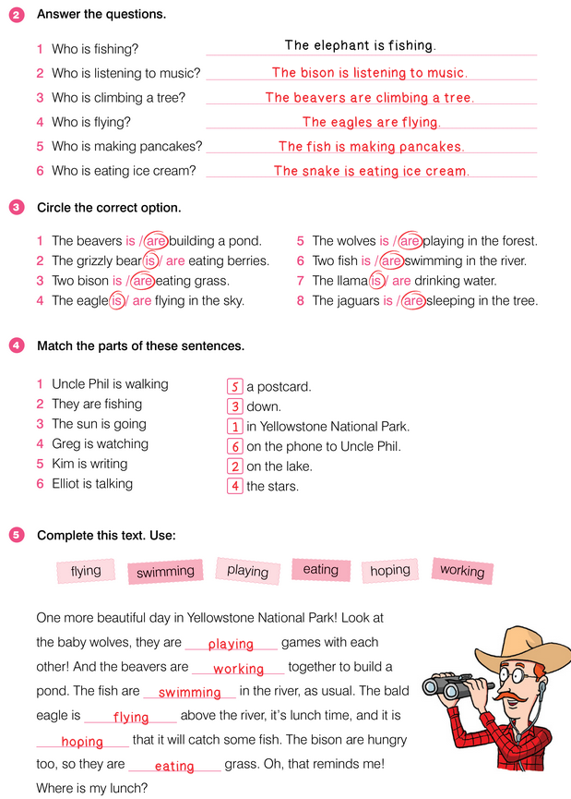
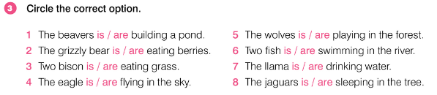
LET’S CHECK!
UNIT 4 WILDLIFE
Notes:
https://hr.izzi.digital/#/repository/204

Slide 6
LET’S CHECK!
UNIT 4 WILDLIFE
Notes:
https://hr.izzi.digital/#/repository/204

Slide 7
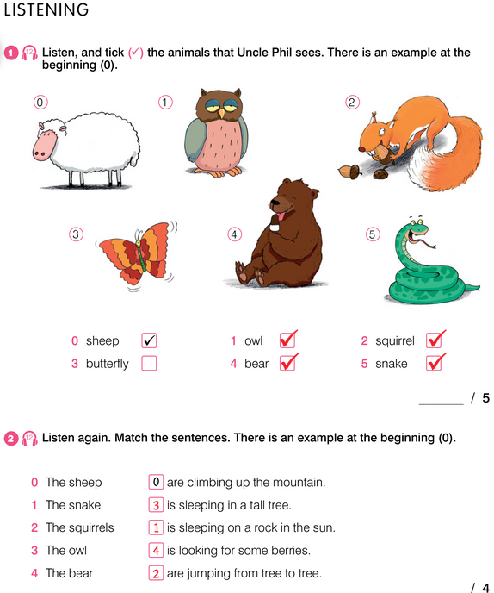

REVISION
UNIT 4 WILDLIFE
Notes:
https://hr.izzi.digital/#/repository/204

Slide 8
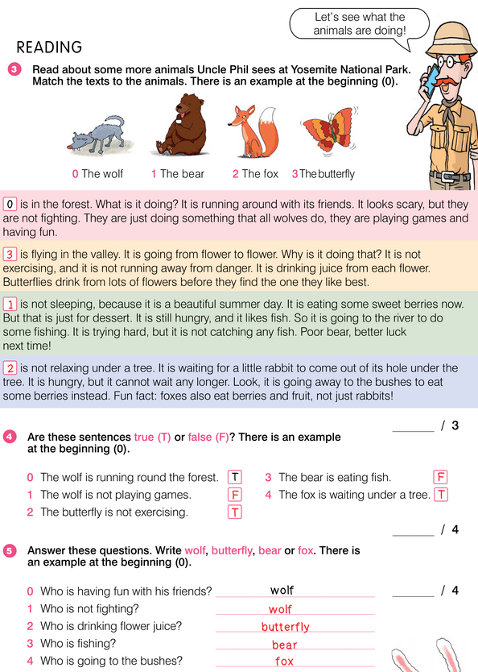
REVISION
UNIT 4 WILDLIFE
Notes:
https://hr.izzi.digital/#/repository/204

Slide 9
REVISION
UNIT 4 WILDLIFE
Notes:
https://hr.izzi.digital/#/repository/204

