Slide 1
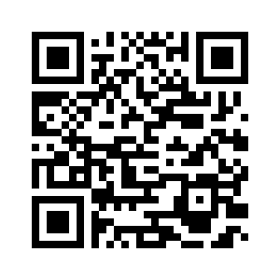
5.1 FINDING MOLLY
UNIT 5 THE PLACE WHERE I LIVE
Notes:
https://hr.izzi.digital/#/repository/204

Slide 2
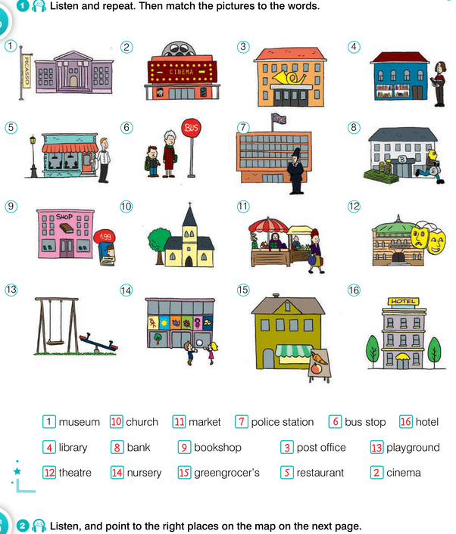
FINDING MOLLY
UNIT 5 THE PLACE WHERE I LIVE
museum = muzej
cinema = kino
post office = poštanski ured
library = knjižnice
restaurant = restoran
bus stop = autobusna postaja
police station = policijska postaja
bank = banka
bookshop = knjižara
church = crkva
market = tržnica
theatre = kazalište
playground = igralište
nursery = vrtić
greengrocer’s = voćarna
hotel = hotel
Notes:
https://hr.izzi.digital/#/repository/204

Slide 3
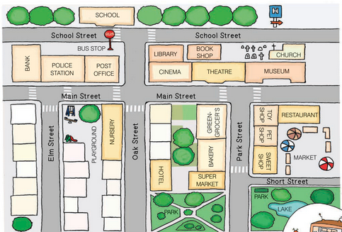
FINDING MOLLY
UNIT 5 THE PLACE WHERE I LIVE
Notes:
https://hr.izzi.digital/#/repository/204

Slide 4
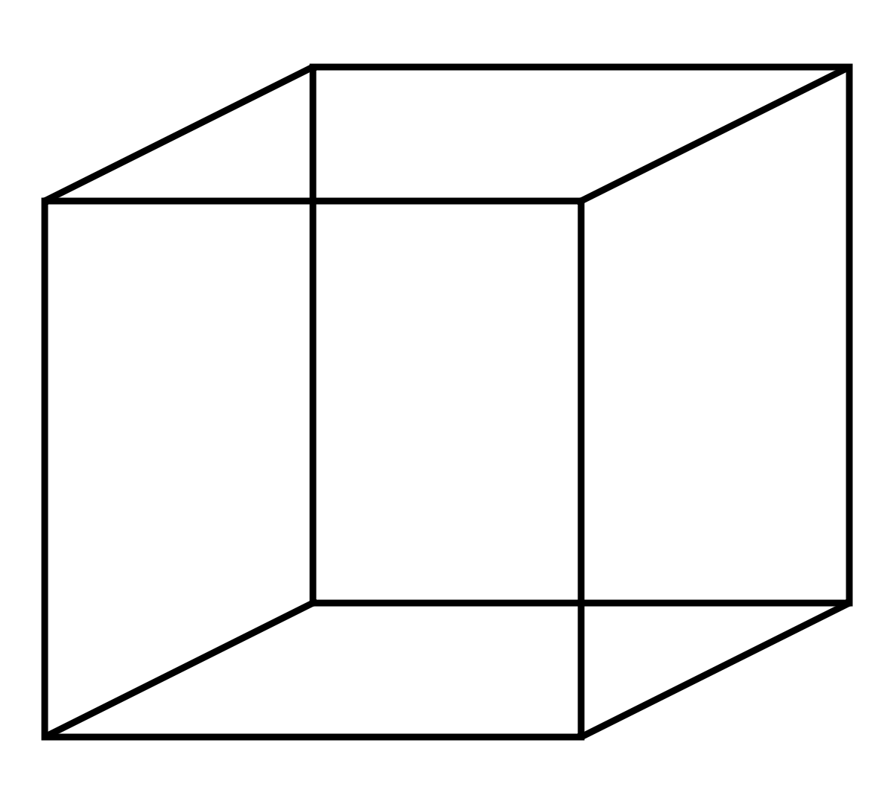
FINDING MOLLY
UNIT 5 THE PLACE WHERE I LIVE
NEXT TO
= pokraj
OPPOSITE= nasuprot
ON THE LEFT SIDE = s lijeve strane
ON THE RIGHT SIDE = s desne strane
Notes:
https://hr.izzi.digital/#/repository/204

Slide 5
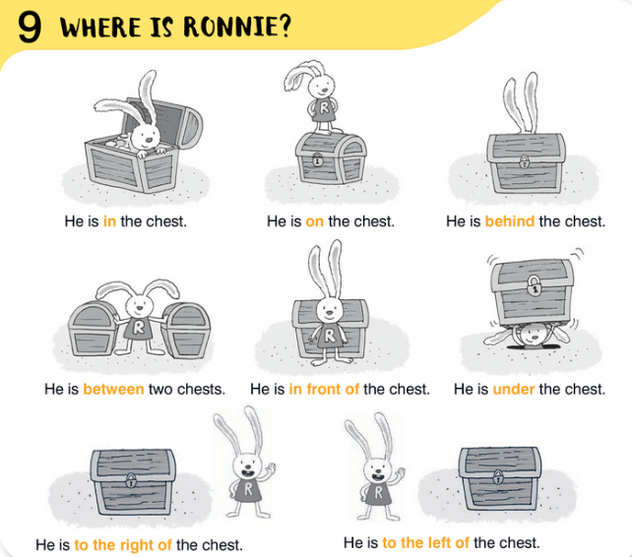
FINDING MOLLY
UNIT 5 THE PLACE WHERE I LIVE
Notes:
https://hr.izzi.digital/#/repository/204

Slide 6
FINDING MOLLY
UNIT 5 THE PLACE WHERE I LIVE
Notes:
https://hr.izzi.digital/#/repository/204

Slide 7
FINDING MOLLY
UNIT 5 THE PLACE WHERE I LIVE
upset = uznemiren
missing = nestao, izgubljen
local = lokalni
excuse me = ispričavam se
you’re welcome = nema na čemu
collection = zbirka
Notes:
https://hr.izzi.digital/#/repository/204

Slide 8
FINDING MOLLY
UNIT 5 THE PLACE WHERE I LIVE
Notes:
https://hr.izzi.digital/#/repository/204

Slide 9
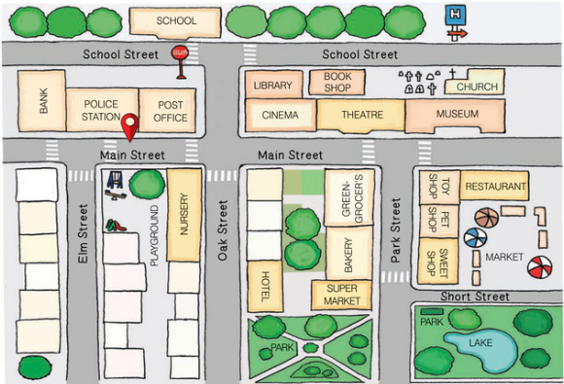
FINDING MOLLY
UNIT 5 THE PLACE WHERE I LIVE
Notes:
https://hr.izzi.digital/#/repository/204

Slide 10
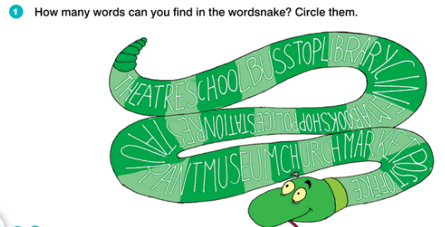
FINDING MOLLY
UNIT 5 THE PLACE WHERE I LIVE
Notes:
https://hr.izzi.digital/#/repository/204

Slide 11
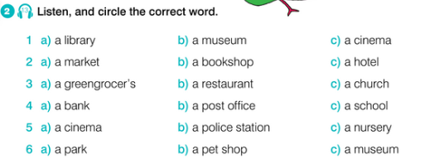
FINDING MOLLY
UNIT 5 THE PLACE WHERE I LIVE
Notes:
https://hr.izzi.digital/#/repository/204

Slide 12
FINDING MOLLY
UNIT 5 THE PLACE WHERE I LIVE
Notes:
https://hr.izzi.digital/#/repository/204

Slide 13
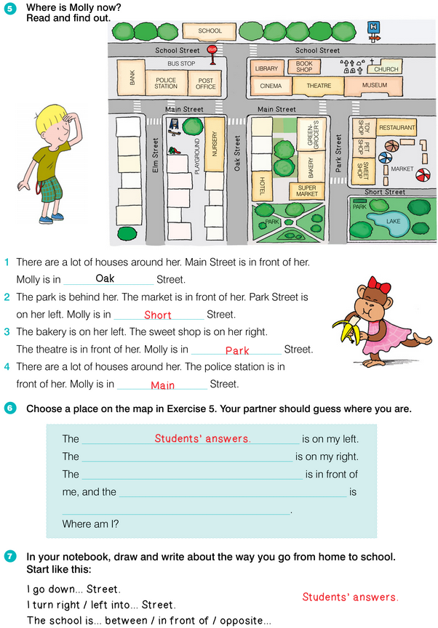
FINDING MOLLY
UNIT 5 THE PLACE WHERE I LIVE
Notes:
https://hr.izzi.digital/#/repository/204

Slide 14
FINDING MOLLY
UNIT 5 THE PLACE WHERE I LIVE
Notes:
https://hr.izzi.digital/#/repository/204

