Slide 1
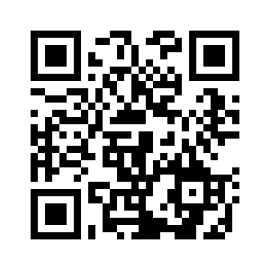
5.2 MY STREET
UNIT 5 THE PLACE WHERE I LIVE
Notes:
https://hr.izzi.digital/#/repository/204

Slide 2
MY STREET
UNIT 5 THE PLACE WHERE I LIVE
a bakery
a supermarket
a sweet shop
a pet shop
a greengrocer’s
a toy shop
Notes:
https://hr.izzi.digital/#/repository/204

Slide 3
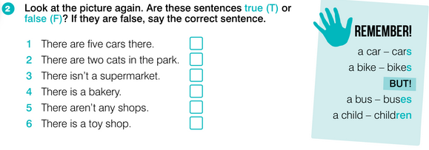
MY STREET
UNIT 5 THE PLACE WHERE I LIVE
Notes:
https://hr.izzi.digital/#/repository/204

Slide 4
MY STREET
UNIT 5 THE PLACE WHERE I LIVE
Notes:
https://hr.izzi.digital/#/repository/204

Slide 5
MY STREET
UNIT 5 THE PLACE WHERE I LIVE
Notes:
https://hr.izzi.digital/#/repository/204

Slide 6
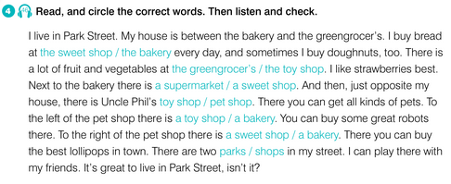
MY STREET
UNIT 5 THE PLACE WHERE I LIVE
Notes:
https://hr.izzi.digital/#/repository/204

Slide 7
MY STREET
UNIT 5 THE PLACE WHERE I LIVE
Notes:
https://hr.izzi.digital/#/repository/204

Slide 8
MY STREET
UNIT 5 THE PLACE WHERE I LIVE
Notes:
https://hr.izzi.digital/#/repository/204

Slide 9
MY STREET
UNIT 5 THE PLACE WHERE I LIVE
Notes:
https://hr.izzi.digital/#/repository/204

Slide 10
MY STREET
UNIT 5 THE PLACE WHERE I LIVE
Notes:
https://hr.izzi.digital/#/repository/204

Slide 11
How many…?
UNIT 5 THE PLACE WHERE I LIVE
MY STREET
cars
lollipops
doughnuts
trees
houses
children
a shop
a park
a street
friends
a school
bakeries
a bus
a bakery
a robot
strawberries
pets
child

Slide 12
How many…?
UNIT 5 THE PLACE WHERE I LIVE
MY STREET
SINGULAR
PLURAL
cars
lollipops
doughnuts
trees
friends
pets
houses
bakeries
strawberries
children
a shop
a park
a street
a school
a robot
a bus
a bakery
strawberry
child

Slide 13
UNIT 5 THE PLACE WHERE I LIVE
MY STREET
-S
SINGULAR | PLURAL
-IES
SINGULAR (-y) | PLURAL (-ies)
-REN
SINGULAR | PLURAL (-ren)

Slide 14
-S
SINGULAR | PLURAL (-s)
car | cars
lollipop | lollipops
doughnut | doughnuts
tree | trees
house | houses
shop | shops
park | parks
street | streets
friend | friends
school | schools
robot | robots
pet | pets

Slide 15
UNIT 5 THE PLACE WHERE I LIVE
MY STREET
-IES
SINGULAR (-y) | PLURAL (-ies)
strawberry | strawberries
bakery | bakeries
-REN
SINGULAR | PLURAL (-ren)
child | children

Slide 16
MY STREET
UNIT 5 THE PLACE WHERE I LIVE
Notes:
https://hr.izzi.digital/#/repository/204

Slide 17
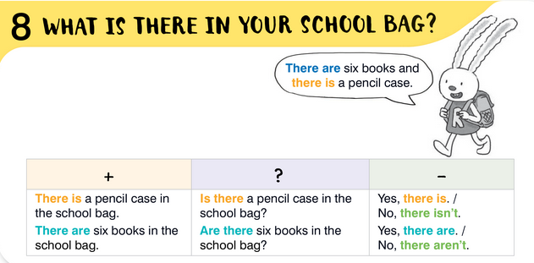
MY STREET
UNIT 5 THE PLACE WHERE I LIVE
Notes:
https://hr.izzi.digital/#/repository/204

Slide 18
MY STREET
UNIT 5 THE PLACE WHERE I LIVE
Notes:
https://hr.izzi.digital/#/repository/204

Slide 19
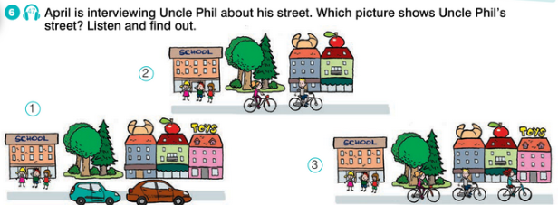
MY STREET
UNIT 5 THE PLACE WHERE I LIVE
Notes:
https://hr.izzi.digital/#/repository/204

Slide 20
MY STREET
UNIT 5 THE PLACE WHERE I LIVE
Notes:
https://hr.izzi.digital/#/repository/204

Slide 21
MY STREET
UNIT 5 THE PLACE WHERE I LIVE
Notes:
https://hr.izzi.digital/#/repository/204

Slide 22
There is…
UNIT 5 THE PLACE WHERE I LIVE
MY STREET
a bakery
1 trgovina voća i povrća
2 supermarket
3 trgovina s igračkama
4 trgovina sa slatkišima
5 pekarnica
6 trgovina sa životinjama
a pet shop
a greengrocer’s
a supermarket
a sweet shop
a toy shop

Slide 23
There is…
UNIT 5 THE PLACE WHERE I LIVE
MY STREET
1 trgovina voća i povrća
2 supermarket
3 trgovina s igračkama
4 trgovina sa slatkišima
5 pekarnica
6 trgovina sa životinjama
a greengrocer’s
a supermarket
a toy shop
a sweet shop
a bakery
a pet shop

Slide 24
There is… There are…
UNIT 5 THE PLACE WHERE I LIVE
MY STREET
THERE IS
THERE ARE
There is one park.
There is one greengrocer’s.
There is one sweet shop.
There is one bakery.
There is one pet shop.
There is one toy shop.
There is one supermarket.
There are two parks.
There are two greengrocer’s.
There are two sweet shops.
There are two bakeries.
There are two pet shops.
There are two toy shops.
There are two supermarkets.

Slide 25
Is there…?
UNIT 5 THE PLACE WHERE I LIVE
MY STREET
THERE IS
IS THERE?
There is one park.
There is one greengrocer’s.
There is one sweet shop.
There is one bakery.
There is one pet shop.
There is one toy shop.
There is one supermarket.
Is there one park?
Is there one greengrocer’s?
Is there one sweet shop?
Is there on bakery?
Is there one pet shop?
Is there one toy shop?
Is there one supermarket?
Yes, there is.
No, there isn’t.

Slide 26
Are there…?
UNIT 5 THE PLACE WHERE I LIVE
MY STREET
THERE ARE
ARE THERE?
There are two parks.
There are two greengrocer’s.
There are two sweet shops.
There are two bakeries.
There are two pet shops.
There are two toy shops.
There are two supermarkets.
Are there two parks?
Are there two greengrocer’s?
Are there two sweet shops?
Are there two bakeries?
Are there two pet shops?
Are there two toy shops?
Are there two supermarkets?
Yes, there are.
No, there aren’t.

Slide 27
MY STREET
UNIT 5 THE PLACE WHERE I LIVE
Notes:
https://hr.izzi.digital/#/repository/204

Slide 28
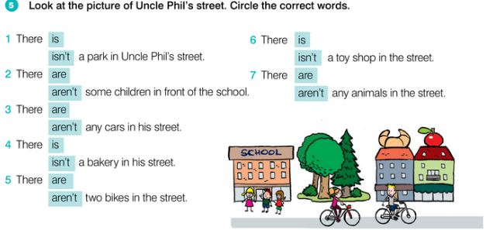
MY STREET
UNIT 5 THE PLACE WHERE I LIVE
Notes:
https://hr.izzi.digital/#/repository/204

Slide 29
MY STREET
UNIT 5 THE PLACE WHERE I LIVE
Notes:
https://hr.izzi.digital/#/repository/204

