Slide 1
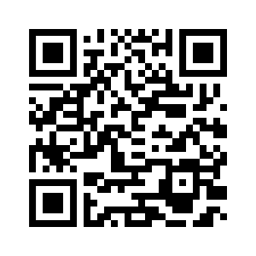
5.3 AT THE MARKET
UNIT 5 THE PLACE WHERE I LIVE
Notes:
https://hr.izzi.digital/#/repository/204

Slide 2
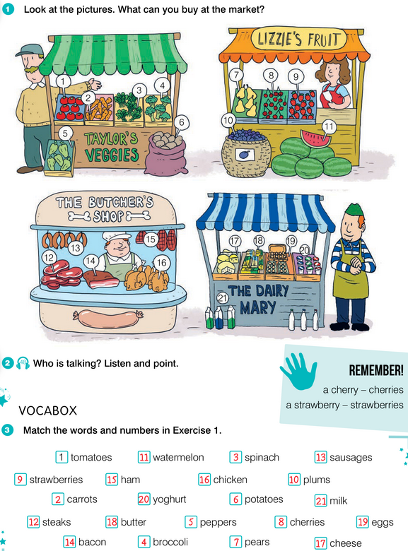
AT THE MARKET
UNIT 5 THE PLACE WHERE I LIVE
dairy = mliječni proizvodi
butcher = mesar
Notes:
https://hr.izzi.digital/#/repository/204

Slide 3
AT THE MARKET
UNIT 5 THE PLACE WHERE I LIVE
Notes:
https://hr.izzi.digital/#/repository/204

Slide 4
AT THE MARKET
UNIT 5 THE PLACE WHERE I LIVE
Notes:
https://hr.izzi.digital/#/repository/204

Slide 5
UNIT 5 THE PLACE WHERE I LIVE
AT THE MARKET
-S
SINGULAR | PLURAL
-IES
SINGULAR (-y) | PLURAL (-ies)
-REN
SINGULAR | PLURAL (-ren)

Slide 6
-S
SINGULAR | PLURAL (-s)
car | cars
lollipop | lollipops
doughnut | doughnuts
tree | trees
house | houses
shop | shops
park | parks
street | streets
friend | friends
school | schools
robot | robots
pet | pets

Slide 7
UNIT 5 THE PLACE WHERE I LIVE
AT THE MARKET
-IES
SINGULAR (-y) | PLURAL (-ies)
strawberry | strawberries
bakery | bakeries
-REN
SINGULAR | PLURAL (-ren)
child | children

Slide 8
AT THE MARKET
UNIT 5 THE PLACE WHERE I LIVE
Notes:
https://hr.izzi.digital/#/repository/204

Slide 9
AT THE MARKET
UNIT 5 THE PLACE WHERE I LIVE
tomatoes = rajčice
carrots = mrkve
spinach = špinat
broccoli = brokula
peppers = paprike
potatoes = krumpiri
pears = kruške
cherries = trešnje
strawberries = jagode
plums = šljive
watermelon = lubenica
steaks = odresci
sausages = kobasice
bacon = slanina, špek
ham = šunka
chicken = piletina
cheese = sir
butter = maslac
eggs = jaja
yoghurt = jogurt
milk = mlijeko
Notes:
https://hr.izzi.digital/#/repository/204

Slide 10
Match.
UNIT 5 THE PLACE WHERE I LIVE
AT THE MARKET
1 tomato / tomatoes
2 carrot / carrots
3 spinach
4 broccoli
5 pepper / peppers
6 potato / potatoes
7 pear / pears
8 cherry / cherries
9 strawberry / strawberries
10 plum / plums
11 watermelon
12 steak
13 sausage / sausages
14 bacon
15 ham
16 chicken
piletina
jagoda
odrezak
šunka
šljiva
paprika
lubenica
slanina
kobasica
krumpir
rajčica
brokula
špinat
mrkva
trešnja
kruška

Slide 11
Match.
UNIT 5 THE PLACE WHERE I LIVE
AT THE MARKET
1 tomato / tomatoes = rajčica
2 carrot / carrots = mrkva
3 spinach = špinat
4 broccoli = brokula
5 pepper / peppers = paprika
6 potato / potatoes = krumpir
7 pear / pears = kruška
8 cherry / cherries = trešnja
9 strawberry / strawberries = jagoda
10 plum / plums = šljiva
11 watermelon = lubenica
12 steak = odrezak
13 sausage / sausages = kobasica
14 bacon = slanina
15 ham = šunka
16 chicken = piletina

Slide 12
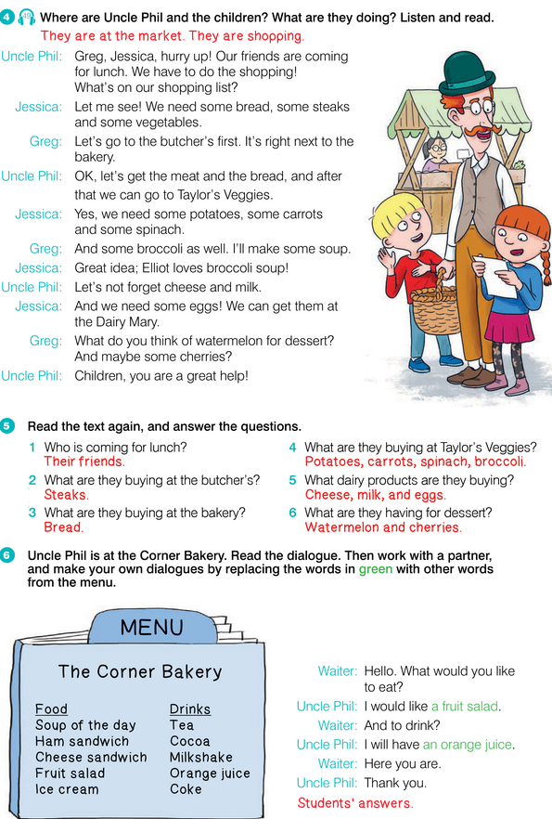
AT THE MARKET
UNIT 5 THE PLACE WHERE I LIVE
Notes:
https://hr.izzi.digital/#/repository/204

Slide 13
AT THE MARKET
UNIT 5 THE PLACE WHERE I LIVE
Notes:
https://hr.izzi.digital/#/repository/204

Slide 14
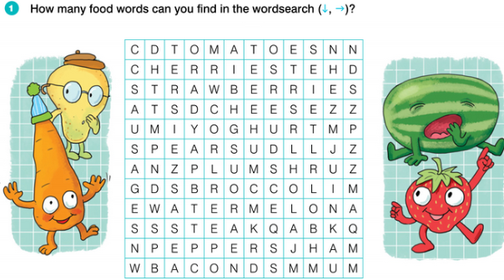
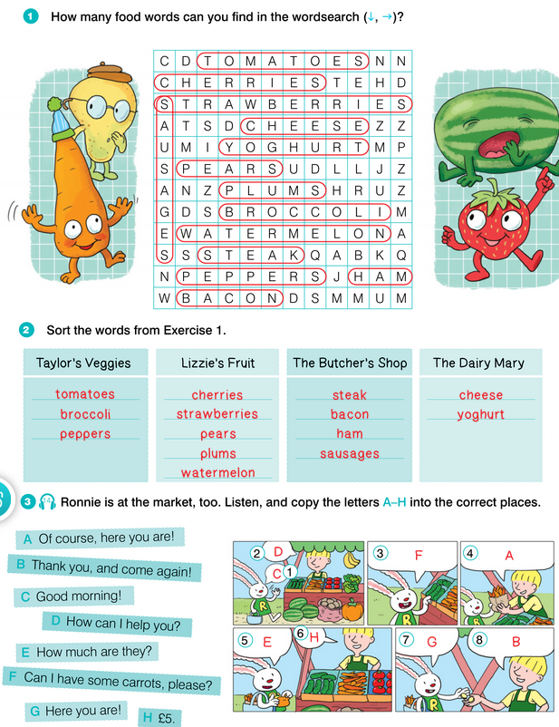
AT THE MARKET
UNIT 5 THE PLACE WHERE I LIVE
Notes:
https://hr.izzi.digital/#/repository/204

Slide 15
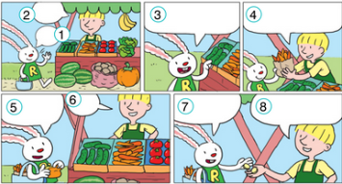
AT THE MARKET
UNIT 5 THE PLACE WHERE I LIVE
Notes:
https://hr.izzi.digital/#/repository/204

Slide 16
AT THE MARKET
UNIT 5 THE PLACE WHERE I LIVE
Notes:
https://hr.izzi.digital/#/repository/204

Slide 17
AT THE MARKET
UNIT 5 THE PLACE WHERE I LIVE
Notes:
https://hr.izzi.digital/#/repository/204

