Slide 1
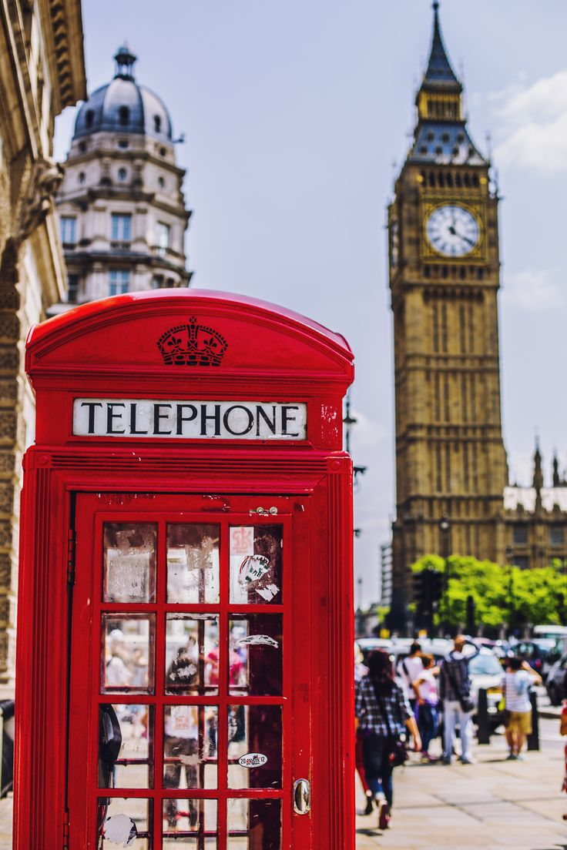

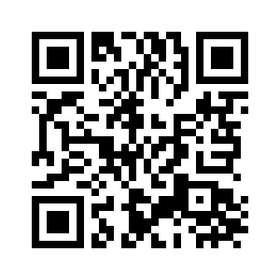
5.4
A TOUR OF LONDON
UNIT 5 THE PLACE WHERE I LIVE
Notes:
https://hr.izzi.digital/#/repository/204

Slide 2
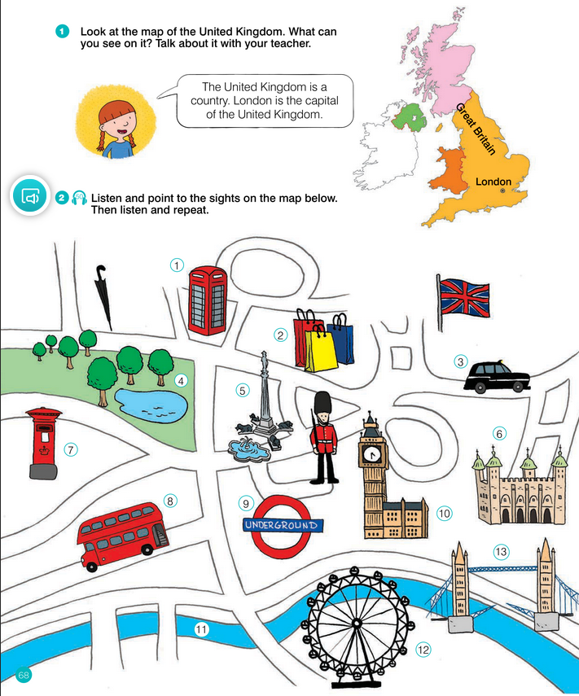
A TOUR OF LONDON
UNIT 5 THE PLACE WHERE I LIVE
Notes:
https://hr.izzi.digital/#/repository/204

Slide 3
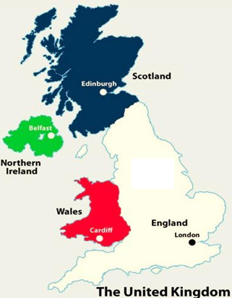
Welcome to the UK!
UNIT 5 THE PLACE WHERE I LIVE
A TOUR OF LONDON

Slide 4
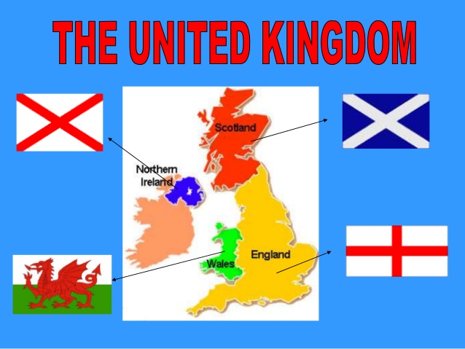

Slide 5
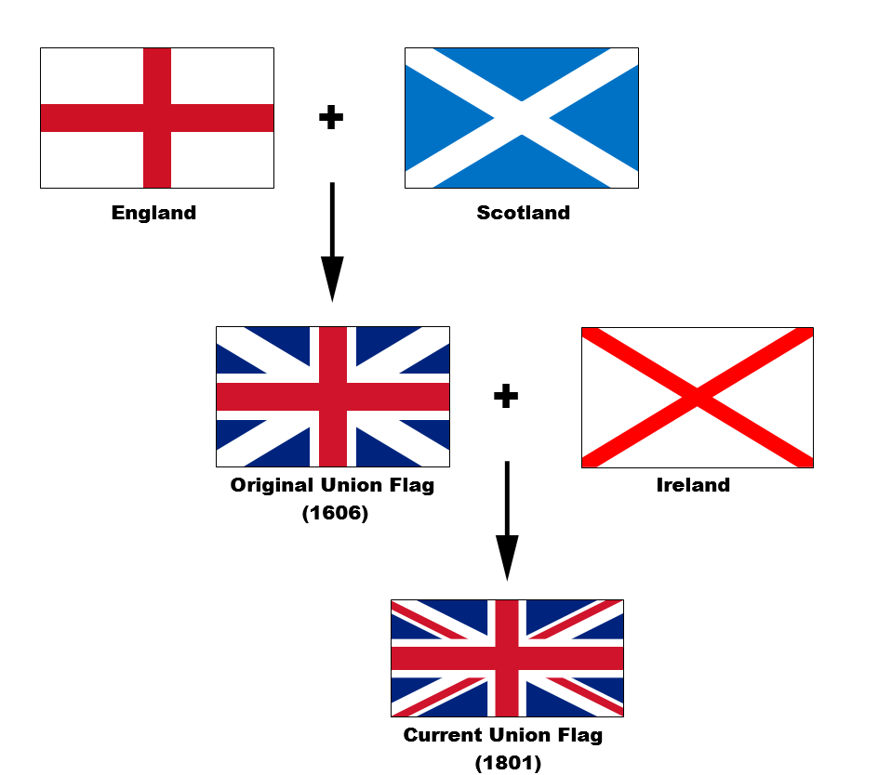
The Flags of Union Jack
UNIT 5 THE PLACE WHERE I LIVE
A TOUR OF LONDON

Slide 6

A TOUR OF LONDON
UNIT 5 THE PLACE WHERE I LIVE
Notes:
https://hr.izzi.digital/#/repository/204

Slide 7
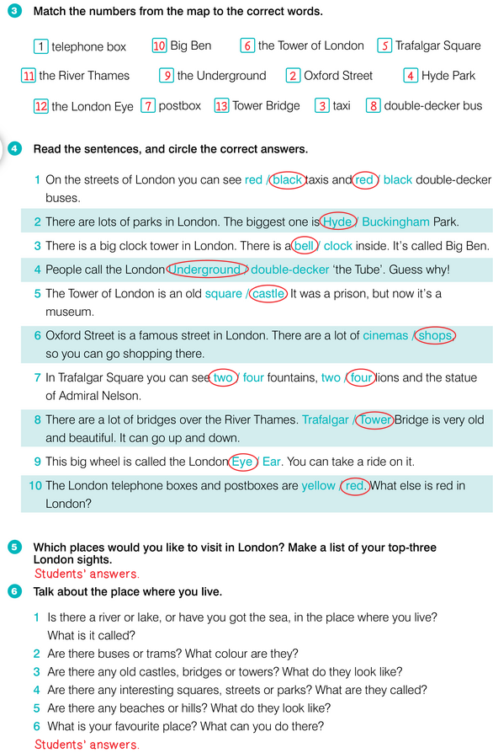
A TOUR OF LONDON
UNIT 5 THE PLACE WHERE I LIVE
Notes:
https://hr.izzi.digital/#/repository/204

Slide 8
Match.
UNIT 5 THE PLACE WHERE I LIVE
A TOUR OF LONDON
postbox
fountain
underground
prison
river
double-decker bus
square
bridge
statue
park
clock tower
wheel
1 zatvor
2 poštanski sandučić
3 kolo
4 toranj sa satom
5 park
6 autobus na kat
7 podzemna željeznica
8 most
9 rijeka
10 trg
11 fontana
12 kip

Slide 9
Match.
UNIT 5 THE PLACE WHERE I LIVE
A TOUR OF LONDON
1 zatvor = prison
2 poštanski sandučić = a postbox
3 kolo = a wheel
4 toranj sa satom = a clock tower
5 park = a park
6 autobus na kat = a double-decker bus
7 podzemna željeznica = the underground
8 most = a bridge
9 rijeka = a river
10 trg = a square
11 fontana = a fountain
12 kip = a statue

Slide 10
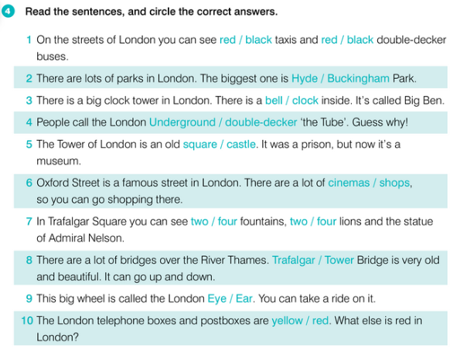
A TOUR OF LONDON
UNIT 5 THE PLACE WHERE I LIVE
Notes:
https://hr.izzi.digital/#/repository/204

Slide 11
A TOUR OF LONDON
UNIT 5 THE PLACE WHERE I LIVE
Notes:
https://hr.izzi.digital/#/repository/204

Slide 12
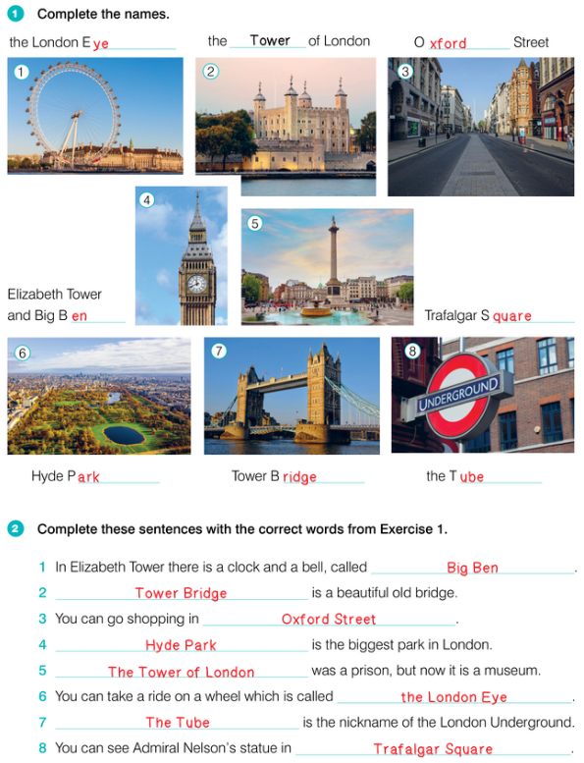
A TOUR OF LONDON
UNIT 5 THE PLACE WHERE I LIVE
Notes:
https://hr.izzi.digital/#/repository/204

Slide 13
A TOUR OF LONDON
UNIT 5 THE PLACE WHERE I LIVE
Notes:
https://hr.izzi.digital/#/repository/204

Slide 14
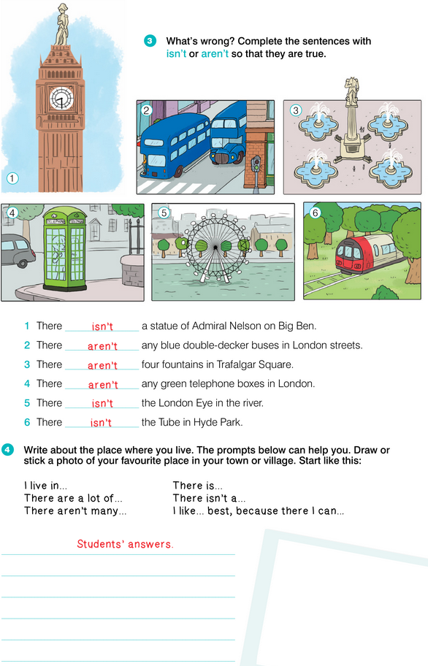
A TOUR OF LONDON
UNIT 5 THE PLACE WHERE I LIVE
Notes:
https://hr.izzi.digital/#/repository/204

Slide 15
A TOUR OF LONDON
UNIT 5 THE PLACE WHERE I LIVE
Notes:
https://hr.izzi.digital/#/repository/204

