Slide 1
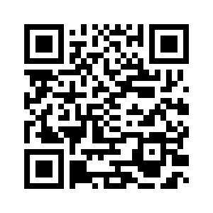
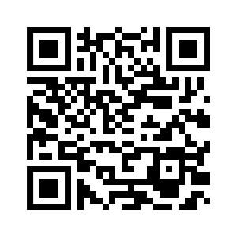
5.5 LET’S CHECK! REVISION
UNIT 5 THE PLACE WHERE I LIVE
Notes:
https://hr.izzi.digital/#/repository/204

Slide 2
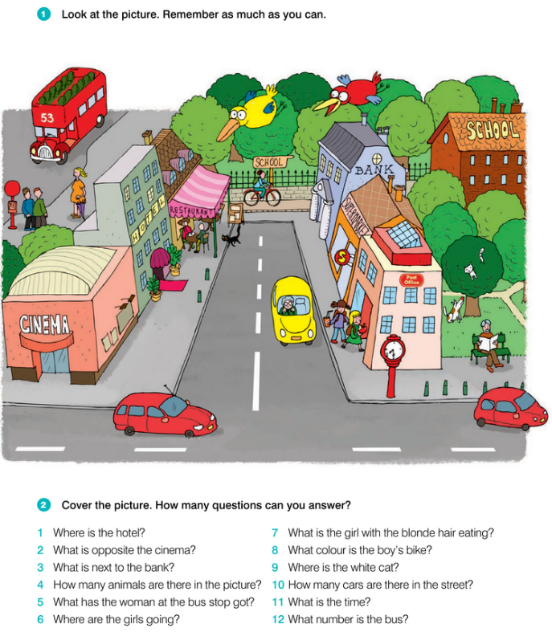
LET’S CHECK!
UNIT 5 THE PLACE WHERE I LIVE
Notes:
https://hr.izzi.digital/#/repository/204

Slide 3
1 Where’s the hotel?
1
2 What’s opposite the cinema?
2
3 What’s next to the bank?
3
4 How many animals are there in the picture?
4
5 What has the woman at the bus stop got?
5
6 Where are the girls going?
6
7 What’s the girl with the blonde hair eating?
7
8 What colour is the boy’s bike?
8
9 Where’s the white cat?
9
10 How many cars are there in the street?
10
11 What’s the time?
11
12 What number is the bus?
12

Slide 4
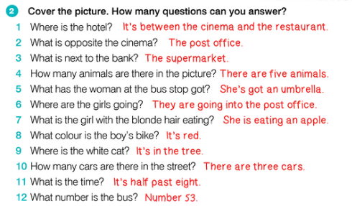
LET’S CHECK!
UNIT 5 THE PLACE WHERE I LIVE
Notes:
https://hr.izzi.digital/#/repository/204

Slide 5
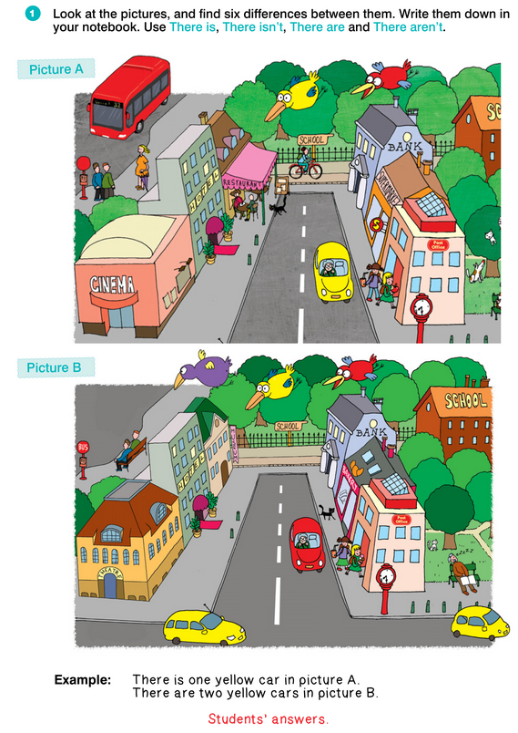
LET’S CHECK!
UNIT 5 THE PLACE WHERE I LIVE
Notes:
https://hr.izzi.digital/#/repository/204

Slide 6
LET’S CHECK!
UNIT 5 THE PLACE WHERE I LIVE
Notes:
https://hr.izzi.digital/#/repository/204

Slide 7
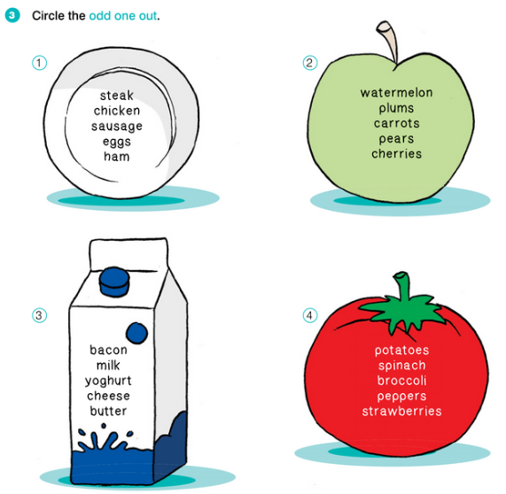
LET’S CHECK!
UNIT 5 THE PLACE WHERE I LIVE
Notes:
https://hr.izzi.digital/#/repository/204

Slide 8
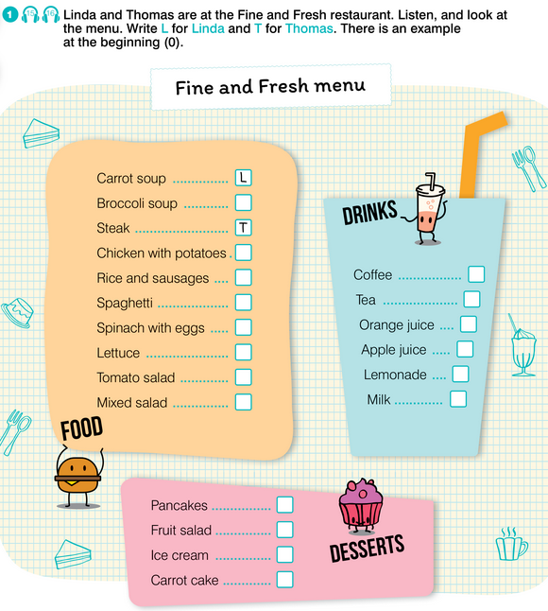
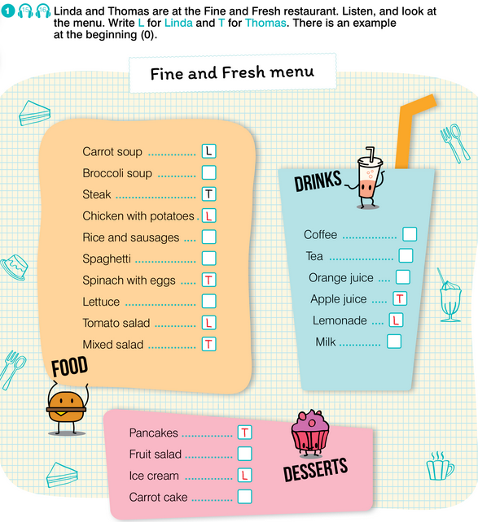
REVISION
UNIT 5 THE PLACE WHERE I LIVE
LISTENING
Notes:
https://hr.izzi.digital/#/repository/204

Slide 9
REVISION
UNIT 5 THE PLACE WHERE I LIVE
Notes:
https://hr.izzi.digital/#/repository/204

Slide 10
REVISION
UNIT 5 THE PLACE WHERE I LIVE
Notes:
https://hr.izzi.digital/#/repository/204

Slide 11
REVISION
UNIT 5 THE PLACE WHERE I LIVE
Notes:
https://hr.izzi.digital/#/repository/204

