Slide 1
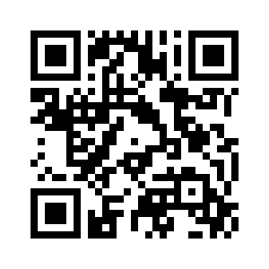
6.1 HOW ARE YOU FEELING?
UNIT 6 WHAT’S WRONG
Notes:
https://hr.izzi.digital/#/repository/204

Slide 2
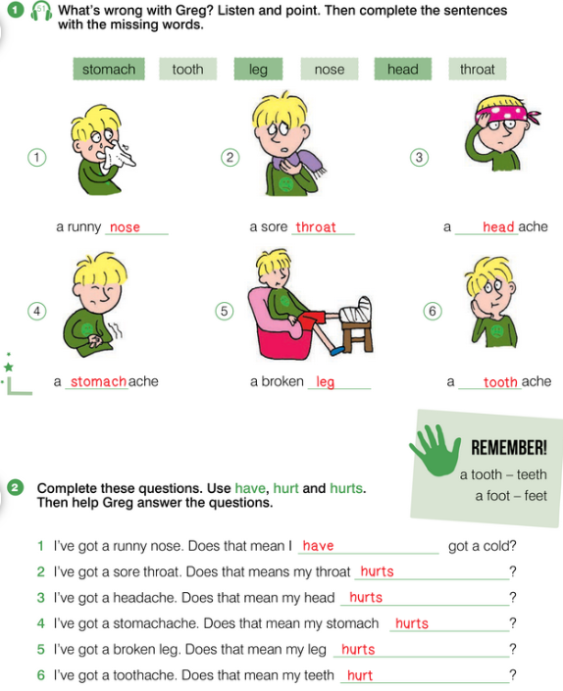
HOW ARE YOU FEELING?
UNIT 6 WHAT’S WRONG
Notes:
https://hr.izzi.digital/#/repository/204

Slide 3
HOW ARE YOU FEELING?
UNIT 6 WHAT’S WRONG
runny nose = šmrkav nos
sore throat = bolno grlo
headache = glavobolja
stomachache = trbobolja
broken leg = slomljena noga
toothache = zubobolja
a cold = prehlada
hurt = boljeti
Notes:
https://hr.izzi.digital/#/repository/204

Slide 4
HOW ARE YOU FEELING?
UNIT 6 WHAT’S WRONG
Notes:
https://hr.izzi.digital/#/repository/204

Slide 5
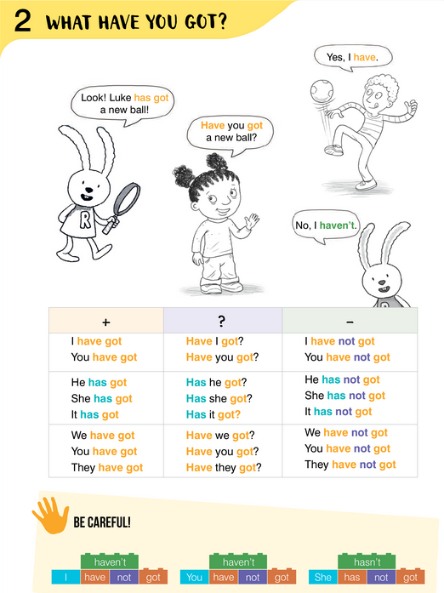
HOW ARE YOU FEELING?
UNIT 6 WHAT’S WRONG
Notes:
https://hr.izzi.digital/#/repository/204

Slide 6
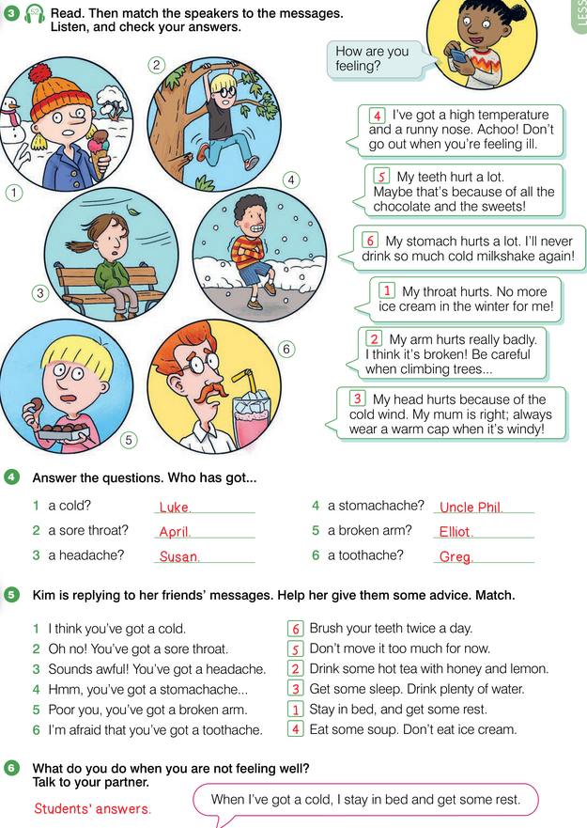
HOW ARE YOU FEELING?
UNIT 6 WHAT’S WRONG
Notes:
https://hr.izzi.digital/#/repository/204

Slide 7
HOW ARE YOU FEELING?
UNIT 6 WHAT’S WRONG
high temperature = visoka temperatura
achoo! = kih!
feel ill = biti/osjećati se bolestan
sweets = slatkiši
milkshake = frape
Notes:
https://hr.izzi.digital/#/repository/204

Slide 8
HOW ARE YOU FEELING?
UNIT 6 WHAT’S WRONG
Notes:
https://hr.izzi.digital/#/repository/204

Slide 9
HOW ARE YOU FEELING?
UNIT 6 WHAT’S WRONG
Notes:
https://hr.izzi.digital/#/repository/204

Slide 10
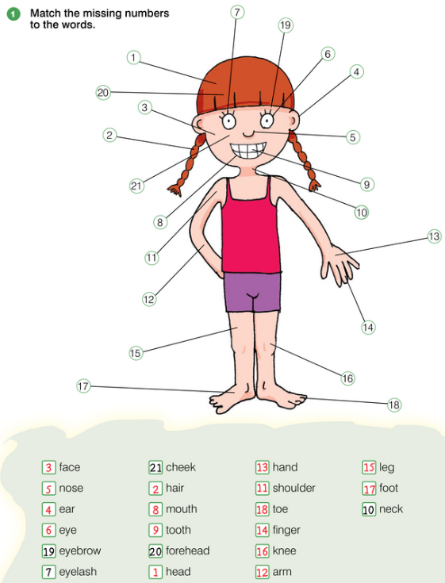
HOW ARE YOU FEELING?
UNIT 6 WHAT’S WRONG
head = glava
hair = kosa
face = lice
ear = uho
nose = nos
eye = oko
eyelash = trepavica
mouth = usta
tooth = zub
neck = vrat
shoulder = rame
arm = ruka
hand = šaka
finger = prst (ručni)
leg = noga
knee = koljeno
foot = stopalo
toe = prst (nožni)
eyebrow = obrva
forehead = čelo
cheek = obraz
Notes:
https://hr.izzi.digital/#/repository/204

Slide 11
HOW ARE YOU FEELING?
UNIT 6 WHAT’S WRONG
Notes:
https://hr.izzi.digital/#/repository/204

Slide 12
HOW ARE YOU FEELING?
UNIT 6 WHAT’S WRONG
Notes:
https://hr.izzi.digital/#/repository/204

Slide 13
HOW ARE YOU FEELING?
UNIT 6 WHAT’S WRONG
Notes:
https://hr.izzi.digital/#/repository/204

Slide 14
HOW ARE YOU FEELING?
UNIT 6 WHAT’S WRONG
lungs = pluća
heart = srce
stomach = želudac
brain = mozak
thermometer = toplomjer
stethoscope = stetoskop
Notes:
https://hr.izzi.digital/#/repository/204

Slide 15
HOW ARE YOU FEELING?
UNIT 6 WHAT’S WRONG
nurse = medicinska sestra
take your temperature = izmjeriti tvoju temperaturu
open your mouth wide = otvori širom usta
take a deep breath = duboko udahni
read the letters = pročitaj slova
completely = potpuno
dentist = zubar
Notes:
https://hr.izzi.digital/#/repository/204

Slide 16
HOW ARE YOU FEELING?
UNIT 6 WHAT’S WRONG
Notes:
https://hr.izzi.digital/#/repository/204

Slide 17
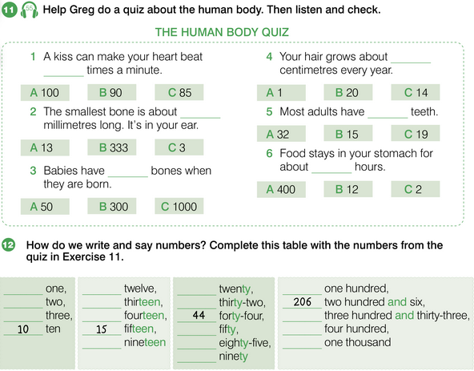
HOW ARE YOU FEELING?
UNIT 6 WHAT’S WRONG
kiss = poljubac
beat = udarati
bone = kost
be born = biti rođen
hair = kosa
grow = rasti
adults = odrasli
Notes:
https://hr.izzi.digital/#/repository/204

Slide 18
HOW ARE YOU FEELING?
UNIT 6 WHAT’S WRONG
Notes:
https://hr.izzi.digital/#/repository/204

Slide 19
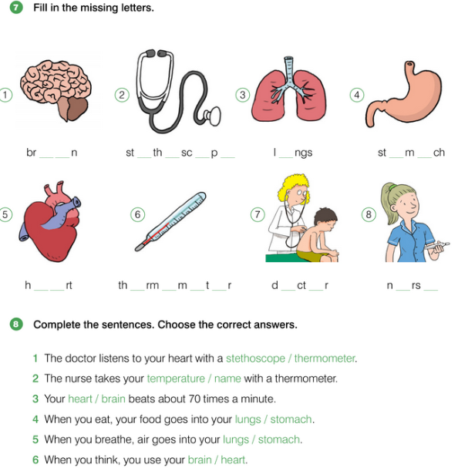
HOW ARE YOU FEELING?
UNIT 6 WHAT’S WRONG
Notes:
https://hr.izzi.digital/#/repository/204

Slide 20
HOW ARE YOU FEELING?
UNIT 6 WHAT’S WRONG
Notes:
https://hr.izzi.digital/#/repository/204

Slide 21
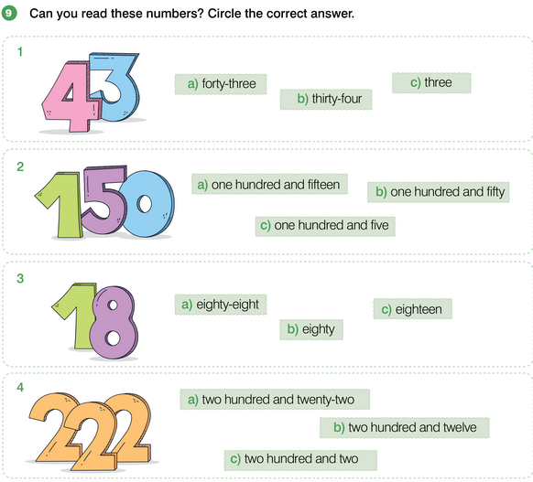
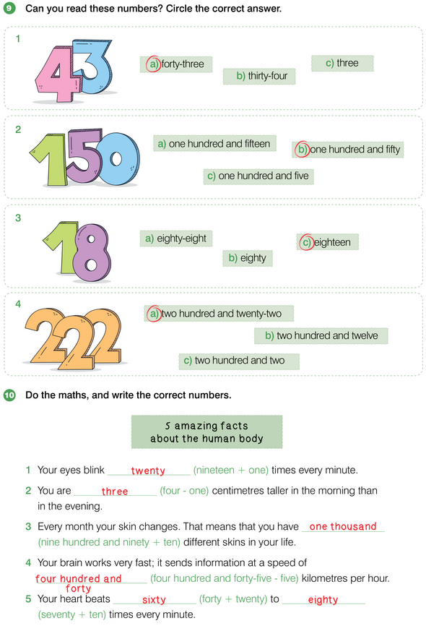
HOW ARE YOU FEELING?
UNIT 6 WHAT’S WRONG
Notes:
https://hr.izzi.digital/#/repository/204

Slide 22
HOW ARE YOU FEELING?
UNIT 6 WHAT’S WRONG
blink = trepnuti
skin = koža
change = mijenjati se
information = podatci
at a speed of = brzinom od
per hour = na sat
Notes:
https://hr.izzi.digital/#/repository/204

