Slide 1
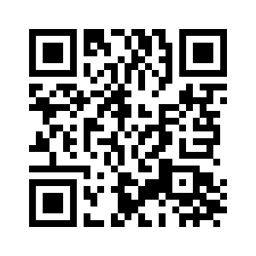
6.2 AT THE DOCTOR’S
UNIT 6 WHAT’S WRONG
Notes:
https://hr.izzi.digital/#/repository/204

Slide 2
AT THE DOCTOR’S
UNIT 6 WHAT’S WRONG
cast = gips
prescription = liječnički recept
syrup = sirup
spray = sprej
pills = tablete
patient = pacijent
Notes:
https://hr.izzi.digital/#/repository/204

Slide 3
AT THE DOCTOR’S
UNIT 6 WHAT’S WRONG
be ill = biti bolestan
take care of = brinuti se o
medicine = lijek
Notes:
https://hr.izzi.digital/#/repository/204

Slide 4
AT THE DOCTOR’S
UNIT 6 WHAT’S WRONG
Notes:
https://hr.izzi.digital/#/repository/204

Slide 5
AT THE DOCTOR’S
UNIT 6 WHAT’S WRONG
What’s wrong? = Što se događa?
terrible = grozan
take a look = vidjeti, pogledati
sweets = slatkiši
repair = popraviti
check-up = pregled
Notes:
https://hr.izzi.digital/#/repository/204

Slide 6
AT THE DOCTOR’S
UNIT 6 WHAT’S WRONG
What’s the matter? = U čemu je problem?
come off = maknuti
take off = skinuti
be scared = biti uplašen
itchy = svrbljiv
leave something to somebody = prepustiti nešto nekome
be better at something = biti bolji u nečemu
Notes:
https://hr.izzi.digital/#/repository/204

Slide 7
AT THE DOCTOR’S
UNIT 6 WHAT’S WRONG
collect = skupiti
check = provjeriti
cold = prehlada
runny nos = nos koji curi
sore throat = upaljeno grlo
Notes:
https://hr.izzi.digital/#/repository/204

Slide 8
AT THE DOCTOR’S
UNIT 6 WHAT’S WRONG
Notes:
https://hr.izzi.digital/#/repository/204

Slide 9
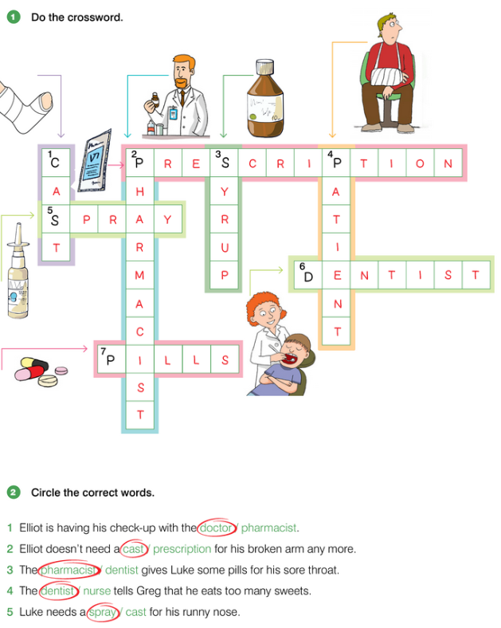
AT THE DOCTOR’S
UNIT 6 WHAT’S WRONG
Notes:
https://hr.izzi.digital/#/repository/204

Slide 10
AT THE DOCTOR’S
UNIT 6 WHAT’S WRONG
Notes:
https://hr.izzi.digital/#/repository/204

Slide 11
AT THE DOCTOR’S
UNIT 6 WHAT’S WRONG
Notes:
https://hr.izzi.digital/#/repository/204

