Slide 1
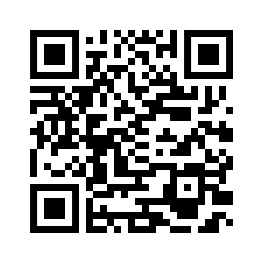

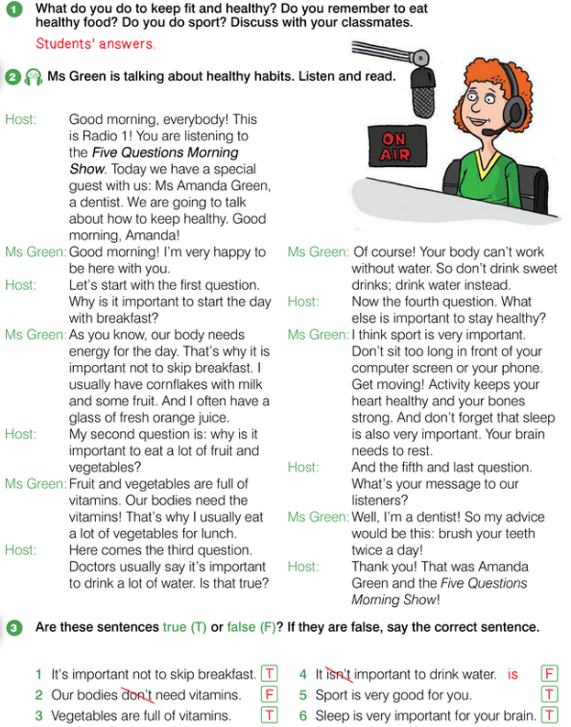
6.3 STAYING HEALTHY
UNIT 6 WHAT’S WRONG
Notes:
https://hr.izzi.digital/#/repository/204

Slide 2

STAYING HEALTHY
UNIT 6 WHAT’S WRONG
special = poseban
keep healthy = biti zdrav
energy = energija, snaga
skip = preskočiti
stay healthy = ostati zdrav
computer screen = zaslon računala
rest = odmoriti se
listeners = slušatelji
Notes:
https://hr.izzi.digital/#/repository/204

Slide 3
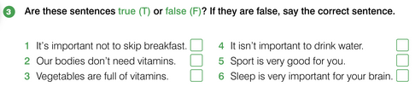
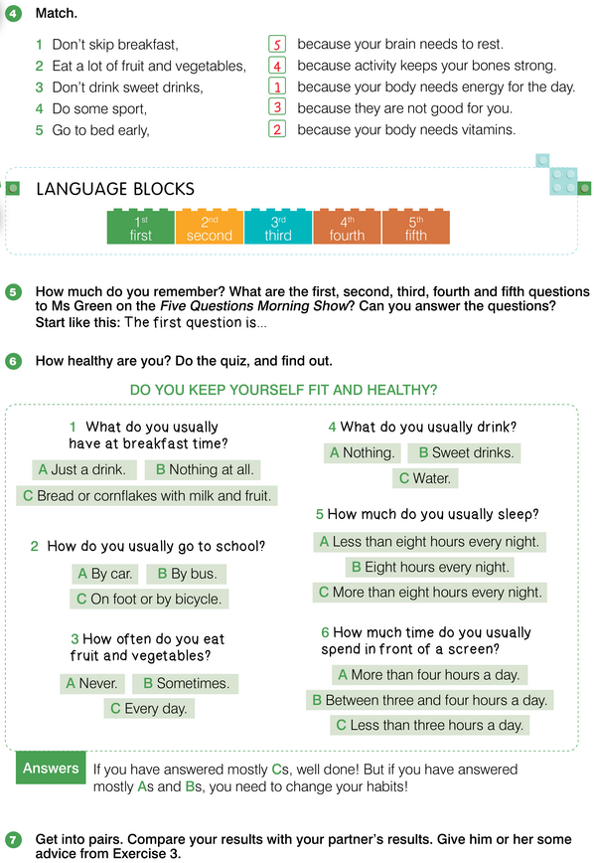
STAYING HEALTHY
UNIT 6 WHAT’S WRONG
Notes:
https://hr.izzi.digital/#/repository/204

Slide 4
STAYING HEALTHY
UNIT 6 WHAT’S WRONG
Notes:
https://hr.izzi.digital/#/repository/204

Slide 5
STAYING HEALTHY
UNIT 6 WHAT’S WRONG
change habits = promijeniti navike
Notes:
https://hr.izzi.digital/#/repository/204

Slide 6
STAYING HEALTHY
UNIT 6 WHAT’S WRONG
Notes:
https://hr.izzi.digital/#/repository/204

Slide 7
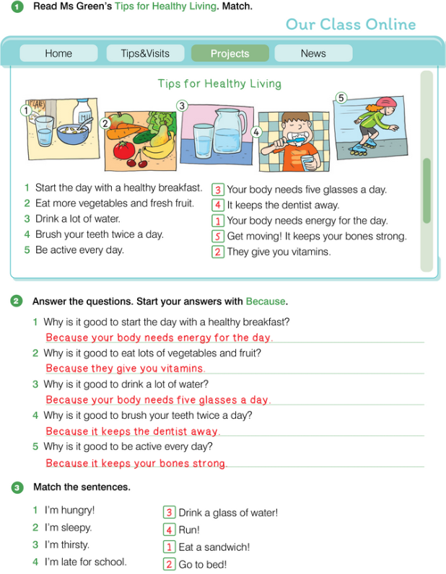
STAYING HEALTHY
UNIT 6 WHAT’S WRONG
Notes:
https://hr.izzi.digital/#/repository/204

Slide 8
STAYING HEALTHY
UNIT 6 WHAT’S WRONG
Notes:
https://hr.izzi.digital/#/repository/204

Slide 9
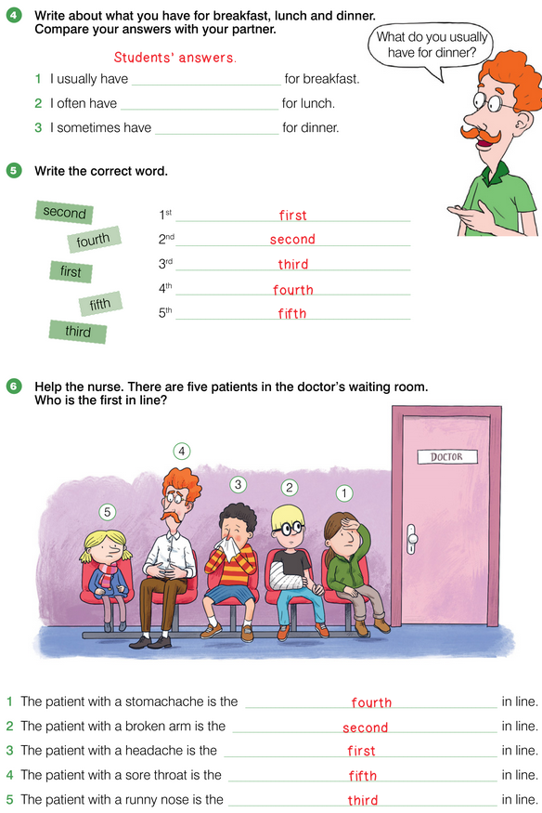
STAYING HEALTHY
UNIT 6 WHAT’S WRONG
Notes:
https://hr.izzi.digital/#/repository/204

Slide 10
STAYING HEALTHY
UNIT 6 WHAT’S WRONG
Notes:
https://hr.izzi.digital/#/repository/204

