Slide 1

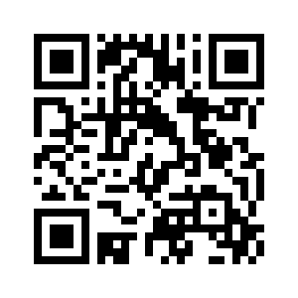
6.4 MISS POLLY
UNIT 6 WHAT’S WRONG
Notes:
https://hr.izzi.digital/#/repository/204

Slide 2

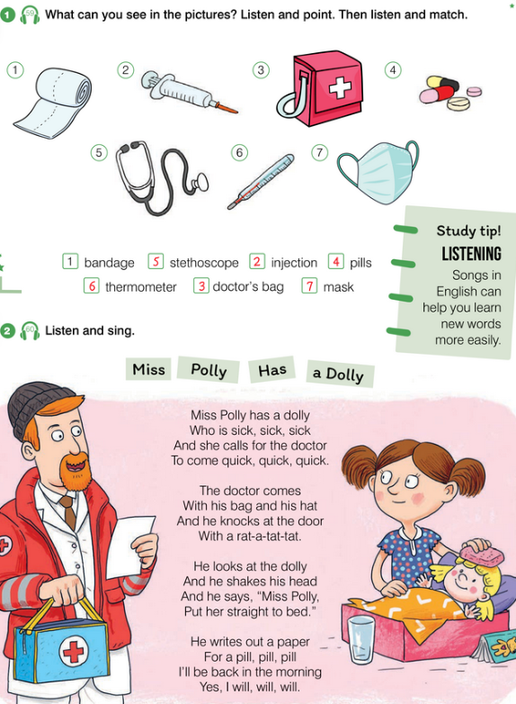
MISS POLLY
UNIT 6 WHAT’S WRONG
bandage = zavoj
injection = injekcija
doctor’s bag = liječnička torba
pills = tablete
stethoscope = stetoskop
thermometer = toplomjer
mask = maska
Notes:
https://hr.izzi.digital/#/repository/204

Slide 3
MISS POLLY
UNIT 6 WHAT’S WRONG
Notes:
https://hr.izzi.digital/#/repository/204

Slide 4
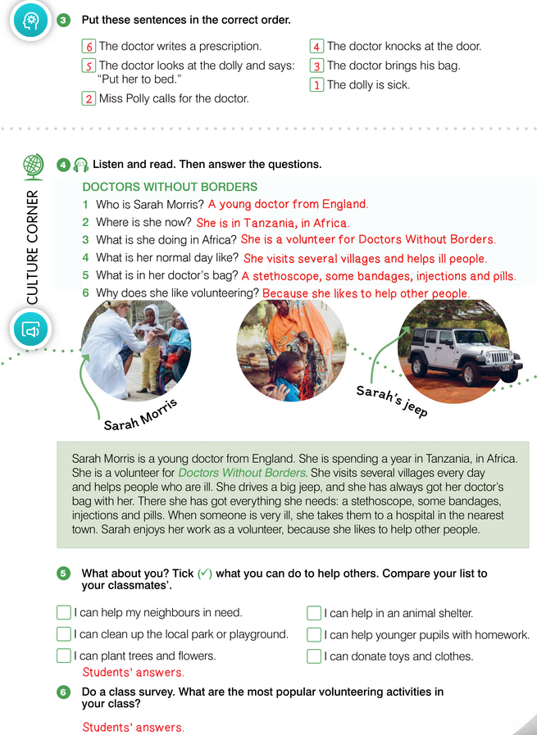
MISS POLLY
UNIT 6 WHAT’S WRONG
Notes:
https://hr.izzi.digital/#/repository/204

Slide 5
MISS POLLY
UNIT 6 WHAT’S WRONG
Notes:
https://hr.izzi.digital/#/repository/204

Slide 6
MISS POLLY
UNIT 6 WHAT’S WRONG
spend = trošiti; provesti
volunteer = dobrovoljac
borders = granice
several = nekoliko
village = selo
jeep = terensko vozilo
nearest = najbliži
enjoy = uživati u
Notes:
https://hr.izzi.digital/#/repository/204

Slide 7
MISS POLLY
UNIT 6 WHAT’S WRONG
in need = kojima je potrebna pomoć
clean up = počistiti
playground = igralište
plant = posaditi
animal shelter = sklonište za nezbrinute životinje
donate = donirati
Notes:
https://hr.izzi.digital/#/repository/204

Slide 8
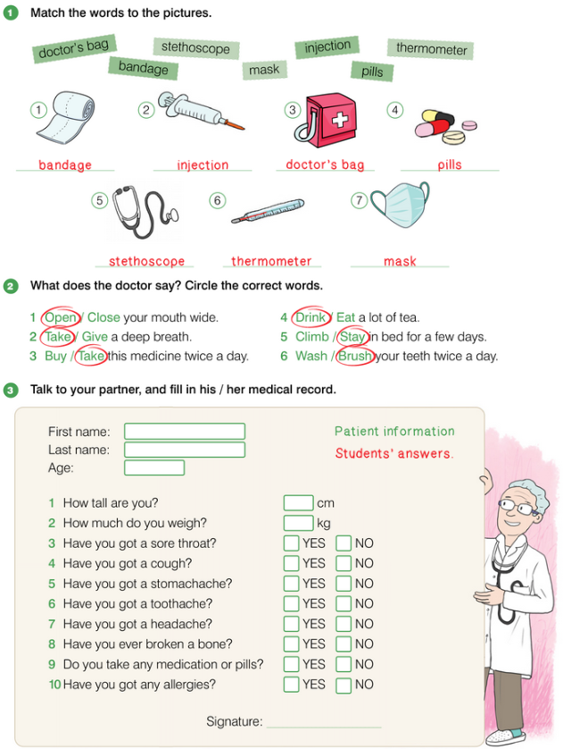
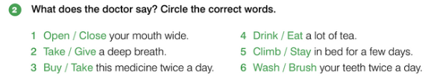
MISS POLLY
UNIT 6 WHAT’S WRONG
Notes:
https://hr.izzi.digital/#/repository/204

Slide 9
MISS POLLY
UNIT 6 WHAT’S WRONG
Notes:
https://hr.izzi.digital/#/repository/204

Slide 10
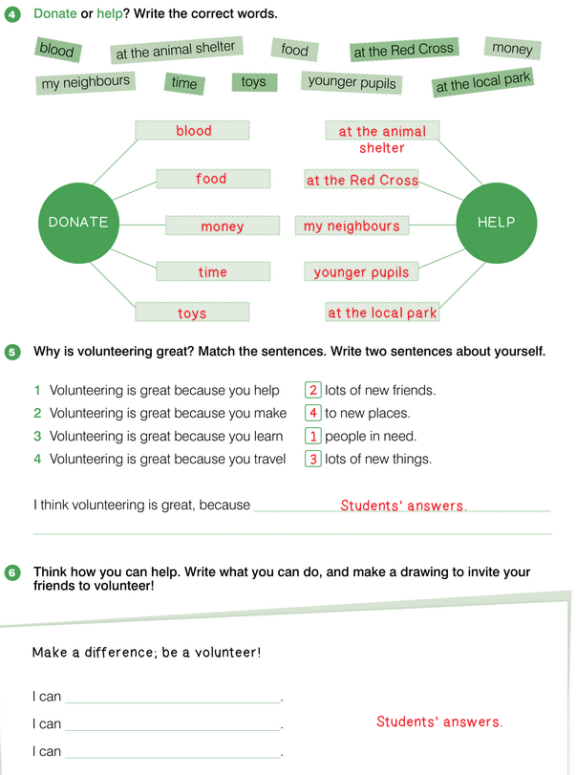
MISS POLLY
UNIT 6 WHAT’S WRONG
Notes:
https://hr.izzi.digital/#/repository/204

Slide 11
MISS POLLY
UNIT 6 WHAT’S WRONG
Notes:
https://hr.izzi.digital/#/repository/204

