Slide 1
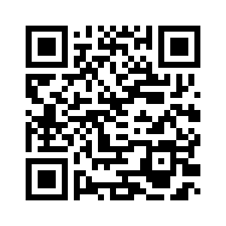
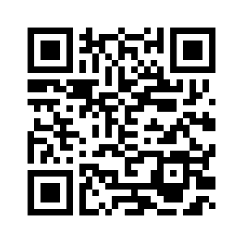

6.5 LET’S CHECK!
REVISION
UNIT 6 WHAT’S WRONG
Notes:
https://hr.izzi.digital/#/repository/204

Slide 2
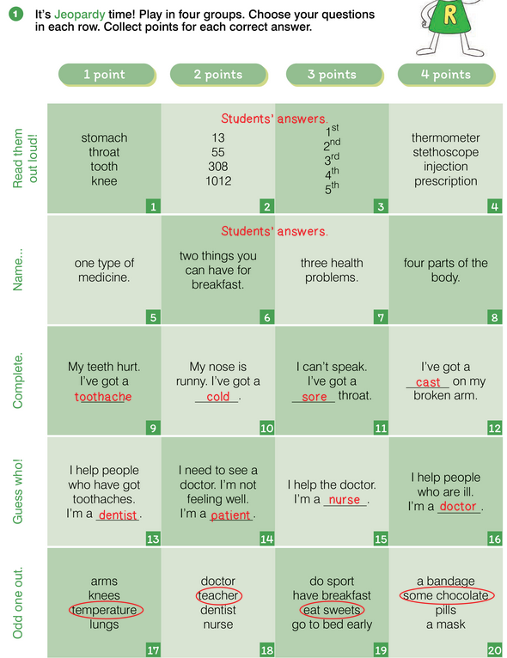
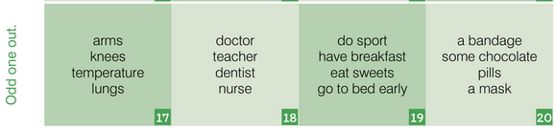
LET’S CHECK!
UNIT 6 WHAT’S WRONG
Notes:
https://hr.izzi.digital/#/repository/204

Slide 3
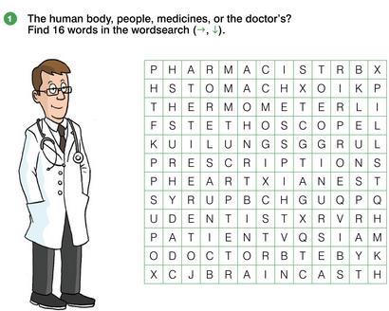
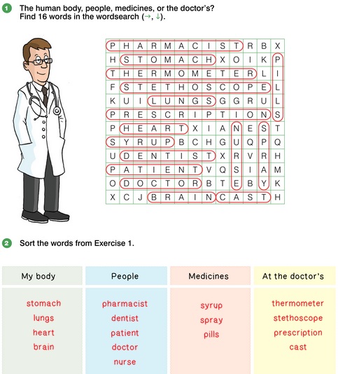
LET’S CHECK!
UNIT 6 WHAT’S WRONG
Notes:
https://hr.izzi.digital/#/repository/204

Slide 4
LET’S CHECK!
UNIT 6 WHAT’S WRONG
Notes:
https://hr.izzi.digital/#/repository/204

Slide 5
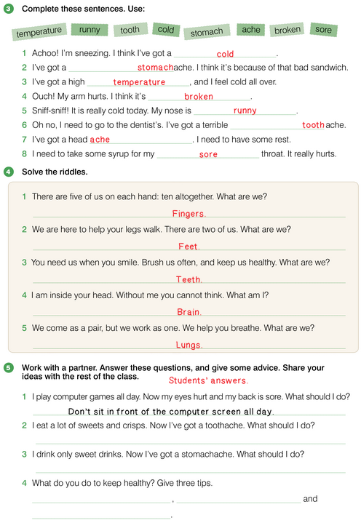
LET’S CHECK!
UNIT 6 WHAT’S WRONG
Notes:
https://hr.izzi.digital/#/repository/204

Slide 6
LET’S CHECK!
UNIT 6 WHAT’S WRONG
Notes:
https://hr.izzi.digital/#/repository/204

Slide 7
LET’S CHECK!
UNIT 6 WHAT’S WRONG
Notes:
https://hr.izzi.digital/#/repository/204

Slide 8

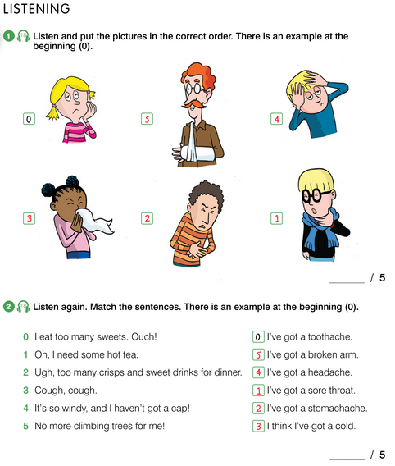
REVISION
UNIT 6 WHAT’S WRONG
Notes:
https://hr.izzi.digital/#/repository/204

Slide 9
REVISION
UNIT 6 WHAT’S WRONG
Notes:
https://hr.izzi.digital/#/repository/204

Slide 10
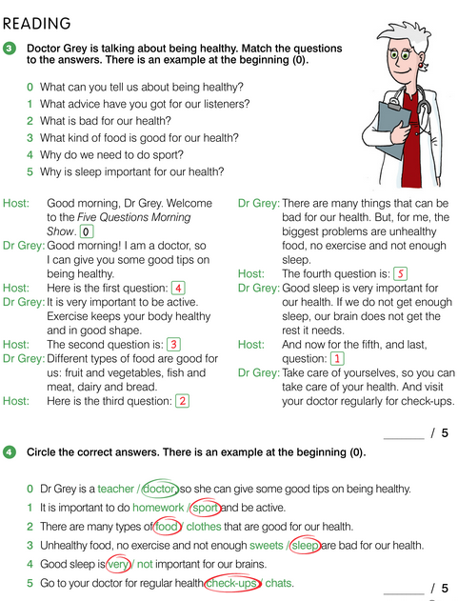
REVISION
UNIT 6 WHAT’S WRONG
Notes:
https://hr.izzi.digital/#/repository/204

Slide 11
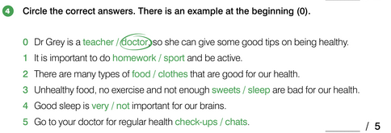
REVISION
UNIT 6 WHAT’S WRONG
Notes:
https://hr.izzi.digital/#/repository/204

