Slide 1
6.6 NOW I CAN!
UNIT 6 WHAT’S WRONG
Notes:
https://hr.izzi.digital/#/repository/204

Slide 2
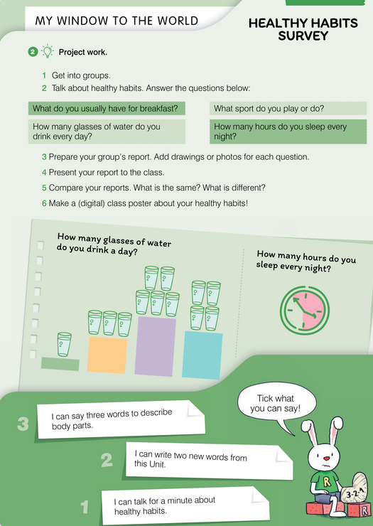
NOW I CAN!
UNIT 6 WHAT’S WRONG
Notes:
https://hr.izzi.digital/#/repository/204

Slide 3
NOW I CAN!
UNIT 6 WHAT’S WRONG
Notes:
https://hr.izzi.digital/#/repository/204

