Slide 1
RONNIE’S CHRISTMAS PUDDING
APPENDIX
Notes:
https://hr.izzi.digital/#/repository/204

Slide 2
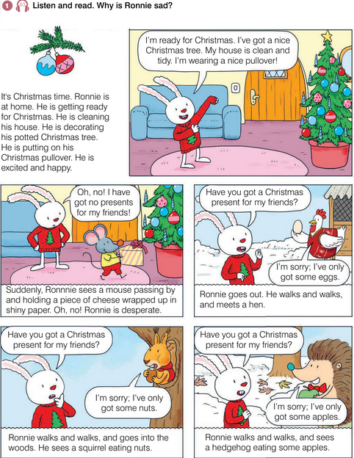
RONNIE’S CHRISTMAS PUDDING
APPENDIX
get ready = spremiti se
decorate = ukrasiti
potted = posađen
excited = uzbuđen
tidy = uredn
suddenly = odjednom
mouse = miš
pass by = prolaziti
wrapped = umotan
shiny = sjajan
desperate = očajan
meet = susresti
nuts = orašasti plodovi
squirrel = vjeverica
hedgehog = jež
Notes:
https://hr.izzi.digital/#/repository/204

Slide 3
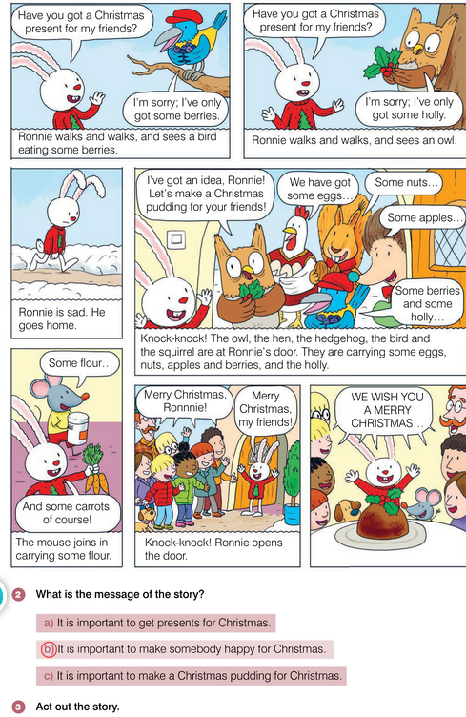
RONNIE’S CHRISTMAS PUDDING
APPENDIX
berries = bobice
holly = božikovina
owl = sova
Christmas pudding = božićni kolač
knock-knock = kuc-kuc
join in = pridružiti se
flour = brašno
Notes:
https://hr.izzi.digital/#/repository/204

Slide 4
RONNIE’S CHRISTMAS PUDDING
APPENDIX
Notes:
https://hr.izzi.digital/#/repository/204

Slide 5
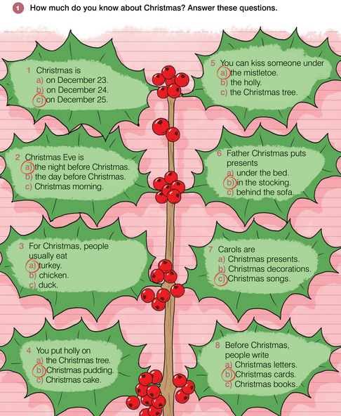
RONNIE’S CHRISTMAS PUDDING
APPENDIX
Christmas Eve = Badnjak
before = prije
turkey = purica
duck = patka
holly = božikovina
kiss = poljubiti
under = ispod
mistletoe = imela
stocking = čarapa
behind = iza
carols = božićne pjesme, kolede
decorations = ukrasi
Notes:
https://hr.izzi.digital/#/repository/204

Slide 6
RONNIE’S CHRISTMAS PUDDING
APPENDIX
Notes:
https://hr.izzi.digital/#/repository/204

Slide 7
RONNIE’S CHRISTMAS PUDDING
APPENDIX
Notes:
https://hr.izzi.digital/#/repository/204

