Slide 1
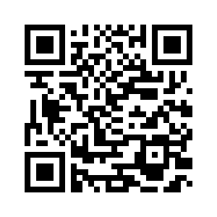
LET’S START!
WELCOME BACK!

Slide 2
LET’S START!
WELCOME BACK!
1
Listen and read. Answer the questions.
Who can you see in the picture?
Where are the children?
What are they wearing?

Slide 3
LET’S START!
WELCOME BACK!
2
Susan is interviewing April. Listen and match her questions to April’s answers.
1 Where do you live?
It’s green.
5
2 Have you got a brother?
Yes, I've got a black spider.
3
3 Have you got a pet?
I'm afraid of ghosts.
6
4 What's your hobby?
I live in a house on Elm Street.
1
5 What's your favourite colour?
I like singing.
4
6 What are you afraid of?
Yes, I have. His name i Elliot.
2

Slide 4
LET’S START!
WELCOME BACK!
2
Susan is interviewing April. Can you remember her question?
2 Have you got a brother?
It’s green.
2 Have you got a brother?
Yes, I've got a black spider.
2 Have you got a brother?
I'm afraid of ghosts.
2 Have you got a brother?
I live in a house on Elm Street.
2 Have you got a brother?
I like singing.
2 Have you got a brother?
Yes, I have. His name i Elliot.

Slide 5
LET’S START!
WELCOME BACK!
3
Work in pairs. Interview your partner. Report back to the class.
1 Have you got a sister?
2 Have you got a pet?
3 Where do you live?
4 Have you got a sweetheart ?
5 Who is your best friend?
6 What are you afraid of?

Slide 6
LET’S START!
WELCOME BACK!
3
Report back to the class. Start like this:
His/her name is _________ .
He/she has got _________ .
He/she lives _________ .
He/she hasn’t got _________ .
His/her best friend is _________ .
He/she is afraid of _________ .

Slide 7
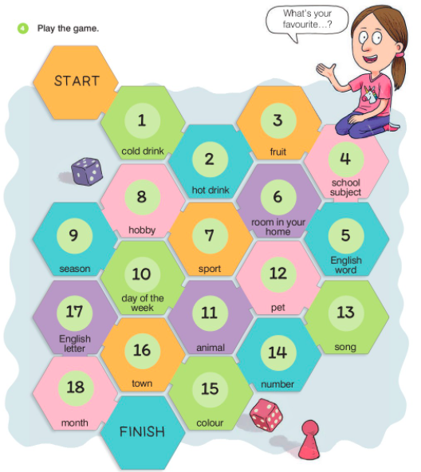
LET’S START!
WELCOME BACK!
4
How do you say it in English?
hladno piće
toplo piće
voće
školski predmet
engleska riječ
soba
cold drink
hot drink
fruit
school subject
English word
room
sport
hobi
godišnje doba
dan u tjednu
životinja
kućni ljubimac
sport
hobby
season
day of the week
animal
pet
pjesma
broj
boja
song
number
colour

Slide 8
LET’S START!
WELCOME BACK!
4
Work with a partner. Write at least two words for each category.
cold drink

Slide 9
LET’S START!
WELCOME BACK!
4
Play the game.
My favourite cold drink is _________ .
My favourite season is _________ .
My favourite colour is _________ .

Slide 10
LET’S START!
WELCOME BACK!

Slide 11
LET’S START!
WELCOME BACK!

Slide 12
LET’S START!
WELCOME BACK!

Slide 13
LET’S START!
WELCOME BACK!

Slide 14
LET’S START!
WELCOME BACK!

