Slide 1
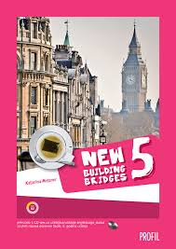
Citizenship Education:
New Building Bridges 5, UNIT 2, Lesson 2.2
Culture Corner: Schoolchildren Around the World
Children’s Rights

Slide 2
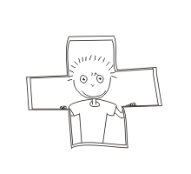
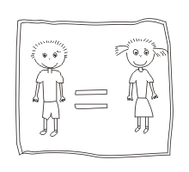
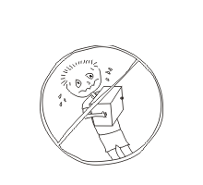
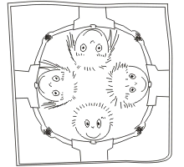
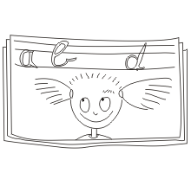
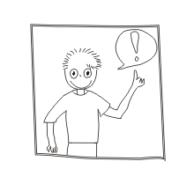
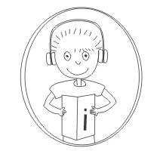
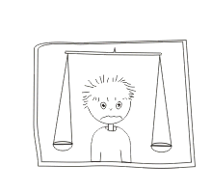
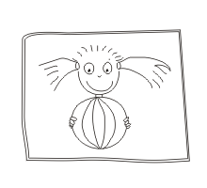
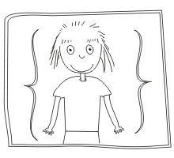
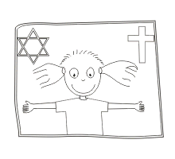
Artwork by:

Slide 3
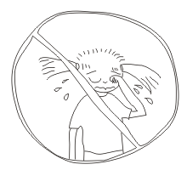
Children have…
The right on healthcare
The right on education
The right to play
The right to express themselves
The right for protection against violence and abuse
The right on information…
From: The Convention on the Rights of the Child. United Nations, 1989

Slide 4
More info…
Cartoons explaining every right:
https://www.youtube.com/watch?v=nyJ5qwOoWbA&list=PLB5401BDACBDEF6D0
Information in Croatian
http://www.zajedno-do-zdravlja.hr/prava_djece.php

Slide 5
That‘s all, folks!
Prepared by: Igor Nikičić

Slide 6
*Some other children rights…
Children have the right to protection from work that threatens their health, education or development
Children have the right to appropriate information
Children have the right to express themselves
Children have the right to protection in times of war
Children have the right to know and live their own culture
Children have the right to protection from neglect
From the: Convention on the Rights of the Child. United Nations, 1989

