Slide 1
PICTURES FROM THE PAST
New Building Bridges 7, UNIT 3, Lesson 3
Pictures from the past
Right to education

Slide 2
Some people like school and some don't
Write three things you like and dislike about school
I LIKE:
1
2
3
I DISLIKE:
1
2
3

Slide 3
Many poor Victorian children never went to school!

Slide 4
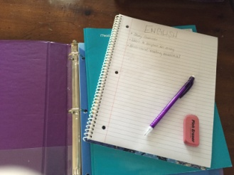
Did you know?
Today, education remains an inaccessible right for millions of children around the world. More than 72 million of children of primary education age are not in school and 759 million adults are illiterate and do not have the awareness necessary to improve both their living conditions and those of their children.
Source: http://www.humanium.org/en/world/right-to-education/

Slide 5
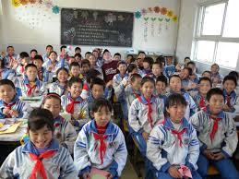
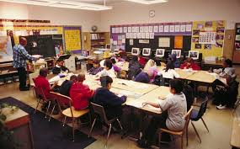
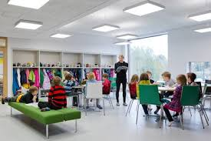
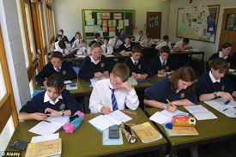
Differences around the world
CHINA
USA
NIGERIA
FINLAND
UNITED KINGDOM

Slide 6
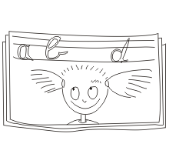
Right to education
One of basic human rights*
It includes the right to free, and compulsory primary education for all
The idea is to rule out discrimination at all levels of the educational system
*Article 26 of the Universal Declaration of Human Rights, 10 December 1948

Slide 7
That‘s all, folks!
Prepared by: Igor Nikičić

