Slide 1
Parents in trouble.com
New Building Bridges 8, UNIT 2, Lesson 4
Parents in trouble.com
Must, mustn't, should, shouldn't, have to don't have to, cant

Slide 2
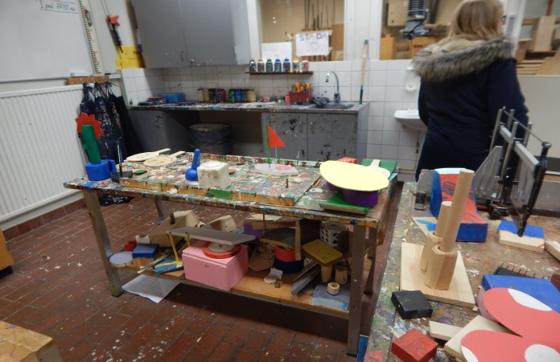
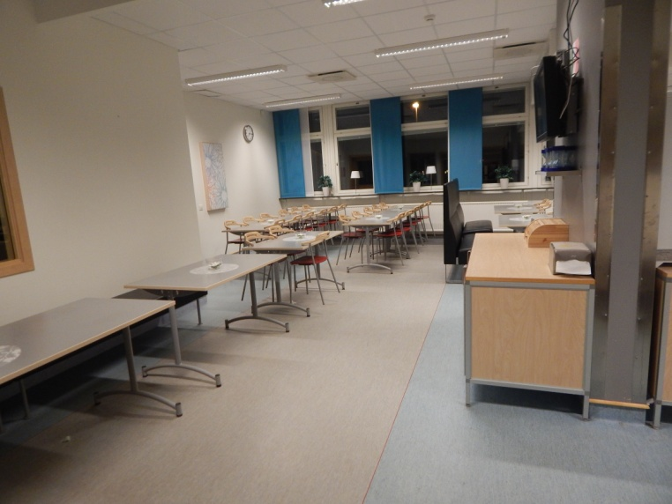
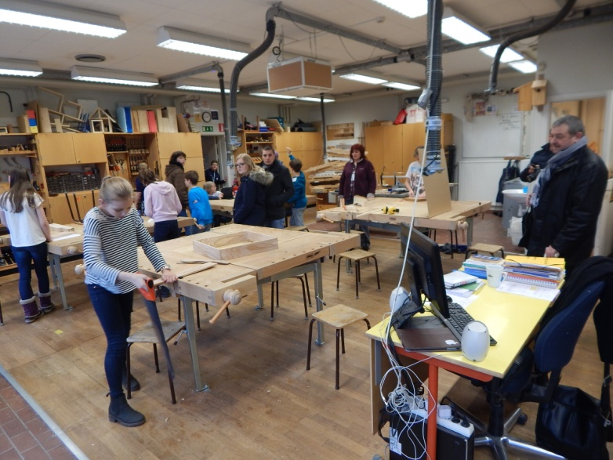
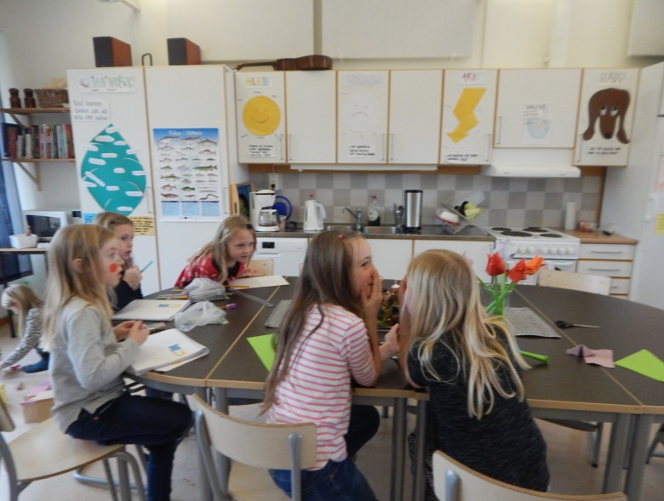
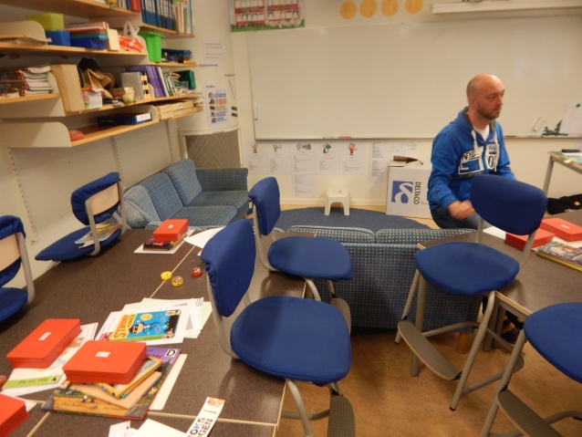
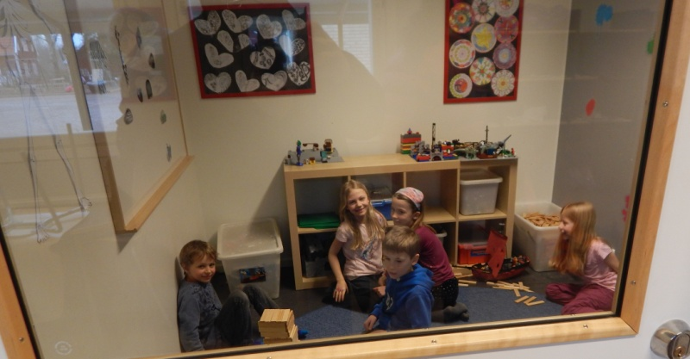
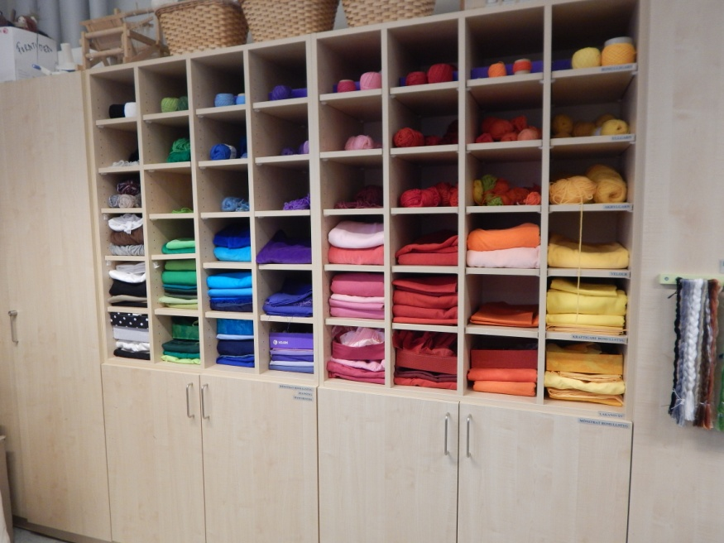
A school in Sweden

Slide 3
Giving advice, mild obligation
SHOULD/SHOULDN'T
We use it for mild obligation and advice
*You should study more.
*Mary shouldn't talk about her problems with Jessa.

Slide 4
Prohibition and strong obligation
MUSTN'T/CAN'T
We use for prohibition
* You mustn't use a mobile phone during classes.
*You can't wear boots at school.
MUST/HAVE TO
We use it for strong obligation
* You must have a change of footwear at school.
* We all have to listen during classes.

Slide 5
No obligation
DONT/DOESNT HAVE TO
We use it for there is no obligation
* I dont have to carry all of my books to school
* The class doesnt have to have all A's !

Slide 6
That‘s all, folks!
Prepared by: Igor Nikičić

