Slide 1
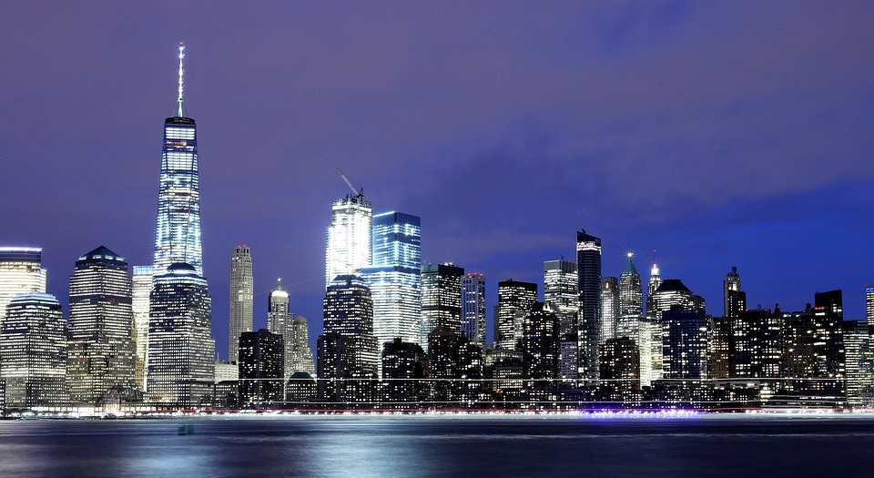
New York City
The Big Apple

Slide 2
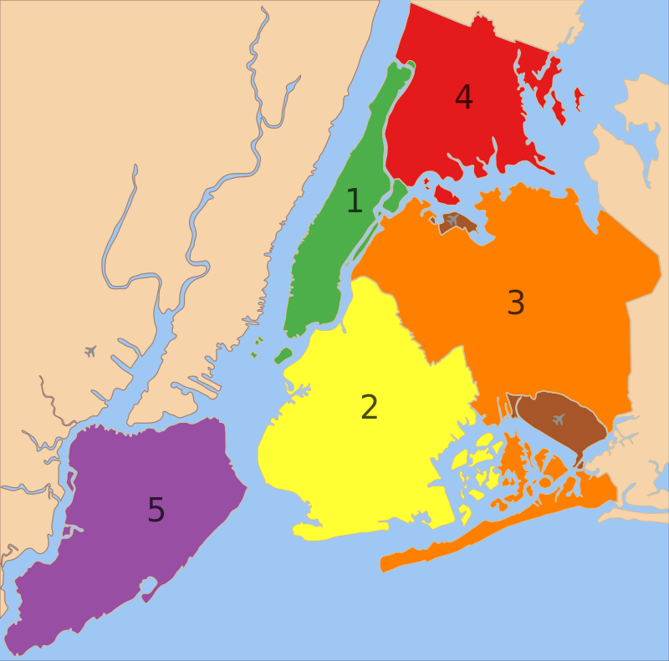
BOROUGHS
New York, often called the Big Apple, has five boroughs: Manhattan, Brooklyn, Queens, The Bronx, and Staten Island.
The five boroughs of New York City: 1. Manhattan
2. Brooklyn
3. Queens
4. The Bronx
5. Staten Island

Slide 3
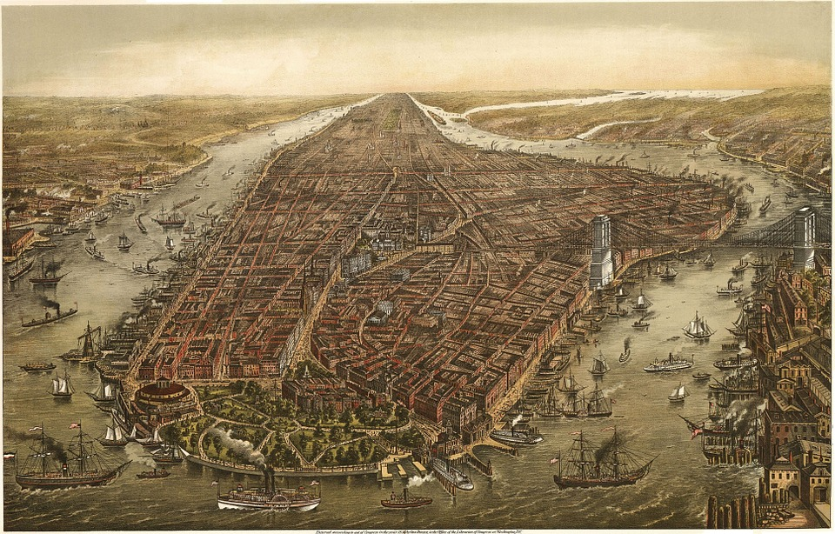
MANHATTAN
Manhattan is an island 21.5 km long and 3.7 km wide. Four hundred years ago Manhattan was the home of the Algonquin Indians. In 1626 they sold Manhattan to a Dutchman Peter Minuit for 60 guilders (about $1,000 in 2006). Minuit built some houses and called the little town New Amsterdam. In 1664 the British took the town from the Dutch and changed its name to New York.

Slide 4
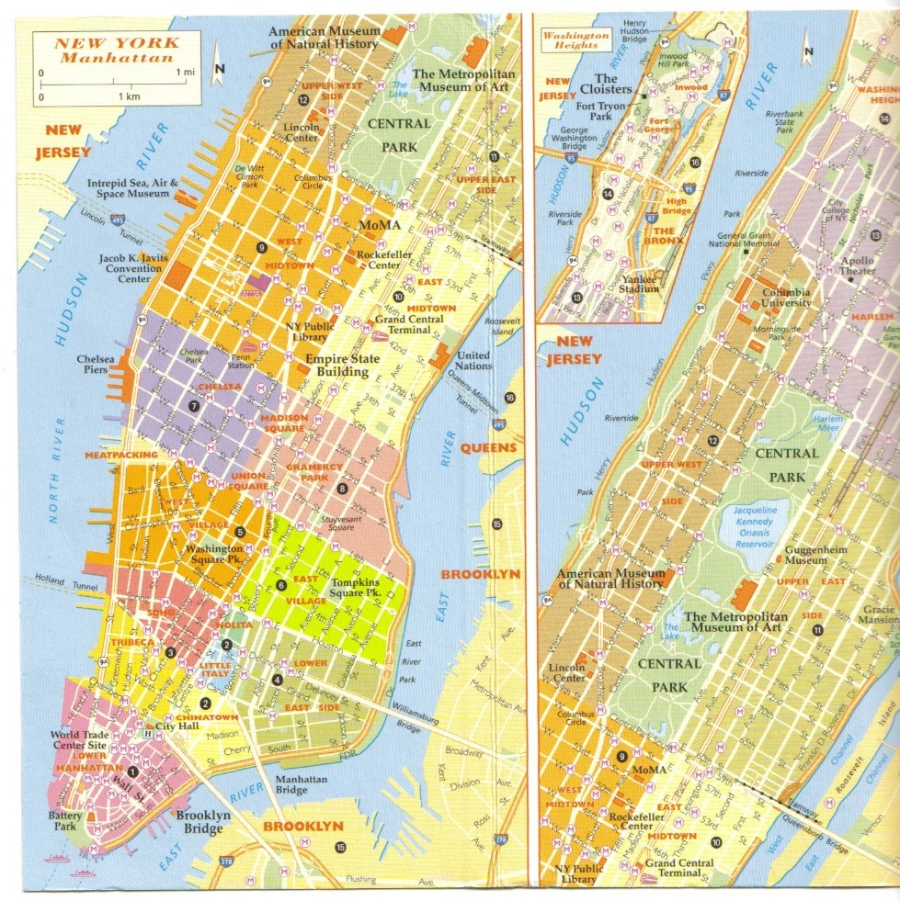
GETTING AROUND
It is not difficult to find your way around. Most of the streets and avenues go in straight lines. Streets go east-west and avenues north-south.

Slide 5
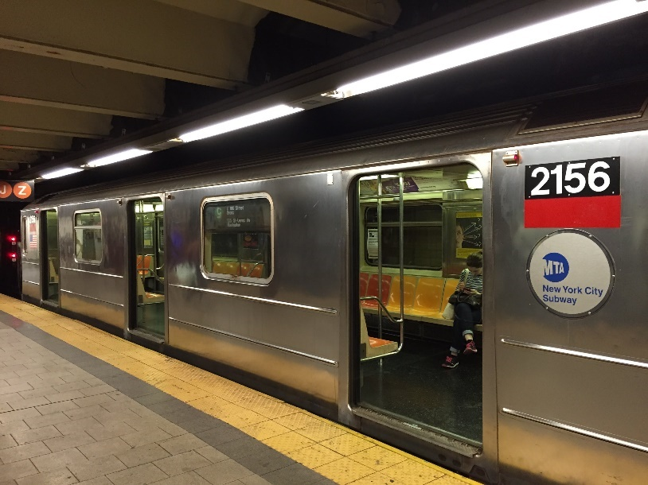
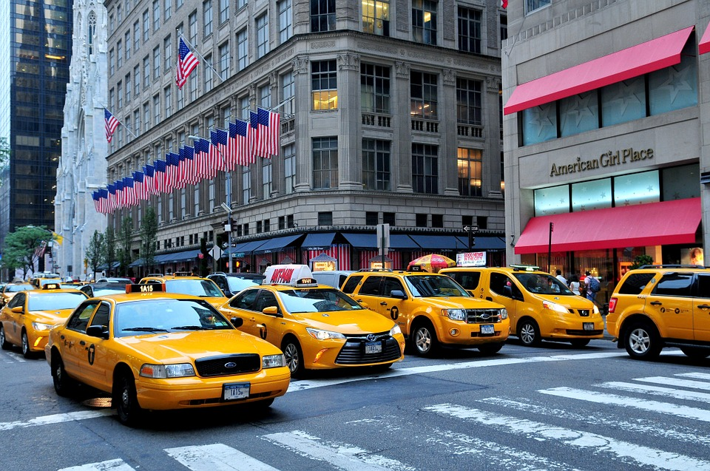
GETTING AROUND
The fastest way to get from one place to another is by taking the subway. You can also take a bus or a taxi. All the taxis are yellow and there are 11,000 of them.

Slide 6
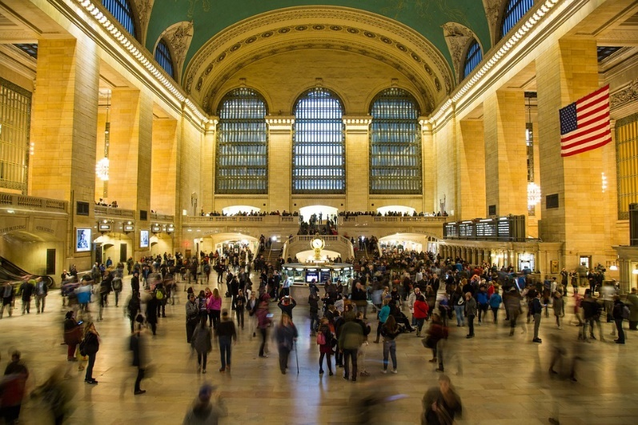
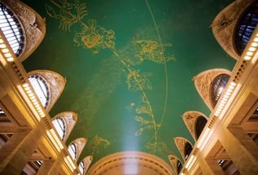
GRAND CENTRAL TERMINAL
Grand Central Terminal (Station), one of New York’s two grand train stations and the only one still standing today. It was built in 1871 and rebuilt in 1913 by the Vanderbilts. In 1967 Americans wanted to tear down this station but Jackie Kennedy protected the building. The foyer of this building is dedicated to her. Grand Central Station has 44 platforms, more than any other railroad station in the world.

Slide 7
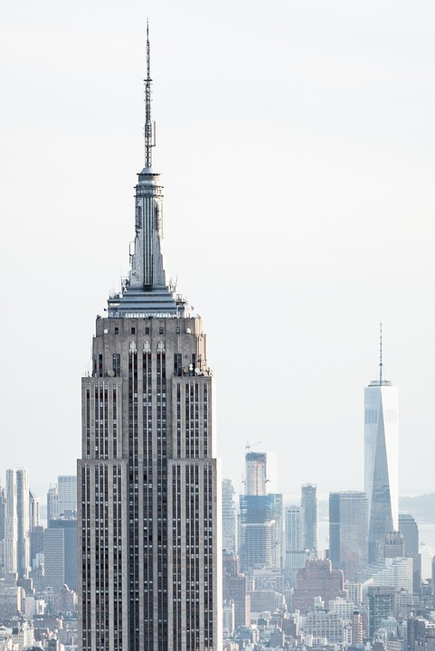
FAMOUS BUILDINGS THE EMPIRE STATE BUILING
The third tallest building in NYC is the 102-story Empire State Building in Midtown Manhattan, which was finished in 1931 and rises to 381 m, increased to 443 m by its antenna.

Slide 8
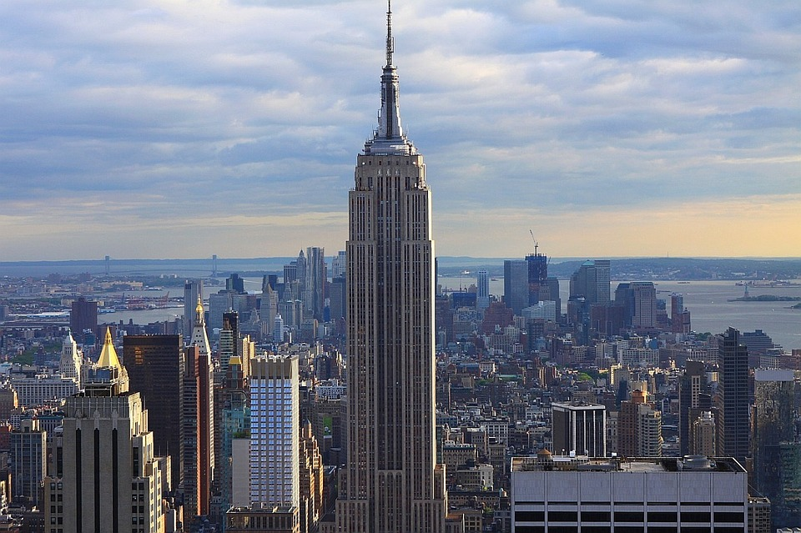
FAMOUS BUILDINGS THE EMPIRE STATE BUILING
The Empire State Building stood as the tallest building in the world from its completion until 1972, when the 110-story North Tower of the original World Trade Center (417 m tall) was completed.

Slide 9
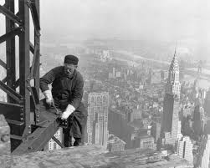
FAMOUS BUILDINGS THE EMPIRE STATE BUILING
The nickname of the Empire State building was the ‘Empty State’ building because it was built in the midst of the Great Depression and a lot of people were unemployed.

Slide 10
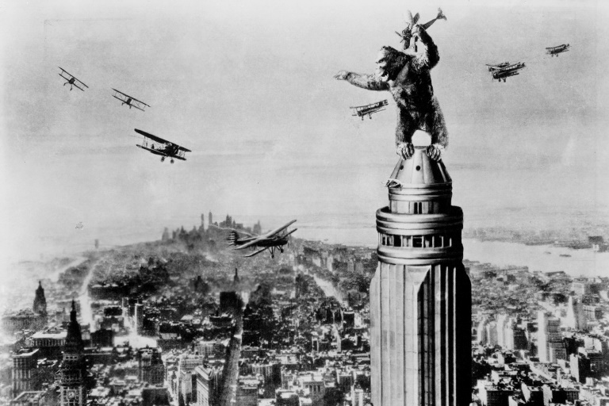
FAMOUS BUILDINGS THE EMPIRE STATE BUILDING
Perhaps the most famous popular representation of the building is in King Kong (1933), in which the title character, a giant ape, climbs to the top to escape his captors but falls to his death after being attacked by airplanes.

Slide 11
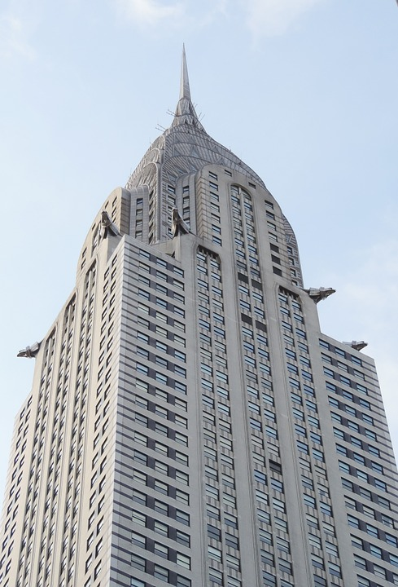
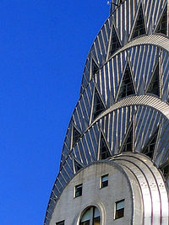
FAMOUS BUILDINGS CHRYSLER BUILDING
The 319 m Chrysler Building is the fifth tallest and it was the world’s tallest building from 1930 until 1931.
The Chrysler Building was built at exactly the same time as the Bank of Manhattan Trust Building on Wall Street and both of their goals was to be the tallest building in the world.

Slide 12
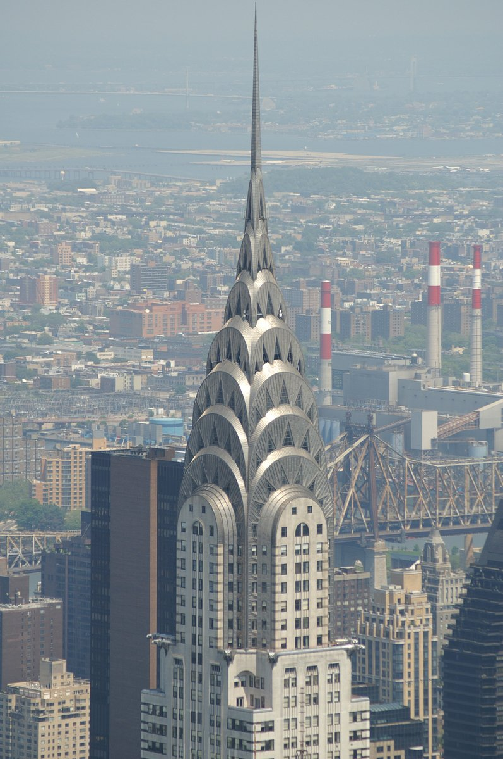
FAMOUS BUILDING THE CHRYSLER BUILDING
Just two weeks after the opening of the Bank of Manhattan Trust, a spire was installed on the Chrysler Building, making it the tallest building in the world. The architect decided to push the spire through the elevator shaft and place it atop the Chrysler Building. The spire hadn’t been published as part of the actual designs of the building and it was built in secrecy.

Slide 13
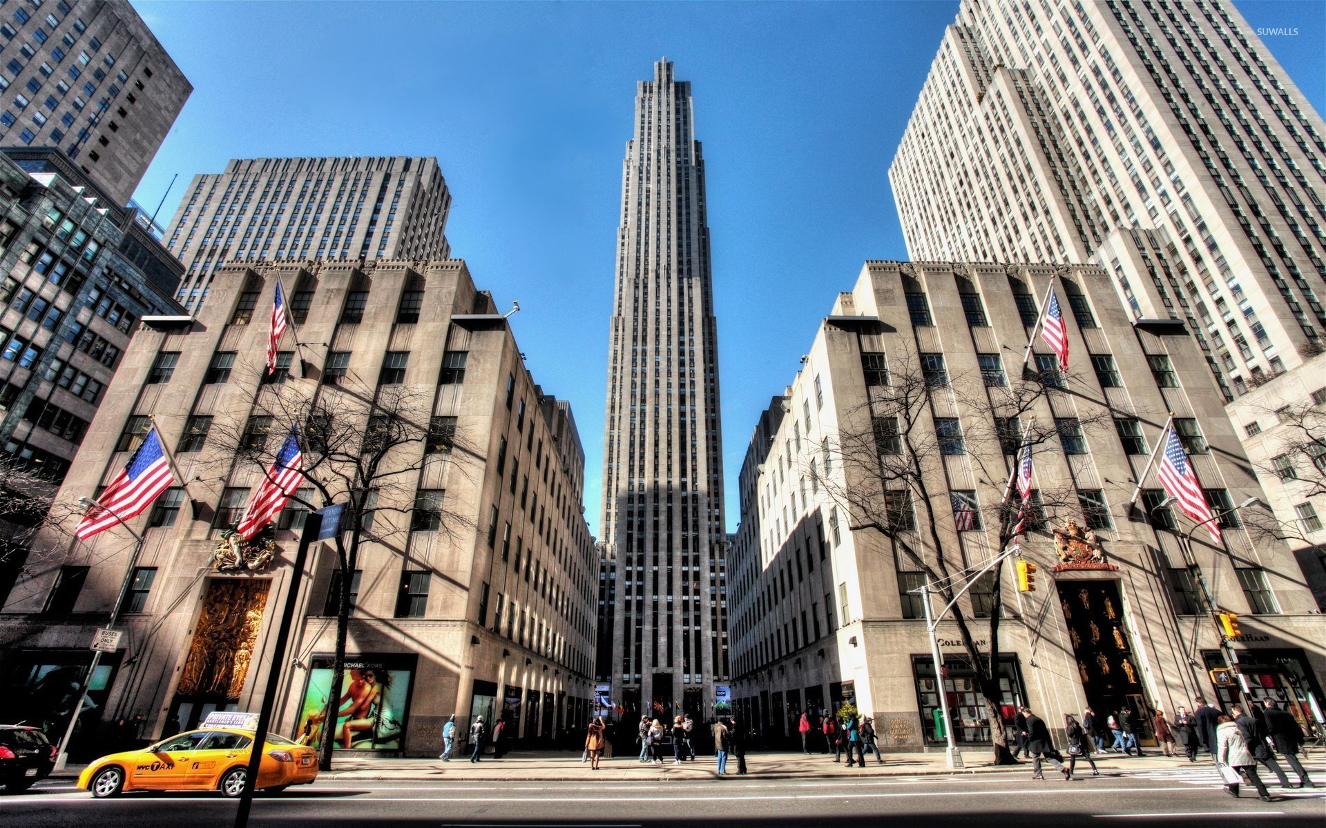
LANDMARKS ROCKEFELLER CENTER
Rockefeller Center is a large complex consisting of 19 high-rise commercial buildings in New York City. It is located in the centre of Midtown Manhattan, spanning the area between Fifth Avenue and Sixth Avenue. It is famous for its annual Christmas tree lighting.

Slide 14
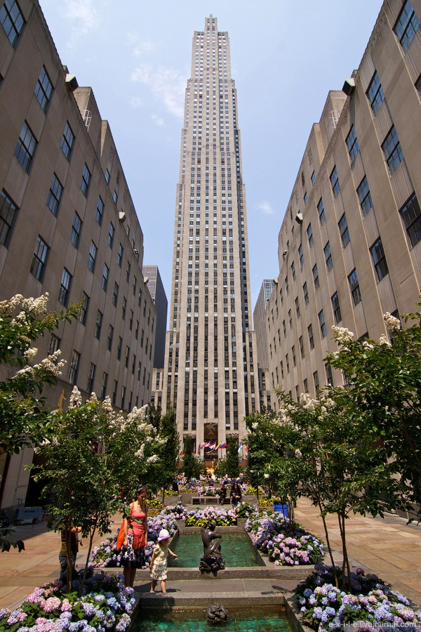
LANDMARKS ROCKEFELLER CENTER
Rockefeller Center was named after John D. Rockefeller, Jr., who leased the space from Columbia University in 1928 and developed it beginning in 1930.

Slide 15
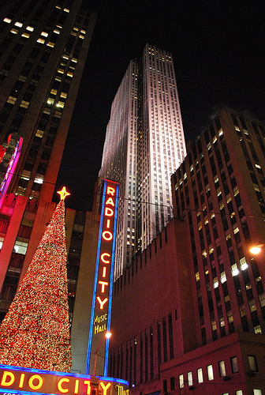
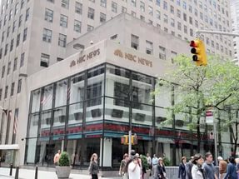
LANDMARKS ROCKEFELLER CENTER
All the biggest radio corporations: ABC, CBS, NBC, RKO, made their home here in Rockefeller Center. The nickname of Rockefeller Center is ‘Radio City’.

Slide 16
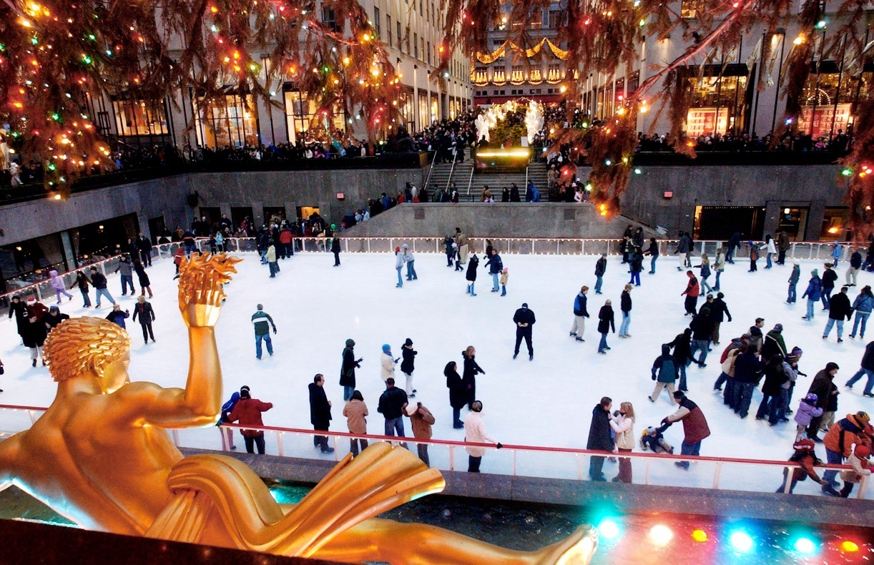
LANDMARKS ROCKEFELLER CENTER
During winter there is an ice skating rink on the Lower Plaza of Rockefeller Center. The Lower Plaza is also known for the statue of the Titan Prometheus, who according to Greek legend brought fire to mankind.

Slide 17
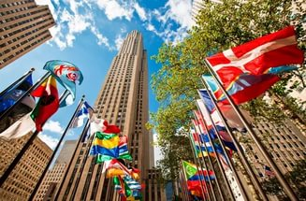
LANDMARKS ROCKEFELLER CENTER
Some 200 flagpoles line the plaza at street level. Flagpoles around the plaza display flags of the United Nations member countries, the U.S. states and territories, or decorative and seasonal motifs. During national and state holidays, every pole carries the flag of the United States.

Slide 18
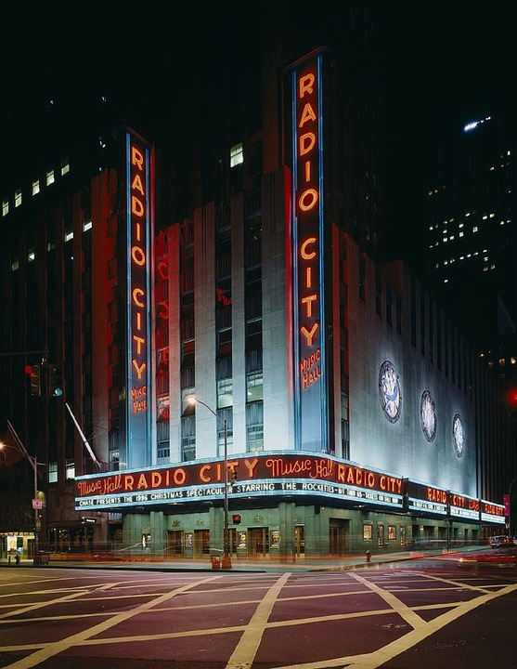
LANDMARKS RADIO CITY MUSIC HALL
Radio City is an art deco theatre and it opened in 1932 as part of the Rockefeller Center. It was going to be called the International Music Hall. It was built in order to revive Vaudeville in the USA.

Slide 19
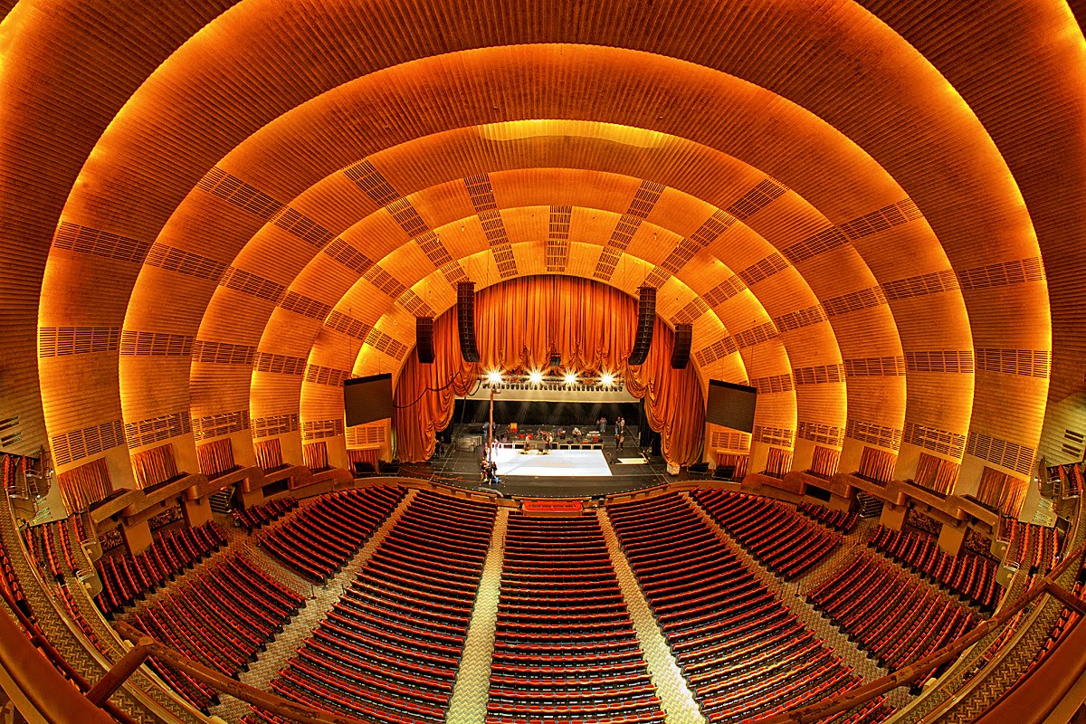
LANDMARKS RADIO CITY MUSIC HALL
When movies became popular, a movie screen was placed on the stage in Radio City. 5000 seats, all watching the same movie. Besides this they also began touring with road shows in the 40s, 50s, and 60s. Radio City also hosts concerts and the Tony Awards.

Slide 20
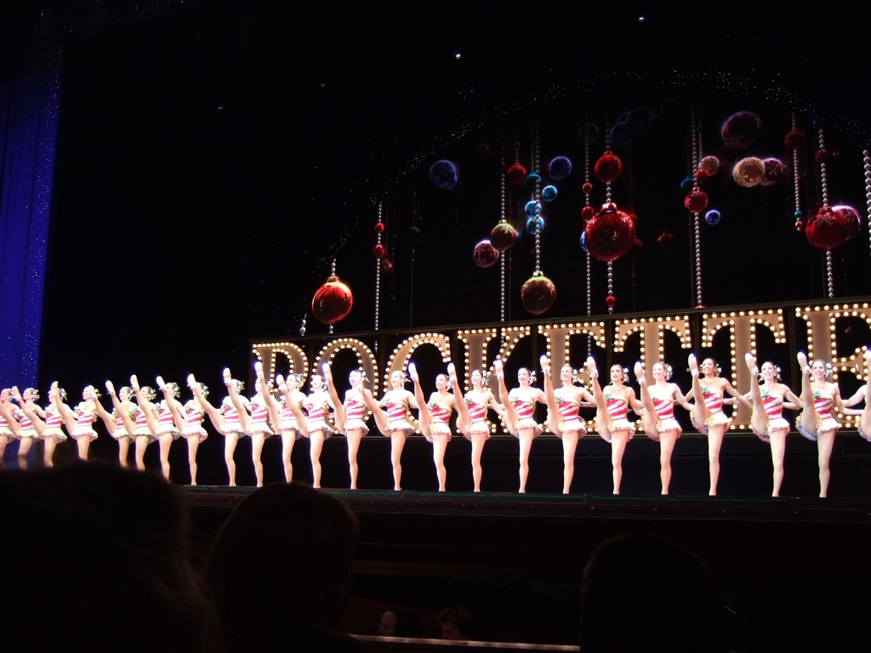
LANDMARKS RADIO CITY MUSIC HALL - THE ROCKETTES
When those big roadshow pictures died out in the 1970s, the building was saved by the Rockettes who would perform before the movie. During the Christmas season, the Rockettes present five shows a day, seven days a week. Until 2015 they also had a touring company.

Slide 21
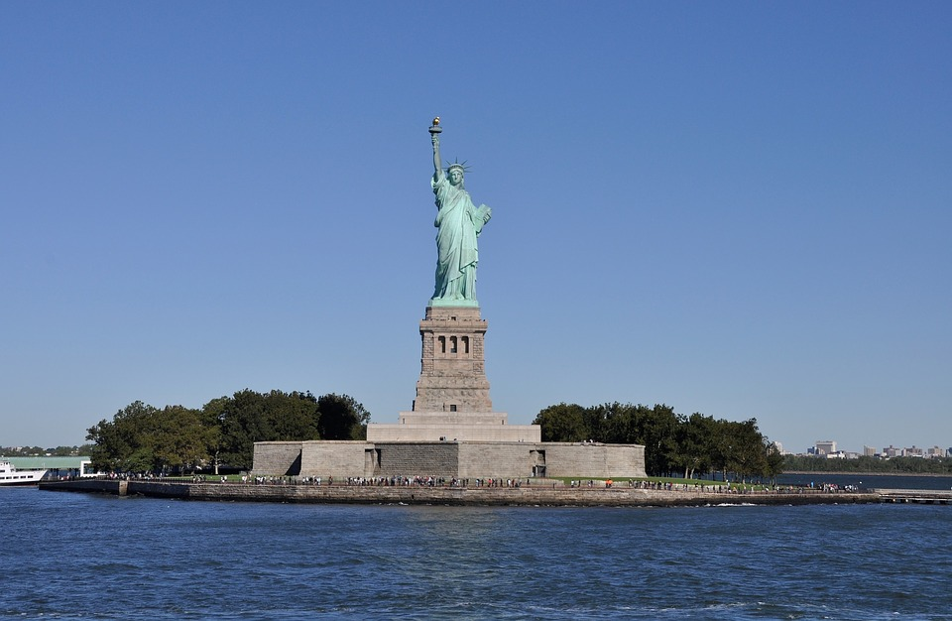
LANDMARKS THE STATUE OF LIBERTY
The Statue of Liberty on Liberty Island in New York Harbour. The French people gave this statue as a gift to the Americans in 1886. The Statue of Liberty holds a torch in her right hand.

Slide 22
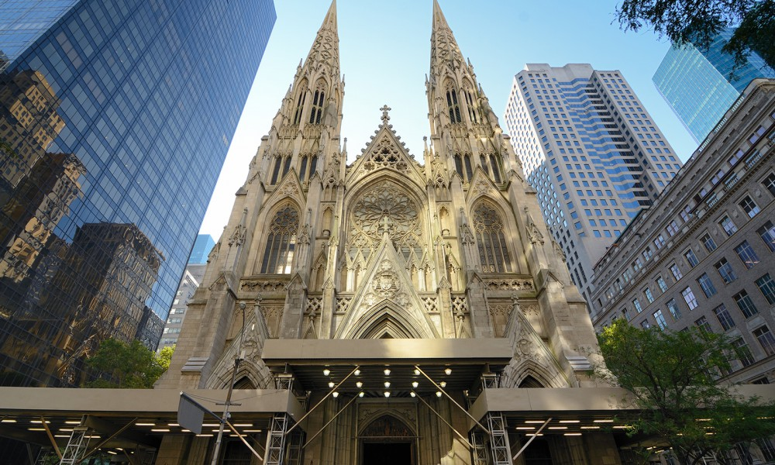
ST. PATRICK’S CATHEDRAL
St. Patrick’s cathedral is a Neo-Gothic style Roman Catholic church and it is the largest Catholic church in the U.S. J.F.K.'s memorial service was held here as per Jackie Kennedy’s wish. The cathedral was completed in 1878.

Slide 23
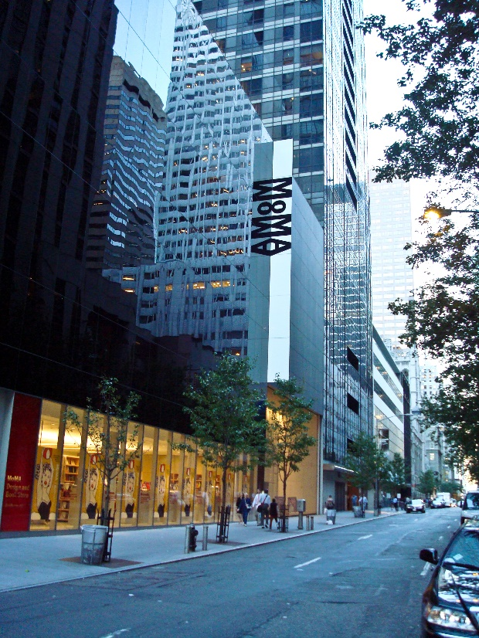
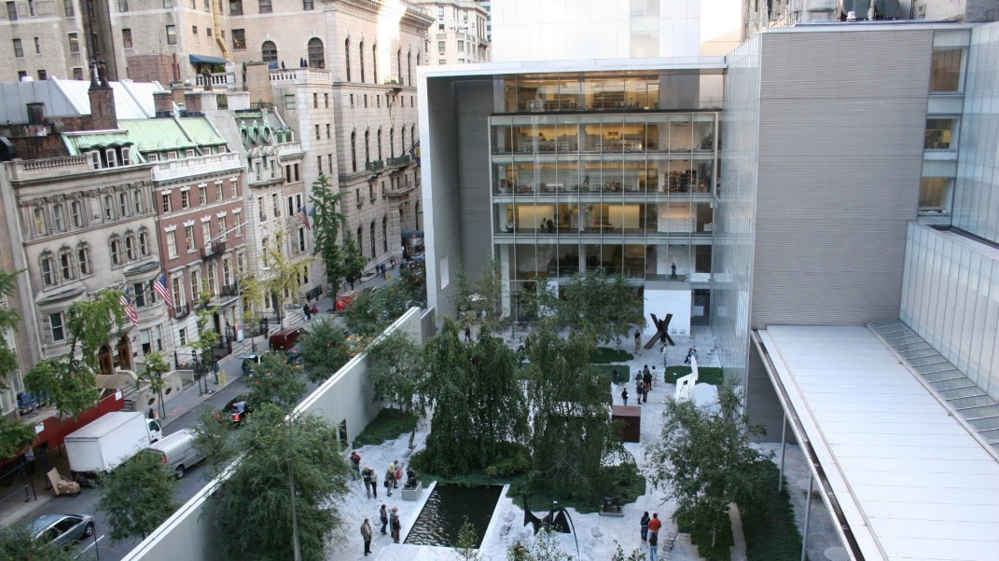
MUSEUMS THE MUSEUM OF MODERN ART
The Museum of Modern Art (MoMA /’moʊmə/) is an art museum located in Midtown Manhattan.
MoMA has been important in developing and collecting modern art, and it is often described as one of the largest and most influential museums of modern art in the world.

Slide 24
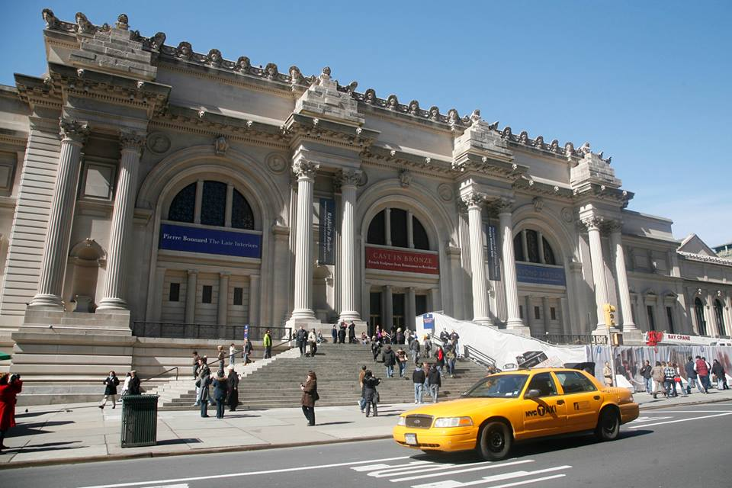
MUSEUMS THE METROPOLITAN MUSEUM OF ART
The Metropolitan Museum of Art, colloquially “the Met”, is the largest art museum in the United States and among the most visited art museums in the world. Its permanent collection contains over two million works.

Slide 25
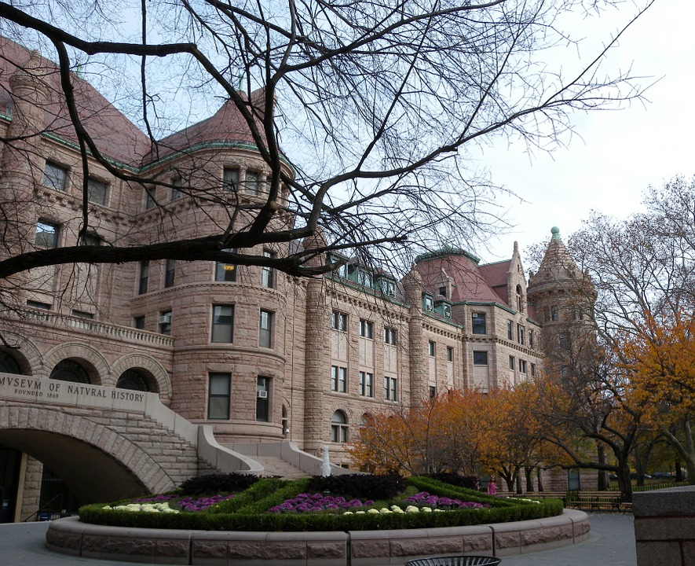
MUSEUMS THE AMERICAN MUSEUM OF NATURAL HISTORY
The American Museum of Natural History (abbreviated as AMNH), located on the Upper West Side of Manhattan, New York City, is one of the largest museums in the world. Located in park-like grounds across the street from Central Park, the museum complex comprises 28 interconnected buildings housing 45 permanent exhibition halls, in addition to a planetarium and a library.

Slide 26
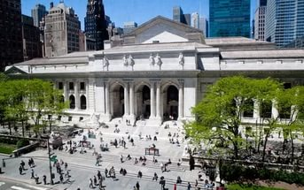
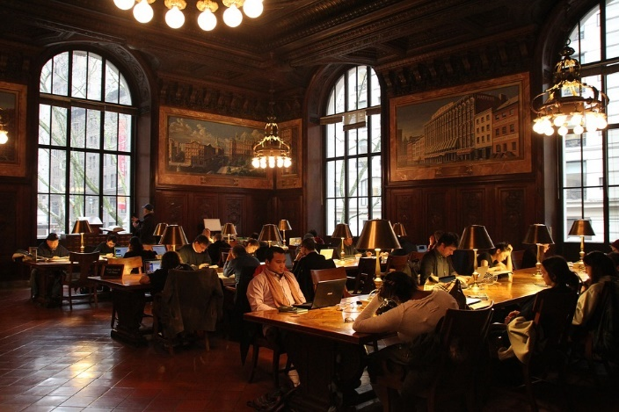
THE NEW YORK PUBLIC LIBRARY
With nearly 53 million items, the New York Public Library is the second largest public library in the United States (behind the Library of Congress). It is a private, non-governmental corporation. On May 23, 1911, the main branch of the New York Public Library was officially opened in a ceremony presided over by President William Howard Taft.

Slide 27
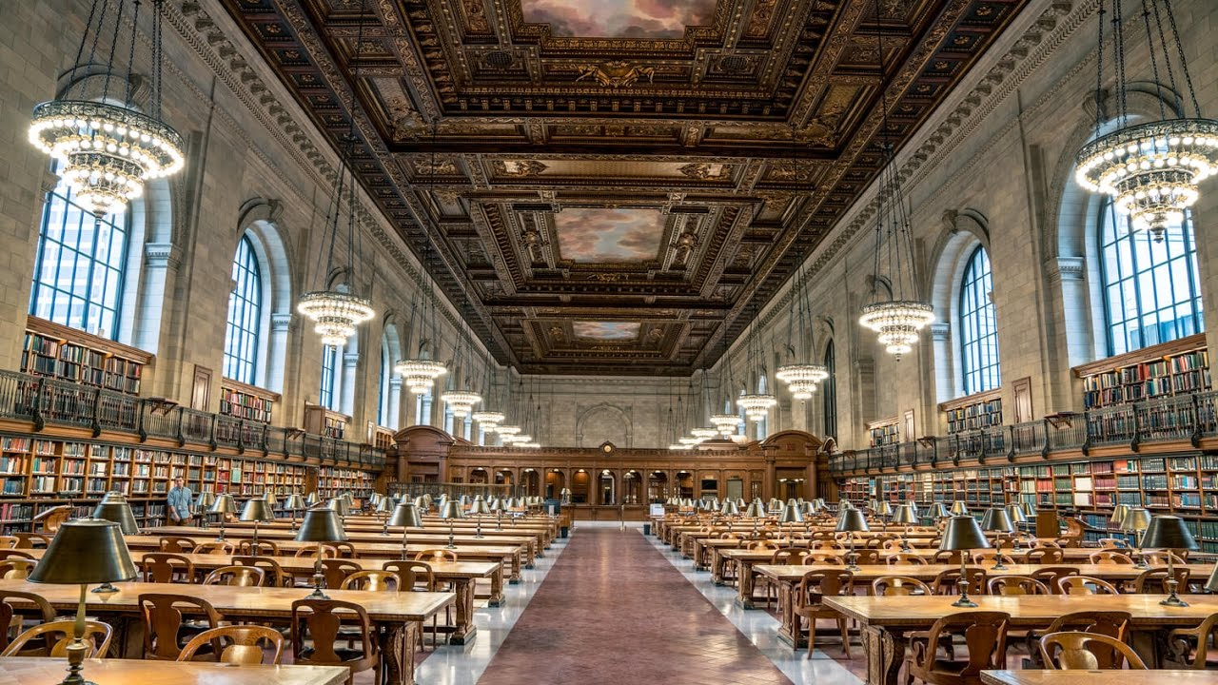
THE NEW YORK PUBLIC LIBRARY
In the 1980s the central research library added more than 125,000 square feet (11,600 m²) below ground level. This expansion required a major construction project in which Bryant Park, directly west of the library, was closed to the public and excavated.

Slide 28
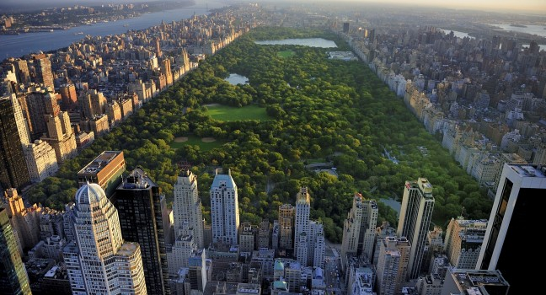
CENTRAL PARK
Central Park, completed in 1873 is the largest manmade park on the planet. Everything inside – trees, beds of grass, lakes, boulders – was put there. Nothing was natural to the area before it was built. The architect designed it in such a way that even skilled New Yorkers get lost inside.

Slide 29
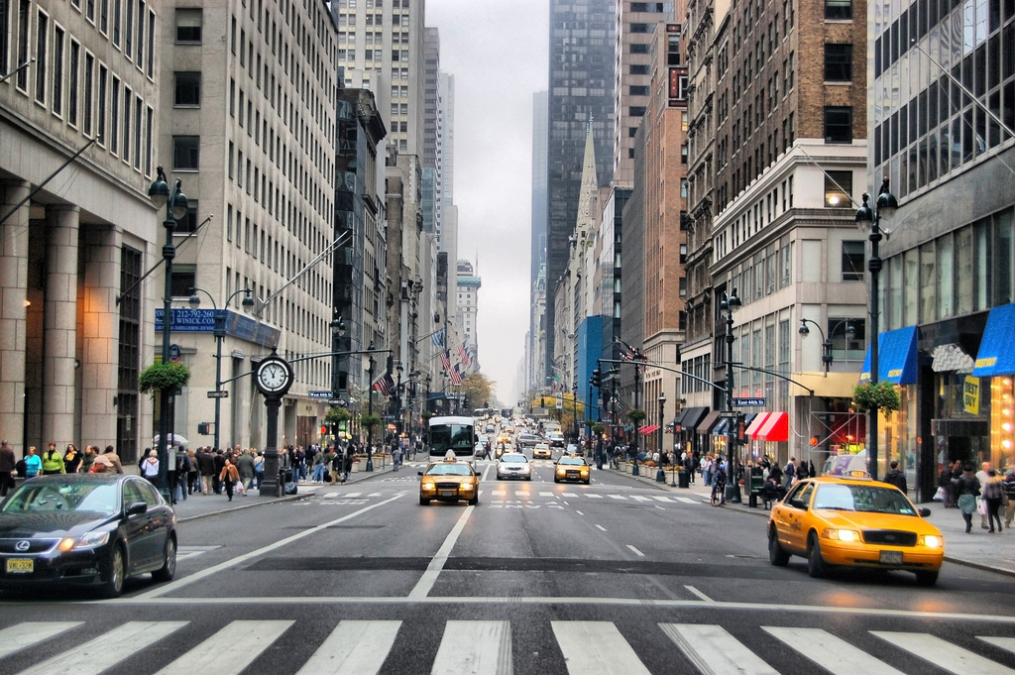
5th AVENUE
Fifth Avenue is famous for fashion and very expensive shops.

Slide 30
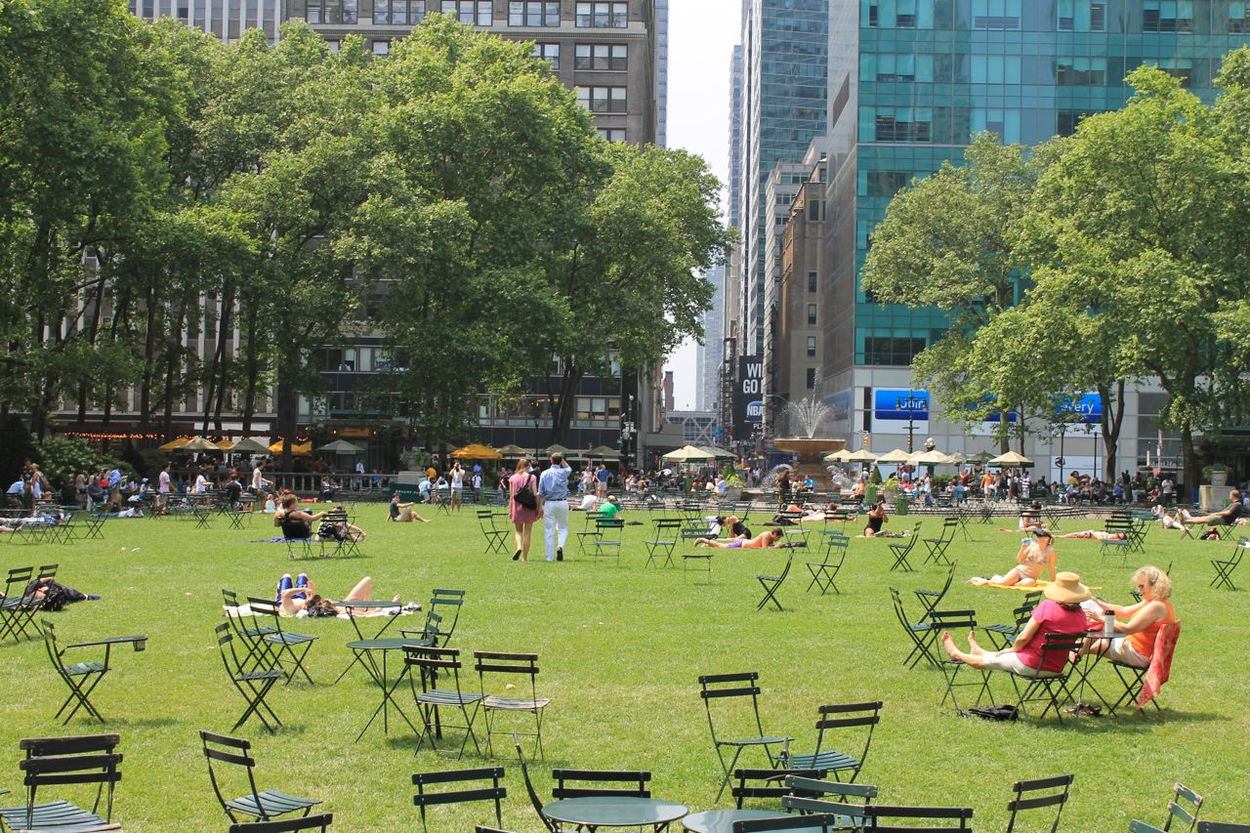
BRYANT PARK
By the 1970s, Bryant Park had been taken over by drug dealers, prostitutes, and the homeless, and was considered a ‘no-go zone’ by residents and visitors. However, efforts by various park groups brought new life to the park and completely turned things around.

Slide 31
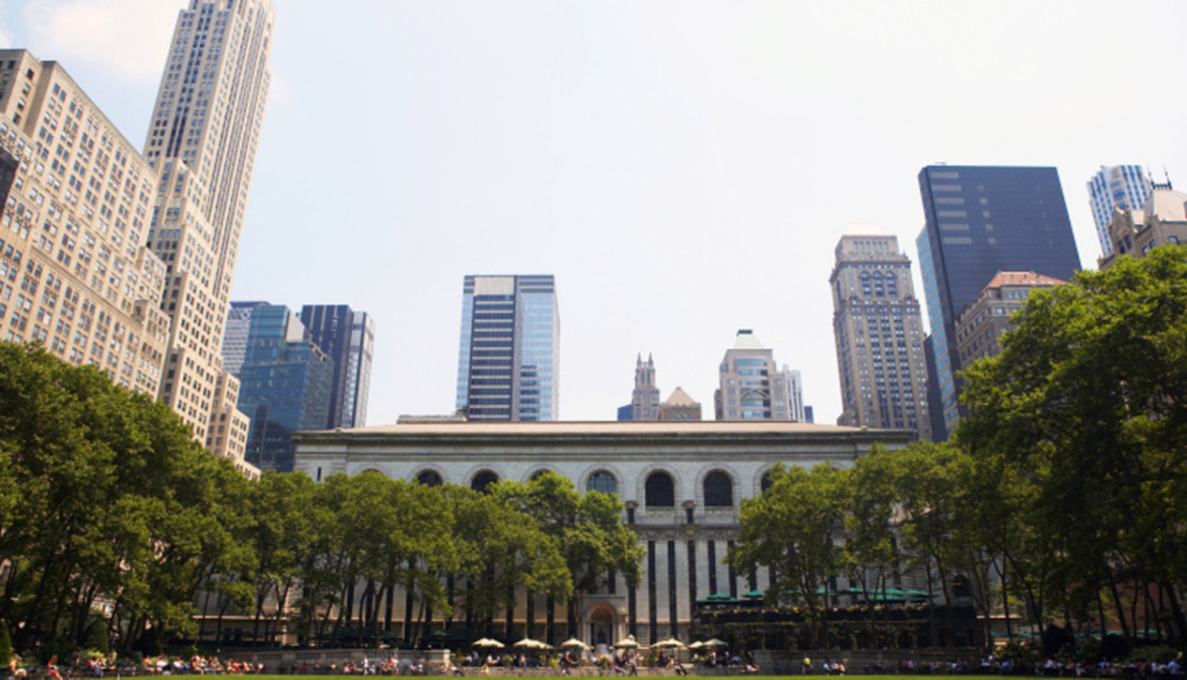
BRYANT PARK AND NEW YORK PUBLIC LIBRARY
The New York Public Library and Bryant Park are meant to represent what used to exist on 5th Avenue in the past. Up and down 5th Avenue used to be the place where the millionaires like the Rockefellers, the Astors, the Morgans, the Vanderbilts had their mansions.

Slide 32
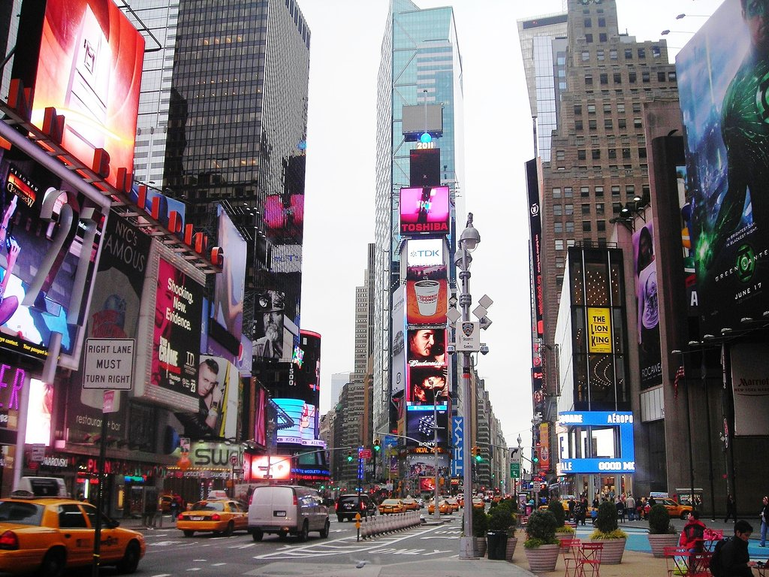
TIMES SQUARE
Times Square was built in 1903. It was called Long Acre Square because it was one acre (4,047m²) in area.
Times Square area is named after the New York Times.
The New York Times headquarters was built around 1904.

Slide 33
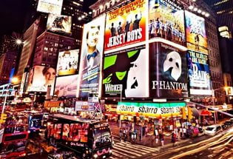
BROADWAY
Broadway is known widely as the heart of the American theatre industry.

Slide 34
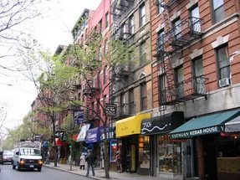
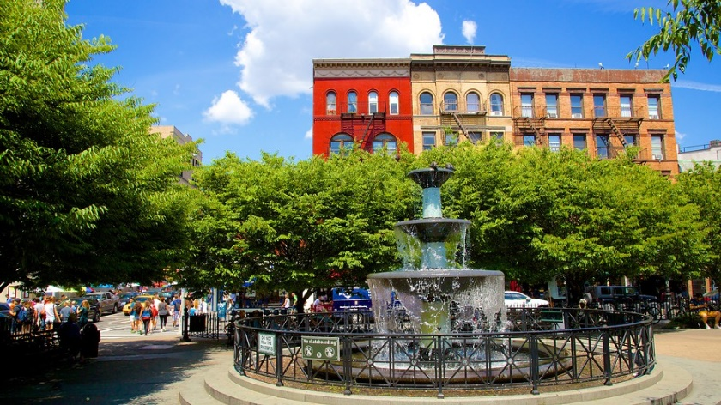
GREENWICH VILLAGE
Greenwich Village, often referred to by locals as simply “the Village”, is a neighborhood on the west side of Lower Manhattan, New York City. Greenwich Village has been known as an artists’ haven and the Bohemian capital.

Slide 35
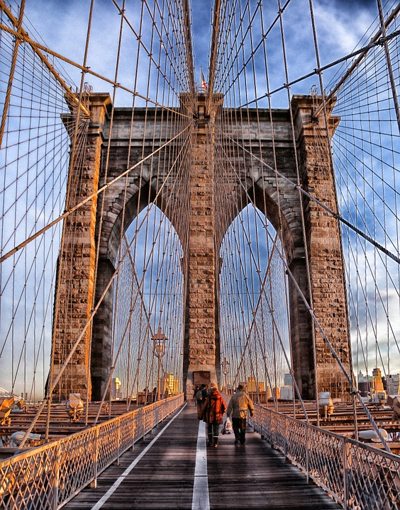
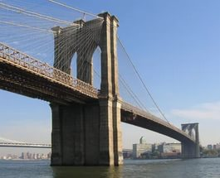
BROOKLYN BRIDGE
The Brooklyn Bridge is one of the oldest bridges of either type in the United States. Completed in 1883, it connects the boroughs of Manhattan and Brooklyn by spanning the East River. It has a main span of 486.3 m and was the first steel-wire suspension bridge constructed.

