Slide 1
A DAY AT THE BEACH
THE FINAL RACE
Notes:
https://hr.izzi.digital/#/repository/204

Slide 2
A DAY AT THE BEACH
THE FINAL RACE
wear = nositi
hat = šešir
scarf = šal
plenty = mnogo
forget = zaboraviti
boots = čizme
sunglasses = sunčane naočale
umbrella = kišobran
sunscreen = krema za sunčanje
Notes:
https://hr.izzi.digital/#/repository/204

Slide 3
A DAY AT THE BEACH
THE FINAL RACE
beach = plaža
trainers = tenisice
helmet = kaciga
power = snaga
run = trčanje
pedal = gurati pedale
Notes:
https://hr.izzi.digital/#/repository/204

Slide 4
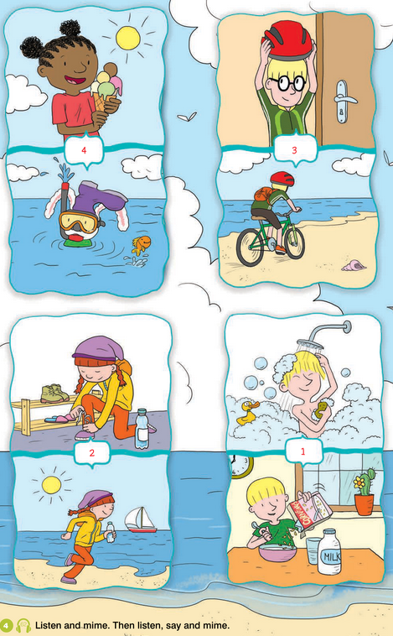
A DAY AT THE BEACH
THE FINAL RACE
Notes:
https://hr.izzi.digital/#/repository/204

Slide 5
A DAY AT THE BEACH
THE FINAL RACE
Notes:
https://hr.izzi.digital/#/repository/204

Slide 6
A DAY AT THE BEACH
THE FINAL RACE
Notes:
https://hr.izzi.digital/#/repository/204

Slide 7
A DAY AT THE BEACH
THE FINAL RACE
Notes:
https://hr.izzi.digital/#/repository/204

Slide 8
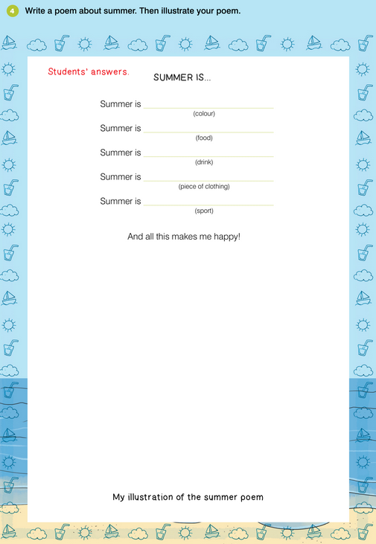
A DAY AT THE BEACH
THE FINAL RACE
Notes:
https://hr.izzi.digital/#/repository/204

